Slide 2
MASH overview

Slide 3
Thank you for using the Elivate™: Creating Change Through Liver Health Education curriculum
Welcome to the Elivate™ curriculum, funded by Novo Nordisk Inc. A third-party provider developed the curriculum content in consultation with Novo Nordisk Inc. and leading liver health clinician experts. Elivate™ relies exclusively on open-source materials available to the general public.
The goal of Elivate™ is to present a complete, accurate, non-promotional, and fair-balanced picture of the current state of metabolic dysfunction-associated steatohepatitis (MASH). Elivate™ is intended to educate healthcare providers on the screening, diagnosis, and management of MASH and improve support for patients. By choosing to access and browse this module of Elivate™, you acknowledge that you have read, understand, and agree to the Elivate™ Terms of Use. If you do not agree with the Elivate™ Terms of Use, you are not permitted to further access this module and should immediately discontinue your use.
View the ElivateTM Terms of Use: https://bit.ly/4aZxVmT
Content current as of January 2026.

Slide 4
Module 1 learning outcome
MASH overview
Learners will be able to demonstrate a foundational understanding of MASLD/MASH, associated metabolic risk factors, disease pathophysiology, patient outcomes, and the importance of early detection and specialty care.
MASH, metabolic dysfunction-associated steatohepatitis; MASLD, metabolic dysfunction-associated steatotic liver disease.

Slide 5
Introduction to steatotic liver disease
Steatotic liver disease (SLD) is the overarching term for conditions characterized by abnormal lipid accumulation in the liver¹
  SLD is defined as >5% hepatocytes affected by steatosis²
Metabolic conditions & heavy alcohol use are common risk factors of SLD¹
MASLD is the new NAFLD⁶⁻⁸
MASH is the new NASH⁶⁻⁸
This nomenclature change represents patient-centric language, destigmatization, and a better understanding of the mechanism
of disease^{7,8}
MASLD/MASH are recognized as the hepatic manifestation of the metabolic syndrome^{1,3}
NAFLD/NASH were previously only diagnosed after the exclusion of other liver diseases; MASLD/MASH can be diagnosed by the presence of hepatic steatosis and ≥1 cardiometabolic risk factor¹
Metabolic dysfunction-associated steatotic liver disease (MASLD) is defined as excess accumulation of fat in hepatocytes in conjunction with at least one cardiometabolic factor^{1,3}
  MASLD does not include individuals with increased alcohol intake; this subgroup is discussed on the next slide^{1,3}
Metabolic dysfunction-associated steatohepatitis (MASH) is a progressive form of MASLD characterized by abnormal hepatocellular adaptation^{1,4}
  Lipotoxicity drives hepatocyte injury, triggering inflammatory cell accumulation, resulting in fibrosis and eventually cirrhosis⁵
MASH, metabolic dysfunction-associated steatohepatitis; MASLD, metabolic dysfunction-associated steatotic liver disease; NAFLD, nonalcoholic fatty liver disease; NASH, nonalcoholic steatohepatitis; SLD, steatotic liver disease.
1. Rinella ME et al. Hepatology. 2023;78(6):1966–1986. 2. Misceo D et al. Nutr Metabol. 2024;21(112):1-26. 3. Veskovic M et al. Curr Issues Mol Biol. 2023;45(11):9084–9102. 4. Estes C et al. Hepatology. 2018;67(1):123–133. 5. Iturbe-Rey S et al. Atherosclerosis. 2025;400:119053. 6. Kim G et al. Clin Mol Hepatol. 2023;29(4):831–843. 7. Multinational liver societies announce new “fatty” liver disease nomenclature that is affirmative and non-stigmatizing. Press release. AASLD. June 24, 2023. https://www.aasld.org/news/multinational-liver-societies-announce-new-fatty-liver-disease-nomenclature-affirmative-and#:~:text=Multinational%20Liver%20Societies%20Announce%20New, Affirmative%20And%20Non%2D Stigmatizing%20%7C%20AASLD. Accessed September 11, 2024. 8. Eslam M et al. J Hepatol. 2020;73(1):202–209.

Slide 6
There are a number of steatotic liver disease subtypes
Metabolic Dysfunction-Associated Steatohepatitis
(MASH)*
Metabolic Dysfunction-Associated Steatotic
Liver Disease (MASLD)
The hepatic manifestation of metabolic syndrome
Can lead to
Steatotic Liver Disease (SLD)
MASLD
predominant
ALD
predominant
MetALD
(MASLD and increased alcohol intake†)
20
30
30
40
50
60
Average daily alcohol intake (g)
Alcohol-Associated (Alcohol-Related) Liver Disease (ALD)
Sustained increased alcohol consumption
Average daily alcohol intake (g)
Female
>50/day
>60/day
Male
*MASH is under the umbrella term MASLD. †Weekly intake 140-350 g female, 210-420 g male (average daily 20-50 g female, 30-60 g male).
ALD, alcohol-associated liver disease; MASH, metabolic dysfunction-associated steatohepatitis; MASLD, metabolic dysfunction-associated steatotic liver disease; MetALD, metabolic dysfunction and alcohol-related steatotic liver disease; SLD, steatotic liver disease.
Rinella ME et al. Hepatology. 2023;78(6):1966–1986.

Slide 7
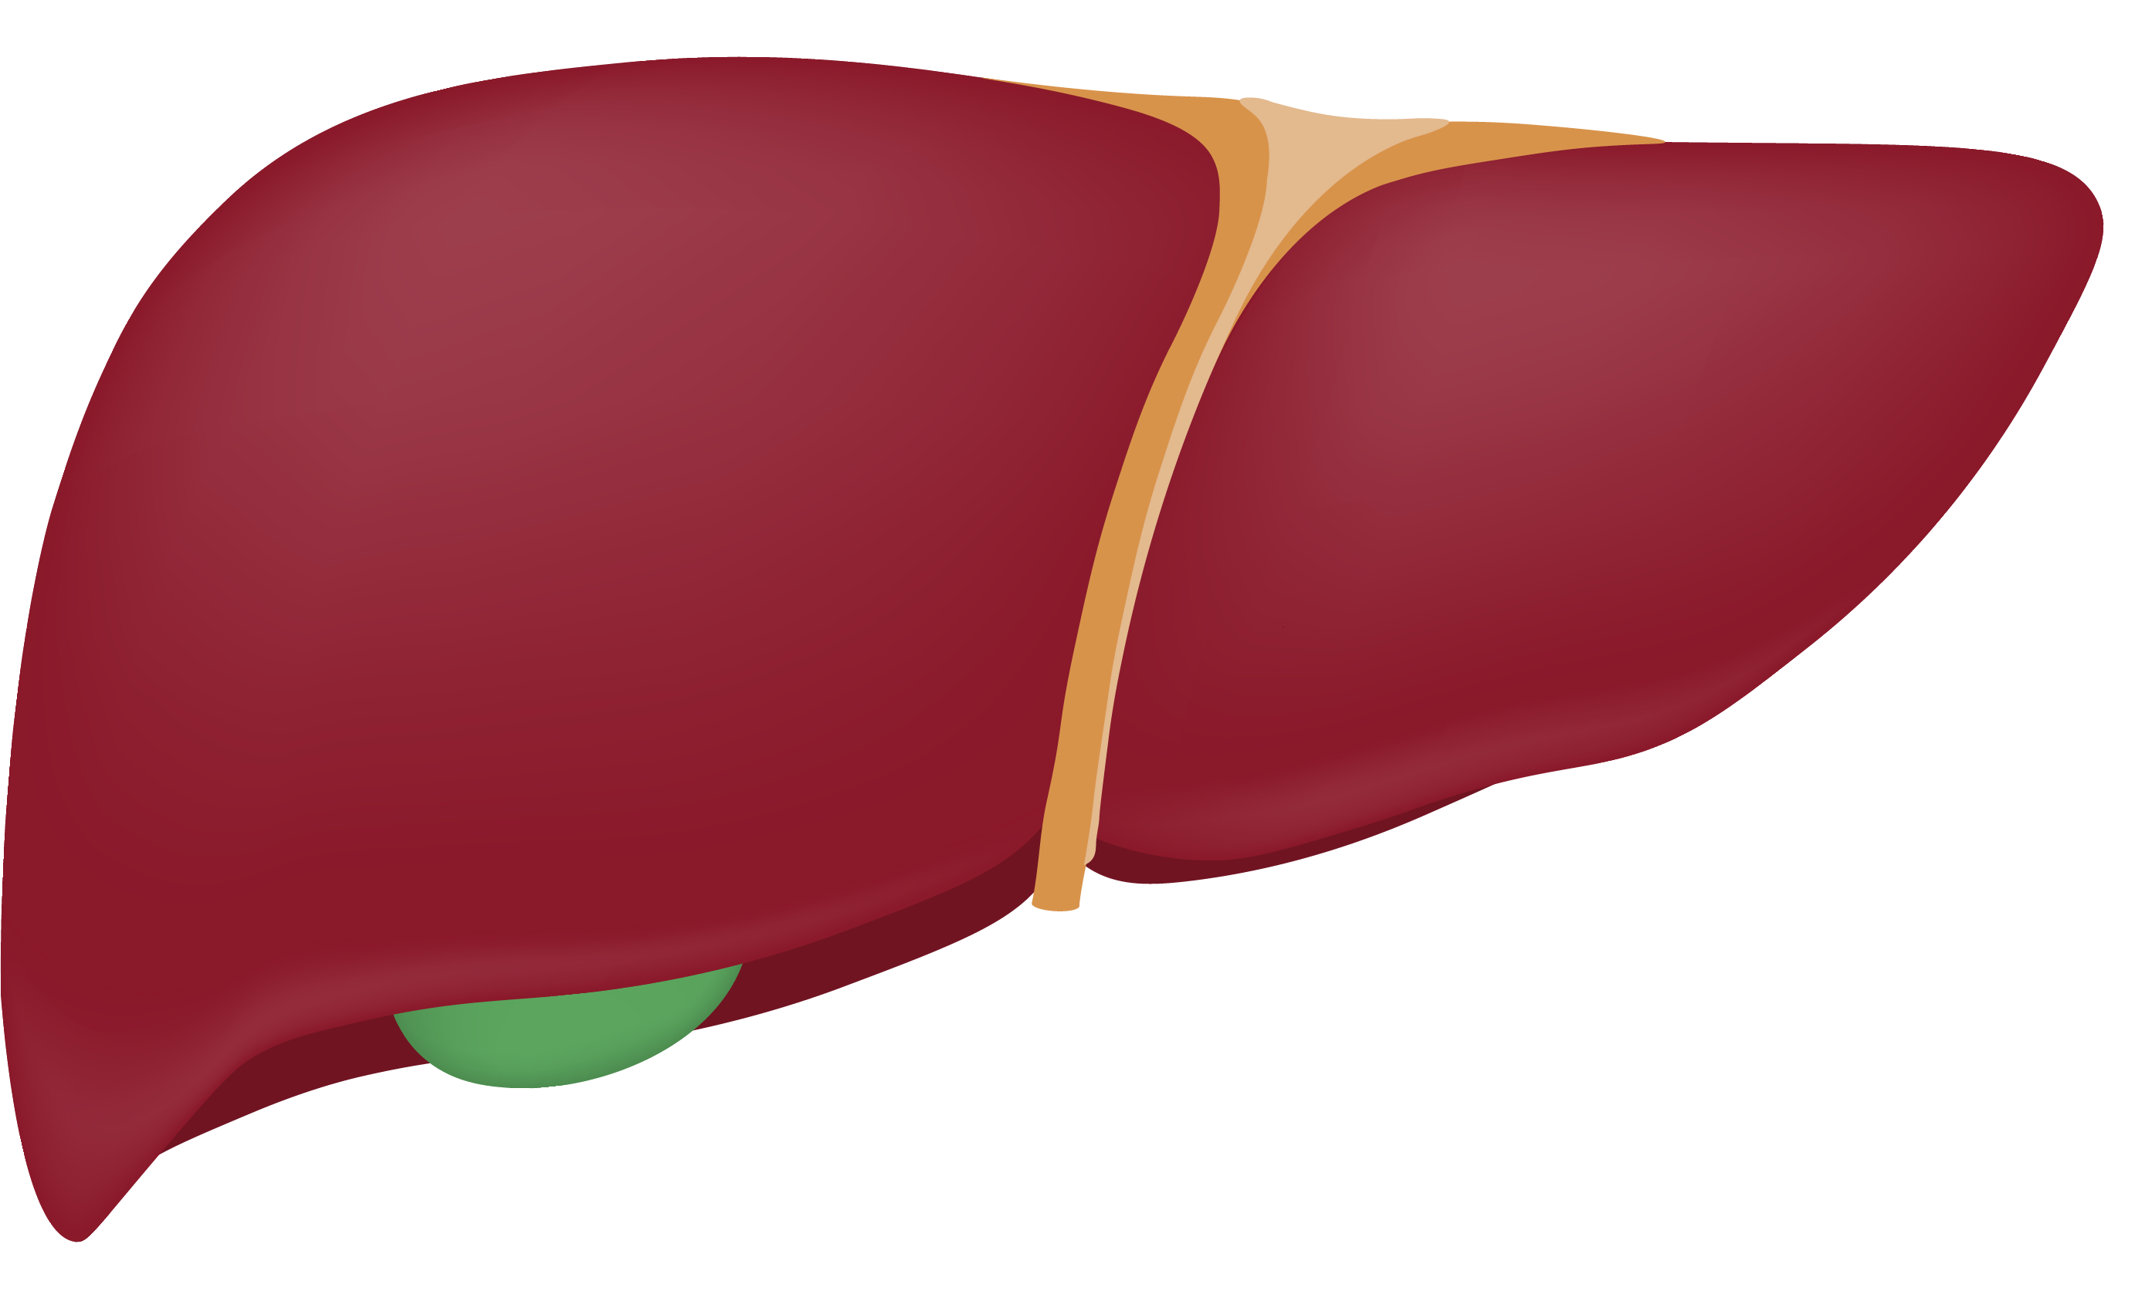
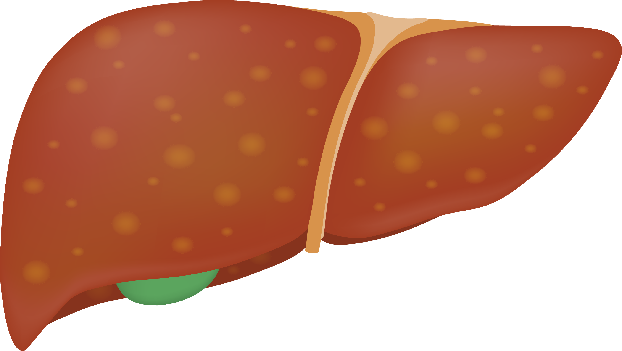
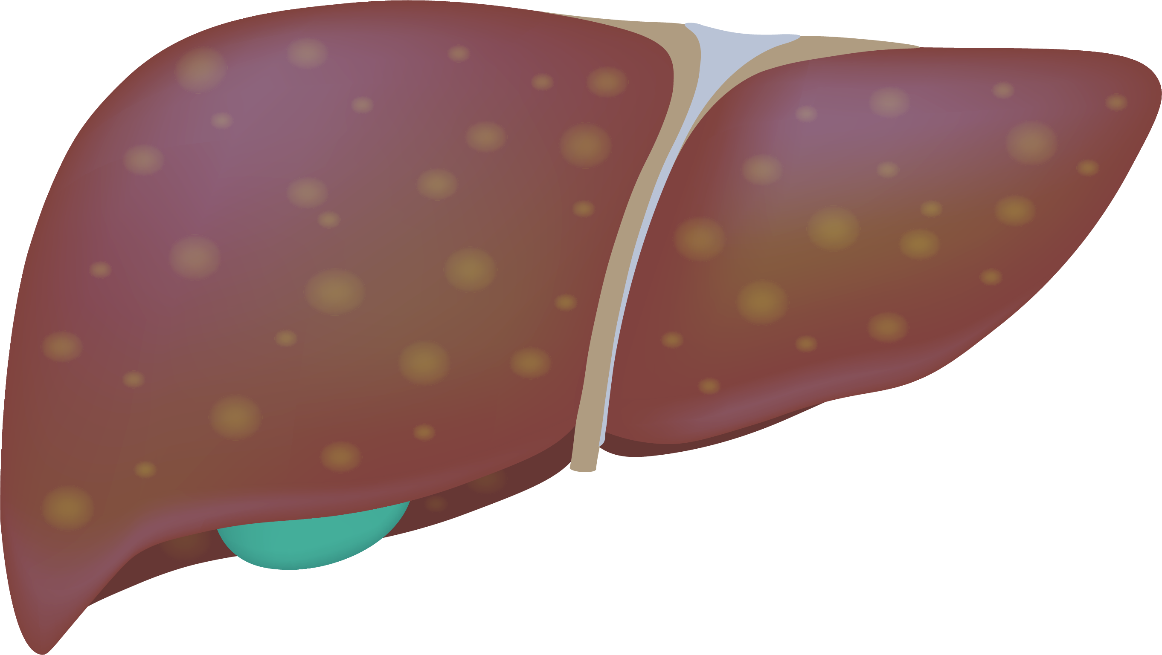
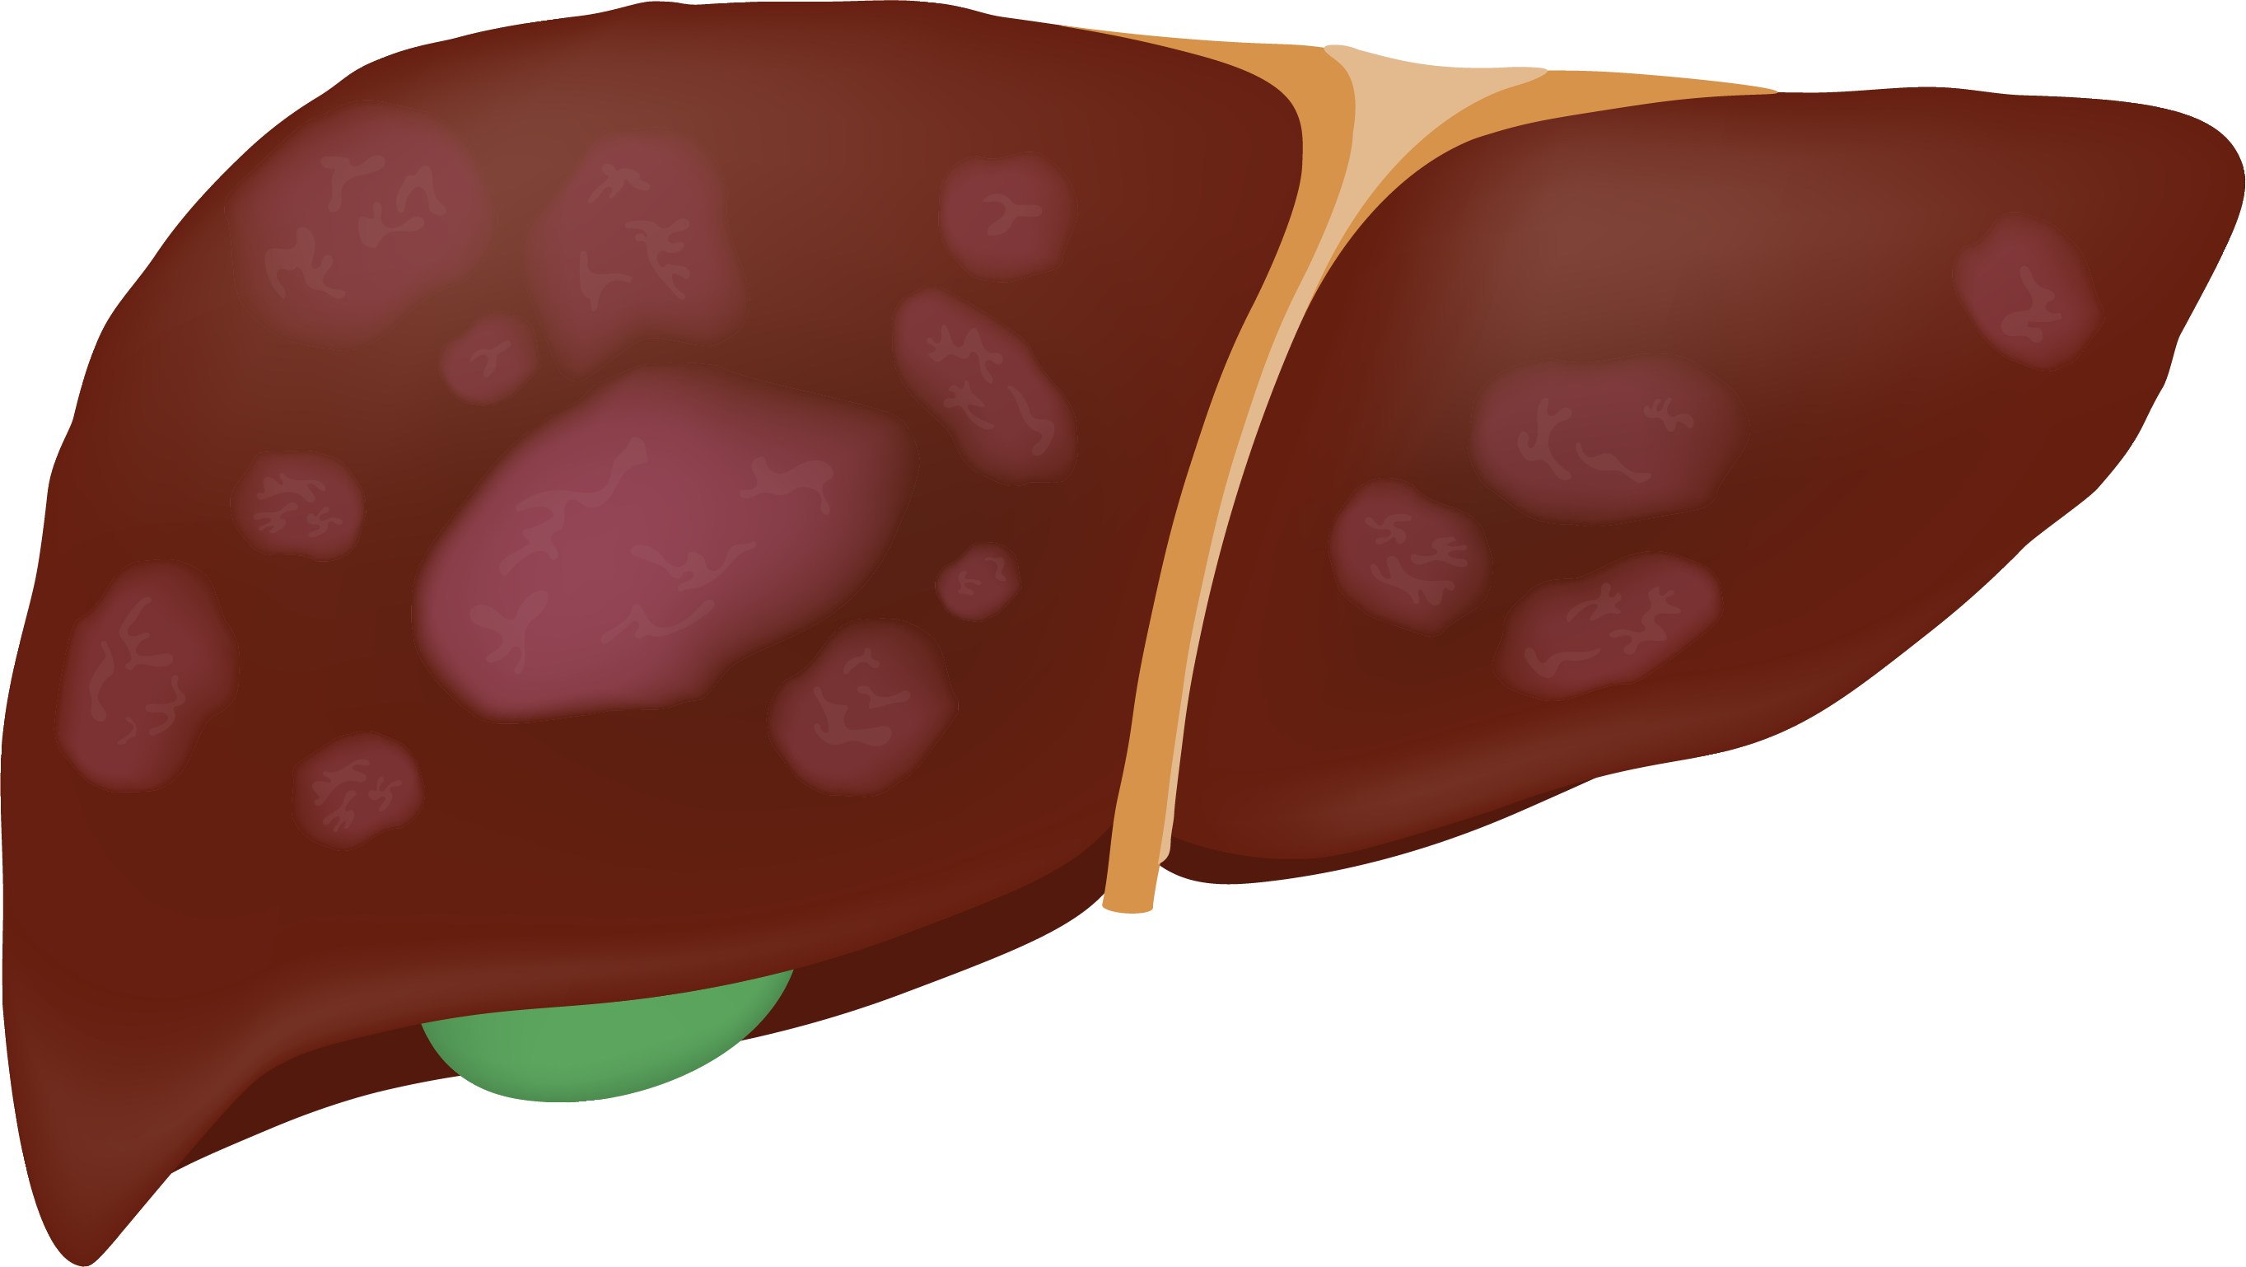
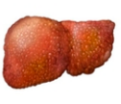
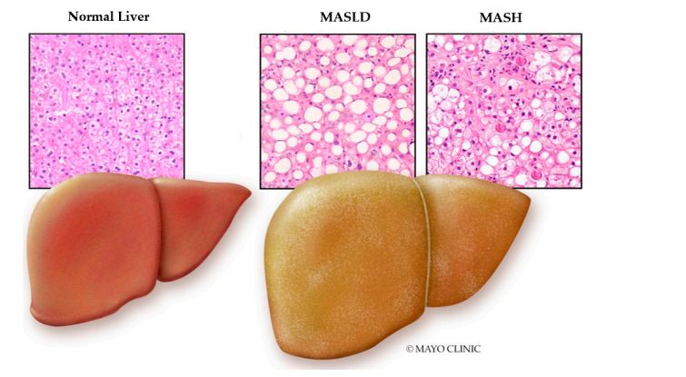
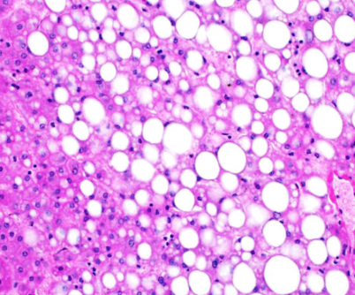
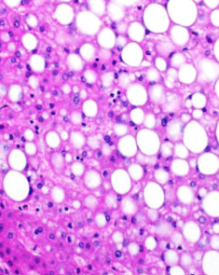
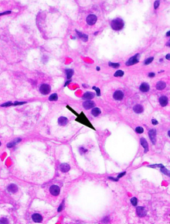
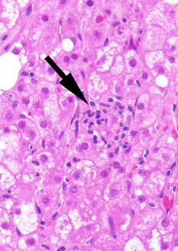
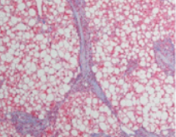
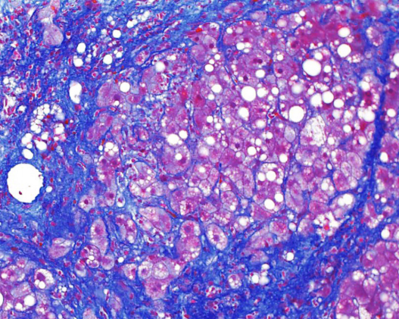
MASH is the progressive form of MASLD^{1,2}
Spectrum of MASLD
MASL
Normal
Steatosis
MASH
MASH with
fibrosis
MASH with
cirrhosis
Steatosis
Ballooning
Inflammation
Late-stage MASH progression markedly
increases the risk of developing HCC and
can even occur without cirrhosis
Images sourced from: https://www.pathologyoutlines.com/topic/livernash.html.
HCC, hepatocellular carcinoma; MASH, metabolic dysfunction-associated steatohepatitis; MASL, metabolic dysfunction-associated steatotic liver; MASLD, metabolic dysfunction-associated steatotic liver disease.
1. Chalasani N et al. Hepatology. 2018;67:328–335. 2. Elshaer A et al. Life (Basel). 2024;14(7):844.

Slide 8
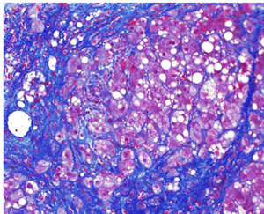
Fibrosis progression is the main determinant of MASH disease progression^{1,2}
Fibrosis, scarring of the liver due to inflammation, is a strong risk factor for adverse liver-related outcomes & death³
Severity of fibrosis in MASH is graded on a scale from F0 to F4²⁻⁴
Clinically significant fibrosis
Advanced fibrosis
F0
No fibrosis
F1
Mild fibrosis
F2
Moderate fibrosis
F3
Advanced fibrosis
F4
Cirrhosis
Fibrosis progression: ~7 years/stage²
Approximately 20% of people with MASH and advanced fibrosis or cirrhosis will develop cirrhosis or decompensation within a 2-year period⁵
4-14% of patients with MASH progress
to cirrhosis at 10 years⁴
Images sourced from: https://www.pathologyoutlines.com/topic/livernash.html.
F, fibrosis stage; MASH, metabolic dysfunction-associated steatohepatitis; MASLD, metabolic dysfunction-associated steatotic liver disease.
1. Chalasani N et al. Hepatology. 2018;67:328–335. 2. Rinella ME et al. Hepatology. 2023;77(5):1797–1835. 3. Shelley K et al. BMC Gastroenterology. 2023;23(1):160. 4. Goodman ZD. J Hepatol. 2007;47:598–607 5. Loomba R, Adams LA. Hepatology. 2019;70(6):1885–1888.

Slide 9
MASH is an underdiagnosed liver disorder with increasing prevalence in the US
MASH is severely underdiagnosed because most patients remain asymptomatic even in advanced stages of the disease, subsequently leading to undertreatment¹
The population with MASH and fibrosis stage of ≥F2 is projected to increase 75%, from 6.7 million in 2020 to 11.7 million in 2050²
23.2
30
18.4
million people
(7.8% of US adults)
MASLD affects 30-35% of the US population
and up to 5% have MASH,² yet
only 0.15% are diagnosed with MASH³
25
million people
(6.7% of US adults)
14.9
20
million people
(5.8% of US adults)
≥F2
11.7 million
By 2030, the prevalence of MASH with
advanced fibrosis (F3-F4) will account for
~29% of all MASH cases⁴
56% projected increase*
MASH patients, in millions
15
≥F2
23% projected increase*
10
There are currently only two FDA-approved available treatment options for the management of MASH^{5,6}
5
0
2020
2030
2050
F0
F1
F2
F3
F4
All data referenced above were demonstrated in patients defined by NAFLD/NASH criteria.
*The projected increase is calculated based on the change in prevalence (number of MASH patients) from 2020 to 2030 and 2050.
F, fibrosis stage; FDA, United States Food and Drug Administration; MASH, metabolic dysfunction-associated steatohepatitis; MASLD, metabolic dysfunction-associated steatotic liver disease; NAFLD, nonalcoholic fatty liver disease; NASH, nonalcoholic steatohepatitis; US, United States.
1. Rinella ME et al. Hepatology. 2023;77(5):1797–1835. 2. Le P et al. JAMA Netw Open. 2025;8(1):e2454707. 3. Charlton M et al. J Med Econ. 2024;27(1):919–930. 4. Estes C et al. Hepatology. 2018;67(1):123–133. 5. Xie Z et al. Life Metabolism. 2024;3(5):loae029. 6. Wegovy (semaglutide). Package insert. Novo Nordisk Inc.; August 2025.

Slide 10
MASLD and MASH disproportionately impact certain racial, sex, and socioeconomic groups
In the US, Hispanic populations have a higher genetic predisposition to MASH and higher rates of MASH than White or Black individuals
Certain genetic variants, such as PNPLA3, TM6SF2, and HSD17B13, are associated with an increased risk and severity of MASLD¹
Frequency of genetic variants across populations¹
49.0%
of Mexican Americans^{1,}*
17.0%
of Black Americans^{1,}*
Men have 19% higher prevalence of MASLD than women²
Postmenopausal women are more prone to developing advanced fibrosis²
18.1%
of Asian Americans^{1,}*
14.4%
of White Americans⁵
Poverty, poor access to nutritious food, and food insecurity can contribute to MASLD disease burden³
These can influence MASLD prevalence by affecting metabolic risk factors such as obesity and T2D⁴
Hispanic populations are underrepresented in MASH clinical trials and may have limited access to screening⁶
*Data from Asian, Mexican, and Black Americans are from the National Health and Nutrition Examination Survey 2011-2016 (n=4538). There was limited available data on groups such as Asian/Pacific Islanders and Native Americans.
MASH, metabolic dysfunction-associated steatohepatitis; MASLD, metabolic dysfunction-associated steatotic liver disease; US, United States.
1. Rich NE et al. Clin Gastroenterol Hepatol. 2018;16:198–210. 2. Yip TCF et al. Hepatology. 2022;00:1–24. 3. Kardashian A et al. Hepatology. 2023;77:1382–1403. 4. Younossi, ZM. et al. J Hepatol. 2024;82(2):203–210. 5. Younossi ZM et al. Hepatology. 2023;77:1335–1347. 6. Diaz LA et al. Curr Treatment Options Gastroenterol. 2022;20:261–278.

Slide 11
Comorbidities contribute to MASLD development and progression
MASLD is closely linked to and often precedes the diagnosis of other metabolic abnormalities¹
The presence of several metabolic abnormalities confers greater risk of MASH progression and mortality¹
The association between MASLD and metabolic comorbidities may reflect bidirectional interactions between the liver and other organs¹
Global consensus recommendations suggest that people with comorbidities at risk of MASLD/MASH should be screened and risk stratified⁹
US guidelines (AASLD) state that patients with clinical suspicion of MASLD should undergo further investigations¹
Metabolic comorbidities
Obesity²⁻⁴
BMI: ≥30 kg/m²
  Asian: ≥25 kg/m²
Waist circumference:
>35 in (female);
>40 in (male)
Type 2 diabetes^{2,3,5}
HbA1c: >6.5%
Fasting plasma glucose: >126 mg/dL
2-hour OGTT: ≥200 mg/dL
Hypertension^{2,6}
SBP: ≥130 mmHg
DBP: ≥80 mmHg
Dyslipidemia^{2,7}
Cholesterol: >200 mg/dL
LDL-c: >130 mg/dL
HDL-c:
<50 mg/dL (female);
<40 mg/dL (male)
Triglycerides:
>150 mg/dL
AASLD
AASLD
AASLD
AASLD
*HOMA-IR cut-off values for different patient populations vary.
AASLD, American Association for the Study of Liver Disease; BMI, body mass index; DBP, diastolic blood pressure; HbA1c, glycated hemoglobin test; HDL-c, high-density lipoprotein cholesterol; HOMA-IR, Homeostatic Model Assessment for Insulin Resistance; LDL-c, low-density lipoprotein cholesterol; MASH, metabolic dysfunction-associated steatohepatitis; MASLD, metabolic dysfunction-associated steatotic liver disease; OGTT, oral glucose tolerance test; SBP, systolic blood pressure.
1. Rinella ME et al. Hepatology. 2023;77(5):1797–1835. 2. Chalasani N et al. Hepatology. 2018;67:328–357. 3. Marengo A et al. Clin Liver Dis. 2016;20:313–324. 4. National Heart, Lung, and Blood Institute. Assessing your weight and health risk. https://www.nhlbi.nih.gov/health/educational/lose_wt/risk.htm Accessed August 13, 2025. 5. Goyal R et al. Type 2 diabetes. StatsPearls [Internet]. Updated June 23, 2023. https://www.ncbi.nlm.nih.gov/books/NBK513253/ Accessed August 13, 2025. 6. Iqbal AM, Jamal SF. Essential hypertension. StatsPearls [Internet]. Updated July 20, 2023. https://www.ncbi.nlm.nih.gov/books/NBK539859/ Accessed August 13, 2025. 7. Pappan N et al. Dyslipidemia. StatPearls [Internet]. Updated March 4, 2024. https://www.ncbi.nlm.nih.gov/books/NBK560891/ Accessed August 13, 2025. 8. Gayoso-Diz P et al. BMC Endocrin Dis. 2013;13(47):1–10. 9. Younossi ZM et al. Clin Liv. 2025;in press:1–16.

Slide 12
Patients with MASH have a higher burden of comorbidities
Opthalmological¹
Diabetic retinopathy
Elevated intraocular pressure
Cataracts
Neurologic²
Cerebrovascular accident​
Neurocognitive dysfunction
Depression and anxiety
Vascular²
Atherogenic dyslipidemia
Coronary artery disease
Hypertension
Cardiovascular²
MACE (CV death, non-fatal MI, non-fatal stroke)
HFpEF
Atrial fibrillation
Musculoskeletal²
Osteoporosis
Sarcopenia
Gastrointestinal¹
Irritable bowel syndrome
Small intestinal bacterial overgrowth
Hepatic²
Chronic liver failure
Hepatocellular carcinoma
Renal²
Chronic kidney disease
Oncologic³
Extrahepatic malignancies
Endocrine/metabolic²
Pre-diabetes
Type 2 diabetes
Obesity
CV, cardiovascular; HFpEF, heart failure with preserved ejection fraction; MACE, major adverse cardiovascular event; MASH, metabolic dysfunction-associated steatohepatitis; MI, myocardial infarction.
1. Orfanidou M et al. Medicina 2025;61:38. 2. Muthiah MD et al. Diabetes Obes Metab. 2022;24:3–14. 3. Allen AM et al. J Hepatol. 2019;71:1229–1236.

Slide 13
Patients with MASH are at elevated risk of liver- and cardiac-related complications and mortality
Liver-related events (liver cirrhosis, HCC, transplantation)
MASH-related cirrhosis is the 2nd leading cause of all liver transplants in the US (after alcohol-related cirrhosis)¹⁻³ with over 11,000 liver transplants performed in 2024⁴
MASH is predicted to be the #1 cause of liver transplants in adults by 2030^{5,6}
MASH is the leading cause of liver transplants in women without HCC²
Cardiovascular disease
CVD is the leading cause of morbidity and mortality in patients with MASLD/MASH⁷
Patients with MASH are 2x as likely to die from CVD than liver disease⁸
Mortality and morbidity
716,800 deaths will occur in the MASH population in the US by 2030³
CVD, cardiovascular disease; HCC, hepatocellular carcinoma; MASH, metabolic dysfunction-associated steatohepatitis; US, United States.
1. Younossi ZM et al. Clin Gastroenterol Hepatol. 2021;19(3):580–589. 2. Kwong AJ et al. OPTN/SRTR 2022 Annual Data Report: Liver. https://srtr.transplant.hrsa.gov/annual_reports/2022/Liver.aspx#fig:LItx-counts-diag. Accessed September 12, 2024. 3. Estes C et al. Hepatology. 2018;67(1):123–133. 4. OPTN. Organ transplants exceeded 48,000 in 2024; a 3.3 percent increase from the transplants performed in 2023. 2025. https://optn.transplant.hrsa.gov/news/organ-transplants-exceeded-48-000-in-2024-a-33-percent-increase-from-the-transplants-performed-in 2023/#:~:text=Liver%20transplants%20had%20the%20next,volume%20in%202023%20(4%2C545) Accessed August 13, 2025. 5. Wong RJ et al. Gastroenterology. 2015;148:547–555. 6. Westfall EC et al. Am Farm Phys. 2020;102(9):603–612. 7. Sanyal A et al. Am Heart J Plus. 2024;41:100386. 8. Kanwal F et al. Diabetes Care. 2021;44(9):2162–2172.

Slide 14
MASH leads to an increased economic burden on the healthcare system
In the US, MASH is the
Leading cause of liver transplants in women without HCC^{1,*}
Fastest growing cause of HCC among US patients listed for liver transplants²
Cost per patient†:
Cirrhosis³
HCC⁴
Liver transplant^{5,‡}
Comorbidity management³
~$100,000 annually
~$104,000 annually
Average billed charges:
~$878,400 per transplant
~$50,000 annually§
Early identification and effective management of MASH is crucial to minimize the clinical and economic burden of MASH⁴
*Based on the analysis of data from the Scientific Registry of Transplant Recipients (2002-2019).^{1 †}Cost per patient is based on the year estimated – cirrhosis: 2024; HCC: 2021; liver transplant: 2020; comorbidity management: 2024. ‡Liver transplant costs are not specific to transplants for MASH. §For patients with three comorbidities.
HCC, hepatocellular carcinoma; MASH, metabolic dysfunction-associated steatohepatitis; US, United States.
1. Younossi ZM et al. Clin Gastroenterol Hepatol. 2021;19(3):580–589. 2. Younossi ZM et al. Hepatology. 2019;69(suppl):2672–2682. 3. Younossi ZM et al. Hepatol Commun. 2024;8(8):e0488. 4. Wong RJ et al. J Clin Gastroenterol. 2021;55(10)891–902. 5. Bentley TS, Ortner NJ. Milliman Research Report; January 2020.

Slide 15
Early identification of patients with MASLD is key to effective management¹
Patients with MASLD or at risk for MASLD should be screened for clinically significant fibrosis^{1,2}
Tools to assess risk (e.g., FIB-4, ELF™, VCTE, MRE) to stratify
patients based on patient needs
Fibrosis
Fibrosis can be diagnosed by histology or
by non-invasive tests.
Biopsy is not required.
Low risk of
advanced fibrosis
Intermediate/high risk of advanced fibrosis
MASLD
Can be diagnosed by imaging steatosis with
the presence of cardiometabolic risk factors.
Biopsy is not required.
Manage in
primary care
Refer to hepatologist/
gastroenterologist
MASH
For more details on:
Patient identification and risk factors, see Module 2
Screening and diagnostics approaches, see Module 3
MASH, by definition, requires a histologic diagnosis which requires a biopsy.*
In practice, MASH is largely considered a diagnosis of exclusion when other causes of fibrosis are ruled out.
*Biopsy is required for MASH diagnosis and FDA approval of therapeutic options.³
ELF™, enhanced liver fibrosis score; FIB-4, fibrosis-4 index; MASH, metabolic dysfunction-associated steatohepatitis; MASLD, metabolic dysfunction-associated steatotic liver disease; MRE, magnetic resonance elastography; VCTE, vibration-controlled transient elastography.
1. Srivastava A et al. J Hepatol. 2019;71(2):371–378. 2. Rinella ME et al. Hepatology. 2023;77(5):1797–1835. 3. Abouelhassan Y et al. Clin Pharmacol Ther. 2025;118(6):1378-1391.

Slide 16
Timely screening with NITs such as FIB-4 and ELF™ supports optimal care
In 2017, a care pathway for patients identified with MASLD in primary care was developed using non-invasive fibrosis assessment (FIB-4 followed by ELF™) to stratify patients to either remain in primary care or to be referred to secondary care
Two years after the introduction of this care pathway:
3x
Improvement in detection of advanced fibrosis and cirrhosis
81%
Reduction in
unnecessary referrals
5x
Improvement in referral of cases of advanced fibrosis and cirrhosis
Results based on a prospective evaluation of the performance of the NAFLD pathway two years after its introduction. The pathway evaluation was conducted between March 2014 and May 2016 in the UK.
ELF™, enhanced liver fibrosis score; FIB-4, fibrosis-4 index; NIT, non-invasive test; VCTE, vibration-controlled transient elastography.
Srivastava A et al. J Hepatol. 2019;71(2):371–378.

Slide 17
Summary
MASH, a progressive form of MASLD, is characterized by inflammation and potentially fibrosis within the liver¹ and is associated with significant adverse outcomes and comorbidities^{1,2}
MASH disproportionately impacts certain racial, sex, and socioeconomic groups, emphasizing the need for proactive care in these populations³⁻⁵
Early identification and effective management of MASLD/MASH is crucial to minimize the clinical and economic burden of MASLD/MASH⁶
MASH, metabolic dysfunction-associated steatohepatitis; MASLD, metabolic dysfunction-associated steatotic liver disease.
1. Rinella ME et al. Hepatology. 2023;77(5):1797–835 2. Estes C, et al. Hepatology. 2018;67(1):123–133. 3. Yip TCF et al. Hepatology. 2022;00:1–24. 4. Rich NE et al. Clin Gastroenterol Hepatol. 2018;16:198–210. 5. Kardashian A et al. Hepatology. 2023;77:1382–1403. 6. Wong RJ et al. J Clin Gastroenterol. 2021;55(10)891–902.

