Slide 1
Patient identification and risk factors

Slide 2
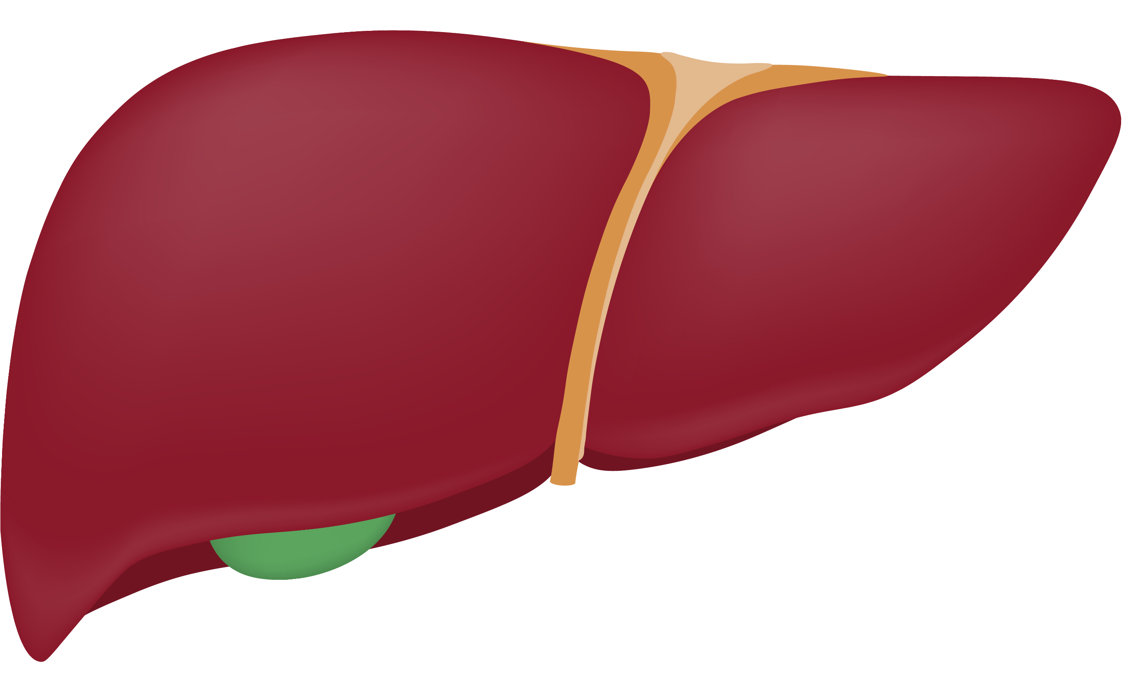
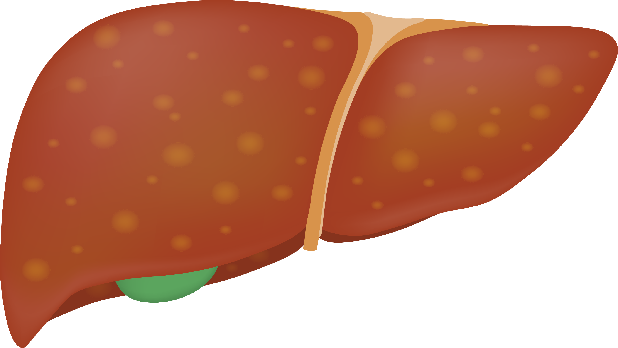
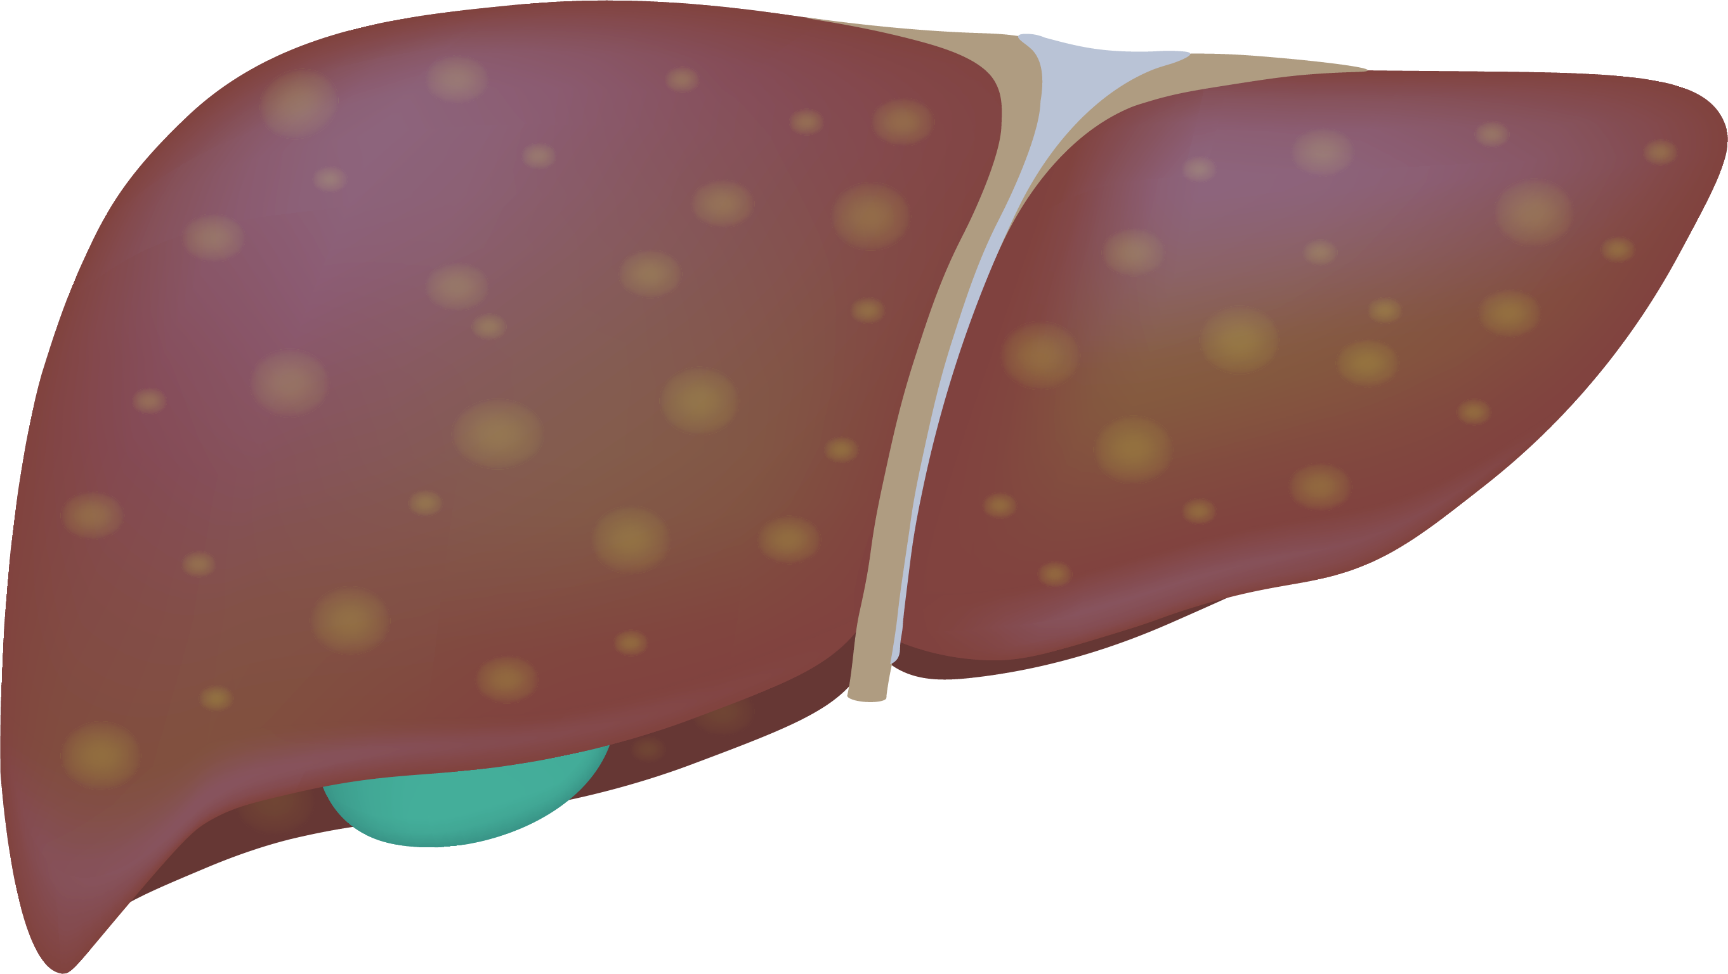
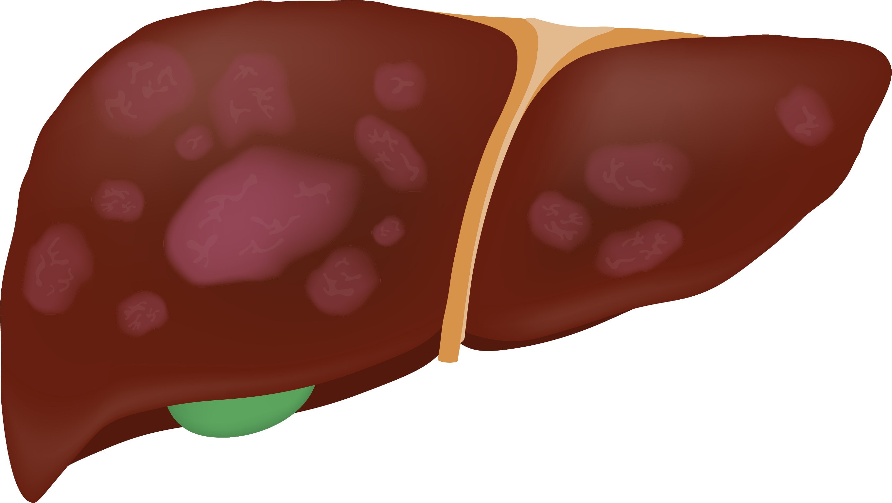
Mortality and CVD risk increases with fibrosis^{1,2}
MASLD is associated with a 1.5-fold higher long-term risk of new onset heart failure regardless of the presence of diabetes, hypertension, and other common CV risk factors³
Early
Advanced
 |  | F0 | F1 | F2 | F3 | F4 (cirrhosis)
Clinical presentation |  | May be asymptomatic until decompensated cirrhosis Symptoms may include fatigue, weight loss, weakness, abdominal discomfort
All-cause mortality RR |  | - | 1.6 | 2.5 | 3.5 | 6.4
Liver-related mortality RR |  | - | 1.4 | 9.6 | 16.7 | 42.3
CVD-related mortality* |  | 1.19-1.38 (across F0-F2) |  |  | 4.36 (across both F3 and F4)
*Cardiovascular mortality at F2-F3 is HFpEF and ASCVD.
ASCVD, atherosclerotic cardiovascular disease; CVD, cardiovascular disease; F, fibrosis stage; HFpEF, heart failure with preserved ejection fraction; RR, relative risk.
1. Dulai PS et al. Hepatology. 2017;65(5):1557–1565. 2. Ekstedt M et al. Hepatology. 2015;61(5):1547–1554. 3. Sanyal AJ et al. Am Heart J Plus. 2024;41:100386.

