Slide 2
Patient identification and risk factors

Slide 3
Thank you for using the Elivate™: Creating Change Through Liver Health Education curriculum
Welcome to the Elivate™ curriculum, funded by Novo Nordisk Inc. A third-party provider developed the curriculum content in consultation with Novo Nordisk Inc. and leading liver health clinician experts. Elivate™ relies exclusively on open-source materials available to the general public.
The goal of Elivate™ is to present a complete, accurate, non-promotional, and fair-balanced picture of the current state of metabolic dysfunction-associated steatohepatitis (MASH). Elivate™ is intended to educate healthcare providers on the screening, diagnosis, and management of MASH and improve support for patients. By choosing to access and browse this module of Elivate™, you acknowledge that you have read, understand, and agree to the Elivate™ Terms of Use. If you do not agree with the Elivate™ Terms of Use, you are not permitted to further access this module and should immediately discontinue your use.
View the ElivateTM Terms of Use: https://bit.ly/4aZxVmT
Content current as of January 2026.

Slide 4
Module 2 learning outcome
Patient identification and risk factors
Learners will be able to analyze the burden and clinical outcomes of MASLD/MASH in high-risk populations, identify comorbidities, apply current screening guidelines, recognize the importance of early identification and recommendations on timing of referral to hepatology for comprehensive evaluation and management.
MASH, metabolic dysfunction-associated steatohepatitis; MASLD, metabolic dysfunction-associated steatotic liver disease.

Slide 5
There are a number of steatotic liver disease subtypes
Metabolic Dysfunction-Associated Steatohepatitis
(MASH)*
The progressive
form of MASLD
Metabolic Dysfunction-Associated Steatotic
Liver Disease (MASLD)
The hepatic manifestation of metabolic syndrome
Can lead to
Steatotic Liver Disease (SLD)
MASLD
predominant
ALD
predominant
MetALD
(MASLD and increased alcohol intake†)
20
30
30
40
50
60
Average daily alcohol intake (g)
Alcohol-Associated (Alcohol-related) Liver Disease (ALD)
Sustained increased alcohol consumption
Average daily alcohol intake (g)
Female
>50/day
>60/day
Male
*MASH is under the umbrella term MASLD. †Weekly intake 140-350 g female, 210-420 g male (average daily 20-50 g female, 30-60 g male). ‡E.g., lysosomal acid lipase deficiency (LALD), Wilson disease, hypobetalipoproteinemia, inborn errors of metabolism. §E.g., hepatitis C virus (HCV), malnutrition, celiac disease.
ALD, alcohol-associated liver disease; DILI, drug-induced liver injury; HCV, hepatitis C virus; LALD, lysosomal acid lipase deficiency; MASH, metabolic dysfunction-associated steatohepatitis; MASLD, metabolic dysfunction-associated steatotic liver disease; MetALD, metabolic dysfunction and alcohol-related steatotic liver disease; SLD, steatotic liver disease.
Rinella ME et al. Hepatology. 2023;78(6):1966–1986.

Slide 6
MASLD diagnosis no longer relies on ruling out other diseases¹
MASLD/MASH is defined by the presence of hepatic steatosis and 1 or more cardiometabolic risk factors:
Ethnically adjusted BMI White: ≥25 kg/m² Asian: ≥23 kg/m² Waist circumference >37” (M); >31.5” (F) | Fasting serum glucose ≥5.6 mmol/L [100 mg/dL] 2-hour post-load glucose levels ≥7.8 mmol/L [≥140 mg/dL] Prediabetes HbA_{1c} ≥5.7% [39 mmol/L] | Type 2 diabetes or treated with diabetes medication Blood pressure ≥130/85 mmHg or treated with hypertension medication | Triglycerides ≥1.70 mmol/L [150 mg/dL] or treated with lipid-lowering medication HDL <40 mg/dL in men; <50 mg/dL in women or treated with lipid-lowering medication
Diagnostic criteria do not require elevated AST and/or ALT^{1,2}
ALD, alcohol-related liver disease; BMI, body mass index; DILI, drug-induced liver injury; F, female; HbA_{1c}, glycated hemoglobin; HDL, high-density lipoprotein; M, male; MASLD, metabolic dysfunction-associated steatotic liver disease; MetALD, metabolic dysfunction and alcohol-related steatotic liver disease; SLD, steatotic liver disease; WC, waist circumference.
1. Rinella ME et al. Hepatology. 2023;78(6):1966–1986. 2. Lominadze Z, Kallwitz ER. Clin Liver Dis (Hoboken). 2018;12(4):96-99.

Slide 7
Overview of diagnostic criteria for MASLD
Steatotic liver disease
(hepatic steatosis identified by imaging or biopsy)
Does the patient meet any of the
cardiometabolic criteria?
Yes
No
Are there known causes of hepatic steatosis?
Are there known causes of hepatic steatosis?
No
Yes
No
Yes
MASLD
MetALD or ALD (depending on extent of alcohol intake) or other combination etiology
Cryptogenic SLD
Other specific etiology SLD
(e.g., ALD, DILI, genetic, nutritional, monogenic diseases, viral hepatitis)
For more details on patient identification and risk factors, see Module 3
ALD, alcohol-related liver disease; BMI, body mass index; DILI, drug-induced liver injury; F, female; HbA_{1c}, glycated hemoglobin; HDL, high-density lipoprotein; M, male; MASLD, metabolic dysfunction-associated steatotic liver disease; MetALD, metabolic dysfunction and alcohol-related steatotic liver disease; SLD, steatotic liver disease; WC, waist circumference.
Rinella ME et al. Hepatology. 2023;78(6):1966–1986.
ALD, alcohol-related liver disease; BMI, body mass index; DILI, drug-induced liver injury; F, female; HbA_{1c}, glycated hemoglobin; HDL, high-density lipoprotein; M, male; MASLD, metabolic dysfunction-associated steatotic liver disease; MetALD, metabolic dysfunction and alcohol-related steatotic liver disease; SLD, steatotic liver disease; WC, waist circumference.
Rinella ME et al. Hepatology. 2023;77(5):1797–1835.

Slide 8
Certain cardiometabolic and other risk factors contribute to the burden of MASLD/MASH
MASLD/MASH is defined by the presence of hepatic steatosis
and 1 or more cardiometabolic risk factors¹⁻⁴
~60-75% of people with type 2 diabetes may have MASLD⁵
Among people with T2D, up to one third (15-30%) are at risk of clinically significant fibrosis⁶
People with pre-diabetes are 4 times more likely to develop MASLD compared to healthy individuals⁷
Risk factors for MASH
Obesity
Pre-diabetes, type 2 diabetes, and insulin resistance
Hyperlipidemia
Ethnicity
Hypertension
~73% of people with metabolic syndrome
have MASLD⁷
Metabolic syndrome
PCOS
Gut microbiota alterations
Sleep apnea
More than
1 in 3 people with obesity may have MASH⁷
Genetic predisposition
Alcohol consumption
Poor diet and/or physical inactivity
Hepatic inflammation and cellular stress
CV, cardiovascular; MASH, metabolic dysfunction-associated steatohepatitis; MASLD, metabolic dysfunction-associated steatotic liver disease; PCOS, polycystic ovary syndrome; T2D, type 2 diabetes.
1. Rinella ME et al. Hepatology. 2023;78(6):1966–1986. 2. 10 Causes or Contributing Factors for MASLD and MASH. Fatty Liver Alliance. January 19, 2024. https://fattyliver.ca/blog/f/10-causes-or-contributing-factors-for-masld-and-mash. Accessed July 14, 2025. 3. Arvanitakis K et al. J Clin Med. 2024;13(14):4243. 4. Kyhl LK et al. Atherosclerosis. 2025;411:120551. 5. Gancheva S et al. Diabetes Res Clin Pract. 2024;217:111846. 6. Gracen L, et al. BMC Health Serv Res. 2022;22:487. 7. Younossi ZM et al. Clin Mol Hepatol. 2024;31(Suppl):S32-S50.

Slide 9
MASLD and MASH disproportionately impact certain sex, racial, and socioeconomic groups¹⁻³
Men have 19% higher prevalence of MASLD than women¹
Postmenopausal women are more prone to developing advanced fibrosis¹
MASH is the leading cause of liver transplants in women without HCC²
Hispanic populations have a higher genetic predisposition to MASH and have higher rates of MASH than White or Black individuals^{1,3,*}
Certain genetic variants, such as PNPLA3, TM6SF2, and HSD17B13, are associated with an increased risk and severity of MASLD⁴
Poverty, poor access to nutritious food, and food insecurity can contribute to MASLD disease burden¹
*There is no single genetic test for diagnosing MASLD/MASH. Specific variants increase the risk of MASLD and MASH.^{1,3}
MASH, metabolic dysfunction-associated steatohepatitis; MASLD, metabolic dysfunction-associated steatotic liver disease.
1. Kardashian A et al. Hepatology. 2023;77(4):1382–1403. 2. Younossi ZM, et al. Clin Gastroenterol Hepatol. 2021;19(3):580-589. 3. Rich NE et al. Clin Gastroenterol Hepatol. 2018;16(2):198–210.e2. 4. Walker RW et al. J Hepatol. 2020;72(6):1070–1081.

Slide 10
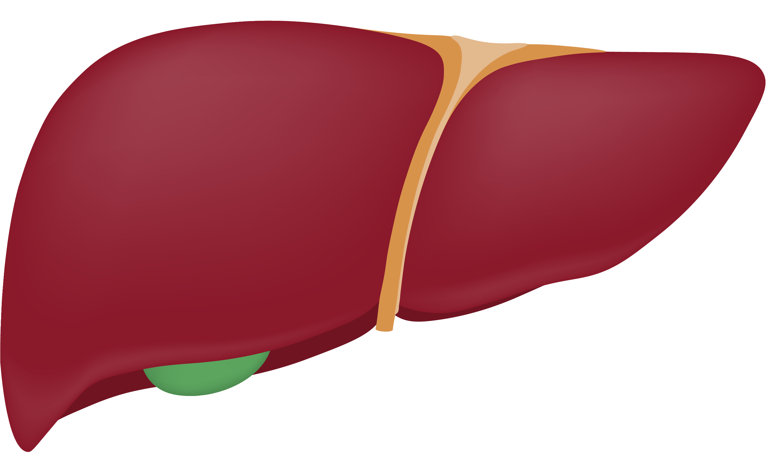
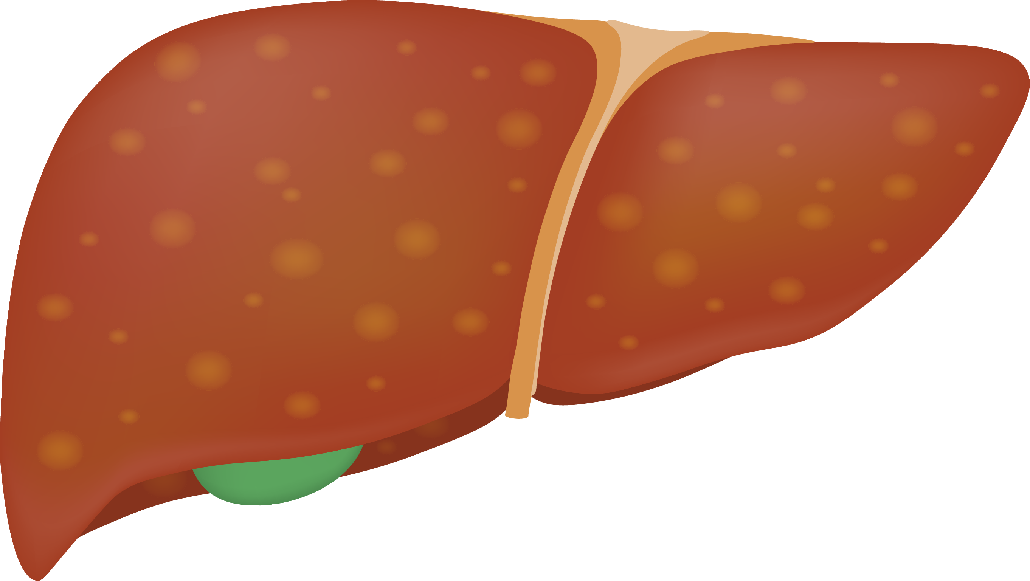
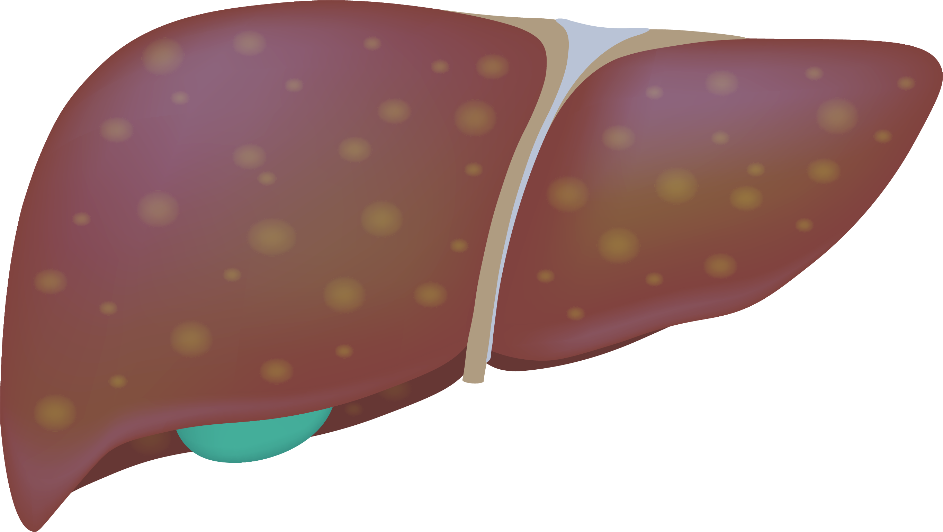
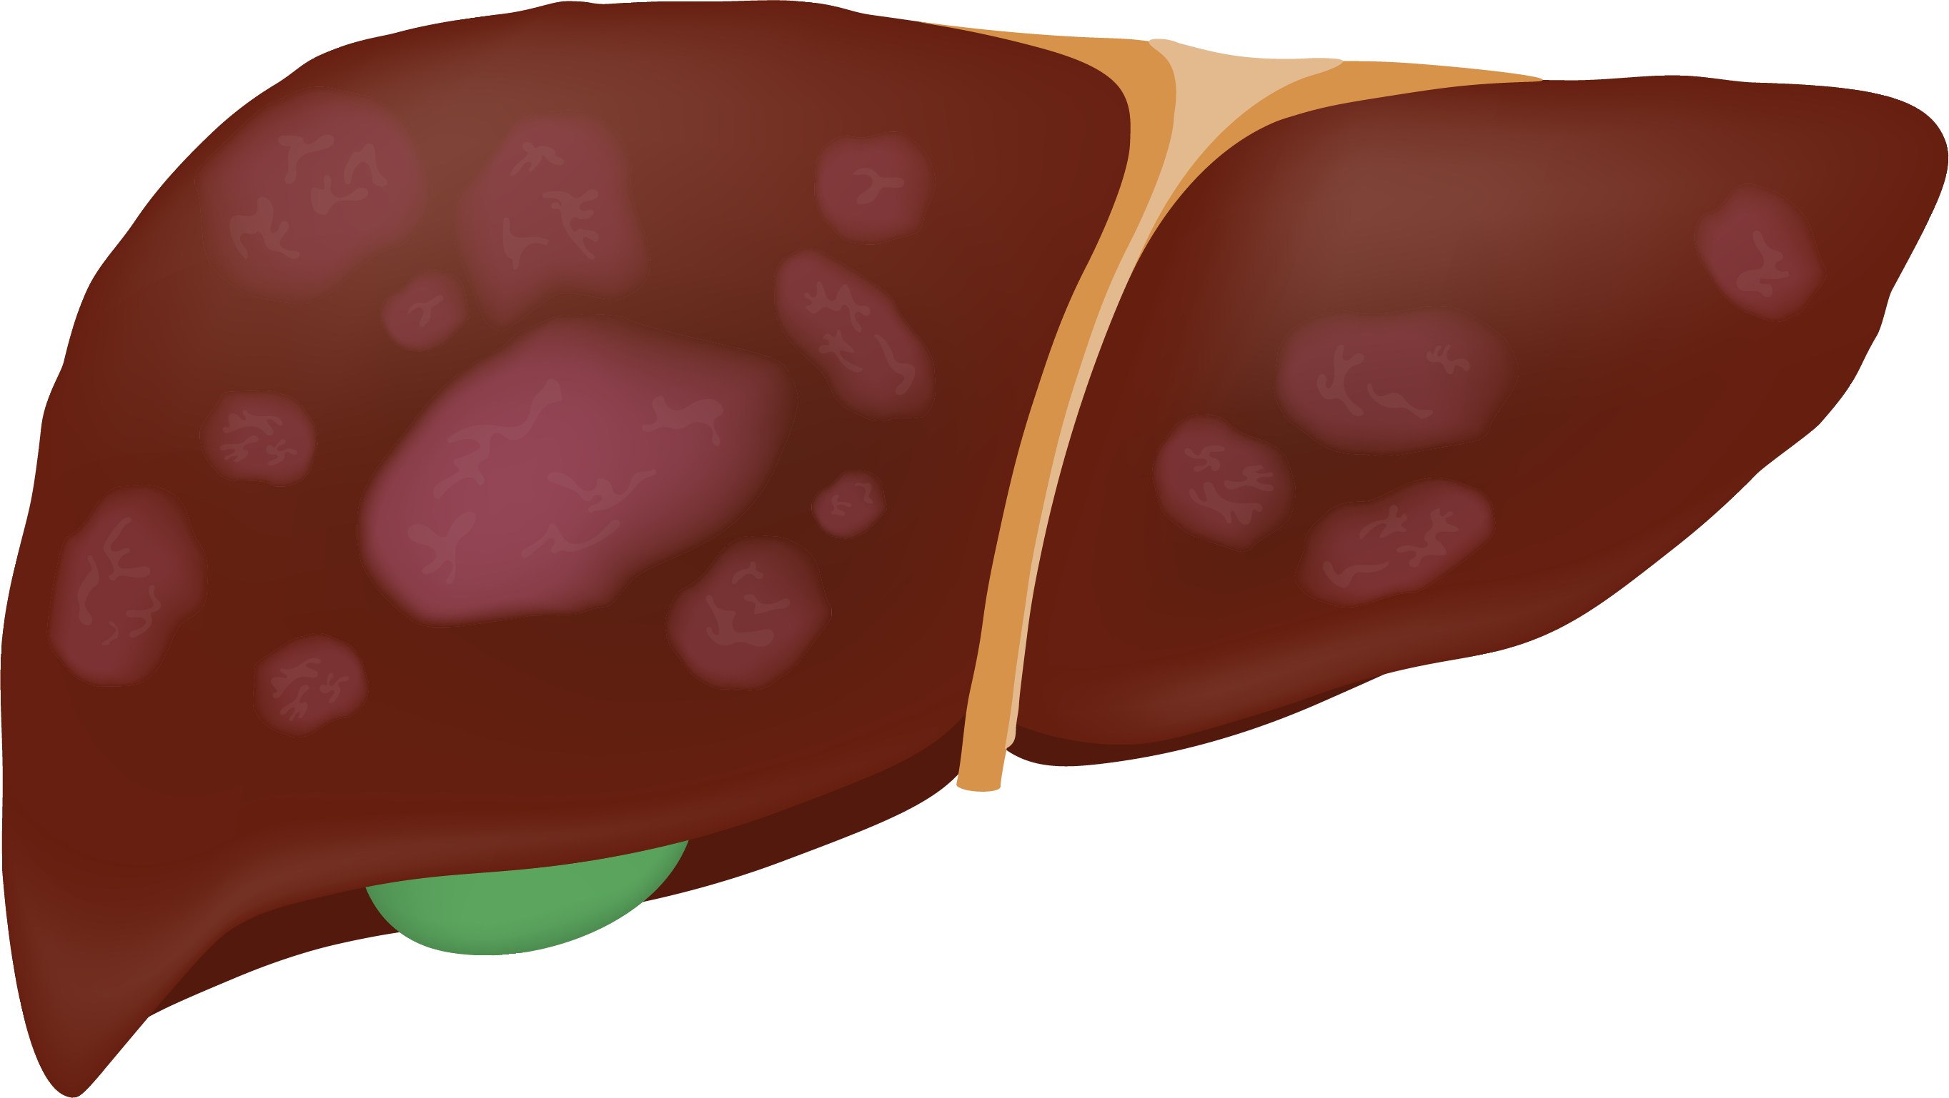
Mortality and CVD risk increases with fibrosis^{1,2}
MASLD is associated with a 1.5-fold higher long-term risk of new onset heart failure regardless of the presence of diabetes, hypertension, and other common CV risk factors³
Early
Advanced
 |  | F0 | F1 | F2 | F3 | F4 (cirrhosis)
Clinical presentation |  | May be asymptomatic until decompensated cirrhosis Symptoms may include fatigue, weight loss, weakness, abdominal discomfort
All-cause mortality RR |  | - | 1.6 | 2.5 | 3.5 | 6.4
Liver-related mortality RR |  | - | 1.4 | 9.6 | 16.7 | 42.3
CVD-related mortality* |  | 1.19-1.38 (across F0-F2) |  |  | 4.36 (across both F3 and F4)
*Cardiovascular mortality at F2-F3 is HFpEF and ASCVD.
ASCVD, atherosclerotic cardiovascular disease; CVD, cardiovascular disease; F, fibrosis stage; HFpEF, heart failure with preserved ejection fraction; RR, relative risk.
1. Dulai PS et al. Hepatology. 2017;65(5):1557–1565. 2. Ekstedt M et al. Hepatology. 2015;61(5):1547–1554. 3. Sanyal AJ et al. Am Heart J Plus. 2024;41:100386.

Slide 11
Average annual total healthcare costs of a patient with MASH in the US
Direct medical costs^{2,3}
Non-medical & indirect costs²
$3,407
PHARMACY
$58
SKILLED NURSING HOME
  The primary direct cost
  is medications
  Caregivers account for the majority of direct non-medical costs
  There are up to 27 different drugs to treat MASH co-morbidities
  Other costs include
  transport, disability allowances, alternative therapies, home alteration, and OTC remedies
$19,225
Average annual total healthcare costs of a patient with MASH in
the US¹
  Other costs include ‘off-label’ prescribing of medications, hospitalizations and surgical procedures
  Costs for patients with advanced fibrosis were higher than for those with early-stage fibrosis
  Indirect costs are very high globally, accounting for productivity loss
$7-8K
Non-cirrhotic MASH (F0-F3)
$34K
Compensated cirrhosis
$158K
Decompensated cirrhosis
$5,061
INPATIENT
$9,794
OUTPATIENT
$906
EMERGENCY DEPARTMENT
Base case per patient annually
All data referenced above were demonstrated in patients defined by NAFLD/NASH criteria.
MASH, metabolic dysfunction-associated steatohepatitis; NAFLD, nonalcoholic fatty liver disease; NASH, nonalcoholic steatohepatitis; US, United States.
1. Charlton M et al. J Manag Care Spec Pharm. 2024;30(12):1414–30. 2. O'Hara J et al. JHEP Reports. 2020;2:10014. 3. ICER Final Evidence Report. Institute for Clinical and Economic Review. 2023.

Slide 12
MASH leads to an increased economic burden on the healthcare system
In the US, MASH is the
Leading cause of liver transplants in women without HCC^{1,*}
Fastest growing cause of HCC among US patients listed for liver transplants²
Cost per patient†:
Cirrhosis³
HCC⁴
Liver transplant^{5,‡}
Comorbidity management³
~$100,000 annually
~$104,000 annually
Average billed charges:
~$878,400 per transplant
~$50,000 annually§
Early identification and effective management of MASH is crucial to minimize the clinical and economic burden of MASH⁴
*Based on the analysis of data from the Scientific Registry of Transplant Recipients (2002-2019).^{1 †}Cost per patient is based on the year estimated – cirrhosis: 2024; HCC: 2021; liver transplant: 2020; comorbidity management: 2024. ‡Liver transplant costs are not specific to transplants for MASH. §For patients with three comorbidities.
HCC, hepatocellular carcinoma; MASH, metabolic dysfunction-associated steatohepatitis; US, United States.
1. Younossi ZM et al. Clin Gastroenterol Hepatol. 2021;19(3):580–589. 2. Younossi ZM et al. Hepatology. 2019;69(suppl):2672–2682. 3. Younossi ZM et al. Hepatol Commun. 2024;8(8):e0488. 4. Wong RJ et al. J Clin Gastroenterol. 2021;55(10)891–902. 5. Bentley TS, Ortner NJ. Milliman Research Report; January 2020.

Slide 13
Guidelines recommend screening patient at high risk of MASH, including¹⁻⁵:
People living with pre-diabetes
or type 2 diabetes
People living with excess weight* or metabolic syndrome
People with hypertension
low HDL, or elevated triglycerides
People with abnormal liver
enzymes
People with moderate-to-severe steatosis based on imaging
*Excess weight defined as BMI ≥25 kg/m² (23 kg/m² for Asian populations), waist circumference >37” (M); >31.5” (F), or ethnically adjusted equivalent.⁶
MASH, metabolic dysfunction-associated steatohepatitis.
1. Chalasani N et al. Hepatology. 2018;67(1):328–335. 2. Younossi ZM et al. Gastroenterology. 2025; in press:1-16. 3. Kanwal F et al. Diabetes Care. 2021:44(9):2162-2172. 4. ADA Professional Practice Committee. Diabetes Care. 2022;45:46–59. 5. Rinella ME et al. Hepatology. 2023;77(5):1797–1835.

Slide 14
Impact of early screening and identification
Prevent progression to, or achieve regression from, advanced liver disease
Identifying MASLD at an earlier fibrosis stage allows time for intervention, supporting fibrosis regression, prevention of further progression, and potentially reversibility of disease
Lifestyle changes and treatment of metabolic risk factors can improve liver health and
prevent progression
Improve management of cardiometabolic risk factors
Early intervention can improve cardiometabolic health and reduce liver-related complications
Lower healthcare costs through appropriate differentiation for specialty referrals
Risk stratification using non-invasive tests (NITs) such as FIB-4, ELF™, or VCTE helps determine low-risk and high-risk patients leading to decreased low-risk referrals to hepatology
FIB-4, fibrosis-4 index.
Cusi K et al. Diabetes Care. 2025;48(7):1057–1082.

Slide 15
Summary
Key MASH risk factors include obesity, type 2 diabetes/insulin resistance, metabolic syndrome, and sedentary behavior and/or diet types¹
Disease burden and health complications rise significantly with advancing fibrosis^{3,4}
Guidelines support screening high-risk patients using non-invasive tests (NITs) to guide care⁵⁻¹¹
Early identification leads to favorable patient outcomes including appropriate referral to specialty care, reduced cardiovascular risk, and possibility for disease reversal through timely intervention¹²
MASH, metabolic dysfunction-associated steatohepatitis.
1. 10 Causes or Contributing Factors for MASLD and MASH. Fatty Liver Alliance. January 19, 2024. https://fattyliver.ca/blog/f/10-causes-or-contributing-factors-for-masld-and-mash. Accessed July 14, 2025. 2. Younossi ZM et al. Hepatology. 2016;64(1):73–84. 3. Dulai PS et al. Hepatology. 2017;65(5):1557–1565. 4. Ekstedt M et al. Hepatology. 2015;61(5):1547–1554. 5. Chalasani N et al. Hepatology. 2018;67(1):328–335. 6. EASL-EASD-EASO. J Hepatol. 2024;81(3):492–542. 7. Kanwal F et al. Gastroenterology. 2021:161(5):1657–1669. 8. Tokushige K et al. J Gastroenterol. 2021;56(11):951–963. 9. American Diabetes Association Professional Practice Committee. Diabetes Care. 2022;45:46–59. 10. Eslam M et al. Hepatol Int. 2020;14(6):889–919. 11. Rinella ME et al. Hepatology. 2023;77(5):1797–1835. 12. Cusi K et al. Diabetes Care. 2025;48(7):1057–1082

