Slide 1
Screening and diagnostics

Slide 2



Magnetic resonance elastography (MRE)* is an additional tool available to measure liver stiffness
Additional clinical NITs available
Quantitative assessment using MR technology to measure
liver stiffness¹
Fibrosis stage | ≥F2 | ≥F3 | F4
Definition | Significant fibrosis | Advanced fibrosis | Cirrhosis
Cut-off | 3.14 kPa | 3.53 kPa | 4.45 kPa
Pretest probability | 39.4% | 24.1% | 8.7%
AUROC | 0.92 | 0.92 | 0.94
Sensitivity | 79% | 87% | 88%
Specificity | 89% | 88% | 89%
Benefits
Ability to identify fibrosis stage with increased accuracy²
Used in clinical practice and research²
Incorporated into guidelines²
Validated in mixed populations²
Limitations
Higher cost^{3,†}
Dependence on sites that have access to MR scanners and
special equipment³
Time consuming²
MRI contraindicated in patients with metallic implants⁴
*LSM obtained from MRE is currently regarded as the most accurate biomarker for non-invasive liver fibrosis evaluation. †The shortened version of MRE may be available at lower cost in some centers.
AUROC, area under the receiver operating characteristic curve; F, fibrosis stage; LSM, liver stiffness measurement; MR, magnetic resonance;
MRE, magnetic resonance elastography; MRI, magnetic resonance imaging.
1. Chen J et al. Eur Radiol. 2022;32(2):950–958. 2. Loomba R et al. Hepatology. 2014;60(6):1920–1928. 3.Charoenuchue P et al. Diagnostics. 2025;15(62):1-15. 4. Ghadimi M, Thomas A. StatPearls [internet]. Updated May 2025. https://www.ncbi.nlm.nih.gov/books/NBK551669/. Accessed December 2025. 5. Liang J et al. J Hepatol. 2023;79(3):592–604.

Slide 3
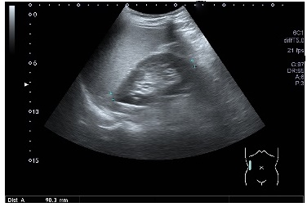
Ultrasound is a commonly used and reliable clinical NIT used to diagnosis steatosis
Additional clinical NITs available
Can reliably diagnose moderate and severe steatosis but does not exclude lower degrees of steatosis^{1,*}
Commonly used in clinical practice¹
Identify steatosis, ascites and masses (e.g., HCC)¹⁻³
BMI may affect accuracy of results⁴
Inter- and intra-observer variability¹
Ultrasound | Can diagnose steatosis
Ultrasound with elastography (e.g. Fibroscan®) | Can diagnose steatosis and fibrosis
AUROC 0.93 for liver steatosis 20–30%¹
*Ultrasound is not recommended for routine use by United States Guidelines.
AUROC, area under the receiver operating characteristic curve; BMI, body mass index; HCC, hepatocellular carcinoma.
1. Hernaez R et al. Hepatology. 2011;54(3):1082–1090. 2. Getnet W et al. Ethiop J Health Sci. 2019;29(3):383–390. 3. Hu H et al. J Clin Transl Hepatol. 2024;12(5):516–524. 4. Li Q et al. World J Hepatol. 2018;10(8):530–542.

