Slide 2
MASH management

Slide 3
Thank you for using the Elivate™: creating change through liver education curriculum
Welcome to the Elivate™ curriculum, funded by Novo Nordisk Inc. A third-party provider developed the curriculum content in consultation with Novo Nordisk Inc. and leading liver health clinician experts. Elivate™ relies exclusively on open-source materials available to the general public.
The goal of Elivate™ is to present a complete, accurate, non-promotional, and fair-balanced picture of the current state of metabolic dysfunction-associated steatohepatitis (MASH). Elivate™ is intended to educate healthcare providers on the screening, diagnosis, and management of MASH and improve support for patients. By choosing to access and browse this module of Elivate™, you acknowledge that you have read, understand, and agree to the Elivate™ Terms of Use. If you do not agree with the Elivate™ Terms of Use, you are not permitted to further access this module and should immediately discontinue your use.
View the ElivateTM Terms of Use: https://bit.ly/4aZxVmT
Content current as of January 2026.

Slide 4
Module 4 learning outcome
MASH management
Learners will be able to apply a patient-centered, guideline-informed approach to the holistic management of liver steatosis and fibrosis and comorbidities in individuals at risk for or diagnosed with MASLD/MASH.
MASH, metabolic dysfunction-associated steatohepatitis; MASLD, metabolic dysfunction-associated steatotic liver disease.

Slide 5
MASH is often undiagnosed until later stages of disease leading to delayed and less effective management
~30-35%
(~80-100 M) of the
US population
have MASLD¹
Of those,
up to 5%
progress to
MASH¹
Yet in real-world practice, MASH is diagnosed in
only 0.15%
of patients^{2,*}
Potential barriers:
Lack of disease awareness³
Limited approved medical therapy^{5,7}
Diagnosis and referral to specialists for management remain low^{5,6}
Limited adoption of noninvasive diagnostic tests⁵
Lack of early symptoms⁴
(silent or non-specific symptoms)
May result in delayed diagnosis and MASH progression⁸
*Calculated as the number of diagnosed cases based on ICD-10 claims divided by the person-years at risk in 2020.
ICD-10, International Classification of Disease, 10th revision; MASH, metabolic dysfunction-associated steatohepatitis.
1. Le P et al. JAMA Netw Open. 2025;8(1):e2454707. 2. Charlton M et al. J Med Econ. 2024;27:919–930. 3. Ratziu V et al. J Hepatol. 2015;62:S65–S75. 4. Ofosu A et al. Ann Gastroenterol. 2018;31:288–295. 5. Cusi K et al. Endocrine Practice. 2022;28:528–627. 6. ADA Professional Practice Committee. Diabetes Care. 2024;47(Suppl.1):S52–S76. 7. Dufour JF et al. Gut. 2020;69:1877–1884. 8. Walker M et al. Aliment Pharmacol Ther. 2016;43(5):621–630.

Slide 6



MASLD/MASH management should be individualized based on patient needs
 | Low risk^{1,2} FIB-4 <1.3 or LSM <8 kPa or liver biopsy F0-F1 | Indeterminate risk^{1,2} FIB-4 1.3-2.67 and/or LSM 9-12 kPa and liver biopsy not available | High risk^{1,2}* FIB-4 >2.67 or LSM >12 kPa or liver biopsy F2-F4
Management considerations | Management by PCP, dietician, endocrinologist, cardiologist, others | Management by hepatologist with multidisciplinary team (PCP, dietician, endocrinologist, cardiologist, others)
Lifestyle intervention† | Yes | Yes | Yes
Weight loss recommended if overweight or obese‡ | Yes May benefit from structured weight loss programs, anti-obesity medications, bariatric surgery | Yes Greater need for structured weight loss programs, anti-obesity medications, bariatric surgery | Yes Strong need for structured weight loss programs, anti-obesity medications, bariatric surgery
Pharmacotherapy for MASH | Not recommended | Yes§ | Yes§,‖
CVD risk reduction¶ | Yes | Yes | Yes
Type 2 diabetes care | Standard of care | Prefer medications with efficacy in MASH (pioglitazone, GLP-1RA) | Prefer medications with efficacy in MASH (pioglitazone, GLP-1RA)
MASLD/MASH management should be individualized and amended periodically according to disease progression¹
MASLD/MASH monitoring focuses on the optimization of treatment of liver disease and concomitant metabolic conditions¹
Continued risk stratification using NITs should be used to monitor risk and make individualized treatment decisions¹
*Patients with F4 or cirrhosis (based on biopsy, LSM values based on VCTE or >5 kPa on MRE) should undergo HCC surveillance. Varices screening is recommended if LSM >20 kPa or platelet count of <150,000/mm³. †All patients require regular physical activity, should consume a healthy diet, and avoid excess alcohol intake. ‡Weight loss recommendations for cardiometabolic benefit and reversal of steatosis. Greater weight loss is often associated with more benefit, such as reversal of steatohepatitis (usually with weight loss ≥7%) or fibrosis (usually with weight loss ≥10%). §Individualize based on further work-up and efforts to confirm the diagnosis of MASH. A liver biopsy provides helpful information and should be considered in cases where there is a diagnostic doubt, such as patients with indeterminate, unreliable, or conflicting noninvasive assessments or as part of phase 2 or phase 3 clinical trials. Patients with T2D may benefit from some diabetes medications that have reported histological improvement in RCTs in patients with MASH. Vitamin E improves steatohepatitis in patients with MASH without diabetes, with less evidence in patients with T2D. ‖Pharmacotherapy in patients with MASH cirrhosis is limited and should be avoided until more data become available. ¶Statins can be used safely in patients with steatohepatitis and liver fibrosis; to be avoided in decompensated cirrhosis.
CVD, cardiovascular disease; F, fibrosis stage; FIB-4, fibrosis-4 test; GLP-1RA, glucagon-like peptide 1 receptor agonist; HCC, hepatocellular carcinoma; LSM, liver stiffness measurement; MASH, metabolic dysfunction-associated steatohepatitis; MRE, magnetic resonance elastography; NIT, non-invasive test; PCP, primary care provider; RCT, randomized controlled trial; T2D, type 2 diabetes; VCTE, vibration-controlled transient elastography.
1. Rinella ME et al. Hepatology. 2023;77(5):1797-1835. 2. Kanwal F et al. Gastroenterology. 2021;161(5):1657-1669.

Slide 7
Guidelines promote a holistic approach to MASLD/MASH management
AASLD guidance for multidisciplinary management of MASLD/MASH
Health psychology
Nutrition/lifestyle intervention
(Various allied HCPs)
Gastroenterology/hepatology
Nutritional and dietary assessment and goals
Identification of barriers
Behavioral intervention and management plan
Comprehensive liver risk stratification
Liver-directed therapies
Identification of additional comorbidities
Management of advanced fibrosis
Clinical trial opportunities are available
Patient with MASLD/ MASH
Weight management medical/interventional
Primary care provider/endocrinology
Initial risk stratification with FIB-4 +/- secondary testing
Management of metabolic comorbidities with preferential use of medications with potential MASLD benefit
Assessment of other endocrine drivers if indicated
Lifestyle interventions
Cardiology/advanced lipid management
AASLD, American Association for the Study of Liver Diseases; FIB-4, fibrosis-4 score;
HCP, healthcare provider; MASH, metabolic dysfunction-associated steatohepatitis;
MASLD, metabolic dysfunction-associated steatotic liver disease.
Rinella ME et al. Hepatology. 2023;77(5):1797–1835.

Slide 8
Treatment options for patients with MASLD/MASH are evolving
Diet and exercise are vital components of treatment in patients with MASH^{1,2}
Limited carbohydrates and saturated fat²
Diets should be enriched with high fiber²
Increase activity level to the extent possible²
Bariatric surgery in patients with BMI ≥35 kg/m² and MASH has demonstrated strong evidence in reducing liver steatosis, liver inflammation, and fibrosis³
There are currently two FDA-approved pharmacotherapy options for MASH, resmetirom and semaglutide^{4,5,*}
*Current as of November 2025.
FDA, United States Federal Drug Administration; GLP-1RA, glucagon-like peptide-1 receptor agonist; MASH, metabolic dysfunction-associated steatohepatitis; MASLD, metabolic dysfunction-associated liver disease; PO, per os (oral); THR-β, thyroid hormone receptor beta agonist.
1. Banini BA, Sanya AJ. Clin Med Insights Ther. 2016;8:75–84. 2. Rinella ME et al. Hepatology. 2023;77(5):1797–1835. 3. Mechanick JI, et al. Endocrine Pract. 2019;25:1–75. 4. Rezdiffra (resmetirom). Package insert. Madrigal Pharmaceuticals, Inc.; March 2024. 5. Wegovy (semaglutide). Package insert. Novo Nordisk Inc.; August 2025.

Slide 9
FDA-approved pharmacotherapies for MASH
Name | Class | Effect | Dosing | Side effects (incidence ≥5%)
Resmetirom, PO¹ | THR-β | Liver-directed therapy that has not been proven to address the metabolic drivers of MASH; requires pairing with diabetes/obesity medication | 60 mg, 80 mg, 100 mg once daily Dosing recommendations are based on actual body weight <100 kg: 80 mg once daily ≥100 kg: 100 mg once daily | Diarrhea Nausea Pruritus Vomiting Constipation Abdominal pain Dizziness
Semaglutide, SC² | GLP-1RA | Cardiometabolic-directed therapy with meaningful liver benefits aside from positive CV and weight outcome | 2.4 mg once weekly Dosage can be decreased to 1.7 mg once weekly based on tolerability | Diarrhea Nausea Pruritus Vomiting Constipation Abdominal pain and/or distension Dizziness Headache | Fatigue Dyspepsia Eructation Hypoglycemia in patients with T2D Flatulence Gastroenteritis Gastroesophageal reflux disease Nasopharyngitis
For full product information, see package insert.
FDA, United States Federal Drug Administration; GLP-1RA, glucagon-like peptide-1 receptor agonist; MASH, metabolic dysfunction-associated steatohepatitis; MASLD, metabolic dysfunction-associated liver disease; PO, per os (oral); THR-β, thyroid hormone receptor beta agonist.
1. Rezdiffra (resmetirom). Package insert. Madrigal Pharmaceuticals, Inc.; March 2024. 2. Wegovy (semaglutide). Package insert. Novo Nordisk Inc.; August 2025.

Slide 10
Summary of management guidelines
AASLD and AACE
 | AASLD¹ | AACE²
Lifestyle | Overweight/Obesity: Prescribe diet that leads to a caloric deficit For additional cardiovascular benefit, diets with high fiber and unsaturated fats (e.g., Mediterranean diet) should be encouraged when possible Increase activity level with individualized prescriptive exercise recommendations Alcohol can be a cofactor for liver disease progression and intake should be assessed on a regular basis; patients with fibrosis stage ≥2 should abstain from alcohol use completely | Increase daily movement and stress reduction through aerobic exercise and other methods Aerobic exercise and resistance training recommended Dietary modifications with reduction of macronutrient content and energy deficit for weight management, diabetes, hypertension and atherogenic dyslipidemia Minimize alcohol intake and avoid if F3 or cirrhosis (F4)
Pharmacotherapy | Resmetirom and semaglutide can be considered for treatments of adults with MASH (F2–F3) but are not recommended for the treatment of cirrhosis^{3,4} Patients with compensated cirrhosis who are receiving semaglutide for another FDA-approved indication should be monitored carefully⁴ Drugs approved to treat associated comorbidities with potential benefit in MASLD may be considered in the appropriate clinical setting: Diabetes: Pioglitazone can be considered in patients with MASH* Vitamin E can be considered in select individuals without diabetes* CVD risk reduction: Statins are safe and recommended in patients with MASLD, including compensated cirrhosis (with careful monitoring, may consider statin use in patients with decompensated cirrhosis if patients have high CVD risk) Avoid metformin, UDCA, DPP-4, statins, and silymarin (milk thistle) for the treatment of MASH as they do not offer a meaningful histologic benefit | Obesity: Phentermine, phentermine/topiramate ER, naltrexone/bupropion, orlistat, liraglutide 3 mg/day or semaglutide 2.4 mg/week Diabetes: Consider agents that reduce liver fat for low-risk (pioglitazone, GLP-1RA, SGLT2i) and strongly consider agents with efficacy in MASH for indeterminate- and high-risk patients (pioglitazone and/or GLP-1RA) Hypertension: First-line therapy with ACEIs and ARBs for all patients except those with decompensated cirrhosis Atherogenic dyslipidemia: First-line therapy with statins unless contraindicated; avoid in patients with decompensated cirrhosis (Child C)
Surgery | Bariatric surgery should be considered as a therapeutic option in patients who meet criteria for metabolic weight loss surgery as it effectively resolves MASLD or MASH in the majority of patients without cirrhosis and reduces mortality from CVD and malignancy | Bariatric surgery may be considered to treat obesity and comorbidities in all patients with MASLD with stronger consideration to treat steatohepatitis and fibrosis in indeterminate- and high-risk groups Indicated for patients with a BMI ≥40 kg/m² irrespective of metabolic comorbid disease or BMI ≥35 kg/m² with comorbidities Avoid bariatric surgery in patients with decompensated cirrhosis
*Available data on pioglitazone and vitamin E do not demonstrate an antifibrotic benefit, and none has been carefully studied in patients with cirrhosis.
AACE, American Association for Clinical Endocrinologists; AASLD, American Association for the Study of Liver Diseases; ACEI, angiotensin-converting enzyme inhibitor; ARB, angiotensin II receptor blocker; CVD, cardiovascular disease; DPP-4, dipeptidyl peptidase 4; ER, extended release; F, fibrosis stage; GLP-1RA, glucagon-like peptide-1 receptor agonist; MASLD, metabolic dysfunction-associated steatotic liver disease; MASH, metabolic dysfunction-associated steatohepatitis; SGLT2i, sodium/glucose cotransporter-2 inhibitor; T2D, type 2 diabetes; UDCA, ursodeoxycholic acid.
1. Rinella ME et al. Hepatology. 2023;77(5):1797–1835. 2. Cusi K et al. Endocrine Practice. 2022;28:528–627. 3. Chen VL et al. Hepatology. 2025;81(1):312–320. 4. Bansal MB et al. Hepatology. 2025. doi:10.1097/HEP.0000000000001608.

Slide 11
Summary of management guidelines
ADA and AGA
 | ADA¹ | AGA²
Lifestyle | T2D or prediabetes with overweight/obesity: Individualized, structured nutrition and physical activity programs that promote weight loss for cardiometabolic benefits and histological improvement Reduction of macronutrient content, limiting saturated fat, starch, and added sugar, with adoption of healthy eating patterns | Regular physical activity Healthy diet Avoid excess alcohol intake
Pharmacotherapy | T2D, particularly with overweight/obesity, with MASLD: Consider using a GLP-1RA with demonstrated benefits in MASH as an adjunctive therapy to lifestyle interventions for weight loss T2D with biopsy-proven MASH or those at high risk for MASLD with clinically significant liver fibrosis using NITs: Pioglitazone or GLP-1RAs are the preferred agents for the treatment of hyperglycemia T2D with decompensated cirrhosis: Insulin therapy is the preferred agent for the treatment of hyperglycemia T2D and compensated cirrhosis from MASH: Statin therapy is safe in adults with and should be initiated or continued for cardiovascular risk reduction as clinically indicated, though should be used with caution and close monitoring in people with decompensated cirrhosis as safety and efficacy data are limited MASH without diabetes: Vitamin E may have a beneficial effect on MASH | Pharmacotherapy for MASH: Pharmacotherapy recommended only for indeterminate- and high-risk patients* Obesity: Recommendation for anti-obesity medications varies by fibrosis risk (low risk: may benefit; indeterminate risk: greater need; high risk: strong need) Diabetes: pharmacotherapy with efficacy in MASH (pioglitazone, GLP-1RA) for indeterminate- and high-risk patients is preferred Atherogenic dyslipidemia: Statins can be safely used in all patients with MASH with fibrosis except in patients with decompensated cirrhosis
Surgery | Consider metabolic surgery in appropriate candidates as an option to treat MASH in adults with type 2 diabetes and MASH and improve cardiovascular outcomes Metabolic surgery should be used with caution in individuals with compensated cirrhosis from MASLD and is not recommended in decompensated cirrhosis | Bariatric surgery may be considered in patients with obesity and MASLD or MASH, with greater needs in indeterminate- and high-risk groups
*Pioglitazone, some GLP-1 RAs with semaglutide having strongest evidence of liver histological benefit and vitamin E improves steatohepatitis in patients with MASH without diabetes.
ADA, American Diabetes Association; AGA, American Gastroenterology Association; F, fibrosis stage; GLP-1RA, glucagon-like peptide-1 receptor agonist; MASH, metabolic dysfunction-associated steatohepatitis; MASLD, metabolic dysfunction-associated steatotic liver disease; NIT, non-invasive test; T2D, type 2 diabetes.
1. ADA Professional Practice Committee. Diabetes Care. 2024;47(Suppl.1):S52–S76. 2. Kanwal F et al. Gastroenterol. 2021;161:1657–1669.

Slide 12
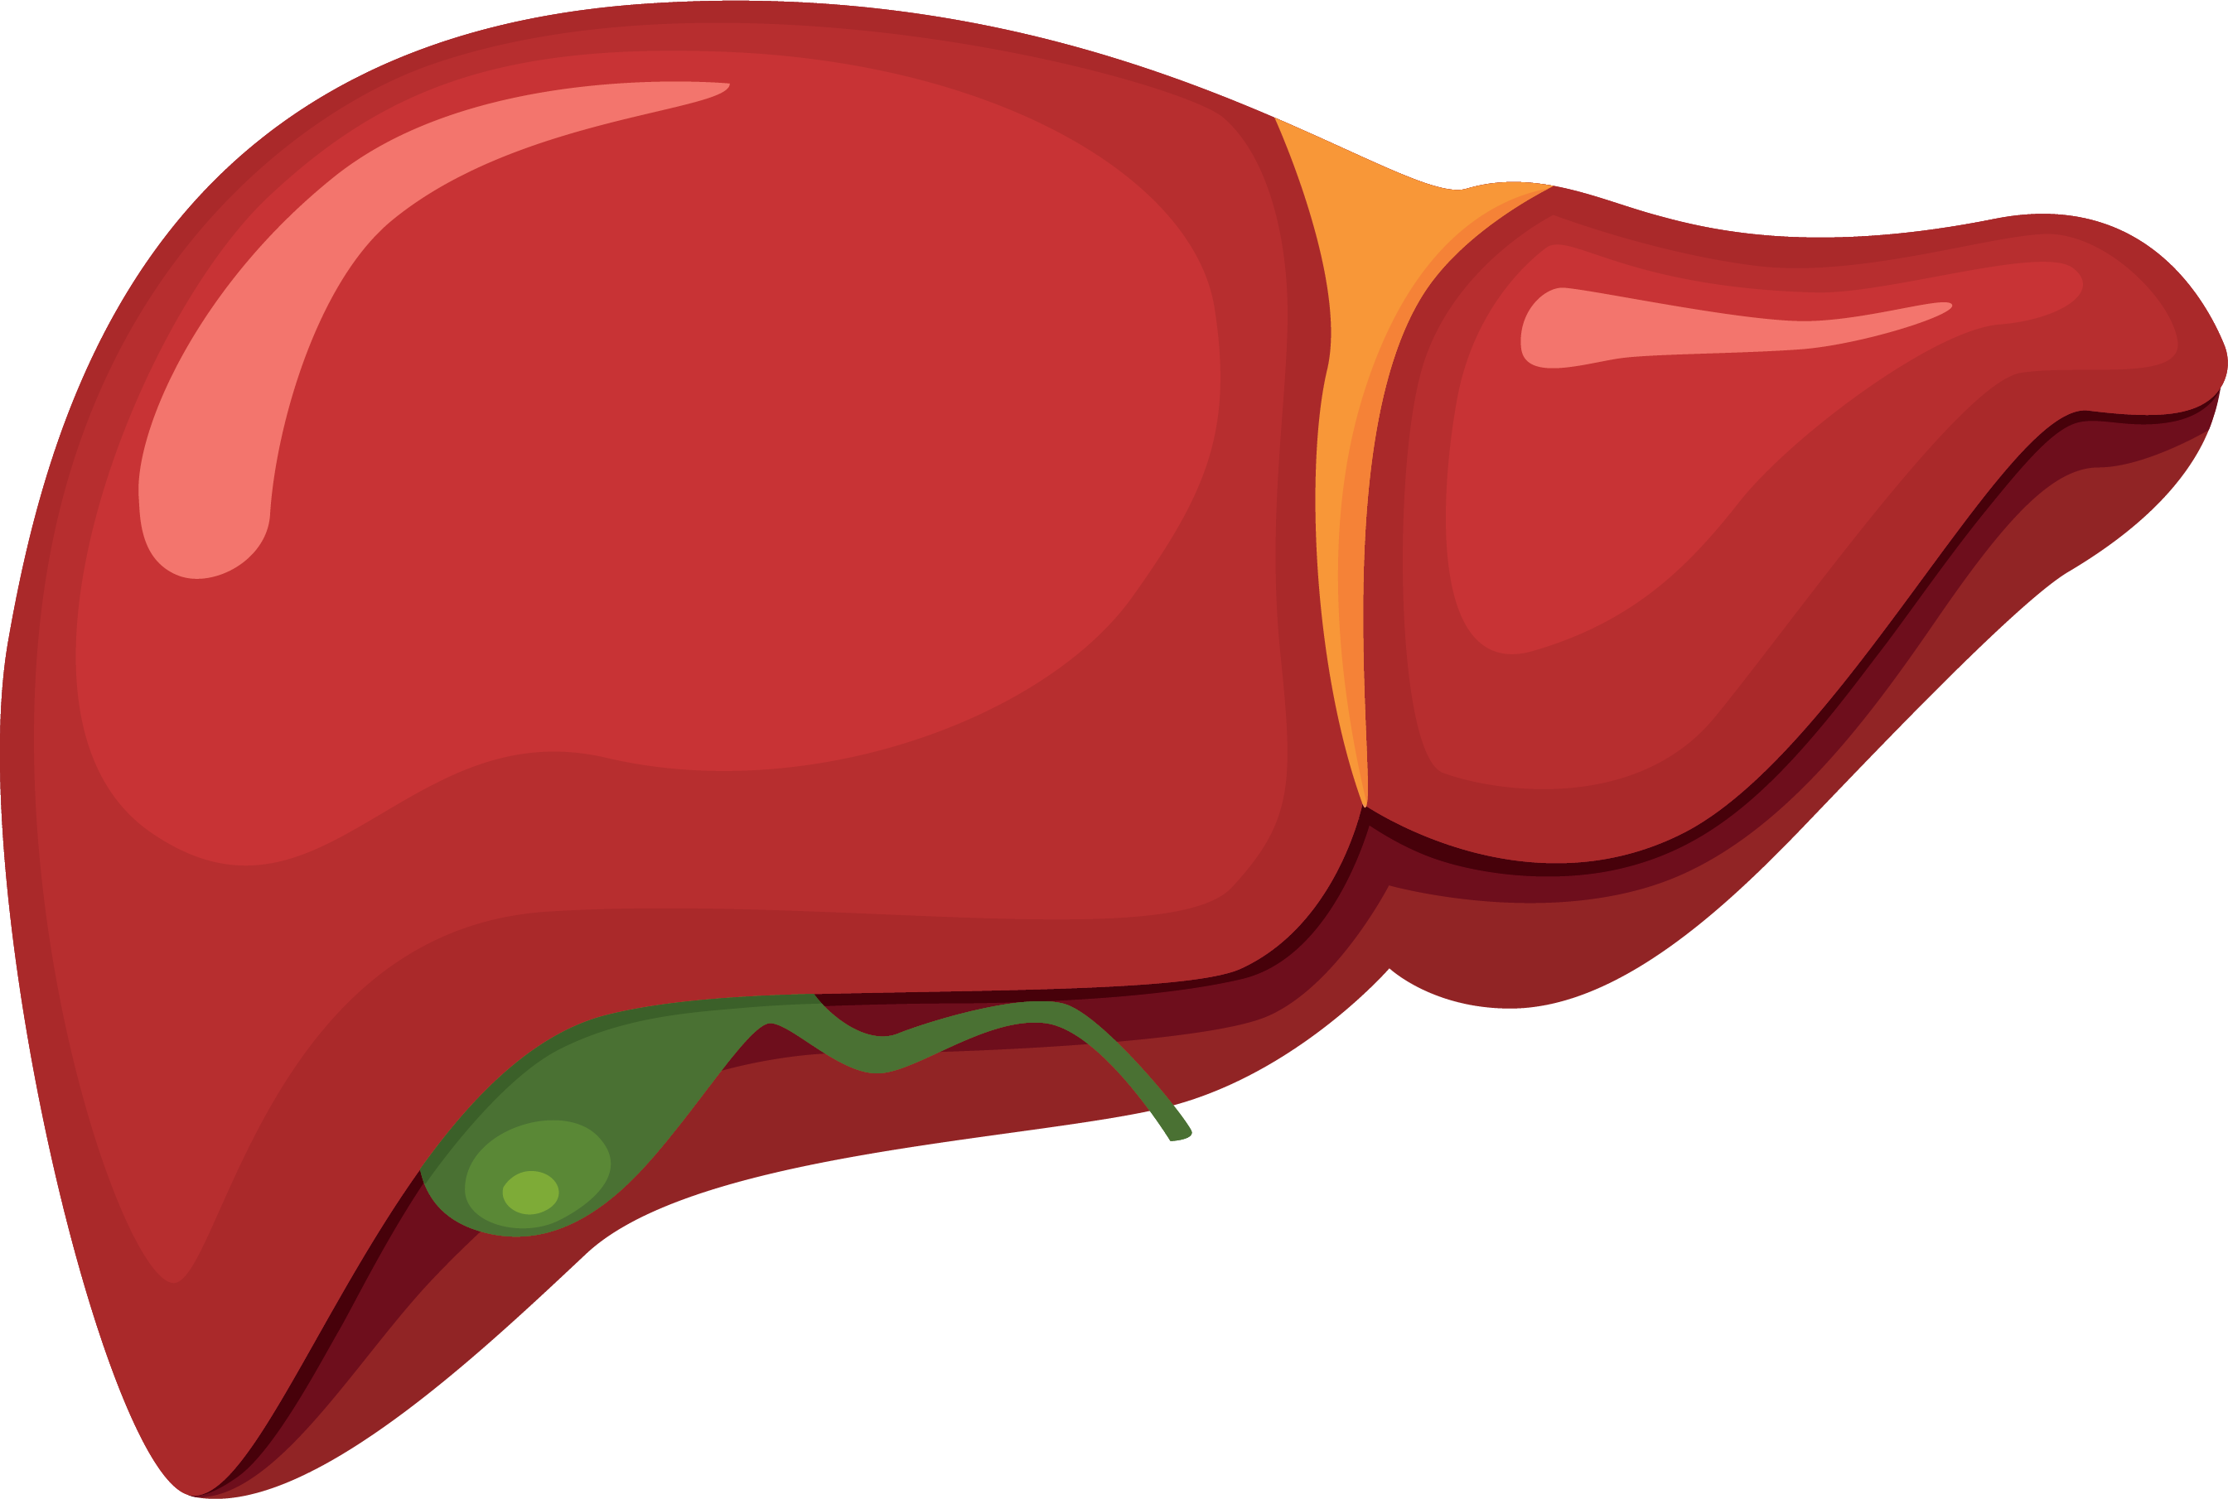
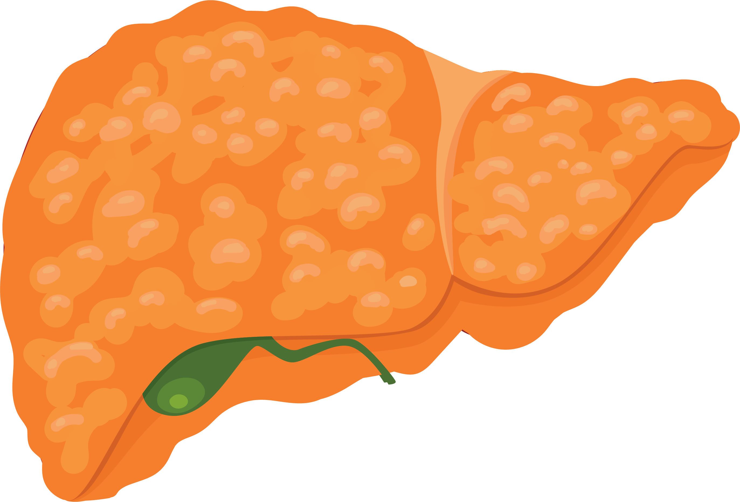
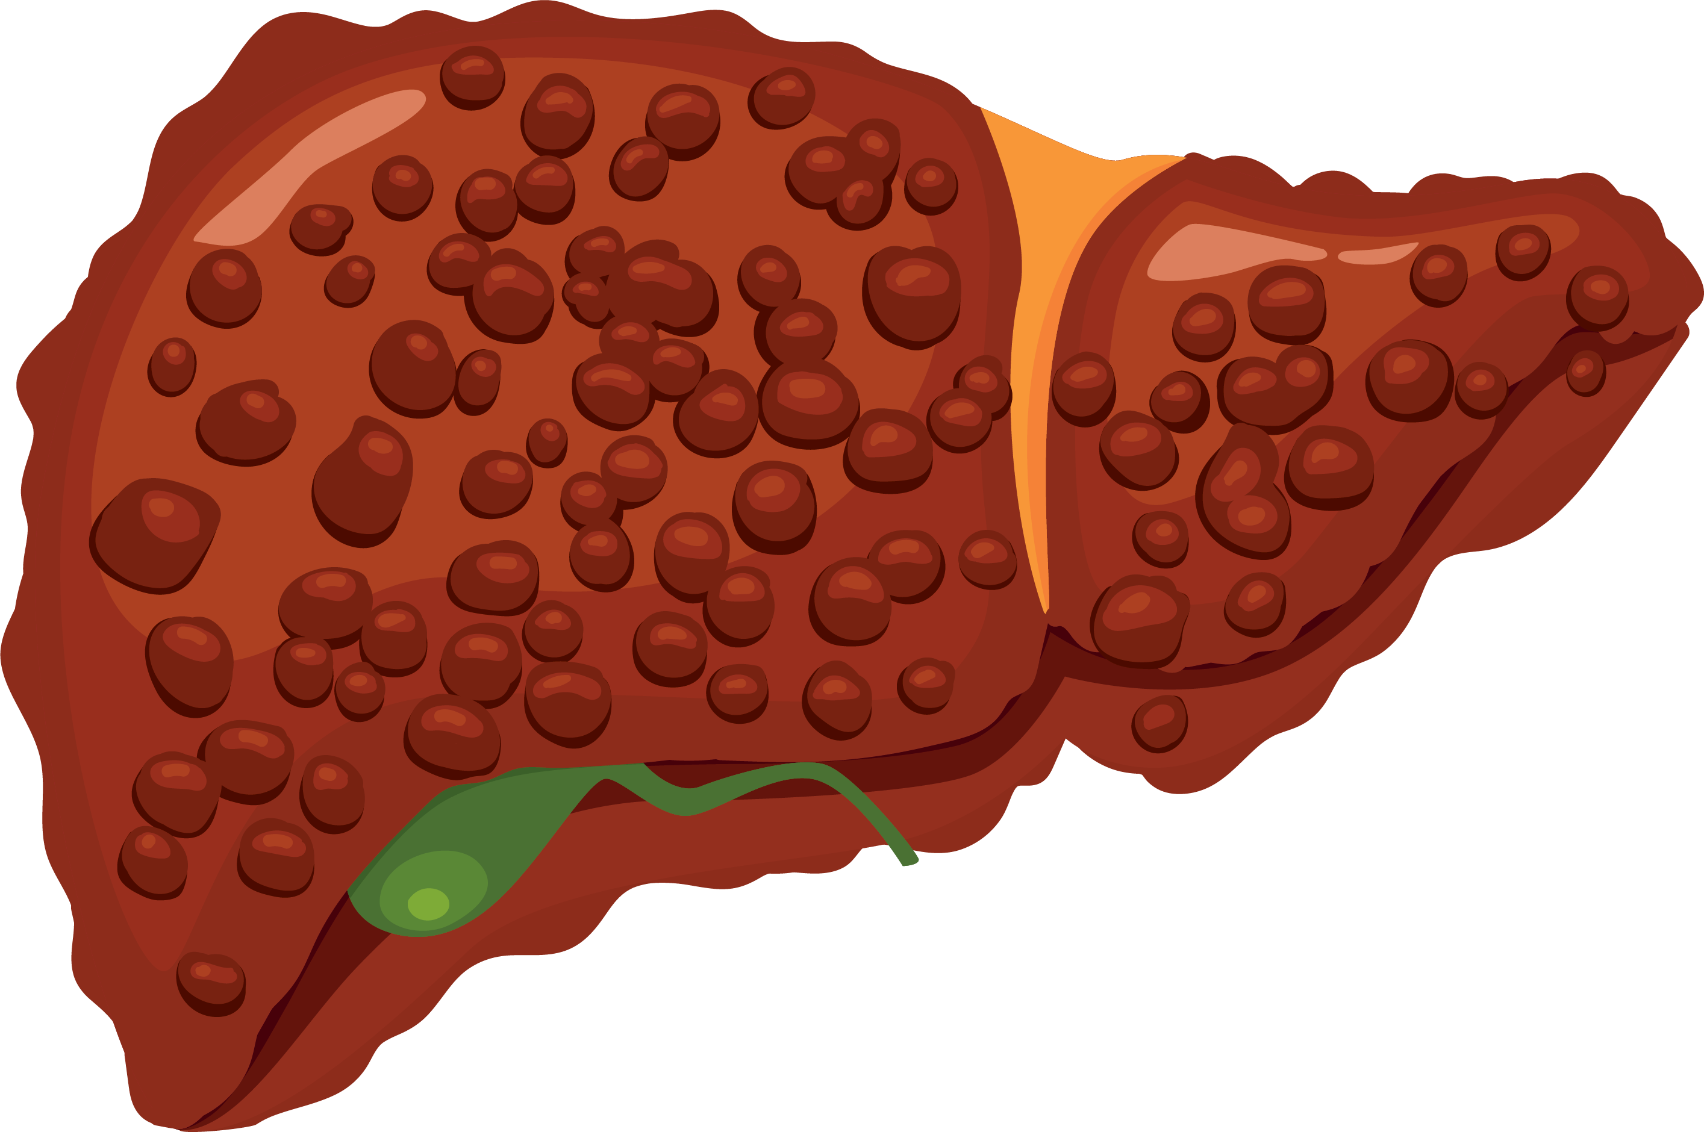
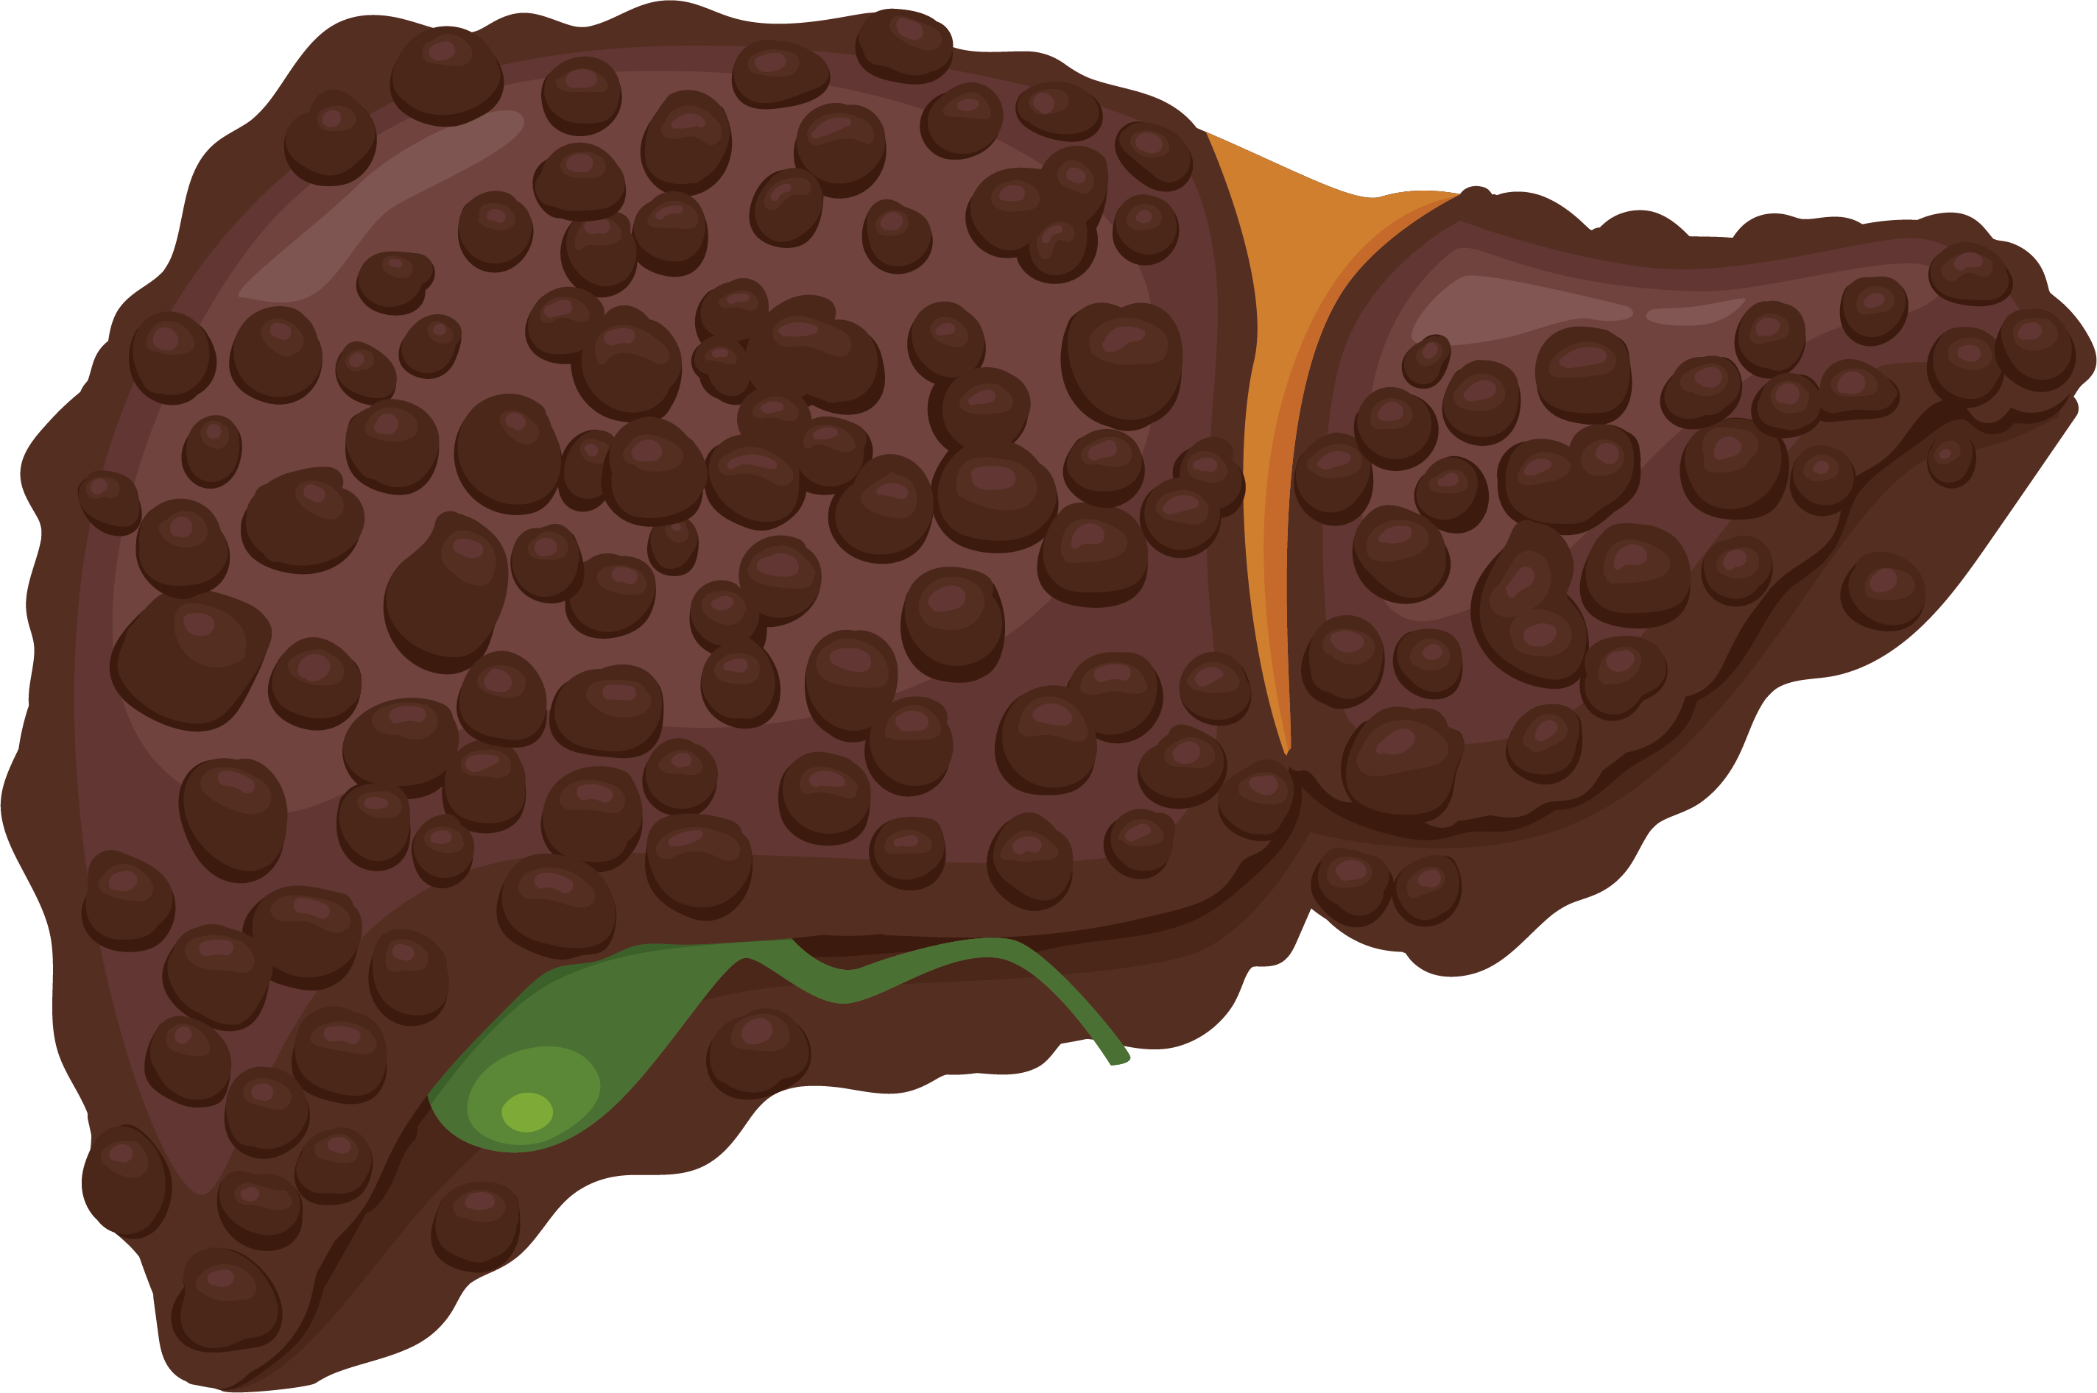
ADA: Treatment recommendations for MASLD fibrosis stages
Individualize care,
targeting the following:
Adoption of healthy lifestyle
Weight loss (if indicated)
Optimal diabetes management (HbA1c)
Cardiovascular risk reduction
Need for metabolic surgery (as recommended by guidelines)
Obesity pharmacotherapy | Diabetes pharmacotherapy | MASH pharmacotherapy
Prefer GLP-1RA, dual GIP and GLP-1RA | Prefer GLP-1RA, dual GIP and GLP-1RA, pioglitazone, SGLT2i | Not indicated
MASLD with F0-F1
Obesity pharmacotherapy | Diabetes pharmacotherapy | MASH pharmacotherapy
Prefer GLP-1RA, dual GIP and GLP-1RA | Prefer GLP-1RA, dual GIP and GLP-1RA, pioglitazone | Resmetirom, semaglutide²
MASLD with
F2-F3
(“at-risk MASH”)
Obesity pharmacotherapy | Diabetes pharmacotherapy | MASH pharmacotherapy
As with F2-F3 with caution* | As with F2-F3 with caution* | AVOID
Compensated cirrhosis
AVOID
Obesity pharmacotherapy | Diabetes pharmacotherapy | MASH pharmacotherapy
AVOID | Only use insulin | AVOID
Decompensated cirrhosis
AVOID
AVOID
*Individualized care and close monitoring needed in compensated cirrhosis given limited safety data available.
ADA, American Diabetes Association; F; fibrosis stage; GIP, glucose-dependent insulinotropic polypeptide; GLP-1RA, glucagon-like peptide-1 receptor agonist; MASH, metabolic dysfunction-associated steatohepatitis; MASLD, metabolic dysfunction-associated steatotic liver disease; SGLT2i, sodium-glucose cotransporter 2 inhibitor.
1. ADA Professional Practice Committee. Diabetes Care. 2025;48(Suppl.1):S59–S85. 2. Wegovy (semaglutide). Package insert. Novo Nordisk Inc.; August 2025.

Slide 13
Identifying patients for use of resmetirom^{1,2}
Resmetirom can be considered for…
Practitioners may consider…
Resmetirom initiation is not
recommended for persons with…
Adults with MASH and moderate to advanced liver fibrosis (F2-F3), evaluated by:
NILDA (imaging-based such as VCTE, MRE preferred over blood-based)
OR
Histological liver biopsy
Expanded noninvasive criteria in making treatment decisions (e.g., LSM by VCTE outside recommended ranges)
Ultimately, it is the prescriber’s prerogative and responsibility to adjudicate patient’s fibrosis status
Compensated or decompensated cirrhosis
Concomitant uncontrolled active autoimmune liver disease
Ongoing alcohol consumption exceeding the daily average 20 g (women) or 30 g (men)
Untreated hyperthyroidism or hypothyroidism
Symptomatic gallstone-related conditions (e.g., acute
cholecystitis)
F, fibrosis stage; LSM, liver stiffness measurement; MASH, metabolic dysfunction-associated steatohepatitis; NILDA, non-invasive liver disease assessment; VCTE, vibration-controlled transient elastography.
1. Chen VL et al. Hepatology. 2025;81:312–320. 2. Rezdiffra (resmetirom). Package insert. Madrigal Pharmaceuticals, Inc.; March 2024.

Slide 14
Resmetirom treatment monitoring and response assessment^{1,2}
On-treatment monitoring
Determining efficacy and futility at 12 months
Continue resmetirom if…
≥ 25% VCTE improvement, or ≥ 20% MRE improvement | Significant fibrosis improvement
Hepatic function panel testing at
3, 6 and 12 months*
To determine response and adverse events while
on resmetirom
Stop resmetirom if…
≥ 25% VCTE worsening, or ≥ 20% MRE worsening | Consistent increase in ALT or fibrosis progression (as assessed by NILDA)
Discontinue if hepatotoxicity develops†
Standard laboratory monitoring
(per established guidelines)
Among persons without clear evidence of liver disease improvement/worsening, consider…
For persons with known thyroid disease
Baseline fibrosis status and potential benefit of slowing or stabilizing liver fibrosis even if no regression is noted
Individual comorbidity profile associated with progressive liver disease
Comorbidity management
Concomitant therapy including adherence and response to lifestyle interventions
Including hyperlipidemia, particularly if statin dose is modified at the outset of resmetirom therapy
Changes in liver biochemical and NILDA parameters
Any adverse events during resmetirom therapy
*There are insufficient data to make a recommendation on monitoring after 12 months of resmetirom treatment, but continued monitoring with hepatic function panel testing every 6 months is suggested. †As defined by the AASLD drug-induced liver injury practice guidelines.
AASLD, American Association for the Study of Liver Diseases; ALT, alanine aminotransferase; MRE, magnetic resonance elastography; NILDA, noninvasive liver disease assessment; VCTE, vibration-controlled transient elastography.
1. Chen VL et al. Hepatology. 2025;81:312–320. 2. Rezdiffra (resmetirom). Package insert. Madrigal Pharmaceuticals, Inc.; March 2024.

Slide 15
Identifying patients for use of semaglutide^{1,2}
Semaglutide can be considered for…
Practitioners may consider…
Semaglutide initiation is
not recommended for persons with…
Adults with MASH and moderate to advanced liver fibrosis (F2-F3), evaluated by:
NIT (such as VCTE, MRE, or ELF™)
OR
Liver biopsy
An individualized decision to treat based on exclusion of cirrhosis with another confirmatory NIT, or cross-sectional imaging excluding nodular-appearing liver contour and signs of portal hypertension, or a platelet count of <150,000/mm³
Compensated or decompensated cirrhosis*
Personal or family history of medullary thyroid cancer (MTC)
Multiple endocrine neoplasia syndrome type 2 (MEN2)
Severe gastroparesis
History of gallbladder disease
(e.g., acute cholecystitis)†
*Patients with compensated cirrhosis who are receiving semaglutide for another FDA-approved indication should be monitored carefully. †This is not an absolute contraindication. Caution is warranted, and patients should be educated on symptoms concerning for biliary complications.
ELF™, enhanced liver function score; F, fibrosis stage; LSM, liver stiffness measurement; MASH, metabolic dysfunction-associated steatohepatitis; MRE, magnetic resonance elastography; NIT, non-invasive test; VCTE, vibration-controlled transient elastography.
1. Bansal MB et al. Hepatology. 2025. doi:10.1097/HEP.0000000000001608. 2. Wegovy (semaglutide). Package insert. Novo Nordisk Inc.; August 2025.

Slide 16
Semaglutide treatment monitoring and response assessment^{1,2}
On-treatment monitoring
Determining efficacy and futility at 72 weeks
Hepatic function panel testing as clinically indicated
Continue semaglutide if…
VCTE LSM: ≥ 30% decrease, or MRE LSM: ≥ 20% decrease, or MRI-PDFF: ≥ 30% decrease, or | ALT: ≥ 17 U/L or ≥ 20% decrease ELF™: ≥ 0.5 decrease
To determine response and adverse events while
on semaglutide
No strict monitoring plan is needed for patients receiving semaglutide for the treatment of MASH
Stop semaglutide if…
NITs suggest worsening or progression to cirrhosis
Concomitant therapy
Comprehensive MASLD management should include lifestyle modification and optimal control of comorbid metabolic conditions
If improvements in NITs are below thresholds and/or no evidence of progression to cirrhosis, consider…
Re-evaluation of strategy; including re-optimization of lifestyle interventions and considering other therapy, with or without stopping semaglutide
Comorbidity management
Including hyperlipidemia, particularly if statin dose is modified at the outset of semaglutide therapy
ALT, alanine aminotransferase; ELF™, enhanced liver function score; LSM, liver stiffness measurement; MASH, metabolic dysfunction-associated steatohepatitis; MASLD, metabolic dysfunction-associated steatotic liver disease; MRE, magnetic resonance elastography; MRI-PDFF, magnetic resonance imaging-proton density fat fraction; NIT, non-invasive test; U/L, units/liter; VCTE, vibration-controlled transient elastography.
1. Bansal MB et al. Hepatology. 2025. doi:10.1097/HEP.0000000000001608. 2. Wegovy (semaglutide). Package insert. Novo Nordisk Inc.; August 2025.

Slide 17
Summary
Optimized MASLD/MASH management is quick, individualized, and includes a multidisciplinary team to address comorbidities¹
Treatment options for MASH include lifestyle modifications, bariatric surgery, and pharmacotherapy¹
There are currently two FDA-approved pharmacotherapy options to manage MASH, resmetirom² and semaglutide,³ with others being investigated⁴
FDA, United States Federal Drug Administration; MASH, metabolic dysfunction-associated steatohepatitis.
1. Rinella ME et al. Hepatology. 2023;77(5):1797–1835. 2. Rezdiffra (resmetirom). Package insert. Madrigal Pharmaceuticals, Inc.; March 2024. 3 Wegovy (semaglutide). Package insert. Novo Nordisk Inc.; August 2025. 4. Xie Z, et al. Life Metabolism. 2024;3(5):loae029.

