Slide 1
Pediatric and Adolescent Obesity​​​ Management
Module 11

Slide 2
Thank you for using the FORWARD: Focus on Obesity Education curriculum.
Welcome to the FORWARD: Focus on Obesity Education curriculum. FORWARD was funded by Novo Nordisk Inc. A third-party provider developed the curriculum’s content in consultation with Novo Nordisk Inc. and leading obesity clinician experts. FORWARD relies exclusively on open-source materials available to the general public.
The goal of FORWARD is to present a complete, accurate, non-promotional and fair-balanced picture of the current state of obesity. FORWARD is intended to inspire the development of obesity education in clinical professional schools, ensuring adequate training of future healthcare providers on the diagnosis and management of obesity. By choosing to access and browse this module of FORWARD, you acknowledge that you have read, understand and agreed to the FORWARD Terms of Use. If you do not agree with the FORWARD Terms of Use, you are not permitted to further access this module and should immediately discontinue your use.
Double click to view:
Content current as of August 2023

Slide 3
Learning outcomes
After completing this module, the learner will be able to:
Classify and diagnose obesity in the pediatric population
Discuss the role of lifestyle modifications and pharmacological therapies for the management of obesity in the pediatric population
Use patient-centered, compassionate communication that is free of stigma and bias when communicating with adolescents with obesity
and their families

Slide 4
Childhood obesity is a disease and an ongoing health issue
“The current and long-term health of 14.4 million children and adolescents is affected by obesity, making it one of the most common pediatric chronic diseases … Because obesity is a chronic disease with escalating effects over time, a life course approach to identification and treatment should begin as early as possible and continue longitudinally through childhood, adolescence, and young adulthood, with transition into adult care”¹
“Childhood obesity is one of the most serious public health challenges of the 21st century. Overweight and obese children are likely to stay obese into adulthood and more likely to develop non-communicable diseases like diabetes and CVD at a younger age. Prevention of childhood obesity therefore needs high priority”²
“Pediatric obesity remains an ongoing serious international health concern affecting ∼17% of U.S. children and adolescents, threatening their adult health and longevity”³
AAP
WHO
ENDO
American Academy of Pediatrics
World Health Organization
Endocrine Society
CVD, cardiovascular disease; U.S., United States.
1. Hampl SE et al. Pediatrics 2023;151:e2022060640; 2. WHO strategic document. Available at: http://www.who.int/dietphysicalactivity/childhood/en/. Accessed May 2023;
3. Styne DM et al. J Clin Endocrinol Metab 2017;102:709–757.

Slide 5
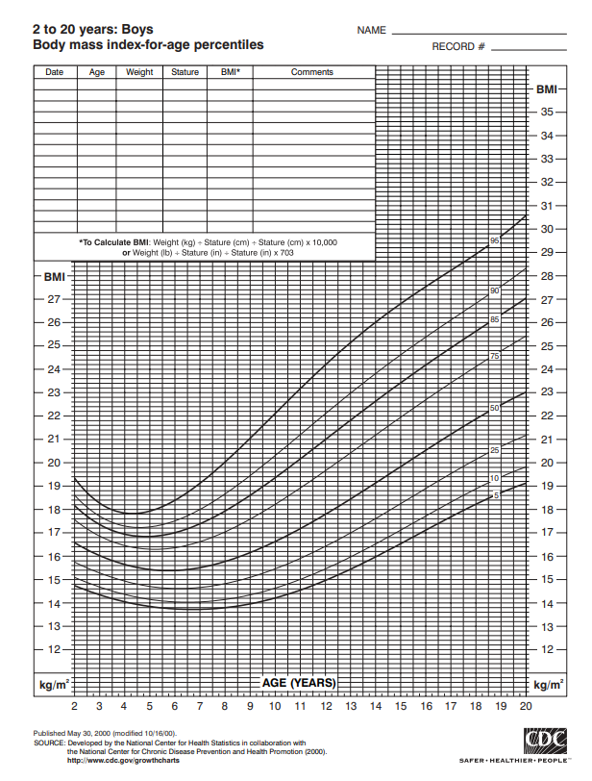
Overweight and obesity defined by
BMI percentiles, not BMI like with adults
Most countries use BMI ≥ the 95th/97th/90th percentile using a World Health Organization and country-specific reference values when defining obesity¹
Classification^{2,3} | Definitions^{2,3}
Overweight | BMI ≥85th percentile for age and sex
Obesity | BMI ≥95th percentile for age and sex
Obesity class II | BMI ≥120% of 95th percentile* for age and sex or a BMI ≥35 kg/m²
Obesity class III | BMI ≥140% of 95th percentile for age and sex† or a BMI ≥40 kg/m²
*Corresponds to 1.2×95th percentile of BMI
†Corresponds to 1.4×95th percentile of BMI
An inclusion criterion for pediatric clinical trials NN8022-4179 and NN8022-4180
is a BMI corresponding to ≥30 kg/m² for adults and ≥95th percentile for age and sex
BMI, body mas index.
1. Middelkoop B and de Wilde JA. Public Health Nutr 2018;21:2969–2971; 2. CDC Growth Charts. Available at: https://www.cdc.gov/growthcharts/cdc_charts.htm. Accessed May 2023;
3. Hampl SE et al. Pediatrics. 2023;151:e2022060640.
Notes:
https://www.cdc.gov/growthcharts/data/set1clinical/cj41l023.pdf

Slide 6
Overweight and obesity defined by
BMI z-scores
BMI z-score of girls (5–19 years)²
z-score*
A BMI z-score indicates how many SDs BMI of a child or adolescent is above/below the average BMI for their age and gender¹
A positive z-score of 1, 2 or 3 indicates that a child is 1, 2 or 3 SDs above the average value¹
BMI z-score is used to classify the different degrees of weight status in children and adolescents. However, this parameter does not always express the true percentage of body fat
3
2
BMI (kg/m²)
1
0
−1
−2
−3
Age (years)
BMI, body mass index; SD, standard deviation.
1. Must A and Anderson SE. Int J Obesity 2006;30:590–594; 2. WHO BMI-for-age. Available at: https://cdn.who.int/media/docs/default-source/child-growth/growth-reference-5-19-years/bmi-for-age-(5-19-years)/sft-bmifa-girls-z-5-19years.pdf?sfvrsn=571135b3_4. Accessed May 2023.

Slide 7
BMI z-scores and BMI percentiles
BMI z-scores and BMI percentiles can be used to determine cut points and classify weight status of children and adolescents¹
For a 10-year-old female that is 150 cm in height and 50 kg in weight²:
BMI = 29.6
BMI Z-score = 2.37
BMI percentile = 99.1
BMI, body mass index.
1. Must A and Anderson SE. Int J Obesity 2006;30:590–594; 2. BMI calculator. Available at: https://my.pbrc.edu/Clinic/Tools/BMI/. Accessed May 2023.

Slide 8

Prevalence of overweight and obesity in U.S.
Overweight and obesity affects children of all ages^{1–3}
Prevalence* of overweight and obesity in U.S. pediatric population
Has increased by 9.7% and 7.45%, respectively,
with age over the last two decades¹
The overall prevalence of obesity in the U.S. is 19.7%^{2–4} and affects about
14.7 million children and adolescents²
*Prevalence estimates provides information on the burden of obesity.
BMI, body mass index; U.S., United States.
Data is age-standardized for individuals 5–19 years.
1. Data from NCD Risk Factor Collaboration (NCD-RisC). Available at: http://ncdrisc.org/data-downloads-adiposity-ado.html. Accessed May 2023;
2. Centers for Disease Control and Prevention (CDC). Overweight and Obesity. Available at:https://www.cdc.gov/obesity/data/childhood.html. Accessed May 2023; 3. Hampl SE et al. Pediatrics. 2023;151:e2022060640; 4. Endocrine Society. Obesity Playbook. Available at: https://www.endocrine.org/-/media/endocrine/files/obesity/obesity-playbook-final_use.pdf. Accessed June 2023.

Slide 9
Obesity prevalence rates in U.S. by state in 2019–2020¹
Children aged 10–17
WA
ID
ME
MT
ND
MN
OR
MI
VT
NH
WI
NY
WY
SD
MA
CA
PA
CT
10–14.9%
NV
NE
IA
IL
OH
NJ
15–19.9%
UT
IN
WV
DE
CO
MD
MO
VA
20–24.9%
KS
KY
25–29.9%
TN
NC
AZ
NM
OK
AR
TX
SC
MS
AL
GA
If obesity trends hold, 57% of children aged 2–19 years will have obesity by the time they are 35 years of age, in 2050²
LA
FL
AK
HI
U.S., United States.
1. The State of Obesity. Available at: https://stateofobesity.org/children1017. Accessed May 2023; 2. Hampl SE et al. Pediatrics. 2023;151:e2022060640.

Slide 10




Proposed risk factors for pediatric obesity are complex and multifactorial
Genetics/
Epigenetics¹⁻³
Hormonal/
endocrine factors^{1,3}
Prenatal/
early developmental factors¹⁻³
Pediatric obesity
Environmental factors¹⁻³
Diet & physical activity¹⁻³
Socioeconomic factors^{1–3}
1. Hampl SE et al. Pediatrics. 2023;151:e2022060640; 2. Fitch A et al. Institute for Clinical Systems Improvement. Prevention and management of obesity for children and adolescents. July 2013. Available at: https://jesse.tg/ngc-archive/summary/10019. Accessed May 2023; 3. Kumar S and Kelly AS. Mayo Clin Proc 2017;92:251–265.

Slide 11

Genetic factors in pediatric obesity
Syndromic obesity
Polygenetic obesity is by far
the most common genetic
cause of obesity^{1*}
Accounts for 30–50% of
variation in adiposity¹
Multiple monogenetic defects associated with
obesity have been identified
Most common is melanocortin-4 receptor (MC4R)^{1,2} and accounts for 2–5% of severe obesity in children³
Others include leptin (LEP), leptin receptor
(LEPR)^{1,2}, brain-derived neurotrophic factor (BDNF) and proopiomelanocortin (POMC)²
Several syndromes associated with obesity
have been identified
Most common is Prader-Willi¹
Others include Alström syndrome (AS), Albright hereditary osteodystrophy (AHO)^{1,2}, Beckwith-Wiedemann syndrome (BWS)¹, Bardet-Biedl syndrome (BBS)^{1,2} and Cohen syndrome (CS)¹
Increasing evidence that epigenetics† play a role¹
Epigenetic factors may
modify the interaction of environment, microbiome, and nutrition on weight¹
<1% of
cases
*Most common for adults also. †Epigenetics refers to changes caused by modification of gene expression rather than alteration of the genetic code.
1. Kumar S and Kelly AS. Mayo Clin Proc 2017;92:251–265; 2. Styne DM et al. J Clin Endocrinol Metab 2017;102:709–757; 3. Hampl SE et al. Pediatrics. 2023;151:e2022060640.
Notes:
Examples of medications used to treat some of mentioned syndromes are orlistat and phentermine
Prader-Willi syndrome:
Growth hormone treatment along with serotonin reuptake inhibitors.
Alström syndrome (AS):
Long-term angiotensin-converting enzyme inhibition (ACE) are considered for patients with cardiomyopathy. Diuretics, beta-blockers and spironolactone are other medications that are recommended.
Albright hereditary osteodystrophy (AHO):
Treatment consists of calcium and vitamin D derivatives.
Beckwith-Wiedemann syndrome (BWS):
Diazoxide are often used to treat hyperinsulinism.
Bardet-Biedl syndrome (BBS):
Antihypertensives and lipid-lowering medications are often prescribed along with weight management treatment.
Cassidy SB et al. Genet Med. 2012;14;10–26.
Marshall JD et al. Eur J Hum Genet. 2007;15:1193–1202.
Simon A et al. Neth J Med. 2000;56:100–109.
Wang KH et al. Front Pediatr. 2020;7:1–12.
Forysthe E & Beales PL. Eur J Hum Genet. 2012;21:8–13

Slide 12
Proposed external causes of pediatric obesity
Prenatal & parental factors
Smoking during pregnancy, lack of breastfeeding^{1,2,8}, and mimicking parents’ poor eating habits are all associated with obesity^{1,3,4,8}
Psychosocial/emotional factors
Depression^{1,3,8}, peer pressure⁵, anxiety^{1,8},
low self-esteem^{1,3,8}, body dissatisfaction^{3,5,8}, eating disorders^{1,5,8}, poor sleep quality^{1,6,8} and maladaptive coping strategies^{1,8} can both cause and result from obesity. Discourage fat-shaming by family members or using shame to motivate the child to lose weight
Socioeconomic factors
Obesity burden greater in lower socioeconomic groups^{1,8}; junk food
is inexpensive, and associated with pleasure and convenience^{4,8}
Environment
Length of the street the children live on, accessibility of nearest playground by foot, frequency of buses/trains passing the street, and the socioeconomic status of the neighborhood^{3,7,8}
Diet and physical activity
High glycemic foods and sugar sweetened
drinks. Television, computers, phones, and tablets increase sedentary time^{1,3,8}
1. Kumar S and Kelly AS. Mayo Clin Proc 2017;92:251–265; 2. Rhee KE et al. Int J Pediatrics 2012;2012:463850; 3. Karnik S and Kanekar A. Int J Prev Med 2012;3:1–7;
4. Sahoo K et al. J Family Med Prim Care 2015;4:187–192; 5. Salvy S-J and Bowker JC. J Obes Weight Loss Ther 2014;4(1):207; 6. Taveras EM et al. Pediatrics 2014;133:1013–1022;
7. Weihrauch-Blüher S and Wiegand S. Curr Obes Rep 2018;7:254–259; 8. Hampl SE et al. Pediatrics. 2023;151:e2022060640.

Slide 13
Endocrine causes of obesity in children
Endocrine causes of weight gain
are rare (identified in <1% of children and adolescents with obesity)^{1–2} and include:
Most children with endocrine disorders resulting in weight
gain have:^{1–3}
Pseudohypoparathyroidism type 1a^{1,2}
Growth hormone deficiency^{2–4}
Hypothyroidism^{2,5}
Cushing’s syndrome^{2,6,7}
Congenital leptin deficiency⁸
Exposure to endocrine disrupting chemicals (eg, BPA, DDT, PFCs)⁹
Poor linear growth
Short stature and/or hypogonadism
BPA, bisphenol A; DDT, dichlorodiphenyltrichloroethane; PFCs, perfluorochemicals.
1. Kumar S and Kelly AS. Mayo Clin Proc 2017;92:251–265; 2. Hampl SE et al. Pediatrics. 2023;151:e2022060640; 3. Aycan Z and Bas VN. J Clin Pediatr Endocrinol 2014;6:62–67;
4. Prader-Willi Syndrome Association UK. Available at: https://www.pwsa.co.uk/what-is-pws. Accessed May 2023; 5. Ghergherehchi R and Hazhir N. Ther Adv Endocrinol Metab 2015;6:51–55;
6. Savage MO and Storr HL. Indian J Endocrinol Metab 2012;16(Suppl 2):S171–S175; 7. Stratakis CA et al. Endocrinol Metab Clin North Am 2012;41:793–803;
8. Skelton JA et al. Pediatr Clin North Am 2011;58:1333–1354;
9. Impact of EDCs on Metabolism and Obesity. Available at https://www.endocrine.org/topics/edc/what-edcs-are/common-edcs/metabolic. Accessed August 2023.

Slide 14
Obesity treatment options for children are limited
Diet, lifestyle, & behavioral interventions^{1–3}
Pharmacotherapy options are limited to older children in the U.S.^{1–8}
RYGB, LAGB sleeve gastrectomy^{1,2}
*Phentermine and topiramate extended-release capsules are approved for patients aged ≥12 with a BMI in the 95th percentile or greater when standardized for age and sex.
ER, extended-release; LAGB, laparoscopic adjustable gastric banding; RYGB, Roux-en-Y gastric bypass; U.S., United States.
1. Fitch A et al. Institute for Clinical Systems Improvement 2013:2022-04; 2. Hampl SE et al. Pediatrics 2023;151:e2022060640; 3. Weghuber D et al. N Engl J Med 2022;387:2245–57;
please see slide notes for references 4-8 (prescribing information).
Notes:
4. U.S. Food & Drug Administration. Available at https://www.accessdata.fda.gov/drugsatfda_docs/label/2012/020766s029lbl.pdf. Accessed August 2023;
5. U.S. Food & Drug Administration. Available at https://www.accessdata.fda.gov/drugsatfda_docs/label/2019/022341s031lbl.pdf. Accessed August 2023;
6. Novo Nordisk. Available at https://www.novonordisk-us.com/media/news-archive/news-details.html?id=151389. Accessed May 2023;
7. U.S. Food & Drug Administration. Available at https://www.fda.gov/drugs/news-events-human-drugs/fda-approves-treatment-chronic-weight-management-pediatric-patients-aged-12-years-and-older. Accessed May 2023;
8. U.S. Food & Drug Administration. Available at https://www.accessdata.fda.gov/drugsatfda_docs/label/2012/085128s065lbl.pdf. Accessed August 2023.

Slide 15
Multicomponent lifestyle and dietary interventions in children with obesity^{1–3}
Dietary
Interventions
Behavioral counseling
↑Physical activity
and ↓sedentary time
Family-centered interventions
1. NICE Obesity clinical guideline 2014. Available at: https://www.nice.org.uk/guidance/cg189. Accessed May 2023; 2. Styne DM et al. J Clin Endocrinol Metab 2017;102:709–757;
3. Hampl SE et al. Pediatrics. 2023;151:e2022060640.

Slide 16
Dietary recommendations in children and adolescents with obesity
Decrease consumption of fast foods, added table sugar, high-fructose corn syrup, fruit juices,
high-fat, high-sodium and processed foods¹
Remove all sugar-sweetened beverages from the diets of children²
The ideal beverage for children at all meals and during the day is water¹
Increased intake of dietary fiber, fruits and vegetables; eating a healthy breakfast¹
Promote diet rich in foods with low caloric density and poor in foods with high caloric density²
Eating family meals²
Avoid watching television while eating²
Portion control education, timely, regular meals, and avoiding constant ‘grazing’ during the day, recognizing eating cues in the child or adolescent’s environment; ensure availability of healthy
snacks¹
AAP, American Academy of Pediatrics; ENDO, Endocrine Society.
1. Styne DM et al. J Clin Endocrinol Metab 2017;102:709–757; 2. Hampl SE et al. Pediatrics. 2023;151:e2022060640.

Slide 17
Recommendations for physical activity and sedentary time reduction in children with obesity
Increasing physical activity
Reducing sedentary time
At least 20 minutes (optimally 60 minutes), vigorous physical activity
≥5 days/week (ENDO)¹
Promotion of active play and lifestyle and family- or sports-based moderate to vigorous physical activity for a total of 60 minutes/day (AAP)²
Limiting non-academic screen time to
1–2 hours/day and decreasing other sedentary behaviors, e.g., digital activities (ENDO/AAP), and television prior to age 2^{1,2}
Balancing unavoidable technology-related screen time in children and adolescents with increased opportunities for physical activity (ENDO)¹
AAP, American Academy of Pediatrics; ENDO, Endocrine Society.
1. Styne DM et al. J Clin Endocrinol Metab 2017;102:709–757; 2. Hampl SE et al. Pediatrics. 2023;151:e2022060640.

Slide 18
Lifestyle intervention improves outcomes in children and adolescents with obesity or overweight
Effect of lifestyle intervention alone (diet and exercise)
vs control (no treatment, usual care or written educational materials) in children ≤18 years of age
Changes with diet and exercise
BMI
−1.25 kg/m²
(95% CI −2.18; −0.32)
vs no treatment
LDL
−5.4 mg/dL
(95% CI −8.1; −0.27)
vs baseline
Triglycerides
−2.7 mg/dL
(95% CI −4.3; −1.3)
vs baseline
Fasting plasma glucose
-1.0 x 10⁻⁶ mg/dL
(95% CI 5.0; 4.38)
vs baseline
BMI, body mass index; CI, confidence interval; LDL, low-density lipoprotein.
Systematic review and meta-analysis of 38 studies conducted between 1975 and 2010.
1. Ho M et al. Pediatrics 2012;130:e1647–1671.

Slide 19
Recommendations for family-centered interventions in children with obesity or overweight
Parental role modeling of healthy dietary and physical activity behaviors (AAP)¹
Educate families about
healthy food and exercise
habits (ENDO)²
Enlist the entire family, prescribing and supporting intensive, age-appropriate, culturally sensitive, family-centered lifestyle modifications (dietary, physical activity, behavioral) (ENDO)²
Diagnose unhealthy intra-family communication patterns and support rearing patterns to enhance the child’s or adolescent’s self-esteem (ENDO)²
AAP, American Academy of Pediatrics; ENDO, Endocrine Society.
1. Hampl SE et al. Pediatrics. 2023;151:e2022060640; 2. Styne DM et al. J Clin Endocrinol Metab 2017;102:709–757.

Slide 20
Other guideline recommendations for management of children with obesity or overweight
Foster healthy sleep patterns (ENDO)¹
Use comprehensive behavior changing interventions (ENDO)¹
Evaluate psychosocial comorbidities and prescribe counseling if needed (ENDO)¹
Although the prevention messages are similar for all pediatric patients, counseling
should be tailored to the child’s developmental stage, and the socioeconomic, cultural, and psychological characteristics of families (AAP)²
AAP, American Academy of Pediatrics; ENDO, Endocrine Society.
1. Styne DM et al. J Clin Endocrinol Metab 2017;102:709–757; 2. Hampl SE et al. Pediatrics. 2023;151:e2022060640.

Slide 21
Recommendations for pharmacotherapy in children with obesity or overweight
Consensus recommendation (AAP)²
Pediatricians and other PHCPs:
May offer children ages 8 through 11 years of age with obesity weight loss pharmacotherapy, according to medication indications, risks, and benefits, as an adjunct to health behavior and lifestyle treatment
Pharmacotherapy recommended only after a formal program of intensive lifestyle modification has failed (ENDO)¹
AAP, American Academy of Pediatrics; ENDO, Endocrine Society; PHCPs, pediatric healthcare professionals.
1. Styne DM et al. J Clin Endocrinol Metab 2017;102:709–757; 2. Hampl SE et al. Pediatrics. 2023;151:e2022060640.

Slide 22
Recommendations for bariatric surgery in children with obesity or overweight
In exceptional circumstances, provided physiological maturity has been achieved and the patient has a stable family unit/adequate support (ENDO)²
Recommend the use of either RYGB or VSG in adolescents (ASMBS)¹
Only be undertaken by an experienced surgeon in a pediatric bariatric surgery center of excellence (ENDO)²
Recommend pediatric metabolic and bariatric surgery to treat severe forms of obesity, i.e., ≥class 2 obesity; BMI ≥35kg/m², or 120% of the 95th percentile for age and sex, whichever is lower (AAP)³
AAP, American Academy of Pediatrics; ASMBS, American Society for Metabolic and Bariatric Surgery; BMI, body mass index; ENDO, Endocrine Society; RYGB, Roux-en-Y gastric bypass;
VSG, vertical gastric sleeve.
1. Pratt JSA et al. Surg for Obesity and Related Diseases 2018;14:882–901; 2. Styne DM et al. J Clin Endocrinol Metab 2017;102:709–757; 3. Hampl SE et al. Pediatrics. 2023;151:e2022060640.

Slide 23
Communicating with caregivers of children/adolescents with obesity
Direct communication with pediatric patients builds trust and rapport, helps socialize children into the patient role, and, in the adult literature, has been identified as a primary mechanism for patient adherence to behavioral recommendations¹
Recognize the child’s/adolescent’s overweight or obesity²
Understand the child’s/adolescent’s readiness or motivation for lifestyle change²
Be direct and initiate conversations about weight to help take the pressure off caregivers²
Use a sensitive approach, be positive, show interest and intervene early²
Use open-ended questions motivated by concern for the child/adolescent²
Use motivational interviewing to increase the child’s/adolescent’s intrinsic motivation²
Be flexible about when the child/adolescent should be involved in the conversation²
Provide and explain resources to help caregivers recognize the risks of obesity²
Speak directly to the child/adolescent in a caring positive manner, sending a clear message regarding the health risks associated with overweight/obesity²
1. Carcone AI et al. Pediatr Clin North Am 2016;63:525–538; 2. Ames H et al. BMC Public Health 2020;20;574.

Slide 24
Key takeaways
Obesity is defined as a BMI at or above the 95th percentile for children and teens of the same age and sex
Prevention is a key first step to negate the increasing prevalence of childhood obesity
Management of childhood obesity requires one or more of dietary interventions, increased physical activity, behavioral therapy, pharmacotherapy and bariatric surgery
Patient-centered and caregiver-centered compassionate communication is critical and linked to better outcomes for patients

Slide 25
Assessment
Which of the following are examples of pre-natal and parental environmental causes of pediatric obesity?
  Playgrounds not within walking distance, suboptimal street length
  Poor sleep quality, peer pressure
  Inexpensive junk food, low socioeconomic group
  Lack of breastfeeding, smoking during pregnancy
According to the American Academy of Pediatrics guidelines, how many minutes of moderate to vigorous physical activity are recommended for children with obesity?
  20 minutes per day
  60 minutes per day
  30 minutes per day
  60 minutes per week
Noah is a 14-year-old male living with obesity, with a BMI in the 99th percentile and significant comorbidities. A formal program of lifestyle modifications has not been successful, so Noah, his parents, and HCP team are exploring pharmacotherapy options. Which of the following FDA-approved pharmacotherapies would be appropriate for Noah?
  Orlistat
  Phentermine
  Topiramate
  Metformin
Which is not an example of direct communication with pediatric patients that builds trust and rapport and can help improve patient adherence to recommendations?
  Using motivational interviewing to increase intrinsic motivation
  Being flexible on when to include the child or adolescent in the conversation
  Initiating conversations about weight to relieve pressure from caregivers
  Using close-ended questions when communicating with pediatrics with obesity
Notes:
Answer Key
d (Slide 11; Lack of breast feeding, smoking during pregnancy are specifically pre-natal and parental environmental causes)
b (Slide 17; 60 minutes per day is recommended according to AAP guidelines)
a (Slides 22; Orlistat and liraglutide is the only FDA-approved therapies for pediatric obesity for Noah’s age)
d (Slide 24; HCPs should Use open-ended questions motivated by concern for the child/adolescent)

Slide 26
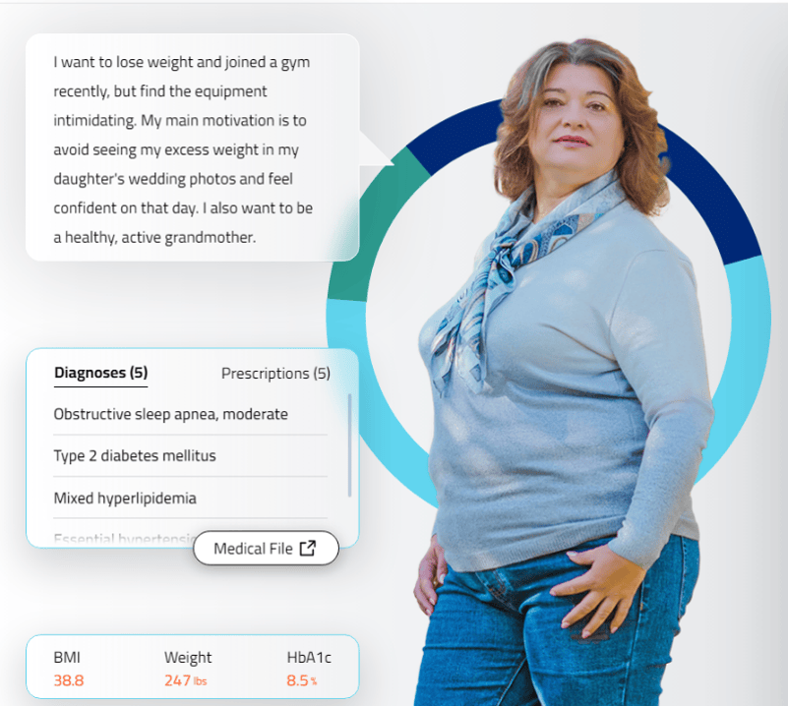


Interactive case-based learning tool developed for, and funded by,
Novo Nordisk Inc.
Provides simulated interactions in real-time feedback, and streamlined interoperability communication.
Click here or scan the QR code below, for an interactive learning experience, including the opportunity to practice hypothetical decision making and patient care

