Slide 1
From Theory to Practice: Treating Patients with Obesity
Module 12

Slide 2
Thank you for using the FORWARD: Focus on Obesity Education curriculum.
Welcome to the FORWARD: Focus on Obesity Education curriculum. FORWARD was funded by Novo Nordisk Inc. A third-party provider developed the curriculum’s content in consultation with Novo Nordisk Inc. and leading obesity clinician experts. FORWARD relies exclusively on open-source materials available to the general public.
The goal of FORWARD is to present a complete, accurate, non-promotional and fair-balanced picture of the current state of obesity. FORWARD is intended to inspire the development of obesity education in clinical professional schools, ensuring adequate training of future healthcare providers on the diagnosis and management of obesity. By choosing to access and browse this module of FORWARD, you acknowledge that you have read, understand and agreed to the FORWARD Terms of Use. If you do not agree with the FORWARD Terms of Use, you are not permitted to further access this module and should immediately discontinue your use.
Double click to view:
Content current as of August 2023

Slide 3
Learning outcomes
After completing this module, the learner will be able to:
Apply knowledge of behavioral modifications, pharmacological treatments, and surgical procedures to develop comprehensive and personalized care plans for adults and children living with obesity that are in accordance with clinical guidelines

Slide 4
Note:
All patient profiles in this module are hypothetical and are provided
for educational purposes only

Slide 5
Yasmin
Recent history/
Presentation
At an initial check up with Yasmin, she mentioned she has gained 20 pounds over the past 6 months. She is concerned about developing diabetes in the future and would like to explore further weight management strategies.
Metrics
Lifestyle
Age (yrs)
Weight (lb)
BMI (kg/m²)
Current medications:
Depo-Provera injection as contraceptive
Biography
Yasmin is almost done her PhD in sociology. She has a 10-year-old daughter, Grace. Her responsibilities as a student and parent sometimes cause her much stress. Yasmin is a non-smoker.
Exercise
She takes brisk 30 min walks with her daughter 1 to 2 times a week.
28
236
32
Gender
Height (in)
Waist Ø (in)
Sleep
She gets 5 to 6 hours of sleep most days, less when she’s busy with thesis deadlines.
Female
72
41
Nutrition
She used to eat healthier, but lately relies on processed foods with high fat, high sodium due to lack of time. She finds her portion sizes have increased.
Family history
She has a family history of type 2 diabetes from her mother and father.
Comorbidities:
None. No physical symptoms, self-esteem issues nor functional limitations
BMI, body mass index.

Slide 6
Questions
How would you classify Yasmin in terms of WHO obesity classification and EOSS staging?
  Class III, Stage 2
  Class II, Stage 3
  Class I, Stage 0
  Class I, Stage 1
Yasmin’s use of contraceptive medication may contribute to her weight gain
  True
  False
Weight circumference is a risk factor in obesity and correlates with visceral fat levels. Yasmin is ethnically Pakistani. What is the threshold for waist circumference for Yasmin and is she considered at risk for obesity, given her current waist circumference?
  ≥74 to 80 cm; yes
  ≥ 88 cm; yes
  ≥ 88 cm; no
  ≥ 102 cm; no
According to AACE/ACE guidelines, which treatment for Yasmin would you recommend to prevent progressive weight gain and/or promote weight loss, in addition to increasing the frequency and intensity of her exercise regime?
  Bariatric surgery
  Reduced-calorie, healthy meal plan
  Add anti-obesity medication
  Both b. and c.
At your initial visit, Yasmin decides that anti-obesity medication is not for her at this time. She returns to your office 6 months later. You check her vitals, and her blood pressure has increased from 135/95 mmHg to 145/100 mmHg and her heart rate has increased from 90 bpm to 105 bpm. Yasmin has not made any lifestyle changes over the last 6 months and subsequently has gained another 10 pounds. What is the best immediate course of action for Yasmin, given this new information?
  Refer her to a nutritionist and give her another 6 months to adopt a healthy eating plan
  Suggest she see a therapist to deal with the stress she experiences with parenthood and graduate school
  Ask if she’d like to try pharmacotherapy for diabetes or obesity now, and, if she agrees, prescribe the medication
  Suggest to increase her exercise intensity and duration
Notes:
Answer Key
c (Module 7, Slide 3 and 6; Class I with BMI ≥30 and <35, Stage 0 since Medical, Mental, and Functional complications are absent
a (Module 7, Slide 7; True, depo-provera can cause weight gain )
a. (Module 7, Slide 7; Yasmin’s weight circumference is 41 in or 102 cm. In South Asian, Southeast Asian and East Asian adults, men with values ≥85 cm and women ≥74 to 80 cm should be considered at risk
d (Module 8; Meal plans and weight loss medications are available options. Bariatric surgery is only recommended for BMI ≥35)
a (Module 8: While her weight gain is worrying, she hasn’t tried lifestyle mods yet. C could also work, but you should check for any drug interactions with her current medications.)

Slide 7
Cassandra
Recent history/
Presentation
Cassandra returns for her annual visit. She is frustrated by her back pain. She thinks her weight is the problem but admits her busy schedule with kids and work leaves her little time to exercise. She isn't interested in talking about her weight today. "I have too many things going on,” she says.
Cassandra has tried multiple times on her own in the past to lose weight but has not responded. She finds it hard to keep the weight off. She currently lives in a high-rise in a metropolitan area with little access to green spaces.
Metrics
Lifestyle
Age (yrs)
Weight (lb)
BMI (kg/m²)
Current medications:
None
Biography
Cassandra works from home as a Marketing Manager. She’s married, with two children in elementary school. She has high stress daily mostly due to work.
She wants to lose some weight for an upcoming wedding for her close friend, Barb. She was at a healthy weight before getting married.
Exercise
Cassandra has no time to exercise.
37
285
42
Sleep
She suffers from insomnia regularly.
Blood Pressure (mmHg)
Gender
Height (in)
Waist Ø (in)
Female
69
40
132/85
Family history
Cassandra has a family history of diabetes and obesity. Most of her extended family is either overweight or obese.
Comorbidities:
Borderline hypertension and occasional back pain, but no medical interventions currently required.
Nutrition
She doesn’t eat fruit or vegetables, skips breakfast and tends to eat junk food at night.
BMI, body mass index.

Slide 8
Questions
What is an example of a way to initiate the conversation with Cassandra using empathic, patient-centric and unbiased language?
  “Cassandra, you’re at risk for heart attack or stroke if you don’t lose weight”
  “You should stop night-time eating”
  "Cassandra, it sounds like your back pain may be related to your weight. Do you mind if we discuss your health and weight?"
  “Your hypertension and back pain will only get worse if you don’t do something about it.”
Cassandra is a candidate for bariatric surgery given her BMI is ≥40 kg/m²
  True
  False
Which of the following are examples of how to motivate Cassandra to increase her physical activity?
  Using motivational interviewing techniques
  Suggest family activities
  Increase consultation frequency
  Help her integrate exercise into her daily routine
  All of the above
Which of the following lifestyle interventions would be recommended for Cassandra’s night-time eating?
  Cognitive restructuring
  Behavioral therapy on meal timing
  Mindfulness training
  Stress resilience
  Improving sleep hygiene
Notes:
Answer Key
c (Module 5, Slide 6; Other answers show lack of empathy for the patient and use insensitive, threatening language)
a
e (Module 7, Slide 12, 13; all of the above)
b (Module 7, Slide 6; Behavior therapy on nutritional timing and content is recommended for night-eating syndrome)

Slide 9
Jay
Recent history/
Presentation
Jay is frustrated by the fact that they cannot keep their weight off and ends up regaining their weight after losing. They add that this never was an issue when they were young. Jay has tried numerous diets as well as some weight loss medications, but nothing has helped.
Jay used to be a former athlete who had no issues losing weight. Despite their sedentary work environment, they still aim to make it to the gym 2–3 times a week.
Metrics
Lifestyle
Age (yrs)
Weight (lb)
BMI (kg/m²)
Current medications:
Metformin for managing blood glucose levels
Atorvastatin for managing lipid levels
Biography
Jay is married to their partner of 12 years, Nancy. Jay is a truck driver who works long hours.
Jay was diagnosed with type 2 diabetes over a year ago.
Exercise
Despite being on the road a lot for their job, Jay manages to lift weights at a gym regularly.
51
300
38
Gender
Height (in)
Waist Ø (in)
Sleep
Irregular sleep schedule, with poor sleep quality.
Non-binary
72
46
Nutrition
Diet high in saturated fats. Jay’s favorite food is burger and fries. They eat at restaurants often.
Family history
No family history of diabetes nor cardiovascular disease. Most family members are not overweight.
Comorbidities:
Type 2 diabetes, high cholesterol, and obstructive sleep apnea
BMI, body mass index.

Slide 10
Questions
You discuss with Jay that their frustration may be due to metabolic adaptations that occur with weight loss. Which one of the following physiological changes does not occur in Jay after weight loss due to caloric restriction?
  Jay is hungrier more often
  Jay’s metabolism decreases
  Increase in GLP-1
  Increase in ghrelin
Jay was assigned male at birth but now identifies as non-binary. Jay’s gender marker has not been legally changed, and therefore their electronic medical record (EMR) at your office automatically identifies Jay as male. In what way does this impact their BMI measurement?
  Jay’s BMI measurement should be compared males
  Jay’s BMI measurement should be compared to females
  Use the Edmonton Obesity Staging System (EOSS) as it is better suited to describe individuals
  Gender does not matter for BMI measurement
On the basis of their BMI and presence of obesity-related comorbidities, Jay is a potential candidate for bariatric surgery. Which one of the following are relevant medical aspects of the pre-operative evaluations for them?
  Screening for active mental illness
  Micronutrient deficiencies
  Evaluation for CVD risk
  Post-operative weight loss plan
  All of the above
What is the most appropriate next step that you would recommend for Jay?
  Eat less take out food
  Increase dose of metformin
  Add pharmacotherapy for diabetes or obesity
  Quit smoking
  Consider bariatric and metabolic surgery
Which of the following are NOT potential mechanisms of how bariatric surgery causes improvements in diabetes?
  Decreased sugary food intake
  Increased GLP-1 levels
  Change in microbiota
  Decreased ghrelin levels
Notes:
Answer Key
c (Module 2, Slide 14; GLP-1 decreases)
d (Module 1; gender does not matter for BMI measurements)
e (Module 10, Slide 12; all of the above are relevant)
e (Since interventions with medication do not currently work, considering bariatric and metabolic surgery is an option and to more broadly discuss next steps)
a (Module 10, Slide 4; decreased in sugary food intake is not a potential mechanism)
d (Module 10; slide pending)

Slide 11
Amy
Recent history/
Presentation
Amy is interested in bariatric surgery. She has gained more weight recently which has made her breathing and joint pain worse. Her quality of life is further impaired. She is more reliant on her daughter who is her caretaker.
She hopes to lose enough weight to improve her mobility and breathing so she can spend more time outdoors.
Metrics
Lifestyle
Age (yrs)
Weight (lb)
BMI (kg/m²)
Current medications:
Multiple medications, including liraglutide 3.0 mg to manage her weight
Biography
Amy is widowed and lives with her daughter, Audrey, her primary caregiver. Amy worries about the impact of her obesity on her daughter’s life. She has tried to lose weight many times and has responded to intermittent fasting.
Exercise
She has a sedentary lifestyle and uses a mobility scooter.
62
371
58
Gender
Height (in)
Waist Ø (in)
Sleep
She sleeps 4 to 5 hours per night and stops breathing intermittently, and often takes naps during the day.
Female
67
55
Nutrition
Amy’s daughter cooks healthy meals at home. She tries to consume protein beverages to help with nutrition and reduction of caloric intake. She mostly drinks water and one can of soda per day
Family history
Amy has a strong family history of obesity.
Comorbidities:
Osteoarthritis, HFpEF, GERD, stroke and myocardial infarction
BMI, body mass index; CVD, cardiovascular disease; GERD, gastroesophageal reflux disease; HFpEF, heart failure with preserved ejection fraction.

Slide 12
Questions
How would you classify Amy in terms of WHO obesity classification and EOSS staging?
  Class I, Stage 3
  Class II, Stage 1
  Class III, Stage 3
  Class III, Stage 4
Amy has unfortunately experienced negative encounters from her previous healthcare providers. Which of the following is an example of weight stigma and discrimination?
  The nurse gives Amy an appropriately sized gown before she is examined by the doctor
  PCP mentions that she is “morbidly obese” and thinks she should not have surgery, but rather focus on her eating problems
  A medical assistant asks permission to weigh Amy, then guides her to the scale in a secluded area
  The radiology tech told her that she is too big for the MRI and will have to be rescheduled in a different radiology suite with a different MRI that holds larger weights
What cardiovascular improvements can Amy expect due to significant weight loss?
  Reduced frequency of apneic events
  Improvements in functional capacity and increased strength
  Increase in her ejection fraction
  Reduced blood pressure
  All of the above
In evaluating Amy for metabolic and bariatric surgery, what recommendations would you make?
  Recommend she stop drinking soda before surgery
  Recommend she see a psychiatrist for evaluation of depression prior to surgery
  No physical activity recommendation is needed before surgery because she is has good functional capacity
  Evaluation for sleep apnea
Notes:
Answer Key
c (Module 7, Slide 3 and 6; Class III with BMI ≥40, Stage 3 since patient has significant obesity-related end-organ damage, and functional limitations)
b (Module 4 and 5; using language of “morbid obesity” is an example of weight stigma)
e
d

Slide 13
Juan
Recent history/
Presentation
Juan’s mother is concerned about his weight gain and brings him in to your office. His mom thinks his weight gain is due to being lazy. Juan often games on his phone and sleeps during school hours. He shows signs of disrupted sleep due to severe obstructive sleep apnea.
Juan does not have many healthy food options at home and the family eats fast food frequently, given time and financial constraints. His mom would like to get him involved in sports, but Juan is not interested.
Metrics
Lifestyle
Age (yrs)
Weight (lb)
BMI (kg/m²)
Current medications:
None
Biography
Juan lives with his mother, Maria, and 2 older sisters. He is currently in eighth grade and will enter high school next year.
Juan has stress related to school, and his teachers are concerned about his performance.
He suffers from past trauma due to verbal and physical abuse from his father. He started to gain weight after that.
Nutrition
Juan consumes at least one fast food meal a day.
13
320
62.5
Exercise
He is sedentary and enjoys video games.
Gender
Height (in)
BMI %ile
z-score
Male
67
99.9
3.05
Sleep
Very poor sleep quality, often disrupted
Family history
There is a strong family history of obesity in Juan’s family. Both parents, siblings and grandparents have obesity. Hypertension and diabetes also run in the family.
Comorbidities:
Severe obstructive sleep apnea, potentially.
BMI, body mass index.

Slide 14
Questions
Given his lifestyle and personal history, which of the following can explain Juan’s childhood weight gain?
  Melanocortin-4 receptor mutation
  Hypothyroidism
  Altered sleep cycle
  Past trauma
  All of the above
Which of the following is an example of dietary interventions that you can recommend to Juan to manage his weight?
  Developing new communication strategies between Juan and his mother
  Decreasing daily screen time
  Walking on park trails with friends
  Choosing healthier options and portions sizes at restaurants
Which of the following is not an example of an intervention that Juan’s family can undertake to help Juan?
  Buying healthy foods at the market
  Planning a weekend biking trip
  Eating together while watching television
  Promoting good sleeping habits
How can Juan’s severe obstructive sleep apnea (OSA) contribute to his stress related to his school performance?
  Impaired neurocognitive functions
  Lack of energy for physical activity
  Disruptions in structured eating habits
  Increased risk of hypertension
Eight months after the initial visit, Juan and his mother return to your office. Juan's weight has not changed despite making many lifestyle modifications and now being on CPAP for OSA. Juan's mother remains concerned about his weight and asks if an anti-obesity medication is an option. What are the next steps in his management?
  Ask Juan for his consent before prescribing any medication
  Start setmelanotide
  Start an FDA-approved anti-obesity medication
  Continue lifestyle modification
Notes:
Answer Key
e
d (Module 11; other options are not dietary interventions)
c (Module 11, Slides 16-19; Eating together is recommended, but watching television while eating should be avoided)
a (OSA is associated with cognitive, behavioral, and functional deficits in young children)
c

Slide 15
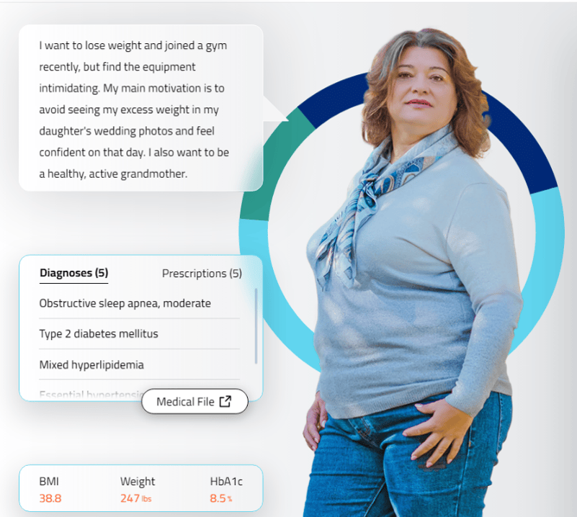


Interactive case-based learning tool developed for, and funded by,
Novo Nordisk Inc.
Provides simulated interactions in real-time feedback, and streamlined interoperability communication.
Click here or scan the QR code below, for an interactive learning experience, including the opportunity to practice hypothetical decision making and patient care

