Slide 1
Pathophysiology
of Obesity: Appetite Dysregulation, and Metabolic & Hormonal Adaptation
Module 2

Slide 2
Thank you for using the FORWARD: Focus on Obesity Education curriculum.
Welcome to the FORWARD: Focus on Obesity Education curriculum. FORWARD was funded by Novo Nordisk Inc. A third-party provider developed the curriculum’s content in consultation with Novo Nordisk Inc. and leading obesity clinician experts. FORWARD relies exclusively on open-source materials available to the general public.
The goal of FORWARD is to present a complete, accurate, non-promotional and fair-balanced picture of the current state of obesity. FORWARD is intended to inspire the development of obesity education in clinical professional schools, ensuring adequate training of future healthcare providers on the diagnosis and management of obesity. By choosing to access and browse this module of FORWARD, you acknowledge that you have read, understand and agreed to the FORWARD Terms of Use. If you do not agree with the FORWARD Terms of Use, you are not permitted to further access this module and should immediately discontinue your use.
Double click to view:
Content current as of August 2023

Slide 3
Learning outcomes
After completing this module, the learner will be able to:
  Demonstrate a working knowledge of the normal biology of weight regulation, obesity including adipocyte physiology, energy homeostasis and body weight/appetite regulation mechanisms
  Demonstrate knowledge of how weight regulation is asymmetric, being more effective in response to weight loss than to weight gain
  Demonstrate a working knowledge of metabolic and hormonal adaption in response to caloric restriction and subsequent weight loss

Slide 4
Body weight regulation
Historic perception: simple as calories in calories out^{1–3}
Energy intake
Energy expenditure*
Physical activity
(30%)
Thermic effect of food (10%)
Resting metabolic rate (60%)
↑ body weight
↓ body weight
*Resting energy expenditure varies based on lean muscle mass predominantly, genetics, epigenetics and the environment.
1. Badman MK and Flier JS. Science 2005;307:1909–1914; 2. National Institutes of Health (NIH): National Heart Lung and Blood Institute (NHLBI). Overweight and obesity: causes. Available at: https://www.nhlbi.nih.gov/health-topics/overweight-and-obesity. Accessed May 2023; 3. Calcagno M et al. J Am Coll Nutr 2019;38:547–551.

Slide 5

Body weight regulation
Holistic view^{1–6}
Short-term regulation: influences quantity of food intake
Long-term regulation: maintains constant nutrient stores
Obesity may result from a dysregulated system secondary to various physiological, genetic*, and environmental factors
Hunger
or satiety
Adipose tissue
Liver
Gut-brain axis
Pancreas
Signal pathways:
Hormonal
Neuronal – vagus
Orexigenic†
Anorexigenic‡
GI tract
Body
Brain
†Orexigenic: Appetite stimulant
‡Anorexigenic: Appetite suppressant
*Twin, family and adoption studies have estimated the heritability of obesity to be between 40% and 70%. Monogenic mutations in LEP, LEPR, POMC and Mc4R can cause early onset obesity.
GI, gastrointestinal; LEP, leptin; LEPR, leptin receptor; POMC, pro-opiomelanocortin; MC4R, melanocortin-4 receptor.
1. Badman MK and Flier JS. Science 2005;307:1909–1914; 2. Campfield LA and Smith FJ. Baillieres Best Pract Res Clin Endocrinol Metab 1999;13;13–30;
3. Chaudhri OB et al. Diabetes Care. 2008;31(suppl 2):S284-S289; 4. Farius MM et al. Metab Syndr Relat Disord 2011;9:85–89;
5. Rogge MM and Gautam B. J Am Assoc Nurse Pract. 2017;29:S15-S29; 6. Woods SC and Seeley RJ. Int J Obes Relat Metab Disord 2002;26:S8–S10.

Slide 6

Role of the brain in appetite regulation
CCK, GIP, GLP-1, PYY, OXM, PP, amylin, insulin
increase satiety
Though signals originate in the GI tract, it is the handling of these signals in the hypothalamus and hindbrain that affects appetite regulation
Homeostatic eating
‘eating for hunger’
Ghrelin
increases hunger
CCK, cholecystokinin; GIP, gastric inhibitory polypeptide; GLP-1, glucagon-like peptide-1; POMC, pro-opiomelanocortin; PP, pancreatic polypeptide; PYY, peptide YY; OXM, oxyntomodulin.
Jastreboff AM & Kushner RF. Annu. Rev. Med. 2023;74:125–139.

Slide 7

Role of the brain in appetite regulation
Dopamine and opioid and cannabinoid receptors control the motivation/drive to eat and the pleasure associated with food
Homeostatic eating
‘eating for hunger’
Hedonic
eating
‘eating for pleasure’
Berridge KC et al. Brain Res. 2010;1350:43–64.

Slide 8



Role of the brain in appetite regulation
Thoughts
Homeostatic eating
‘eating for hunger’
Hedonic
eating
‘eating for pleasure’
Executive function
‘deciding to eat’
Executive function is where
lifestyle counseling resides
Feelings
Behaviour
Examples:
Knowing your daily caloric target
Counting your calories
Delaying eating for future gain
Conscious control of eliminating mindless eating when not hungry
Vallis M. Clin Obes. 2019;9:e12299.

Slide 9
Hormonal appetite signaling
Organs and tissue that secrete appetite-regulating hormones
in the periphery (examples):^{1–6}
Hormones are responsible for initiation and termination of eating
Appetite-regulating hormones are secreted from the periphery to regulate energy balance in response to:^{1–6}
Stomach
Intestines
Pancreas
Adipose tissue
Fasting
Intake of a meal
A need to regulate energy stores
Ghrelin
CCK
GLP-1
PYY
OXM
Amylin
Insulin
PP
Glucagon
Leptin
Adiponectin
Orexigenic
(increase appetite)
Anorexigenic
(decrease appetite)
CCK, cholecystokinin; GLP-1, glucagon-like peptide-1; NPY, neuropeptide Y; OXM, oxyntomodulin; PP, pancreatic polypeptide; PYY, pancreatic peptide YY.
1. Badman MK and Flier JS. Science. 2005;307:1909–1914; 2. Rogge MM and Gautam B. J Am Assoc Nurse Pract. 2017;29:S15-S29; 3. Secher A et al. J Clin Invest 2014;124:4473–4488;
4. Seo S. et al. Endocr J. 2008;55:867–874; 5. Suzuki K et al. Exp Diabetes Res. 2012;2012:824305; 6. Woods SC and Seeley RJ. Int J Obes Relat Metab Disord 2002;26:S8–10.

Slide 10
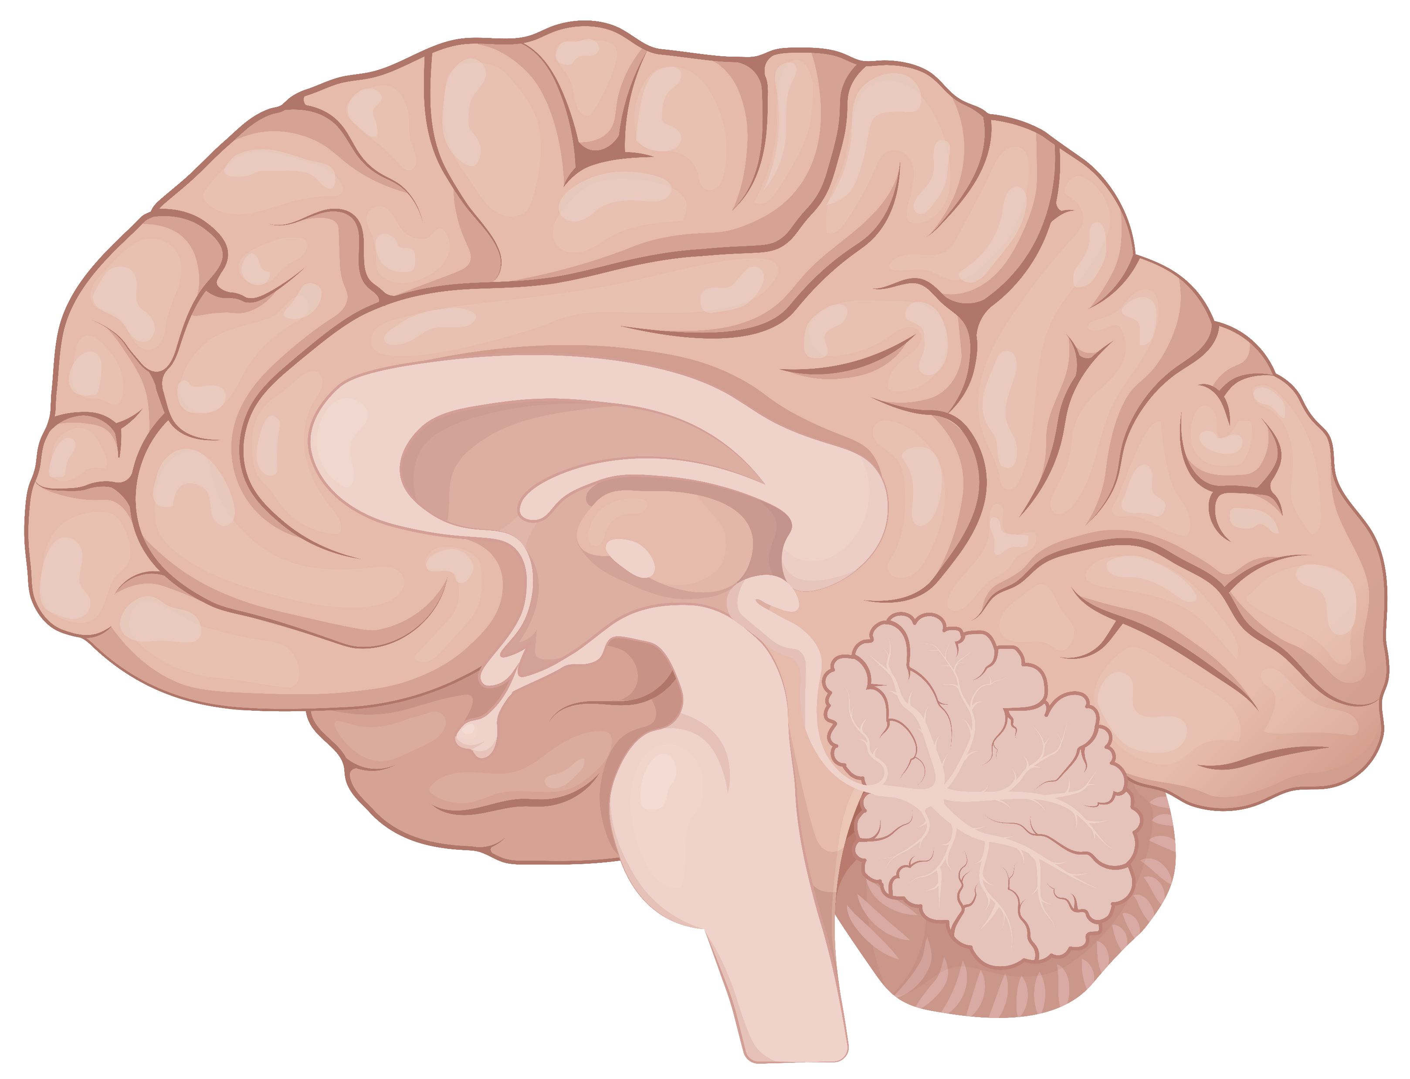
Hormonal appetite signaling^{1–6}
Orexigenic (hunger)
Anorexigenic (satiety/fullness)
Perception
(via other ‘second-order’ neurons)
Hunger
Satiety
Hypothalamic
integration
(arcuate nucleus)
NPY
AgRP
POMC
CART
Hormonal
signals (examples)
Ghrelin
Amylin
CCK
Glucagon
GLP-1
Leptin
Insulin
PYY
Adiponectin
PP
OXM
Glucose
AgRP, agouti-related protein; CART, cocaine- and amphetamine-regulated transcript; CCK, cholecystokinin; GLP-1, glucagon-like peptide-1; NPY, neuropeptide Y; OXM, oxyntomodulin;
PP, pancreatic polypeptide; POMC, proopiomelanocortin; PYY, pancreatic peptide YY.
1. Badman MK and Flier JS. Science. 2005;307:1909–1914; 2. Rogge MM and Gautam B. J Am Assoc Nurse Pract. 2017;29:S15-S29; 3. Secher A et al. J Clin Invest 2014;124:4473–4488;
4. Seo S. et al. Endocr J. 2008;55:867–874; 5. Suzuki K et al. Exp Diabetes Res. 2012;2012:824305; 6. Woods SC and Seeley RJ. Int J Obes Relat Metab Disord 2002;26:S8–10.

Slide 11
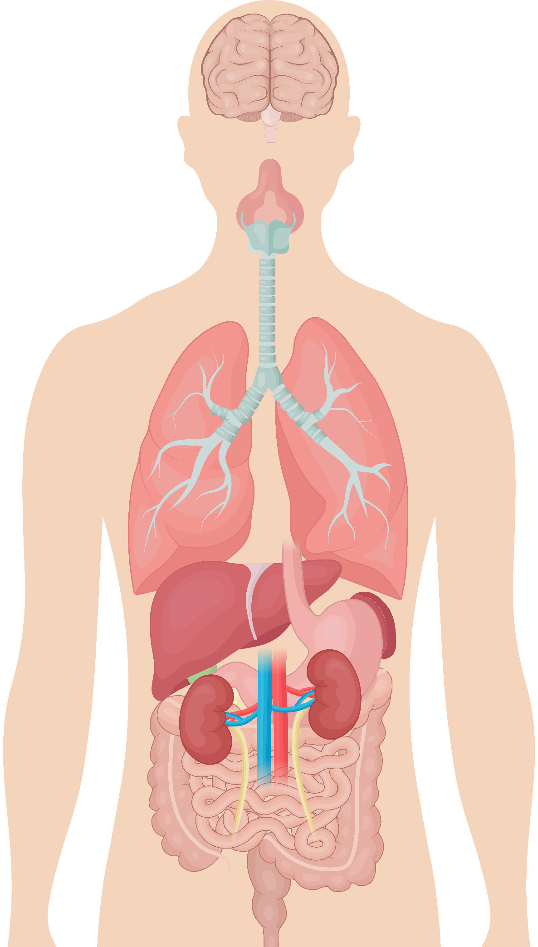
Neuronal appetite signaling
Hindbrain (Nucleus of the solitary tract and area postrema)
The vagal afferent pathway
In the brain, communication between the nucleus of the solitary tract and the area postrema homeostatically regulates energy intake and expenditure, and ultimately body weight
Vagal afferents
Signals from the periphery (enteric nervous system) travel along the vagus nerve (cranial nerve 10) and are modulated by the presence of appetite-enhancing (ghrelin) or appetite-suppressing hormones (CCK, GIP, peptide YY, and GLP-1)
Vagal afferents originate from the stomach, intestine and pancreas; they can inform about physical (gastric stretch receptors) and chemical (hormonal) stimuli by sending a signal from the periphery to the nucleus of the solitary tract via vagal afferent nerve fibers
CCK, cholecystokinin; GIP, gastric inhibitory polypeptide; GLP-1, glucagon-like peptide-1; peptide YY, peptide tyrosine tyrosine.
Badman MK and Flier JS. Science. 2005;307:1909–1914.

Slide 12
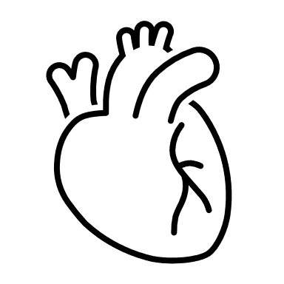
Dysregulation of appetite and energy homeostasis
Lean
adipocytes
Net positive calories^{1,2}
Hypertrophic
adipocytes
Biological dysregulation
Lean adipose tissue
Dysfunctional adipose tissue
Systemic inflammation^{1,2}
↑IL 6, ↑TNFα, ↑IL-1β
CCL2, CCL5, CXCL5^{1,2}
↑ Endothelial permeability
↑ Plaque development
↑ Atherosclerosis¹
↓ HDL and ↑ LDL cholesterol
↑ Glucose production
↑ Insulin resistance¹
↓ Glucose uptake
↑ Insulin resistance¹
↓ Insulin secretion¹
Microvascular injury²
CVD
T2D
CCL, chemokine (C-C motif) ligand; CVD, cardiovascular disease; CXCL5, chemokine (C-X-C motif) ligand 5; HDL, high-density lipoprotein; IL, interleukin; LDL, low-density lipoprotein; T2D, type 2 diabetes; TNFα, tumour necrosis factor alpha.
1. Yao L et al. J Immunol Res 2014;2014:181450; 2. Wang M et al. Int J Mol Sci. 2022;23:747.

Slide 13
Summary of appetite signaling
Body weight is regulated by hormonal
and neuronal signals along the gut-brain axis
Hormonal signaling from the periphery to the brain is integrated in the arcuate nucleus of the hypothalamus
In the hypothalamus, orexigenic (hunger) signaling is driven by upregulation of NPY and AgRP neurons and anorexigenic (fullness) signaling is driven by stimulation of POMC and CART neurons
Neural and hormonal inputs from the periphery bind to receptors along the vagus nerve and terminate in the NTS or area postrema
Integration of hormonal and neuronal systems regulate appetite, energy expenditure and feeding behaviors
Eat or
exercise?
AgRP, agouti-related protein; CART, cocaine- and amphetamine-regulated transcript; NPY, neuropeptide Y; NTS, nucleus of the solitary tract; POMC, proopiomelanocortin.

Slide 14

Physiological responses to caloric restriction and weight loss favor weight regain^{1–4}
Resting energy
expenditure
Energy intake
*Obesity protects obesity
Upon weight loss, the body triggers increased appetite through modulation of satiety hormones and slowing of metabolism which drive weight regain
Set point
+
↓ energy intake*
↑ energy intake
↑ hunger
↓ metabolism
Weight
↓ hunger
↑ metabolism
*Anti-obesity medications can aid in achieving and maintaining weight loss while the suppressive effects of the molecule are engaged; however, when these medications are discontinued, set-point mechanisms remain active, leading to weight gain that may surpass the initial weight.
1. Schwartz A and Doucet E. Obes Rev. 2010;11(7);531-547; 2. Sumithran P et al. N Engl J Med. 2011;365:1597-1604; 3. Farius MM et al. Metab Syndr Relat Disord 2011;9:85–89;
4. Garvey WT. Endocr Pract. 2022;28:214–222.

Slide 15
Weight regain after diet-based weight loss intervention
50 individuals with overweight/obesity lost weight on a 10-week very low energy diet, followed by gradual regain over the next year⁵
After 10 weeks, individuals:
Who lost ≥10% of their initial body weight were gradually reintroduced to ordinary foods
95
Received counseling and written advice from a dietician on dietary intake with the goal of weight maintenance
All patients (ITT)
90
Weight (kg)
Were advised to consume carbohydrates with a low glycemic index and reduce fat intake
85
80
Were encouraged to engage in 30 minutes of moderately intense physical activity on most days of the week
0
0
10
18
26
36
44
52
62
Week
Received continued dietary counseling via telephone
ITT, intention to treat.
Sumithran P et al. N Engl J Med 2011;365:1597–1604.

Slide 16
Postprandial hormonal changes to diet-based weight loss
Week 0
Week 10
Week 62
*
*
*
Plasma Concentration (pg/ml)
*
Plasma Concentration (fmol/ml)
*
One year after initial weight reduction, levels of the circulating mediators of appetite that encourage weight regain after diet-induced weight loss do not revert to the levels recorded before weight loss
The high rate of relapse among people with obesity who have lost weight has a strong physiological basis and is not simply
the result of the voluntary resumption of old habits
*P<0.05 vs. baseline on a very-low-energy diet.
CCK, cholecystokinin; GLP-1, glucagon-like peptide-1; PYY, peptide YY.
Sumithran P et al. N Engl J Med 2011;365:1597–1604.

Slide 17
Key takeaways
Obesity is a chronic disease that occurs as a result of energy dysregulation causing excess caloric input and adiposity
Long term energy balance is centrally regulated by peripheral input on energy stores and nutritional state via neural and endocrine pathways
The body demonstrates a variety of adaptations to weight loss that promote weight regain after a caloric deficit

Slide 18
Assessments
John is a 55-year-old man from Montgomery, AL and is home for the holidays. He has just finished eating a large Thanksgiving meal and no longer feels hungry. Which hormone secreted by the intestines contributes to his feeling of satiation with food?
  amylin
  leptin
  glucagon-like peptide-1
  ghrelin
John also has obesity and suffers from type 2 diabetes and cardiovascular disease. In both diseases, obesity-related systemic inflammation leads to which of the following increased effects in the liver?
  glucose uptake
  glucose production
  insulin secretion
  triglyceride uptake
John is a 48-year-old man with a body mass index (BMI) of 36 kg/m². He has recently made some lifestyle-based changes, which include caloric restriction and increased exercise. However, he finds it challenging to lose the weight and keep it off. Regardless of the intervention, what metabolic adaptation following weight loss makes it difficult for John to maintain the weight loss?
  decreased resting metabolic rate
  decreased levels of ghrelin
  increased levels of amylin
  decreased fat mass
Notes:
Answer Key
c (Slide 8; glucagon-like peptide-1 (GLP-1) is anorexigenic or appetite-reducing hormone secreted by the intestines)
b (Slide 11; For both T2D and CVD, systemic inflammation leads to increased glucose production in the liver)
a (Slides 14, 15; decreased resting metabolic rate makes it difficult to maintain weight loss)

Slide 19



Interactive case-based learning tool developed for, and funded by,
Novo Nordisk Inc.
Provides simulated interactions in real-time feedback, and streamlined interoperability communication.
Click here or scan the QR code below, for an interactive learning experience, including the opportunity to practice hypothetical decision making and patient care

