Slide 1
Addressing Stigma and Bias in Caring for Patients with Obesity​
Module 4

Slide 2
Thank you for using the FORWARD: Focus on Obesity Education curriculum.
Welcome to the FORWARD: Focus on Obesity Education curriculum. FORWARD was funded by Novo Nordisk Inc. A third-party provider developed the curriculum’s content in consultation with Novo Nordisk Inc. and leading obesity clinician experts. FORWARD relies exclusively on open-source materials available to the general public.
The goal of FORWARD is to present a complete, accurate, non-promotional and fair-balanced picture of the current state of obesity. FORWARD is intended to inspire the development of obesity education in clinical professional schools, ensuring adequate training of future healthcare providers on the diagnosis and management of obesity. By choosing to access and browse this module of FORWARD, you acknowledge that you have read, understand and agreed to the FORWARD Terms of Use. If you do not agree with the FORWARD Terms of Use, you are not permitted to further access this module and should immediately discontinue your use.
Double click to view:
Content current as of August 2023

Slide 3
Learning outcomes
After completing this module, the learner will be able to:
  Recognize weight stigma and bias as a barrier to providing appropriate care to patients with obesity
  Understand the impact of implicit and explicit bias against obesity
  in the healthcare setting
  Advocate for accommodations that are respectful and free of
  weight bias
  Use non-biased, non-judgmental, empathetic, and respectful verbal and non-verbal language when communicating with patients with obesity and their family members

Slide 4
Perception of obesity
Obesity is a chronic disease (% agreement)
80%
65%
HCPs
People with obesity
HCP, healthcare professional.
Kaplan LM et al. Obesity (Silver Spring) 2018;26:61–69.

Slide 5
Perception of obesity
of people with obesity discussed weight with an HCP within the past 5 years
However
71%
Mean of 7 serious weight loss attempts
before discussing a weight loss plan with an HCP
HCP, healthcare professional.
Kaplan LM et al. Obesity (Silver Spring) 2018;26:61–69.

Slide 6
Weight bias
Weight bias ranks just below race, gender, and age as the fourth most common form
of discrimination in the U.S.²
5%
and
10%
Weight bias is defined as
negative ideologies associated with excess body weight¹
Of men and women with obesity, respectively
Reported daily or lifetime discrimination due to weight²
1. Nadolsky K et al. AACE Consensus Statement. Endocr Pract. 2023;https://doi.org/10.1016/j.eprac.2023.03.272; 2. Puhl R et al. Int J Obes 2008;32:992–1000.

Slide 7
Implicit vs explicit bias^{1–3}
Bias within conscious awareness intentionally influences outward behavior
Explicit bias
Unconscious attitudes & stereotypes affecting actions & decisions
Implicit bias
Activated without awareness or control
Different from known biases a person chooses to conceal
1. Still C. Bariatric Times 2018;15:3; 2. Nadolsky K et al. AACE Consensus Statement. Endocr Pract. 2023;https://doi.org/10.1016/j.eprac.2023.03.272;
3. Understanding Implicit Bias. Kirwan Institute for the Study of Race and Ethnicity. 2015. Available at: http://kirwaninstitute.osu.edu. Accessed May 2023.

Slide 8
HCP weight bias impacts care
Healthcare providers have strong explicit and implicit biases against people with obesity
Healthcare obesity stigma is characterized by stereotypes of laziness, lack of discipline and willpower
Weight bias is a major barrier to healthcare utilization
  People with obesity are less likely to schedule healthcare encounters and are three times more likely to report being denied healthcare
BMI, body mass index; HCP, healthcare professional.
Westbury S et al. Curr Obes Rep. 2023;12:10–23.

Slide 9
HCP weight bias impacts care
HCPs provide less time in consultations with people with obesity vs people with normal-weight^{1,2}
Physicians reported spending close to
9 minutes fewer in appointments with people with obesity (BMI=36 kg/m²) than with people
with average weight (BMI=23 kg/m²)¹
BMI, body mass index; HCP, healthcare professional.
1. Hebl MR and Xu J. Int J Obes 2001;25;1246–1252; 2. Westbury S et al. Curr Obes Rep. 2023;12:10–23.

Slide 10
HCP weight bias impacts care
Reasons people with obesity avoid care:
of women with BMI
>55 kg/m² delayed care due to bias even with insurance coverage¹
36%
68%
Uncomfortable with HCP
46%
Unsolicited advice
increased risk of mortality associated with weight-based discrimination²
~60%
36%
Provider negative attitude
BMI, body mass index; HCP, healthcare professional.
1. Amy NK et al. Int J Obes 2006;30:147–155; 2. Sutin AR et al. Psychol Sci 2015;26:1803–1811.

Slide 11
Weight stigma
Weight stigma refers to prejudiced, stereotyped and discriminatory views and actions affixed to people with obesity, often fueled by inaccurate ideologies about the causes of obesity¹
DEVALUATION
MOCKERY
DISCRIMINATION^{1–4}
“Describing individuals as obese as opposed to having obesity could have negative impact on how people view them. People-first language has been widely adopted for most chronic diseases and disabilities,
but not obesity³”
In all written communication, use non-stigmatizing, people-first language
(i.e., patients with obesity vs obese patients)
1. Westbury S et al. Curr Obes Rep. 2023;12:10–23; 2. Pearl L et al. Obesity 2017;25:317–322; 3. Phelan SM et al. Obesity Reviews 2015;16:319–326;
4. Obesity Action Coalition. Weight Bias. People-First Language. 2023. Available at: https://www.obesityaction.org/action-through-advocacy/weight-bias/people-first-language/. Accessed May 2023.

Slide 12
Patients who experience weight stigma have both behavioral and physiological changes
1.5X higher distress over body image^{1,2}
3.4X more calories consumed⁴
1.4X increased BP⁶
2.4X more likely to have a major depressive episode³
1.4X lower score on self-efficacy scale* for dietary control⁵
2.3X more likely to
avoid exercise⁷
*Self-efficacy scale assessed confidence on the following questions: Could you control what you eat; avoid eating unhealthy food that you like; avoid unhealthy foods every day; stick to your diet even when you are hungry; and avoid giving in to temptation to break a diet if offered tempting foods.
BP, blood pressure.
1. Puhl M et al. Clin Diabetes 2016;34:44–50; 2. Phelan SM et al. Obesity Reviews 2015;16:319–326; 3. Hatzenbuehler ML et al. Obesity (Silver Spring) 2009;17:2033–2039;
4. Schvey NA et al. Obesity 2011;19:1957–1962; 5. Major B et al. J Exp Soc Psychol 2014;51:74–80; 6. Major B et al. Soc Psychol Personal Sci 2012;3:651–658;
7. Vartanian LR and Novak SA. Obesity 2011;19:757–762.

Slide 13
Weight stigma impacts quality of care
Worse patient outcomes when HCPs provide less patient-centered care¹
20.1% of patients achieved ≥10% weight loss if they did not perceive judgment by their HCP, compared to 13.5% who perceived judgment²
HCP, healthcare professional.
1. Puhl M et al. Clin Diabetes 2016;34:44–50; 2. Gudzune KA et al. Prev Med 2014;62:103–107.

Slide 14
Body positivity movement: Health at every size
Body positivity is a social movement focused on the acceptance of all body types¹
Body positivity must be inclusive¹:
Body positivity means²:
Body positivity is not²:
+
Respecting one’s body enough to seek medical help when weight becomes unhealthy
Acceptance of unhealthy weight
Encouragement of unhealthy eating habits
All physical abilities
All ages
BIPOC
2SLGBTQAI+
Body positivity and self-compassion are key outcomes that are tied to better psychological and physical health³
BIPOC, Black, Indigenous and People of Color; 2SLGBTQAI+, Two-Spirit, Lesbian, Gay, Bisexual, Transgender, Queer or Questioning and additional sexual orientations and gender identities.
1. Griffin M et al. Front Sports Act Living. 2022;4:908580; 2. Yang L et al. J Patient Exp. 2022;9:23743735221117366; 3. McCallum M et al. Int J Environ Res Public Health. 2021;18:13358.

Slide 15
Non-whites have systematically experienced greater socioeconomic obstacles to health
Underlying risks for disparities in obesity prevalence in non-Hispanic Black, Native Americans,
Pacific Islanders and Hispanics^{1,2}
Lower high school graduation rates
Bias and stigma
Provider
attitudes
Patient
factors*
Higher rates of unemployment
Higher levels of food insecurity
Obesity
Social determinants of health
Poor access to healthy food
Poor health outcomes
Less access to convenient places for physical activity
Chronic diseases
Targeted marketing of unhealthy foods
Poor access to healthcare or referrals
*Patient experiences, i.e., psychological, stress, due to weight stigma and bias.
CDC, Centers for Disease Control and Prevention.
1. CDC, Racial and Ethnic Disparities in Adult Obesity in the United States: CDC’s Tracking to Inform State and Local Action 2019 Available at: https://www.cdc.gov/pcd/issues/2019/18_0579.htm. Accessed May 2023; 2. Westbury S et al. Curr Obes Rep. 2023;12:10–23.

Slide 16




Medical societies’ recommendations for addressing obesity
1
Patients with obesity should be screened for the presence and degree of stigmatization and IWB
IWB and stigmatization can lead to or exacerbate psychological disorders such as depression, anxiety, stress, and disordered eating; patients with obesity should be screened and treated for these psychological issues
Health care professionals and organizations should advocate for improved access to evidence-based treatment modalities
2
Advance equitable access to obesity care
Utilize physician education, advocacy and partnerships to advance a stigma-free culture
Develop new clinical guidelines and recommendations on obesity
Empower HCPs to better address social drivers of health
3
Discuss ways to finance a comprehensive national program for the study, prevention and treatment of obesity while serving vulnerable populations
Promote physician awareness that obesity is a treatable chronic disease with evidence-based treatment options
Advocate for patient access to and physician payment for the full continuum of evidence-based adult and pediatric obesity treatment modalities
4
Promote education on obesity science and compassionate care
Destigmatize obesity through empathy and patient-centered language
Advocate for coverage of obesity treatment through the Treat and Reduce Obesity Act or other proposed legislation
Explore limitations of the BMI - and alternatives that are inclusive of sex and race
AACE, American Association of Clinical Endocrinology; ABCD, adiposity-based chronic disease; ACP, American College of Physicians; AMA, American Medical Association;
AMWA, American Medical Women’s Association; BMI, body mass index; HCP, healthcare professional; IWB, internalized weight bias.
1. Nadolsky K et al. AACE Consensus Statement. Endocr Pract. 2023;https://doi.org/10.1016/j.eprac.2023.03.272; 2. American College of Physicians (ACP). Available at: https://www.acponline.org/acp-newsroom/american-college-of-physicians-announces-initiative-to-advance-equitable-access-to-obesity-care. Accessed May 2023; 3. American Medical Association (AMA). Available at: https://policysearch.ama-assn.org/policyfinder/detail/obesity?uri=%2FAMADoc%2Fdirectives.xml-0-1498.xml. Accessed May 2023; 4. American Medical Women’s Association (AMWA). Available at: https://www.amwa-doc.org/wp-content/uploads/2022/12/The-Impact-of-Obesity-on-Women-Final-12-5-22.pdf. Accessed May 2023.

Slide 17
Strategies to mitigate weight stigma and bias
Emphasize benefits of
healthy behaviors¹
Reduce emphasis on obesity/weight loss
High BMI
Unhealthy weight
Having obesity
Avoid stigmatizing or blaming words^{1,2}
Obese
Morbidly obese
Fat
Nutrient-rich diets
Regular physical activity
Sleep sufficiency
Use “patient-first” language & be mindful of your approach¹
Could we talk about
your weight today?
Implement sensitivity training & check materials for language & imagery²
Teach the biology of obesity²
Patients with obesity, patients affected by obesity…
1. Westbury S et al. Curr Obes Rep. 2023;12:10–23; 2. Still C. Bariatric Times 2018;15:3.

Slide 18
Key takeaways
Weight stigma and bias are inherently harmful and negatively impact treatment of obesity
The burden of obesity is exacerbated by racial and ethnic disparities where groups of individuals have systematically experienced greater social and/or economic obstacles to health
Many societies are advocating for equitable access to obesity care
HCPs who are self-aware and engage in empathetic conversations can create environments and interactions that are conducive to improvements in the care of their patients with obesity
HCP, healthcare professional.

Slide 19
Assessments
Arjun is a 43-year-old man who has recently undergone laparoscopic Roux-en-Y gastric bypass surgery. He has attended his 3 scheduled postoperative visits at one, 6-, and 12-weeks post-surgery. After his last visit, he expressed that he will not be returning for a further follow up due to feeling uncomfortable with the HCPs. What weight bias could Arjun have experienced that led him to decline additional follow up?
  Surgeon seemed rushed during appointments and with brief replies to Arjun’s questions
  Dietician referred to Arjun as having obesity not as an obese patient
  Surgeon expressed disbelief that Arjun was following the dietician’s plan given Arjun’s less than optimal weight loss
  Both a. and c.
Yichen is a 37-year-old woman with a BMI of 36 kg/m² and comorbidities, including hypertension and type 2 diabetes. After attending an information seminar, she decided she needed formal treatment for her obesity though gastrectomy surgery. Throughout her hospital stay, the staff constantly questioned if she met the criteria for surgery and perceived her as taking the easy way out. What negative effect could this weight stigma have on Yichen’s weight loss journey?
  Yichen loses more weight due to this judgement
  Yichen is more likely to avoid exercise
  Yichen experiences less distress over her body image
  Yichen exercises greater control over her diet
Valentina is a 52-year-old woman who started her weight loss journey at 564 pounds (256 kilograms). During her preoperative weight loss program, she was treated respectfully by the staff, but often felt ashamed and dehumanized due to the lack of accessibility in the hospital. What are some strategies to improve accessibility and comfort in healthcare environments for patients with obesity?
  Scales with adequate capacity for people with obesity
  Removal of reading materials that stigmatize weight
  Weighing patients in discrete areas
  All of the above
Kadeem is a 24-year-old nonbinary individual who is seeing their family physician, Dr. Patel, for an initial check up. Kadeem has been gaining weight lately, largely due to stress with a hectic college life – a fact which is unknown to Dr. Patel. Upon seeing Kadeem for the first time, Dr. Patel observes that Kadeem is African American. She immediately attributes Kadeem’s obesity to unhealthy eating habits that she believes are typical of African American diets. What type of bias does this example illustrate?
  Implicit bias
  Explicit bias
  Both explicit and implicit bias
  No bias
Notes:
Answer Key
d (Slides 6-8; Both a and c are forms of weight bias i.e. shorter appointment times for patients with obesity and not believing them or thinking that they’re lazy)
b (Slides 11-12; Weight stigma can lead to greater avoidance of exercise)
d (Slide 15; All of these are strategies for improving accessibility in healthcare environments)
a (Slide 8; This is an example of unconscious/implicit bias, specifically attribution bias, which is the tendency to explain a person's behavior by referring to their character rather than any situational factor)

Slide 20
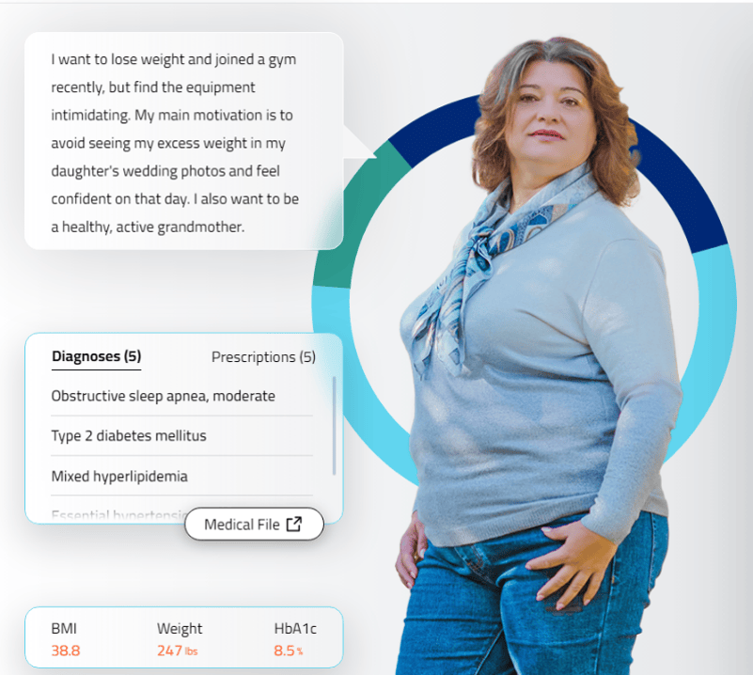


Interactive case-based learning tool developed for, and funded by,
Novo Nordisk Inc.
Provides simulated interactions in real-time feedback, and streamlined interoperability communication.
Click here or scan the QR code below, for an interactive learning experience, including the opportunity to practice hypothetical decision making and patient care

