Slide 1
Communication
in Obesity Care: With Patients, Family Members and Healthcare Professionals​​
Module 5

Slide 2
Thank you for using the FORWARD: Focus on Obesity Education curriculum.
Welcome to the FORWARD: Focus on Obesity Education curriculum. FORWARD was funded by Novo Nordisk Inc. A third-party provider developed the curriculum’s content in consultation with Novo Nordisk Inc. and leading obesity clinician experts. FORWARD relies exclusively on open-source materials available to the general public.
The goal of FORWARD is to present a complete, accurate, non-promotional and fair-balanced picture of the current state of obesity. FORWARD is intended to inspire the development of obesity education in clinical professional schools, ensuring adequate training of future healthcare providers on the diagnosis and management of obesity. By choosing to access and browse this module of FORWARD, you acknowledge that you have read, understand and agreed to the FORWARD Terms of Use. If you do not agree with the FORWARD Terms of Use, you are not permitted to further access this module and should immediately discontinue your use.
Double click to view:
Content current as of August 2023

Slide 3
Learning outcomes
After completing this module, the learner will be able to:
  Use patient-centered, compassionate communication that is free of stigma and bias when treating individuals with obesity and their families
  Display compassion, respect, ethical behavior and integrity towards patients and families living with obesity

Slide 4
Meet Maria
Maria is a patient in your practice. After a routine physical and some blood work, you have set up an appointment to discuss the results with her. Maria arrives at your office with her partner, Nick.
After discussing Maria’s most recent lab results, she expresses that she would like to reduce her risk of another heart attack because she provides care for her young granddaughter during the day. She is feeling guilt and shame for not taking better care of herself.
Age: 68 years old
Gender: Female
Occupation: Retired teacher
Clinical parameters:
BMI: 38 kg/m²
Medical history: Hypertension, MI two months ago
Recent HbA_{1c}: 6.4% (Prediabetes)
Recent LDL levels: 141 mg/dL (High)
Family history: Diabetes and cardiovascular disease
BMI, body mass index; LDL, low-density lipoprotein; MI, myocardial infarction.

Slide 5

Discussing obesity with patients
The complex and sensitive nature of obesity can make conversations difficult to have with patients^{1–3}
Patients are more likely to attempt weight loss when HCPs employ an empathetic approach and other techniques consistent with shared decision making² and motivational interviewing³
2/3
of people living with obesity would like their HCPs to discuss their weight¹ with a focus on problems/modifiable risk factors rather than the weight itself²
HCPs, healthcare professionals.
1. Caterson I et al. Diabetes Obes Metab 2019:21:1914–1924; 2. Lindberg CS et al. Obes Sci Pract. 2023;1–23. https://doi.org/10.1002/osp4.669;
3. Pollak K et al. J Fam Pract 2007:56:1031–1036.

Slide 6
Motivational interviewing
Motivational interviewing is a collaborative, patient-centric form of guiding that elicits and strengthens motivation for change and involves^{1,2}:
Collaboration
Patient autonomy
Caring, non-judgmental language
Active listening and empathetic responding
Preserving the patient’s self-esteem
Eliciting the patient’s own goals and ideas first
ASK
LISTEN
REFLECT
EMPATHIZE
SUPPORT
1. Resnicow K et al. Int J Behav Nutr Phys Act 2012:9:19; 2. Agency for Healthcare Research and Quality (AHRQ). Integrating primary care practices and community-based resources to manage obesity. Available at: https://www.ahrq.gov/ncepcr/tools/obesity/obpcp3.html. Accessed June 2023.

Slide 7
Principles of motivational interviewing^{1,2}
The patient must see a compelling need for change
The patient must feel confident that they are able to do what is suggested and that the proposed change will help
Fundamental assumption: building ongoing relationship and trust
Not motivating patients, but helping the patient get to their own internal motivation
Patient should do most of the talking
Interviewing patients to elicit their own internal motivating factors helps facilitate their decision-making process
1. Resnicow K et al. Int J Behav Nutr Phys Act 2012:9:19; 2. Agency for Healthcare Research and Quality (AHRQ). Integrating primary care practices and community-based resources to manage obesity. Available at: https://www.ahrq.gov/ncepcr/tools/obesity/obpcp3.html. Accessed June 2023.

Slide 8

Maria’s motivation for weight loss
List Maria’s top motivators to improve her health by managing her weight below:
______________________________________________________
______________________________________________________
Notes:
Answer key:
Taking care of her granddaughter
Reducing risk of another heart attack

Slide 9



Ask permission
When opening the conversation, it is important to ask for permission because talking about weight can be a sensitive topic^{1,2}
“Would it be alright to discuss your weight today?”
Once you have permission, ensure you use positive, motivational and patient-first language at all times:^{3,4}
Best practice: “Would you mind if we discuss your weight today?”
Avoid: “I have noticed you are obese, have you tried eating less and moving more?”
If a patient does not give permission, do not push the topic and let them know you will be available to discuss if they change their mind²
1. Caterson I et al. Diabetes Obes Metab 2019:21:1914–1924; 2. Vallis M et al. Can Fam Physician 2013;59:27–31; 3. Wadden T et al. Obes Res 2003;11:1140–1146;
4. Puhl RM et al. Pediatrics. 2022;150:e2022058204.

Slide 10
Initiating weight management conversations
Below are some examples of how your weight management conversations could start:
“If we can review your previous test results for a moment, I think it may be beneficial to discuss how your health can be improved by losing weight and how it will help improve some of these results in the future”
“Carrying excess weight can be a cause of some of your health concerns. Can we discuss how losing weight can improve your health?”

Slide 11

Initiating the conversation with Maria
What would be the best way to initiate the conversion with Maria
in an empathic, patient-centric and unbiased way that is free
of stigma?
  “Maria, I’m concerned that you have been gaining weight in the last few months. I would like you to lose some weight.”
  “You should eat less and exercise more Maria, unless you want to gain more weight.”
  “I understand that you are interested in improving your health. Would it be alright to discuss your weight today, Maria?”
  “You are obese, Maria. That’s understandable because your family members are obese too. We need to get you on a weight loss plan soon.”
Notes:
Answer key:
c (Slides 9; Other approaches show lack of empathy and compassion for the patient and uses insensitive language)

Slide 12
Inform patients about health risks associated with obesity
Advise patients on¹⁻⁷:
A weight loss of 5% having significant health benefits on comorbidities such a dyslipidemia, hypertension and progression to T2D
A sustained weight loss of 5–10% or more further enhancing these benefits
“Because of your weight, you are at risk of developing several weight-related complications including diabetes. Your weight may also increase the risk of another heart attack”⁸
“With weight loss of as little as 5% you can significantly reduce your blood pressure and chances of developing diabetes. A sustained weight loss of 10–15% or more can further enhance these benefits and provide additional improvements to your health”^{1-7,9}
T2D, type 2 diabetes.
1. Knowler WC et al. N Eng J Med 2002;346:393–403; 2. Wing RR et al. Diabetes Care 2011;34:1481–1486; 3. Dattilo AM et al. Am J Clin Nutr 1992;56:320–328; 4. Coggon D et al. Intl J Obes Relat Metab Disord 2001;25:622–627; 5. Christensen R et al. Ann Rheum Dis 2007; 66:433–439; 6. Zelber-Sagi S et al. Therap Adv Gastroenterol 2016;9:392–407; 7. Glass LM et al. Dig Dis Sci 2015;60:1024–1030; 8. Must A et al. JAMA 1999;282:1523–1529; 9. Seagle H et al. J Am Assoc 2009;109:330–346.

Slide 13
Recognize that obesity is not the patient’s fault
Patients with obesity may feel frustrated, have feelings of failure and low self-esteem, and experience mental health problems
Explain that obesity is not the patient’s fault
Help the patient understand that body weight is influenced by many factors, including genetics, environment and hormones, and that is why losing weight and maintaining weight loss is challenging¹
National Institutes of Health. Clinical Guidelines On The Identification, Evaluation, And Treatment Of Overweight And Obesity In Adults. Available at: http://www.nhlbi.nih.gov/guidelines/obesity/ob_gdlns.pdf. Accessed June 2023.

Slide 14

Discussing obesity with Maria
After Maria agrees to discuss her weight with you, what are some factors associated with obesity that you can incorporate into the conversation?
  Increased risk of weight-related complications like coronary heart disease and diabetes
  Significant benefits after only a 5% decrease in weight
  Additional health improvement with 5–10% weight loss
  Emphasizing that Maria’s weight is not her fault and obesity is a complex condition that is associated with genetic, environmental and hormonal factors
  All of the above
Notes:
Answer key:
e (Slide 11,12; All are factors that can be incorporated into patient conversations on obesity)

Slide 15
Set realistic and attainable goals
Once you have a good understanding of the patient’s weight journey so far, you can progress to discussing and setting goals together
“What are some reasonable goals you could set regarding your weight?”
Start by eliciting what your patient’s goals are. By doing this, you can help them determine realistic and achievable targets
Explore how they will be able to achieve these goals. Next steps should be measurable and build on each other over time
“What kind of changes would you be willing to start with?”
Set realistic dates for when your patient will aim to achieve both their short- and long-term goals and set expectations that obesity management is a long-term process
Vallis M et al. Can Fam Physician 2013;59:27–31.

Slide 16





Use the SMART framework to set goals
    Specific
“I will go on walks on Mondays, Wednesdays and Fridays around my neighborhood for 30 minutes in order to lose 5lbs by Thanksgiving”
    Measurable
    Attainable
    Relevant
    Time-bound
O’Neill J, Cozemius A. The Power of SMART Goals: Using Goals to Improve Student Learning. Bloomington, IN: Solution Tree; 2005.

Slide 17


Communicating with family members and other healthcare professionals
Avoid stigmatizing or blaming words
Use patient-first language
Avoid using words that are perceived negatively when talking to and about patients and replace them with other terms^{*1,2}
Allows the patient to be distinguished from their weight. Remember that people are not their disease when discussing obesity¹
Obese
Obese
Morbidly obese
Patients with obesity
Fat
Patients affected by obesity
Large
Weight stigma can adversely impact patients’ success with weight loss³; therefore, family and social support for healthy eating and physical activity will improve weight management⁴
Unhealthy weight
High body mass index
*Youth with a BMI ≥85th percentile, Black/African American, and Hispanic Latinx youth indicated a greater preference for their parents using the term “thick” to describe their body weight compared with those with lower body weight and/or identifying as white.
1. Still C. Bariatric Times 2018;15:3; 2. Puhl RM et al. Pediatrics. 2022;150:e2022058204; 3. Pearl RL et al. Ann Behav Med. 2020;54:904–914;
4. Wang ML et al. Obesity (Silver Spring). 2014;22:1973–1980.

Slide 18

Setting goals with Maria and her family members
What is a good example of discussing weight management with Maria and her partner Nick?
  Getting Maria’s and Nick’s input on her weight loss journey so far in order to set attainable short- and long-term goals
  Referring to Maria as obese
  Setting weight loss goals in accordance with clinical guidelines without discussing Maria’s personal goals
.
Notes:
Answer key:
a (Slide 14; patient should be involved in weight management discussions)

Slide 19
Key takeaways
Patients are more likely to attempt weight loss when clinicians
employ an empathetic approach and techniques consistent with motivational interviewing
The motivation to lose weight must come from patients
Clinicians should assist patients in setting realistic and achievable weight loss goals
Avoid stigmatizing or blaming words and use patient-first language when communicating with patients and family members of those
with obesity

Slide 20
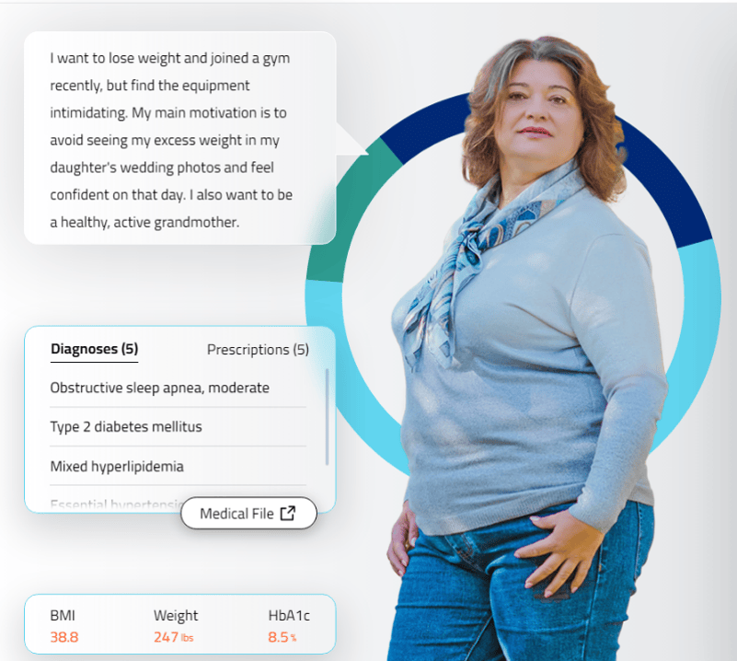

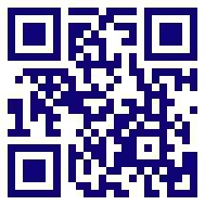
Interactive case-based learning tool developed for, and funded by,
Novo Nordisk Inc.
Provides simulated interactions in real-time feedback, and streamlined interoperability communication.
Click here or scan the QR code below, for an interactive learning experience, including the opportunity to practice hypothetical decision making and patient care

