Slide 1
Caring for Patients with Obesity
Module 7

Slide 2
Thank you for using the FORWARD: Focus on Obesity Education curriculum.
Welcome to the FORWARD: Focus on Obesity Education curriculum. FORWARD was funded by Novo Nordisk Inc. A third-party provider developed the curriculum’s content in consultation with Novo Nordisk Inc. and leading obesity clinician experts. FORWARD relies exclusively on open-source materials available to the general public.
The goal of FORWARD is to present a complete, accurate, non-promotional and fair-balanced picture of the current state of obesity. FORWARD is intended to inspire the development of obesity education in clinical professional schools, ensuring adequate training of future healthcare providers on the diagnosis and management of obesity. By choosing to access and browse this module of FORWARD, you acknowledge that you have read, understand and agreed to the FORWARD Terms of Use. If you do not agree with the FORWARD Terms of Use, you are not permitted to further access this module and should immediately discontinue your use.
Double click to view:
Content current as of August 2023

Slide 3
Learning outcomes
After completing this module, the learner will be able to:
  Understand the staging system and diagnostic criteria for obesity
  Assess the patient's readiness to change using shared-decision making and evidence-based approached such as the 5 As of obesity
  Identify drug classes that can cause medication-induced weight gain
  Understand that obesity is a chronic disease that may require ongoing care
  Recognize the role of various healthcare professionals in caring for people with obesity in a multidisciplinary setting

Slide 4
Classification of obesity: BMI
The first stage of clinical management is evaluation of patient’s level of obesity
Body mass index (BMI) is correlated to fat mass in the general population^{1,2}
BMI loses predictability when applied on the individual level¹
Classification | BMI (kg/m²)
 | International classification^{3,4} | Asian population⁵
Underweight | <18.5
Normal range | ≥18.5 and <25 | ≥18 and <23
Pre-obesity* | ≥25 and <30 | ≥23 and <25
Obesity | ≥30 | >25
Obesity class I | ≥30 and <35
Obesity class II | ≥35 and <40
Obesity class III | ≥40
BMI
weight (kg)
=
height (m²)
Limitation:
Represents excess weight and body size rather than excess body fat/visceral adiposity
*Pre-obesity, previously called overweight, medicalizes the term, and like pre-diabetes may assist patients and HCPs in taking their weight more seriously.
WHO, world health organization.
1. American Medical Association (AMA). Available at: https://www.ama-assn.org/delivering-care/public-health/ama-use-bmi-alone-imperfect-clinical-measure. Accessed June 2023;
2. Obesity playbook. Endocrine Society. 2023. Available at: https://www.endocrine.org/-/media/endocrine/files/obesity/obesity-playbook-final_use.pdf. Accessed May 2023;
3. Centers for Disease Control and Prevention (CDC). Defining adult overweight & obesity. Available at: https://www.cdc.gov/obesity/basics/adult-defining.html#:~:text=Obesity%20is%20frequently%20subdivided%20into,BMI%20of%2040%20or%20higher. Accessed June 2023;
4. Bhaskaran K et al. Lancet Diabetes Endocrinol. 2018;6:doi:10.1016/S2213-8587(18)30288-2; 5. Misra A et al. J Assoc Physicians India 2009;57:163–170.

Slide 5
Limitations of BMI on an individual level
BMI does not directly assess body fat; therefore, it should not be used as a diagnostic tool^{1,2}
Limitations can influence the widespread use of BMI in clinical settings^{1,2}
Consider the utility of BMI in conjunction with other valid assessments of risk via:¹
Age
Confirmation of increased waist circumference
Assessment for metabolic problems
Assessment for biomechanical
complications (e.g., knee pain)
Sex
Ethnicity
Muscle mass
Relative body shape and composition heterogeneity across race and ethnic groups, sexes, genders and age-span are essential to consider when applying BMI as a measure of adiposity^{1,2}
1. American Medical Association (AMA). Available at: https://www.ama-assn.org/delivering-care/public-health/ama-use-bmi-alone-imperfect-clinical-measure. Accessed June 2023;
2. Centers for Disease Control and Prevention (CDC). Available at: https://www.cdc.gov/obesity/downloads/bmiforpactitioners.pdf. Accessed June 2023.

Slide 6

Classification of obesity: Waist circumference
Waist circumference measures central/visceral obesity and predicts risk independent of BMI, so measuring both BMI and waist circumference is recommended^{1,2}
This risk goes up with waist size that is greater than
88 cm for women or greater than 102 cm for men*
The threshold for waist circumference depends on
race and ethnicity
  In South Asian, Southeast Asian and East Asian adults,
  men with values ≥85 cm and women ≥74 to 80 cm
  should be considered at risk
*These values are based for Caucasian individuals; other thresholds are recommended for non-Caucasian individuals.
BMI, body mass index.
1. Padwal RS et al. CMAJ 2011;183:E1059–1066; 2. Kushner R et al. Practical Manual of Clinical Obesity. 2013; Wiley-Blackwell;
3. NIH, National Heart, Lung and Blood Institute. Available at: https://www.nhlbi.nih.gov/health/educational/lose_wt/BMI/bmi_dis.htm. Accessed June 2023; 4. Garvey WT et al. AACE CPG. Endocr Pract. 2016;22:1–203.​

Slide 7
Consider two patients with excess body fat
Patient A
BMI = 37 kg/m²
FPG = 92 mg/dL
HDL-C = 54 mg/dL
LDL-C = 125 mg/dL
TG = 131 mg/dL
BP = 122/78
WC = 108 cm
Patient B
BMI = 31 kg/m²
FPG = 110 mg/dL (prediabetes)
HDL-C = 38 mg/dL
LDL-C = 125 mg/dL
TG = 301 mg/dL
BP = 138/84 (stage I hypertension)
WC = 125 cm
Patient B has a more metabolically severe presentation of obesity despite having a lower BMI
BMI, body mass index; BP, blood pressure; FPG, fasting plasma glucose; HDL-C, high-density lipoprotein cholesterol; LDL-C, low-density lipoprotein cholesterol; TG, triglycerides;
WC, waist circumference.

Slide 8
Obesity staging systems^{1,2}
Several obesity staging systems have been developed to assist clinicians in characterizing obesity severity and aid in clinical decision-making
One of these alternative staging systems is the Edmonton Obesity Staging System (EOSS)
The EOSS allows assessment of the effect of obesity-related comorbidities on individuals, beyond weight
Stage 0
Stage 1
Stage 2
Stage 3
Stage 4
No clinical risk factors
Subclinical risk factors
Established disease
Severe
End-stage, disabling
Case example:
28 years old
BMI = 23 kg/m²
Physically active
Blood chemistries within normal limits
No obesity-related risk factors, no physical symptoms, no functional limitations
Case example:
20 years old
BMI = 40 kg/m²
Borderline hypertension
Impaired FPG
Mild lower back and knee pain
Does not require medical intervention
Case example:
49 years old
BMI = 36 kg/m²
Primary hypertension
T2D
OSA
Fatty liver
Depression
Medications for hypertension, T2D and depression
Case example:
45 years old
BMI = 67 kg/m²
Angina
Cardiovascular disease
Dyspnea
Coronary bypass surgery
Major depression
Reduced mobility due to OA and gout
Case example:
38 years old
BMI = 56 kg/m²
Hyperpnea
Anxiety disorder
Disabling arthritis
Non-ambulatory, uses wheelchair
The EOSS combined with BMI enables improved functional and prognostic assessment for patients
BMI, body mass index; BP, blood pressure; FPG, fasting plasma glucose; HDL-C, high-density lipoprotein cholesterol; LDL-C, low-density lipoprotein cholesterol; OA, osteoarthritis;
OSA, obstructive sleep apnea; T2D, type 2 diabetes.
1. Kodsi R et al. Nutrients. 2022;14:967; 2. Sharma AM & Kushner RF. Int J Obes (Lond). 2009;33:289–295.

Slide 9
AACE staging system characterization
Stage 0 | Stage 1 | Stage 2
Case example: BMI = 30 kg/m² Absence of weight-related complications | Case example: BMI = 25 kg/m² One or more mild to moderate complications Pre-diabetes Pre-hypertension MASLD | Case example: BMI = 25 kg/m² One or more severe weight-related complications Primary hypertension Type 2 diabetes MASH
Clinical goals: Prevent progressive weight gain Prevention of development of weight-related complications | Clinical pearls: May require intensive lifestyle/behavior therapy Consideration of weight loss medications | Clinical goals: Severe complications treated with intensive lifestyle/ behavioral therapy along with weight-loss medications Consideration of bariatric surgery
AACE, American Association of Clinical Endocrinologists; BMI, body mass index; MASH, metabolic dysfunction-associated steatohepatitis;
MASLD, metabolic dysfunction-associated steatotic liver disease.
AACE/ACE Obesity CPG. Garvey WT et al. Endocr Pract. 2016:22(Suppl 3):1–203.
Notes:
Update nomenclature for NAFLD/NASH nomenclature updates on the slide

Slide 10
Medication-induced weight gain^{1,2}
Medication-induced weight gain is a serious side effect
of many commonly used drugs leading to exacerbation of complications and comorbid conditions related
to obesity
It is important for HCPs to consider the weight effects of medications prior to prescribing or during the course of treatment and provide alternatives, if appropriate
Medication type | Weight gain | Weight neutral/less weight gain | Weight loss
Antidiabetics | Insulin, Meglitinides, Sulfonylureas, Thiazolidinediones | α-glucosidase inhibitors, bromocriptine, colesevelam, DPP-4 inhibitors | GLP-1 agonists, metformin, pramlintide, SGLT2 inhibitors
Antihypertensives | α-adrenergic blockers β-adrenergic blockers (atenolol, metoprolol, nadolol, propranolol) | ACE inhibitors, ARBs, β-adrenergic blockers (carvedilol, nebivolol), calcium channel blockers (amlodipine, diltiazem), thiazides
Antidepressants | Lithium, MAOIs, mirtazapine, SSRIs (paroxetine), tricyclic antidepressants (amitriptyline, doxepin, imipramine, nortriptyline) | SSRIs (fluoxetine, sertraline) | Bupropion
Antipsychotics | Clozapine, olanzapine, quetiapine, risperidone | Aripiprazole, lurasidone, ziprasidone
Anti-epileptics | Carbamazepine, gabapentin, pregabalin, valproic acid | Lamotrigine, levetiracetam, phenytoin | Topiramate, zonisamide
Contraceptives | Medroxyprogesterone acetate | Barrier methods, intrauterine device, surgical sterilization (hysteroscopic sterilization, tubal ligation)
Antihistamines | First-generation antihistamines (diphenhydramine) | Second- and third-generation antihistamines
Anti-inflammatories | Glucocorticoids | Inhaled steroids, topical steroids, NSAIDs, DMARDs
ACE, angiotensin-converting enzyme; ARB, angiotensin II receptor blockers; DMARD, disease-modifying antirheumatic drug; DPP-4, dipeptidyl peptidase-4; GLP-1, glucagon-like peptide-1; MAOI, monoamine oxidase inhibitor; NSAID, nonsteroidal anti-inflammatory drug; SGLT2, sodium-glucose co-transporter 2; SSRI, selective serotonin reuptake inhibitor.
1. Saunders KH et al. J Fam Pract 2016; 65(11):780–788; 2. Apovian CM et al. Clinical Management of Obesity Professional Communications, Inc, West Islip, NY. 2015.

Slide 11
Principles of care
Suggestions from the Obesity Medicine Association
Obesity as a disease
Data collection
Evaluation and
assessment
Management decisions
Motivational interviewing
Nutritional intervention
Physical activity
Behavior therapy
Pharmacotherapy
Bariatric procedures
Bays HE et al. Obesity Algorithm Slides, presented by the Obesity Medicine Association 2021. Available at: https://obesitymedicine.org/wp-content/uploads/2021/01/2021-Obesity-Algorithm.pdf. Accessed June 2023.

Slide 12

Motivational interviewing and goal-setting are effective strategies to promote weight loss
Individuals must have their own internal motivation for change to happen and for it to stick
Motivational interviewing is a collaborative, patient-centered form of guiding that is used to elicit and strengthen motivation for change
5 As of obesity management for adults:
ASK for permission to discuss weight and
explore readiness
ASSESS obesity related risks and ‘root causes’
of obesity
ADVISE on health risks and treatment options
AGREE on health outcomes and behavioral goals
ASSIST in accessing appropriate resources and providers
Help people with obesity set SMART goals:
Specific
Measurable
Attainable
Relevant
Time-bound
Obesity Canada. 5 As of Obesity Management. https://obesitycanada.ca/resources/5as/. Accessed June 2023.

Slide 13


Pharmacokinetic and pharmacodynamic challenges in people with obesity
Obesity can have a significant impact on the distribution, metabolism and excretion of some medications due to changes in:¹
Body composition
Fat accumulation in liver
Blood flow
Total clearance
ClCr estimation methods do not consider body composition accurately. In patients with obesity, using:¹
Actual body weight will significantly overestimate renal function
Ideal body weight will significantly underestimate renal function
Cockcroft-Gault 40% obesity adjustment:
Adjusted weight = IBW + 0.4(ABW – IBW)
Collaborate with pharmacists in managing medications for people with obesity¹
Incorrect application of TBW,
LBW and IBW may result in underdosing or overdosing of certain medications²
ABW, actual body weight; ClCr, creatinine clearance; IBW, ideal body weight; LBW, lean body weight; TBW, total body weight.
1. Barras M. Aust Prescr 2017:40(5):189–193;
2. OpenAnesthesis. Drug dosing in patients with obesity. Available at: https://www.openanesthesia.org/keywords/drug-dosing-in-patients-with-obesity/. Accessed June 2023.

Slide 14

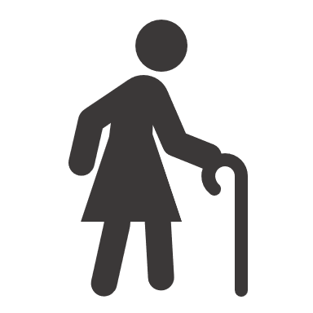

Obesity is a chronic disease and requires ongoing care
Similar to other chronic diseases, obesity requires long-term management and ongoing care and support^{1,2}
Maintaining a healthy weight throughout life is one of the most important ways to protect against obesity-related complications^{1,2}
Obesity in middle-aged adults is a risk factor for many
age-related diseases and decreases life expectancy by
about 7 years²
1. Obesity playbook. Endocrine Society. 2023. Available at: https://www.endocrine.org/-/media/endocrine/files/obesity/obesity-playbook-final_use.pdf. Accessed June 2023;
2. Khan SS et al. JAMA Network Open. 2022;5:e222318.

Slide 15
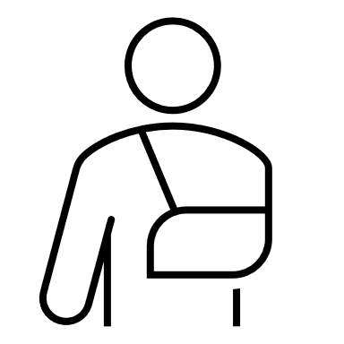
Obesity in older adults
Sarcopenic obesity: With aging, muscle mass can decline while fat mass increases, leaving overall weight relatively unchanged. In this situation, obesity-related complications continue as a result of the body’s higher percentage of fat¹
For persons ≥60 there is an increase in sarcopenic obesity, dependency and disability:^{2 –4}
1.16 times increased risk of falls
1.18 times increased risk of multiple falls
  Muscle endurance
  Pro-inflammatory cytokines
Aging
  Lipid infiltration of muscle
Obesity
  Muscle disuse, wasting
Reduced muscle quality and function
1. Batsis JA et al. Nat Rev Endocrinol 2018;14(9):513–537; 2. Chang VW et al. Am J Epidemiol 2017;186:688–695; 3. Neri SGR et al. J Gerontol A Biol Sci Med Sci 2020;75:952–960;
4. Donini LM et al. Obes Facts. 2022;15:321–335.

Slide 16
Key takeaways
BMI is a good population-based screening measure but has limitations for the individual
Waist circumference can be used to augment BMI to categorize stage I, II, III class obesity
Obesity is a chronic disease and does require ongoing care throughout the patient’s life

Slide 17
Assessment
Juan has a BMI of 38 kg/m². Keith has a BMI of 29 kg/m². Keith has higher levels of fasting plasma glucose, LDL-C, triglycerides, and blood pressure than Juan. Keith has a lower risk from his obesity than Juan because of his lower BMI.
  True
  False
Which of the following is an example of a SMART goal for a person with obesity?
  “I will lose weight so that I can feel better and have a healthier relationship with my wife”
  “I will go on a walk on Mondays, Wednesdays and Fridays around my neighborhood for 20 minutes in order to lose 3 lbs by June 30”
  “I am going to exercise more and eat more vegetables. These are 2 behavior changes that I feel confident I can do.”
  “I will lose 20 lbs by end of next month. I have done this before and I know I can do this again.”
Dose adjustments in patients with obesity may be required due to the impact of obesity on drug distribution, metabolism, and excretion. Which of the following obesity-related factors is most likely to contribute to the need for dose adjustments?
  Lower body fat distribution
  Changes in reproductive functions
  Changes in blood flow
  Hypercellular adiposity
Which of the following statements regarding management of obesity in older adults is most accurate?
  Weight loss in older individuals may promote osteoporosis
  Older adults with obesity require high intensity exercise
  Older adults require from 2.0–2.5 grams of protein per kilogram of body weight to increase lean body mass
  Older adults with obesity are at a decreased risk of disability compared to younger adults with obesity
Notes:
Answer Key
b (Slide 5; False, while patients may have lower BMI they can still have a more metabolically severe presentation of obesity)
b (Slide 9; This is an example of a goal that is specific, measurable, attainable, relevant and timely”
d (Slides 11; Both change in body composition and change in blood flow affect drug metabolism, distribution and clearance
b (Slides 13 and 14; weight loss in older adults may promote osteoporosis due to loss of bone mass)

Slide 18
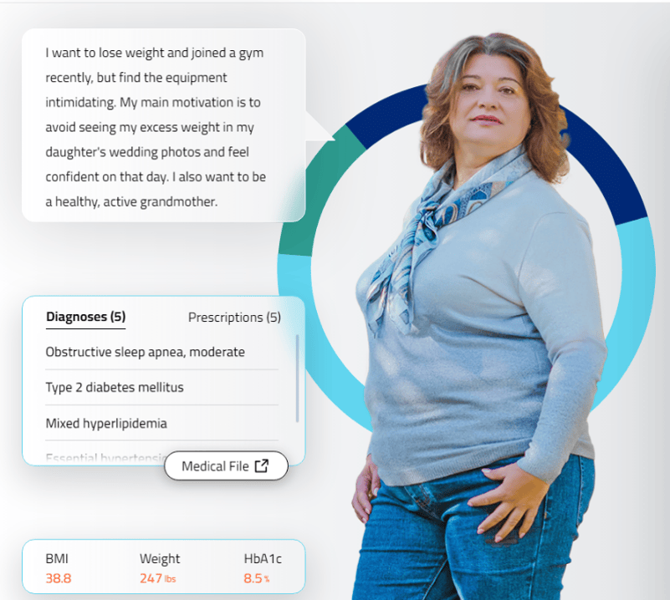


Interactive case-based learning tool developed for, and funded by,
Novo Nordisk Inc.
Provides simulated interactions in real-time feedback, and streamlined interoperability communication.
Click here or scan the QR code below, for an interactive learning experience, including the opportunity to practice hypothetical decision making and patient care

