Slide 1
Special Considerations for Weight Management Across Adult Populations​​​
Module 12

Slide 2
Thank you for using the FORWARD: Focus on Obesity Education curriculum.
Welcome to the FORWARD: Focus on Obesity Education curriculum. FORWARD was funded by Novo Nordisk Inc. A third-party provider developed the curriculum’s content in consultation with Novo Nordisk Inc. and leading obesity clinician experts. FORWARD relies exclusively on open-source materials available to the general public.
The goal of FORWARD is to present a complete, accurate, non-promotional and fair-balanced picture of the current state of obesity. FORWARD is intended to inspire the development of obesity education in clinical professional schools, ensuring adequate training of future healthcare providers on the diagnosis and management of obesity. By choosing to access and browse this module of FORWARD, you acknowledge that you have read, understand and agreed to the FORWARD Terms of Use. If you do not agree with the FORWARD Terms of Use, you are not permitted to further access this module and should immediately discontinue your use.
Double click to view:
Content current as of November 2025
Content current as of August 2023

Slide 3
Learning outcomes
After completing this module,
the learner will be able to:
  Understand the role of sex hormones in weight gain
  in adulthood
  Understand the risk of obesity-related complications and premature mortality in adults due to childhood/adolescent obesity
  Understand sex-specific and life stage–specific risk of obesity-related complications
Estimated time to complete: 30 min

Slide 4
Prevalence of adult obesity in the US
Obesity (BMI ≥30 kg/m²)
by age and sex
Severe obesity (BMI ≥40 kg/m²)
by age and sex
40.3%
of US adults are living with obesity
(BMI ≥30 kg/m²)
Peak in middle age for both sexes
Similar rate of obesity between women and men across age groups
Peak in middle age for both sexes
Higher rate of severe obesity among women vs men across age groups
BMI, body mass index.
Prevalence of obesity and severe obesity was estimated from data from the August 2021–August 2023 National Health and Nutrition Examination Survey (NHANES); all examined NHANES participants age 20 and older were included. NHANES is a cross-sectional survey designed to monitor the health and nutritional status of the US civilian non-institutionalized population and is conducted by the National Center for Health Statistics.
Centers for Disease Control and Prevention (CDC). NCHS Data Brief: No 508. https://www.cdc.gov/nchs/data/databriefs/db508.pdf. Accessed November 2025.

Slide 5
Prevalence of adult obesity in the US by race/ethnicity
Obesity (BMI ≥30 kg/m²) by race/ethnicity
BMI, body mass index.
Prevalence of obesity and severe obesity by race/ethnicity was estimated from data from the 2017–2018 National Health and Nutrition Examination Survey (NHANES); all examined NHANES participants age ≥20 were included.
NHANES is a cross-sectional survey designed to monitor the health and nutritional status of the US civilian non-institutionalized population and is conducted by the National Center for Health Statistics.
CDC. NCHS Data Brief: No 360. https://www.cdc.gov/nchs/data/databriefs/db360-h.pdf. Accessed November 2025.

Slide 6
Utility and limitations of BMI to assess adult obesity
BMI is a surrogate measure for adiposity^{1,2}
Widely used population health measure^{1,3}
Overestimates body fat in those with BMI ≥30 mg/kg who have^{3–5}
Muscular build
Larger bone structure
Useful primary healthcare screening tool³
Limited as an individual health assessment^{2,3}
Underestimates excess body fat in those with BMI <30 mg/kg in^{4–7}
Postmenopausal women
Elderly people with sarcopenic obesity
Asian populations*
Does not differentiate fat mass vs lean mass^{2–4}
Does not reflect distribution of body fat^{1–3}
BMI, body mass index.
*Recommended BMI cut-off for obesity for Asian populations is ≥27.5 kg/m².
1. Ponti F et al. Front Endocrinol 2020;10:861; 2. Byker Shanks C et al. Int J Behav Nutr Phys Act 2025;22:23; 3. Wu Y et al. Int J Environ Res Public Health 2024;21:757; 4. Holmes CJ et al. Nutrients 2021;13:2493; 5. Nadolsky K et al. Endocr Pract 2025:S1530-891X(25)00977-2; 6. Banack HR et al. Menopause 2018;25:307–313; 7. Li Z et al. Obesity (Silver Spring) 2023;31:316–328.

Slide 7
Methods used to assess excess body fat
Anthropometric measures used to confirm excess abdominal adiposity
 | Cut-off for men | Cut-off for women
Waist circumference*^{,1,2} | >40 inches >102 cm† | >34.5 inches >88 cm†
Waist-to-height ratio^{1,2} | ≥0.5 | ≥0.5
Waist-to-hip ratio¹ | ≥0.90 | ≥0.85
Bioelectrical impedance or
dual-energy X-ray absorptiometry
should be used to assess body composition and/or distribution of
adipose tissue when anthropometric measures are discordant or do not match clinical findings²
High values for these measures are associated
with increased risk of cardiometabolic disease¹
*Suggested cut-off values for men and women in the United States and Canada.
†>94 cm in men with insulin resistance and >80 cm in women with insulin resistance.
1. Holmes CJ et al. Nutrients 2021;13:2493; 2. Nadolsky K et al. Endocr Pract 2025:S1530-891X(25)00977-2.

Slide 8
Sex-specific differences
in obesity

Slide 9
Weight gain manifests differently in men vs women
Visceral
adipose tissue
Gluteal/subcutaneous
adipose tissue (premenopause)
The accumulation of fat derived
from free fatty acids and triglycerides is rate-limited by lipoprotein lipase activity, which is higher in the
abdominal/visceral fat depot in males
and higher in the gluteal/
subcutaneous fat depot in females
Main fat storage compartment is the abdominal depot
Main fat storage compartment is the gluteofemoral depot
Characterized by
increase in size of
adipose cells –
hypertrophy
Characterized by increase in number of adipose
cells – hyperplasia
Total adipose tissue is 10% greater in females compared with males at the same BMI
BMI, body mass index.
Koceva A et al. Int J Mol Sci 2024;25:7342.

Slide 10
Testosterone and male obesity:
A bidirectional relationship
Testosterone acts as a metabolic hormone influencing body fat composition and muscle mass in men^{1,2} Men with obesity exhibit low levels of testosterone – secondary hypogonadism³
Male obesity^{1,2,4}
Testosterone deficiency in men²
Elevated levels of aromatase in
adipocytes convert testosterone to estradiol
Increase
Fat deposition
Fat synthesis
Adipocyte proliferation
Decrease
Muscle cell mass
Metabolic rate
Hypothalamus–pituitary–testicular dysregulation:
Gonadotropin reduction
Weight gain
Increased body fat
Obesity
Impaired testicular testosterone production (secondary hypogonadism)
1. Kelly DM et al. J Endocrinol 2013;217:R25–R45; 2. Ma H et al. PLoS One 2024;19:e0294567; 3. Fui MNT et al. Asian J Androl 2014;16:223–231; 4. Koceva A et al. Int J Mol Sci 2024;25:7342.

Slide 11
Sex-specific hormones and female pattern weight gain
Life stage–specific hormonal and metabolic changes in women can lead to
increased fat accumulation and altered fat distributon¹
Reproductive
years
Menopause transition/
postmenopause
Pregnancy
High estrogen levels fosters subcutaneous fat
accumulation on
hips and thighs^{1,2}
Hormonal, behavioral, and metabolic changes during pregnancy influence gestational weight gain and postpartum weight retention³
Decline in estrogen leads to
decrease in muscle mass and increase in abdominal/
visceral fat^{1,2,4}
Gynoid
Android
1. Ayesh H et al. Circ Res 2025;136:594–605; 2 Steiner BM et al. Front Endocrinol 2022;13:889923; 3.Gilmore LA et al. Semin Perinatol 2015;39:296–303; 4. Hurtado MD et al. Curr Obes Rep 2024;13:352–363.

Slide 12
Consequences of excess gestational weight gain (GWG) and postpartum weight retention
GWG retained
GWG retained
First pregnancy:
GWG leads to:
↑ BMI
↑ Fat mass
↑ Visceral fat
Second pregnancy:
↑ Preconception BMI
↑ Excess GWG
↑ Fat mass
↑ Visceral fat
Metabolic consequences:
↑ GDM
↑ Preeclampsia
↑ Hypercholesterolemia
Later in life:
↑ BMI
↑ Fat mass
↑ Visceral fat
Metabolic consequences:
↑ Risk for type 2 diabetes
↑ Risk for cardiovascular disease
↑ Risk for metabolic syndrome
BMI, body mass index; GDM, gestational diabetes mellitus; GWG, gestational weight gain.
Gilmore LA et al. Semin Perinatol 2015;39:296–303.

Slide 13
Menopause transition is a susceptible time in a woman’s life for weight gain and a shift to central adiposity
Aging plays a key role in weight gain, with menopause
altering body composition in midlife women¹
Resting metabolic rate declines with age due to muscle mass loss¹
Decline in estrogen level during
the menopausal transition^{1,2}
Weight gain even if no dietary or physical activity change¹
Increase fat deposition
in abdominal area^{1,2}
Clinical implications
  Cardiometabolic risk
  Mechanical complications
  Cancer risk
  Menopause symptoms
Visceral obesity
BMI, body mass index.
1. Hurtado MD et al. Curr Obes Rep 2024;13:352–363; 2. Ayesh H et al. Circ Res 2025;136:594–605.
Notes:
Given the shift to central adiposity rather than BMI, waist-to-hip ratio or whole-body adiposity by DXA could be considered for screening for obesity in postmenopausal women.

Slide 14
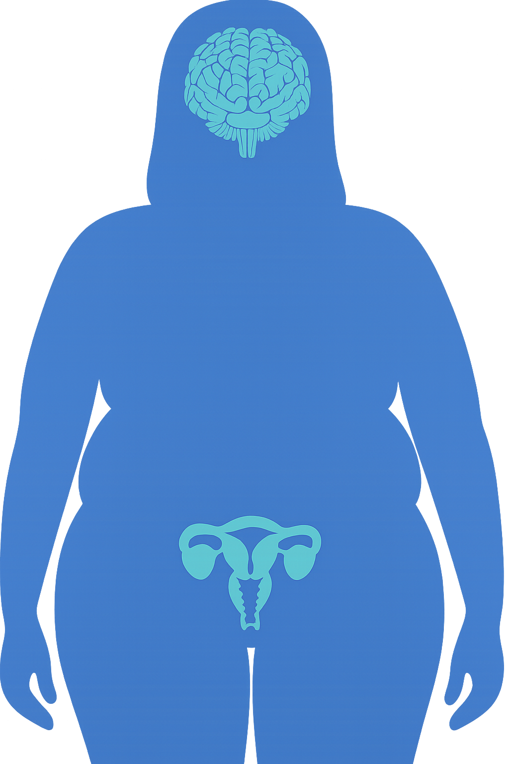
Obesity can impact a woman’s menopause experience
Up to 75% of women experience VMS due to menopause¹
Higher BMI is associated with higher hot flash frequency during the menopausal transition²
VMS have been linked to weight gain with sleep problems being a contributing factor³
Sleep disruption is reported by 40‒60% of menopausal women¹
High BMI and abdominal obesity are sources of sleep disturbances, decreasing deep sleep, and sleep efficiency, while increasing the risk of OSA in postmenopausal women⁴
Urogenital symptoms affect up to 85% of women in menopausal transition⁵
Higher prevalence of urinary incontinence and urgency among women living with obesity^{2,5}
Postmenopausal women with obesity are 4× more likely to have vulvovaginal itching and irritation⁵
Obesity increases the symptoms of impaired sexual functioning²
Weight loss is the only effective and recommended lifestyle modification
when it comes to managing menopause symptoms⁶
BMI, body mass index; OSA, obstructive sleep apnea; VMS, vasomotor symptoms.
1. Monteleone P et al. Nat Rev Endocrinol 2018;14:199–215; 2. Palacios S et al. Gynecol Endocrinol 2024;40:2312885; 3. Gibson CJ et al. Menopause 2023;30:709–716; 4. Naufel MF et al. Menopause. 2018;25:139–144; 5. Hurtado MD et al. Curr Obes Rep 2024;13:352–363; 6. The 2023 nonhormone therapy position statement of The North American Menopause Society. Menopause 2023;30:573–590.

Slide 15
Adult consequences of obesity in childhood/adolescence

Slide 16
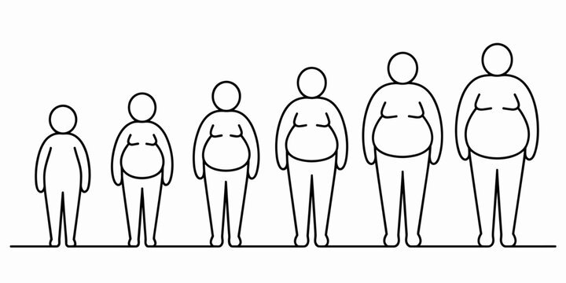
There is a strong association between obesity in adulthood and childhood/adolescent obesity
5×
greater risk of obesity in adulthood among children/adolescents with obesity vs without obesity*
80%
&
70%
of adults with obesity in
early adulthood
of adults with obesity over the age of 30 years
RR 5.21 (95% CI 4.50, 6.02)
had overweight/obesity in adolescence
*Meta-analysis included 10 studies.
CI, confidence interval; RR, relative risk.
Simmonds M et al. Obes Rev 2016;17:95–107.

Slide 17
There is an association between diabetes in early adulthood and childhood/adolescent obesity
Several studies have shown an association between type 2 diabetes
in early adulthood and obesity in childhood/adolescence
 | Article | Sex | No. of cases | Hazard ratio (95% CI)
 | Twig G, 2020 | Males | 1490 |  | 13.5 (11.5, 15.7)
 | Twig G, 2020 | Females | 687 |  | 21.1 (16.0, 27.8)
 | Zimmerman E, 2017 | Males | 11,548 |  | 2.5 (2.1, 3.0)
 | Zimmerman E, 2017 | Females | 7472 |  | 2.8 (2.3, 3.5)
 | Bjerregaard LG, 2018 | Males | 6710 |  | 1.7 (1.4, 2.1)
1
2
4
8
16
Type 2 diabetes more likely in young adults
with childhood/adolescent obesity
Pathophysiology and clinical course of early-onset type 2 diabetes
is more aggressive than onset in midlife
CI, confidence interval.
Horesh A et al. Curr Obes Rep 2021;10:301–310.

Slide 18
Adults are at increased risk of premature cardiovascular disease due to childhood/adolescent obesity
Childhood obesity is a risk factor for premature CVD in adulthood¹
At follow up, 21 years later, a significant increase in subclinical atherosclerosis was
observed in the adults that had overweight/obesity in adolescence²
0.70
P<0.0001
Mean (SD) age in 1986, years
16.0 (4.9)
16.2 (5.0)
16.2 (5.7)
16.5 (5.5)
0.68
P=0.005
No overweight/obesity
No metabolic disturbance
0.66
P=0.05
Obesity in childhood can accelerate atherogenesis, leading to the development of atherosclerosis¹
0.64
No overweight/obesity
With metabolic disturbance
Carotid intima-media thickness (mm) [95% CI]
in 2007
0.62
0.60
With overweight/obesity
No metabolic disturbance
0.58
n=
1032
n=
390
n=
90
n=
94
0.56
With overweight/obesity
With metabolic disturbance
0.00
Adolescent phenotype in 1986
Higher BMI during childhood has been shown to be
associated with an increased risk of CHD in adulthood³
BMI, body mass index; CHD, coronary heart disease; CI, confidence interval; CVD, cardiovascular disease; SD, standard deviation.
1. Drozdz D et al. Nutrients 2021;13:4176; 2. Koskinen J et al. Diabetes Care 2014;37:1870–1877; 3. Baker JL et al. N Engl J Med 2007;357:2329–2337.

Slide 19
Cancer risk increases among adults with adolescent obesity
Analyses from a nationwide cohort of 2 million adolescents followed up for >45 years provided
strong evidence of a link between increased BMI during adolescence and cancer in adulthood^{1–3}
Adult cancer risk associated
with adolescent obesity*^{,1}
Adult cancer types associated
with adolescent obesity^{2,3}
26% increased cancer risk
(HR 1.26 [95% CI 1.18, 1.35])
Digestive
system cancers
Renal cancer
Gastroesophageal
Pancreatic
27% increased cancer risk (excluding cervical and premenopausal breast cancer)
(HR 1.27 [95% CI 1.13, 1.44])
Colorectal
Hematologic cancers
Leukemia
Non-Hodgkin lymphoma
Acute myeloid leukemia
BMI, body mass index; CI, confidence interval; HR, hazard ratio.
*Analysis included data from 2,298,130 participants (n=928,110 women and n=1,370,020 men); 26,353 incident cases of cancer were recorded during 29,542,735 person-years of follow-up in men, and 29,488 incident cases were recorded in 18,044,863 person-years of follow-up in women.
1. Furer A et al. Lancet Diabetes Endocrinol 2020;8:216–225; 2. Horesh A et al. Curr Obes Rep 2021;10:301–310; 3. Weihrauch-Blüher S et al. Metabolism 2019;92:147–152.

Slide 20
An increased risk of mortality in middle adulthood has been associated with childhood/adolescent overweight/obesity
Premature all-cause mortality (before 30 years old)*
1.000
0.995
0.990
Survival probability
0.985
0.980
Young adults in a childhood obesity cohort had a 3× greater risk of all-cause mortality than age/gender-matched control subjects
(crude RR 2.92 [95% CI 1.97, 4.35];
P <0.001)
0.975
Comparison group
Childhood obesity cohort
0.970
18
20
22
25
26
28
30
Age (years)
Number at risk
Childhood obesity cohort 7049 (100%) 4861 (69%) 3213 (46%) 2077 (29%) 1286 (18%) 754 (11%) 427 (6%)
Comparison group 34,310 (100%) 23,562 (69%) 15,554 (45%) 10,075 (29%) 6201 (18%) 3647 (11%) 2066 (6%)
CI, confidence interval; RR, relative risk.
*Analysis of data from 7049 children with obesity from the Swedish Childhood Obesity Treatment Register and 34,310 gender- and age-matched controls from the Swedish Total Population Register; information on date of death was retrieved from the Cause of Death Register.
Lindberg L et al. PLoS Med 2019;17:e1003078.

Slide 21
Sex-specific considerations of obesity-related complications and comorbidities

Slide 22
Sex-specific cancers
Mechanisms underlying obesity and cancer include modulation of circulating adipokines,
altered sex hormone production, insulin resistance and IGF-1 system abnormalities, inflammation, and oxidative stress
Women have a higher rate of cancer diagnoses related to overweight/obesity than men
This is driven by the high incidence of
obesity-related ovarian, endometrial
and breast cancer
Women
Men
IGF, insulin-like growth factor.
Argyrakopoulou G et al. Curr Obes Rep 2021;10:100–115.

Slide 23
Impact of obesity on male fertility
Men with obesity are more likely to experience impaired fertility than those without obesity*^{,1}
Multiple mechanisms have been proposed to
explain obesity-related fertility impairment^{2–4}
OR 1.66
(95% CI 1.53, 1.79)
HPT axis disruption
Decreased luteinizing hormone and testosterone levels impair sperm production
Endocrine disruptors
Insulin, leptin, cortisol, cytokines, adipokines, and inflammation can impair
sperm production
Sperm quantity and quantity have been shown
to be affected in men with obesity^{†,2}
Lower:
Semen volume
Semen concentration
Sperm count
Total and progressive sperm motility
Normal sperm morphology
Scrotal temperature dysregulation due to excess hip, abdominal, and scrotal fat tissues impair sperm production
Complications from comorbid conditions such as erectile dysfunction due to peripheral vascular disease
*Meta-analysis of 2 studies.
†Metanalysis of 29 studies and 60,383 subjects.
CI, confidence interval; HPT, hypothalamus–pituitary–testicular; OR, odds ratio.
1. Campbell JM et al. Reprod Biomed Online 2015;31:593–604; 2. Santi D et al. Andrology 2024;12:123–136; 3. Armeni E. Metab Target Organ Damage 2023;3:9; 4. Service CA et al. Fertil Steril 2023;120:1098–1111.

Slide 24
Impact of obesity on female fertility and reproductive system
Women with obesity have a 2.7-fold risk
of infertility than those without obesity*^{,1}
Dysfunction of the HPO axis is considered the primary cause of reduced fertility in women with obesity⁴
High circulating insulin levels (hyperinsulinemia)
Increase ovarian androgen
(testosterone and DHT) production
High rate of androgen to estrogen conversion by aromatase in the adipocytes due to excess adipose tissue
Obesity affects^{2,3}
Follicular development and maturation
Number, quality, and maturity of oocytes
Reduced endometrial receptivity to embryo implantation
Increased placenta abnormalities
Negative feedback on HPO affecting FSH and LH production
Menstrual cycle alterations and ovarian dysfunction
DHT, dihydrotestosterone; FSH, follicle-stimulating hormone; HPO, hypothalamic–pituitary–ovarian; LH, luteinizing hormone.
1. Yong W et al. Int J Med Sci. 2023;20(3):366–375; 2. Marinelli S et al. Acta Biomed 2022;93(4):e2022278; 3. Amiri M et al. Int J Endocrinol Metab. 2020;8(3):e101776; 4. Broughton DE et al. Fertil Steril 2017;107:840–847.

Slide 25
Relationship between PCOS and overweight/obesity
Relationship
between
PCOS
OBESITY
PCOS
Endocrine disorder and a major
cause of anovulatory infertility¹
Obesity²
Adipokine
release
Insulin resistance
Multifactorial condition with genetic, metabolic, endocrine, and environmental components¹
Hyperinsulinemia
Weight gain and obesity are contributory factors in genetically predisposed women²
Ovarian androgen production
Ovarian dysfunction
Metabolic dysfunction
Insulin resistance is a key component
and is highly prevalent^{1,3}
PCOS
PCOS, polycystic ovary syndrome.
1. De Leo V et al. Reprod Biol Endocrinol 2016;14:38; 2. Barber TM et al. Clin Med Insights Reprod Health 2019;13:1179558119874042; 3. Osibogun O et al. Trends Cardiovasc Med 2020;30:399–404.

Slide 26
Impact of maternal obesity on pregnancy, childbirth, and neurodevelopmental outcomes for the child
Obstetric complications that carry a higher risk for women with obesity vs those without obesity¹
Children of women with obesity vs those without obesity during pregnancy have a higher risk of adverse neurological outcomes²
Venous thromboembolism
Gestational hypertension/preeclampsia
Gestational diabetes
Large for gestational age
During
pregnancy
Shoulder dystocia
Elective C-section
Emergency C-section
Induction of labor
Fetal prematurity
Stillbirth
Postpartum hemorrhage
Wound infection
ADHD ASD Cognitive/intellectual delay Emotional/behavioral problems
Childbirth/
labor
Neonate
Neonatal death
ADHD, attention-deficit/hyperactivity disorder; ASD, autism spectrum disorder.
1. Taylor CR et al. Local Reg Anesth 2019:12:111–124; 2. Sanchez CE et al. Obes Rev 2018;19:464–484.

Slide 27
Impact of the menopause transition on central adiposity, cardiometabolic risk, and mechanical conditions
Hormonal changes related to menopause transition trigger a shift in body composition that increases
the risk of cardiometabolic disease and mechanical complications^{1–3}
Estrogen loss
Altered homeostasis
Physiologic consequence
Clinical consequence
  Estrogen impacts numerous energy homeostasis pathways
  Reduced resting
  metabolic rate
  Decreased spontaneous physical activity
  Increased caloric intake
  Increased abdominal/
  visceral fat distribution
  Decreased lean mass
  Worsened insulin
  resistance and atherogenic dyslipidemia
  Accelerated
  cardiometabolic disease risk
  Mechanical complications such as osteoarthritis
When managing obesity in women, special considerations must be made for pregnancy and menopause⁴
1. Koceva A et al. Int J Mol Sci 2024;25:7342; 2. Palacios S et al. Gynecol Endocrinol 2024;40:2312885; 3. Hurtado MD et al. Curr Obes Rep 2024;13:352–363; 4. Ayesh H et al. Circ Res 2025;136:594–605.

Slide 28
Menopause transition is a time of accelerated CVD risk¹
Inverse relationship between age at menopause and CVD events^{*,†,2}
2.0
95% CI
HR
 | Age at natural menopause, years
 | <40 | 40–44 | 45–50 | 50–51 | 52–54 | ≥55
HR (95% CI)‡ | 1·55 (1.38, 1.73) | 1.30 (1.22, 1.39) | 1.12 (1.07, 1.18) | Ref | 0.96 (0.91, 1.01) | 0.88 (0.83, 0.93)
Risk of CVD event vs reference | 55% | 30% | 12% | Ref | 4% | 12%
1.5
HR
1.0
0.5
Premenopausal/perimenopausal women had a decreased risk of CVD events of 48% (HR 0.52 [95% CI 0.48, 0.56]) vs reference group
35
40
45
50
Age at natural menopause, years
*Pooled individual-level data from 301,438 women from 15 observational studies conducted in Australia, Japan, Scandinavia, the UK, and the USA between 1946 and 2013.
†Primary endpoint was occurrence of first non-fatal CVD events, defined as a composite outcome of incident coronary heart disease (including heart attack and angina) or stroke (including ischemic stroke or hemorrhagic stroke).
‡Adjusted for age at last follow-up, ethnicity, education level, body mass index, smoking status, hypertension status, and postmenopausal menopausal hormone therapy status, or oral contraception use in the pre/perimenopause group.
CI, confidence interval; CVD, cardiovascular disease; HR, hazard ratio.
1. El Khoudary SR et al. Circulation 2020;142:e506–e532; 2. Zu D et al. Lancet Public Health 2019;4:e553–e564.

Slide 29
Central adiposity increases the risk of CVD mortality in midlife women, irrespective of BMI
Strong association between central adiposity
and CVD mortality in midlife women*^{,1}
BMI | 18.5–24.9 kg/m² |  | 25–29.9 kg/m² |  | >30 mg/m²
Central adiposity (WC >88 cm) | No | Yes | No | Yes | No | Yes
HR (95% CI) | Ref | 1.24 (1.05, 1.46) | 0.97 (0.93, 1.03) | 1.28 (1.21, 1.35) | 1.04 (0.93, 1.16) | 1.53 (1.46, 1.61)
Risk of CVD death vs reference† | Ref | 24% | 3% | 28% | 4% | 53%
This study highlights the importance of measuring central adiposity
as well as BMI to assess CVD risk in postmenopausal women
*Data from a nationwide, prospective cohort study of 156,624 postmenopausal women enrolled in the Women’s Health Initiative at 40 clinical centers in the United States between 1993 and 1998.
†Model adjusted for age at baseline and race/ethnicity education, income, component of Women’s Health Initiative, neighborhood socioeconomic status, unopposed estrogen usage status, and estrogen plus progesterone usage status, smoking status, physical activity, total energy intake, and Alternative Healthy Eating Index 2010 score.
BMI, body mass index, CI confidence interval; CVD, cardiovascular disease; HR, hazard ratio; WC, waist circumference.
Sun Y et al. JAMA Netw Open 2019;2:e197337–e197337.

Slide 30
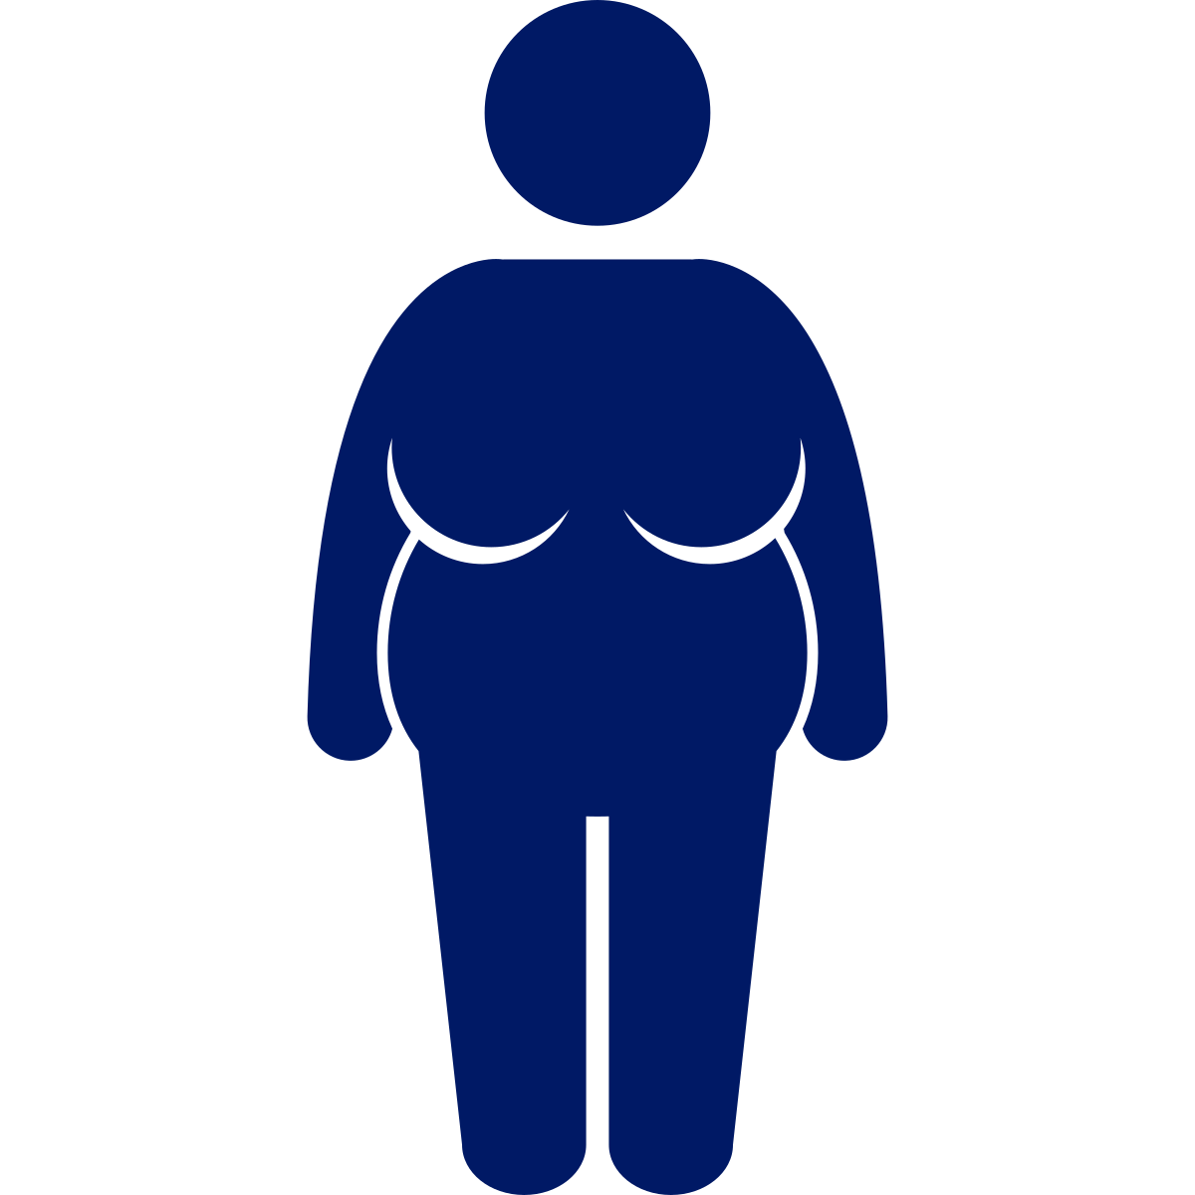
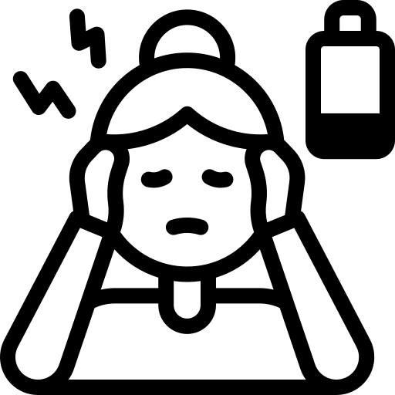
At menopause, cardiometabolic changes occur that increase CVD risk
Cardiometabolic changes that increase CVD risk^{1,2}
Chronological aging
Ovarian aging
Increased metabolic syndrome risk
Decreased lean
muscle mass
Pericardial fat deposition
Insulin
resistance
Weight
gain
Reduced
energy
expenditure
Hypertension
Increased LDL-C,
Apo-B, TG, TC; decreased HDL-C function
Carotid
atherosclerosis
Increased central
visceral fat
Increased risk of CVD during menopause can be attributed to cardiometabolic changes such as alterations in body fat distribution, disruptions in lipoprotein levels, and endothelial dysfuntion¹
Apo-B, apolipoprotein B; HDL-C, high-density lipoprotein cholesterol; LDL-C, low-density lipoprotein cholesterol; TC, cholesterol; TG, triglycerides.
1. Uddenberg ER et al. Maturitas 2024;185:107974; 2. Hurtado MD et al. Curr Obes Rep 2024;13:352–363.

Slide 31
Osteoarthritis, menopause, and overweight/obesity
Higher prevalence of OA, especially knee OA, among women vs men¹
Hormonal¹
Evidence to support association between estrogen decline in menopause and OA is inconclusive¹
Radiographic knee OA | Men | Women
60‒69 years | 27.4% | 35.2%
70‒79 years | 33.5% | 44.6%
≥80 years | 40.7% | 55.6%
Increased weight²
Increased weight is an established
OA risk factor
Women tend to gain weight in midlife
Mean BMI over 11 years was shown to contribute to increased prevalence of knee but not hand OA in midlife women
Potential
reasons
The incidence of OA rises more steeply in
women than in men above the age of 50 years¹
Precise reasons why women are more susceptible to OA are unclear¹
BMI body mass index; OA, osteoarthritis.
1. Stevens-Lapsley JE, Kohrt WM. Womens Health (Lond) 2010;6:601–615; 2. Szoeke CEI, et al. Bone 2006;39:1149–1155.

Slide 32
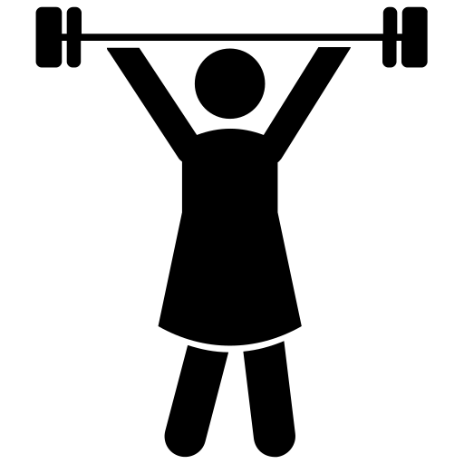
Considerations for weight management
Weight management in midlife women should be the same
as for the general population¹
Healthy eating diets
Mediterranean, Paleo, or high-protein diets have show to be effective lifestyle interventions
Specific exercise regimens
to reduce visceral adiposity and prevent lean mass loss
CBT
to reduce weight, improve
restrained eating and QOL
AOMs/surgery
when metabolic/behavioral adaptations in response to caloric restriction hinder weight loss or result in weight regain
Midlife women may benefit from^{1,2}
AOM, anti-obesity medication; CBT, cognitive behavioral therapy; QOL, quality of life.
1. Hurtado MD et al. Curr Obes Rep 2024;13:352–363; 2. Ayesh H et al. Circ Res 2025;136:594–605.

Slide 33
Obesity-related complications and comorbidities in older age

Slide 34
Sarcopenic obesity (SO) among older adults
SO – a functional and clinical condition¹
Excess fat (obesity)
Low muscle mass
(sarcopenia)
Weight loss in older adults may lead to SO in the presence of functional decline as measured by altered skeletal muscle functional parameters that consider strength (e.g., handgrip strength,
chair stand test)
Global prevalence of 11% in older adults²
Associated with increased risk of^{1,3}
Frailty
Physical disability
Mortality
Cardiometabolic dysfunction
SO, sarcopenic obesity.
1. Donini LM et al. Obes Facts 2022;15:321–335; 2. Gao Q et al. Clin Nutr 2021;40:4633–4641; 3. Colleluori G, Villareal DT. Exp Gerontol 2021;155.

Slide 35
ESPEN/EASO diagnostic criteria for sarcopenic obesity^{1,2}
Screening
A. High BMI or waist circumference (based on ethnic cut-offs) B. Surrogate parameters for sarcopenia (clinical symptoms, clinical suspicion, or questionnaires) A + B to be present to proceed with diagnosis
Diagnosis
C. Altered skeletal muscle functional parameters considering strength (e.g., handgrip strength, chair stand test – if yes, go to D) D. Altered body composition:  fat mass and  muscle mass by ALM/W DXA or as SMM/W by BIA C + D to be present to assess the presence of SO
Due to a lack of universally recognized diagnostic criteria for SO, ESPEN and EASO proposed a diagnostic algorithm to be implemented in clinical practice and research
ALM/W, appendicular lean mass adjusted to body weight; BIA, bioelectrical impedance analysis; BMI, body mass index; DXA, dual X-ray absorptiometry; EASO, European Association for the Study of Obesity; ESPEN, European Society for Clinical Nutrition and Metabolism; SMM/W, total skeletal muscle mass adjusted by weight; SO, sarcopenic obesity.
1. Donini LM et al. Obes Facts 2022;15:321–335; 2. Donini LM et al. Clin Nutr 2022;41:990–1000.

Slide 36
Key takeaways
1
Prevalence of obesity in men and woman peaks in middle age; reasons includes hormonal, metabolic, and body composition changes
2
Adults have an increased risk of obesity,
type 2 diabetes, CVD, and cancer due to childhood/adolescent obesity
3
Obesity impacts fertility in men and women and pregnant women with obesity are at risk of gestational diabetes, preeclampsia, and birthing complications
4
Menopause transition is a time when women are particularly susceptible to weight gain and central adiposity, which can accelerate
CVD risk
5
Sarcopenic obesity is a condition to be especially aware of in older individuals, and is associated with frailty
CVD, cardiovascular disease.

Slide 37
Assessments
1
Alex is a 32-year-old male who has a BMI of 32. Screening has suggested that his BMI is in the obesity class 1 category. What are the next steps for assessment that you would you recommend for Alex?
Advise lifestyle changes, including resistance training and a healthy eating plan
Prescribe an anti-obesity medication
Assess suitability for a referral for bariatric surgery
Confirm the presence of obesity by obtaining a waist-to-height ratio
2
Why do women typically accumulate more adipose tissue around the thighs and hips, whereas men are more prone to fat accumulation around the abdomen?
  Women have a higher basal metabolic rate, leading to peripheral fat deposition
  Estrogen promotes gluteofemoral fat storage, whereas testosterone favors visceral fat accumulation
  Men consume more dietary fat, leading to central adiposity
  Fat distribution is primarily determined by dietary choices rather than hormonal factors
3
Which of the following best explains the increased cardiovascular risk observed in postmenopausal women? Select all that apply
  Progesterone increases LDL levels and blood pressure after menopause
  Estrogen directly increases arterial stiffness and promotes thrombosis after menopause
  Loss of estrogen leads to unfavorable lipid profiles, increased visceral fat accumulation, and endothelial dysfunction
  Menopause and aging is associated with hyperinsulinemia, which increases cardiovascular risk
Notes:
Answer key:
d (slides 6 and 7; BMI is a screening tool and not a diagnostic)
b (slide 9; Sex hormones play a key role in determining fat distribution in men and women)
c and d (slide 31; Increased risk of CVD during menopause can be attributed to cardiometabolic changes such as alterations in body fat distribution, disruptions in lipoprotein levels, endothelial dysfunction, and insulin resistance as part of aging)

