Slide 1
Pathophysiology of Obesity:
Appetite Dysregulation, and
Metabolic and Hormonal Adaptation
Module 2

Slide 2
Thank you for using the FORWARD: Focus on Obesity Education curriculum.
Welcome to the FORWARD: Focus on Obesity Education curriculum. FORWARD was funded by Novo Nordisk Inc. A third-party provider developed the curriculum’s content in consultation with Novo Nordisk Inc. and leading obesity clinician experts.
FORWARD relies exclusively on open-source materials available to the general public.
The goal of FORWARD is to present a complete, accurate, non-promotional and fair-balanced picture of the current state of obesity. FORWARD is intended to inspire the development of obesity education in clinical professional schools, ensuring adequate training of future healthcare providers on the diagnosis and management of obesity. By choosing to access and browse this module of FORWARD, you acknowledge that you have read, understand and agreed to the FORWARD Terms of Use. If you do not agree with the FORWARD Terms of Use, you are not permitted to further access this module and should immediately discontinue your use.
Double click to view:
Content current as of November 2025
Content current as of January 2025

Slide 3


Learning outcomes
After completing this module,
the learner will be able to:
  Demonstrate a working knowledge of the normal biology of weight regulation, obesity including adipocyte physiology, energy homeostasis, and body weight/appetite regulation mechanisms
  Demonstrate knowledge of how weight regulation is asymmetric, being more effective in response to weight loss than to weight gain
  Demonstrate a working knowledge of metabolic adaptation in response to caloric restriction and subsequent weight loss
Estimated time to complete: 25 min

Slide 4



Body weight regulation
Historic perception: Simple as calories in calories out^{1–3}
Physical activity
(30%)
Energy
intake
Energy
expenditure*
Thermic effect of food
(10%)
↑ Body weight
↓ Body weight
Resting metabolic rate
(60%)
*Resting energy expenditure varies based on lean muscle mass, which is influenced by genetics, epigenetics, and the environment.
1. Badman MK, Flier JS. Science 2005;307:1909–1914; 2. National Institutes of Health (NIH): National Heart Lung and Blood Institute (NHLBI). Overweight and obesity: Causes. https://www.nhlbi.nih.gov/health-topics/overweight-and-obesity. Accessed November 2025; 3. Calcagno M et al. J Am Coll Nutr 2019;38:547–551.

Slide 5
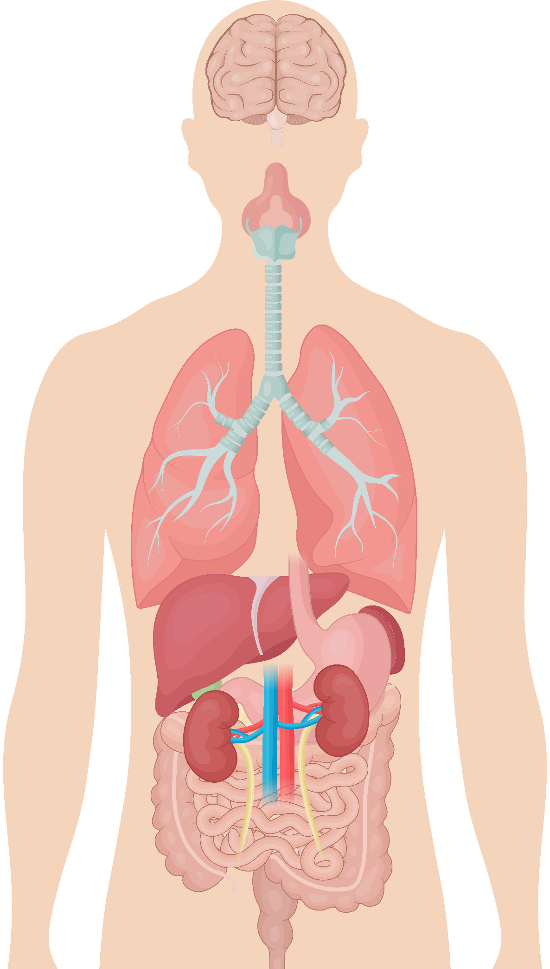
Body weight regulation
Holistic view: Appetite regulation via the gut‒brain axis^{1–6}
Short-term regulation:
influences quantity of food intake
Long-term regulation:
maintains constant nutrient stores
Hunger
or satiety
Gut–brain axis
Signal pathways:
Hormonal
Orexigenic†
Anorexigenic‡
Neuronal – vagus
Obesity may result from a dysregulated system secondary to various physiological, genetic,* and environmental factors
Liver
Pancreas
GI tract
Adipose tissue
*Twin, family, and adoption studies have estimated the heritability of obesity to be between 40% and 70%. Monogenic mutations in LEP, LEPR, POMC, and Mc4R can cause early onset obesity;
†Orexigenic: Appetite stimulant; ‡Anorexigenic: Appetite suppressant.
GI, gastrointestinal; LEP, leptin; LEPR, leptin receptor; POMC, pro-opiomelanocortin; MC4R, melanocortin-4 receptor.
1. Badman MK, Flier JS. Science 2005;307:1909–1914; 2. Campfield LA, Smith FJ. Baillieres Best Pract Res Clin Endocrinol Metab 1999;13;13–30; 3. Chaudhri OB et al. Diabetes Care 2008;31(suppl 2):S284–S289; 4. Farius MM et al. Metab Syndr Relat Disord 2011;9:85–89; 5. Rogge MM, Gautam B. J Am Assoc Nurse Pract 2017;29:S15–S29; 6. Woods SC, Seeley RJ. Int J Obes Relat Metab Disord 2002;26:S8–S10.

Slide 6
Appetite-regulating hormones
Appetite-regulating hormones secreted from peripheral organs and tissues
are responsible for initiation and termination of eating^{1‒6}
Stomach secretes
Intestines secrete
Pancreas secretes
Adipose tissue secretes
Ghrelin
Cholecystokinin (CCK)
Glucagon-like peptide or (GLP-1)
Peptide YY or (PYY)
Oxyntomodulin or (OXM)
Amylin
Insulin
Pancreatic polypeptide (PP)
Glucagon
Leptin
Adiponectin
Orexigenic
Increases appetite
Anorexigenic
Decreases appetite
Appetite-regulating hormones regulate energy balance in response to fasting,
meal intake, and the need to regulate energy stores^{1–6}
1. Badman MK, Flier JS. Science 2005;307:1909–1914; 2. Rogge MM, Gautam B. J Am Assoc Nurse Pract 2017;29:S15–S29; 3. Secher A et al. J Clin Invest 2014;124:4473–4488; 4. Seo S et al. Endocr J 2008;55:867–874;
5. Suzuki K et al. Exp Diabetes Res 2012;2012:824305; 6. Woods SC, Seeley RJ. Int J Obes Relat Metab Disord 2002;26:S8–S10.

Slide 7
Role of the brain in appetite regulation
Select an item
to learn more
Homeostatic eating
‘eating for hunger’
Hedonic eating
‘eating for pleasure’
Executive function
‘deciding to eat’

Slide 8
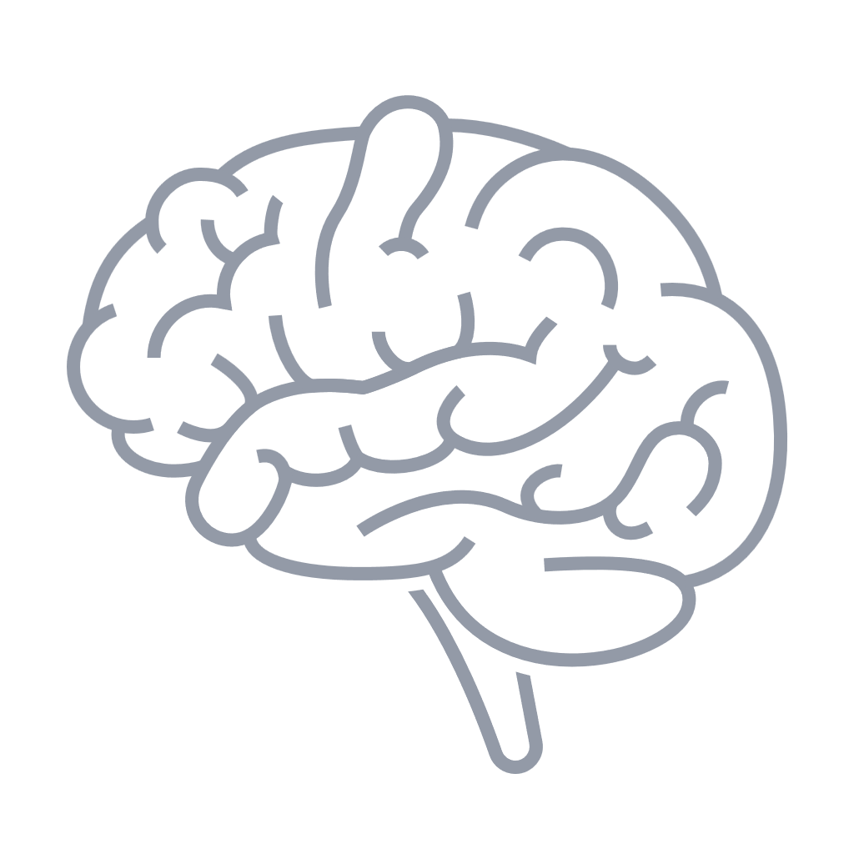
Role of the brain in appetite regulation
Select an item
to learn more
CCK, GIP, GLP-1, PYY,
OXM, PP, amylin, insulin
increase satiety
Though signals originate in the GI tract, it is the handling of these signals in the hypothalamus and hindbrain that affects appetite regulation
Homeostatic eating
‘eating for hunger’
Hedonic eating
‘eating for pleasure’
Ghrelin
increases hunger
Executive function
‘deciding to eat’
CCK, cholecystokinin; GI, gastrointestinal; GIP, gastric inhibitory polypeptide; GLP-1, glucagon-like peptide-1; OXM, oxyntomodulin; PP, pancreatic polypeptide; PYY, peptide YY.
Jastreboff AM, Kushner RF. Annu Rev Med 2023;74:125–139.

Slide 9

Role of the brain in appetite regulation
Select an item
to learn more
Homeostatic eating
‘eating for hunger’
Hedonic eating
‘eating for pleasure’
Executive function
‘deciding to eat’
Dopamine and opioid and cannabinoid receptors control the motivation/drive to eat and the pleasure associated with food
Berridge KC et al. Brain Res 2010;1350:43–64.

Slide 10

Role of the brain in appetite regulation
Thoughts
Select an item
to learn more
Feelings
Behavior
Homeostatic eating
‘eating for hunger’
Hedonic eating
‘eating for pleasure’
Executive function is where
lifestyle counseling resides
Executive function
‘deciding to eat’
Examples:
Knowing your daily caloric target
Counting your calories
Delaying eating for future gain
Conscious control of eliminating mindless eating when not hungry
Vallis M. Clin Obes 2019;9:e12299.

Slide 11


Hormonal appetite signaling^{1–5}
Click to play video
AgRP, agouti-related peptide; CART, cocaine- and amphetamine-stimulated transcript peptide; CNS, central nervous system; GLP-1, glucagon-like peptide-1; NPY, neuropeptide Y; OXM, oxyntomodulin; PP, pancreatic polypeptide;
POMC, pro-opiomelanocortin; PYY, peptide YY.
1. Badman MK, Flier JS. Science 2005;307:1909–1914; 2. Li S et al. Nutrients 2023;15:3728; 3. Rogge MM, Gautam B. J Am Assoc Nurse Pract 2017;29:S15–S29; 4. Suzuki K et al. Exp Diabetes Res 2012;2012:824305; 5. Roh E, Choi KM. Int J Mol Sci 2023;24(4):3384.
Notes:
Voice over:
The hypothalamic arcuate nucleus contains the appetite regulating NPY/AgRP and POMC/CART neurons
NPY/AgRP and POMC/CART neurons integrate peripheral hormonal signals and send hunger or satiety signals via neural projections to other nuclei within the central nervous system
The orexigenic hormone, ghrelin, activates the NPY/AgRP hunger pathway
The enhanced activity of the NPY/AgRP neurons inhibit POMC/CART neurons, reducing their appetite-suppressing effects​
Anorexigenic hormones such as leptin and amylin activate the POMC/CART satiety pathway
Anorexigenic hormones inhibit the activity of NPY/AgRP neurons reducing their appetite-stimulating effects
NPY/AgRP and POMC/CART neurons integrate hormonal signals to regulate appetite

Slide 12

Neuronal appetite signaling^{1–5}
Click to play video
CCK, cholecystokinin; GLP-1, glucagon-like peptide-1.
1. Badman MK, Flier JS. Science 2005;307:1909–1914; 2. Sun X et al. Front. Nutr 2025;12:1484827; 3. Farhadipour M, Depoortere I. Nutrients 2021;13:1839; 4. Li S et al. Nutrients 2023;15:3728; 5. Azemi AK et al. Obesity Medicine 2025;54:100588.
Notes:
Voice over:
Vagal afferent nerve terminals in the intestine and stomach express mechanoreceptors and receptors for appetite-stimulating and appetite-suppressing hormones
Following activation of receptors either by distension or appetite hormones, vagal afferent nerve fibers send signals to the vagus nerve
The vagus nerve transmits the signals to the nucleus of the solitary tract
The nucleus of the solitary tract and area postrema in the brainstem process the mechanical and hormonal signals from the gastrointestinal tract to regulate energy intake and expenditure, and appetite

Slide 13

Summary of appetite signaling
Body weight is regulated by hormonal and neuronal signals along the
gut–brain axis
Hormonal signaling from the periphery to the brain is integrated in the arcuate nucleus of the hypothalamus
In the hypothalamus, orexigenic (hunger) signaling is driven by upregulation of NPY and AgRP neurons and anorexigenic (fullness) signaling is driven by stimulation of POMC and CART neurons
Neural and hormonal inputs from the stomach and intestine are transmitted via the vagal afferent pathway to the nucleus of the solitary tract or area postrema
Integration of hormonal and neuronal systems regulate appetite, energy expenditure, and feeding behaviors
Eat or
exercise?
AgRP, agouti-related protein; CART, cocaine- and amphetamine-regulated transcript; NPY, neuropeptide Y; POMC, pro-opiomelanocortin.

Slide 14
Dysregulation of hunger and satiety mechanisms can contribute to overeating and obesity development
Examples of altered hormonal signaling in obesity
Leptin resistance
Reduced sensitivity in the brain leading to impaired ability to
induce satiety
Ghrelin
Alterations in secretion or clearance, or reduced sensitivity of CNS to ghrelin’s effects, leading to persistent hunger and inability to achieve satiety
Insulin resistance
Reduced sensitivity in the liver, muscle, and adipose tissues and brain diminishes ability to suppress hunger and regulate energy balance
CNS, central nervous system.
Azemi AK et al. Obesity Medicine 2025;54:100588.

Slide 15

Dysregulation of appetite and energy homeostasis and cytokine induced inflammation^{1–4}
Click to play video
CCL, chemokine (C-C motif) ligand; CKD, chronic kidney disease; CVD, cardiovascular disease; CXCL5, chemokine (C-X-C motif) ligand 5; HDL-C, high-density lipoprotein cholesterol; IL, interleukin; MASH, metabolic dysfunction–associated steatohepatitis; T2D, type 2 diabetes; TNFα, tumor necrosis factor alpha; VLDL-C, very low-density lipoprotein cholesterol.
1. Yao L et al. J Immunol Res 2014;2014:181450; 2. Sandireddy R et al. Front Cell Dev Biol 2024;12:1433857; 3. Fahed G et al. Int J Mol Sci 2022;23:786; 4. Wang M et al. Int J Mol Sci 2022;23:747.
Notes:
Voice over:
Prolonged over consumption of calorie-dense food causes an imbalance between calorie intake and energy expenditure, increasing lipid storage into adipocytes
Increased lipid storage causes adipocytes to become hypertrophic and produce proinflammatory cytokines and chemokines
The cytokines and chemokines trigger proinflammatory immune cells in the adipose tissue causing low-grade chronic adipose tissue inflammation
Prolonged low grade adipose tissue inflammation progresses to systemic inflammation that has widespread implications
Systemic inflammation affects the vasculature increasing the permeability of endothelium and triggering plaque development and cardiovascular disease
Systemic inflammation in the liver causes insulin resistance resulting in altered cholesterol and glucose metabolism which can lead to cardiovascular disease, metabolic dysfunction–associated steatohepatitis, and type 2 diabetes
Insulin resistance in the skeletal muscle impairs glucose disposal which contributes to type 2 diabetes
Systemic inflammation in the pancreas, decreases insulin secretion leading to hyperglycemia, which is a hallmark of diabetes
In the kidney, inflammation and insulin resistance contributes to renal injury and chronic kidney disease
Obesity and low-grade chronic inflammation contribute to development of cardiovascular disease, metabolic dysfunction–associated steatohepatitis, type 2 diabetes, and chronic kidney disease

Slide 16


Physiological responses to caloric restriction and weight loss favor weight recurrence^{1,2}
Following weight loss, changes in levels of appetite-regulating
hormones promote weight regain
Insulin
Leptin
PYY
CCK
GLP-1
Obesity protects obesity*
Upon weight loss, the body triggers increased energy intake and weight gain through modulation of satiety hormones and slowing of metabolism, which drive weight recurrence
Decreased satiety
Increased hunger
Ghrelin
*Anti-obesity medications can aid in achieving and maintaining weight loss while the suppressive effects of the molecule are engaged; however, when these medications are discontinued, set-point mechanisms remain active, leading to weight gain that may surpass the initial weight.
CCK, cholecystokinin; GLP-1, glucagon-like peptide-1; PYY, peptide YY.
1. Fothergil E et al. Obesity (Silver Spring) 2016;24:1612–19; 2. Sumithran et al. N Engl J Med 2011;365:1597–1604.

Slide 17

Weight recurrence after diet-based weight loss intervention
After 10 weeks, individuals who lost ≥10%
of their initial body weight:
50 individuals with overweight/obesity lost weight on a 10-week very-low-energy diet, followed by gradual recurrence over the next year⁵
Were gradually reintroduced to ordinary foods
All patients (ITT)
95
Received counseling and written advice from a dietitian on dietary intake with the goal of weight maintenance
90
Weight (kg)
Were advised to consume carbohydrates with a low
glycemic index and reduce fat intake
85
80
Were encouraged to engage in 30 minutes of moderately intense physical activity on most days of the week
0
0
10
18
26
36
44
52
62
Week
Received continued dietary counseling via telephone
ITT, intention-to-treat.
Sumithran P et al. N Engl J Med 2011;365:1597–1604.

Slide 18
Postprandial hormonal changes to diet-based weight loss
*
Week 0
Week 10
Week 62
*
*
Plasma concentration (pg/mL)
*
Plasma concentration (fmol/mL)
*
One year after initial weight reduction, levels of the circulating mediators of appetite that encourage weight recurrence after diet-induced weight loss do not revert to the levels recorded before weight loss
The high rate of relapse among people with obesity who have lost weight has a strong physiological basis
and is not simply the result of voluntary resumption of old habits
*P<0.05 vs baseline on a very-low-energy diet.
CCK, cholecystokinin; GLP-1, glucagon-like peptide-1; PYY, peptide YY.
Sumithran P et al. N Engl J Med 2011;365:1597–1604.

Slide 19


Effect of metabolic adaptation on weight management interventions
Needs of obesity practice
Maintaining weight loss after following a specific regimen such as calorie restriction, exercise, drug treatment, or surgical intervention always requires a careful assessment at the individual level
This should be followed by meticulous customization of weight management regimens to achieve a potent, sustained, and healthy body weight
The final goal is to prevent weight recurrence by maintaining minimum cellular stress and accumulation of adipose tissue, which requires controlling a set of metabolic indices different from those targeted during initial weight loss
Needs of obesity management
Scheduled biometric monitoring of fat and lean body mass along the weight loss period and periodically during maintenance phase
Farhana A, Rehman A. StatPearls [Internet] 2023. PMID: 34283511.

Slide 20
Key takeaways
1
Obesity is a chronic disease that occurs as a result of energy dysregulation causing excess caloric input and adiposity
2
Long-term energy balance is centrally regulated by peripheral input on energy stores and nutritional state via neural and endocrine pathways
3
The body demonstrates a variety of adaptations to weight loss that promote weight recurrence after a caloric deficit

Slide 21

Assessments
1
John is a 55-year-old man from Montgomery, AL and is home for the holidays. He has just finished eating a large Thanksgiving meal and no longer feels hungry. Which hormone secreted by the intestines contributes to his feeling of satiation with food?
Amylin
Leptin
Glucagon-like peptide-1
Ghrelin
2
John also has obesity and suffers from type 2 diabetes and cardiovascular disease. In both diseases, obesity-related systemic inflammation leads to which of the following increased effects in the liver?
Glucose uptake
Glucose production
Insulin secretion
Triglyceride uptake
3
Patrick is a 48-year-old man with a body mass index (BMI) of 36 kg/m². He has recently made some lifestyle-based changes, which include caloric restriction and increased exercise. However, he finds it challenging to lose the weight and keep it off. Regardless of the intervention, what metabolic adaptation following weight loss makes it difficult for John to maintain the weight loss?
Decreased resting metabolic rate
Decreased levels of ghrelin
Increased levels of amylin
Decreased fat mass
Notes:
Answer key:
c (slide 9); GLP-1 is an anorexigenic or appetite-reducing hormone secreted by the intestines
b (slide 15); for both T2D and CVD, systemic inflammation leads to increased glucose production in the liver
a (slides 16 and 17); decreased resting metabolic rate makes it difficult to maintain weight loss

