Slide 1
Pathophysiology of Obesity:
Genetic, Environmental, and Social Causes
Module 3

Slide 2
Thank you for using the FORWARD: Focus on Obesity Education curriculum.
Welcome to the FORWARD: Focus on Obesity Education curriculum. FORWARD was funded by Novo Nordisk Inc. A third-party provider developed the curriculum’s content in consultation with Novo Nordisk Inc. and leading obesity clinician experts.
FORWARD relies exclusively on open-source materials available to the general public.
The goal of FORWARD is to present a complete, accurate, non-promotional and fair-balanced picture of the current state of obesity. FORWARD is intended to inspire the development of obesity education in clinical professional schools, ensuring adequate training of future healthcare providers on the diagnosis and management of obesity. By choosing to access and browse this module of FORWARD, you acknowledge that you have read, understand and agreed to the FORWARD Terms of Use. If you do not agree with the FORWARD Terms of Use, you are not permitted to further access this module and should immediately discontinue your use.
Double click to view:
Content current as of November 2025
Content current as of January 2025

Slide 3


Learning outcomes
After completing this module,
the learner will be able to:
Describe the role of genetics in the
development of obesity
Understand polygenic obesity is the most
common form of obesity
Recognize the phenotypic patterns associated with monogenic and polygenic mutations resulting in obesity
Identify environmental and social factors that
interact with genes and contribute to the development of obesity
Estimated time to complete: 15 min

Slide 4

Obesity is a chronic, heterogenous disease of excess adiposity impairing health
Clinical obesity: excess adiposity causing negative health outcomes that can be objectively documented by specific signs and symptoms¹
Classification | BMI (kg/m²)
 | International classification^{4,5} | Asian population⁶
Underweight | <18.5
Healthy weight | ≥18.5 and <25 | ≥18 and <23
Overweight* | ≥25 and <30 | ≥23 and <25
Obesity | ≥30 | >25
Obesity class 1 | ≥30 and <35
Obesity class 2 | ≥35 and <40
Obesity class 3 | ≥40
Body mass index (BMI) is correlated to
fat mass in the general population^{2,3}
BMI loses predictability when applied
at the individual level²
BMI
weight (kg)
=
height (m²)
A report by the AMA outlines the harms of using BMI as it does not account for differences
across race/ethnic groups, sexes, genders, and age⁷
*The Lancet Commission has recommended the term pre-obesity to replace overweight. This has not been adopted into professional society guidelines as of this update.
AMA, American Medical Association; BMI, body mass index; HCP, healthcare professional.
1. Rubino F et al. Lancet Diabetes Endocrinol 2023;11:226–228; 2. American Medical Association (AMA). https://www.ama-assn.org/delivering-care/public-health/ama-use-bmi-alone-imperfect-clinical-measure. Accessed November 2025;
3. Endocrine Society. https://www.endocrine.org/-/media/endocrine/files/obesity/obesity-playbook-final_use.pdf. Accessed November 2025; 4. Bhaskaran K et al. Lancet Diabetes Endocrinol 2018;6:944–953; 5. Centers for Disease Control and Prevention (CDC). https://www.cdc.gov/bmi/adult-calculator/bmi-categories.html?CDC_AAref_Val=https://www.cdc.gov/obesity/basics/adult-defining.html. Accessed November 2025; 6. Misra A et al. J Assoc Physicians India 2009;57:163–170;
7. AMA. https://www.ama-assn.org/press-center/ama-press-releases/ama-adopts-new-policy-clarifying-role-bmi-measure-medicine. Accessed November 2025.

Slide 5




The disease of obesity:
Why do we eat more when we have adequate energy stores, leading to excess adiposity?
Energy dysregulation
Excess caloric intake
Excess adiposity
Elevated BMI
Biological signals affecting energy balance:
Other factors affecting energy balance:
Adipose
tissue
Stomach and intestines
Pancreas
Medications
Hedonic
input
Genetics
Environment
Energy expenditure
Energy intake
Basal metabolism
Physical activity
Thermic effect of food
Behavior
Food availability
Hunger and satiety
Hormonal and neuronal appetite signaling
Obesity results from inappropriate energy intake cues (hormones and signals)
driven by genetic predisposition to an obesogenic environment
BMI, body mass index.
Spiegelman BM et al. Cell 2001;104:531–543.
Notes:
SUGGESTED SPEAKER NOTES
Adipose tissue: Leptin produced mostly by white adipocytes, secretion is positively correlated with lipid content and signals to the hypothalamus to reduce appetite
Stomach and intestines: GLP-1, peptide YY, oxyntomodulin, for example, mediate satiety
Pancreas: Pancreatic polypeptide and amylin, for example, mediate satiety
Medications: Some medications (e.g., corticosteroids) cause unwanted weight gain in addition to its intended therapeutic effect(s)
Hedonic input refers to eating based on pleasure, and is mainly under mesolimbic control, mediated by feelings of wanting or liking to eat
Genetics: Approximately 70–80% of weight variation is attributed to genetic factors. Human obesity genotypes result from complex networks of gene–gene and gene–environment interactions with a growing number of obesity-related or obesity-causing genes
Environment: Obesogenic environments are not enough to explain obesity, but early (i.e., prenatal) / general exposure to adverse environments can cause vascular, metabolic, and neuroendocrine adaptations that predispose a person to late-onset diseases, i.e., obesity

Slide 6


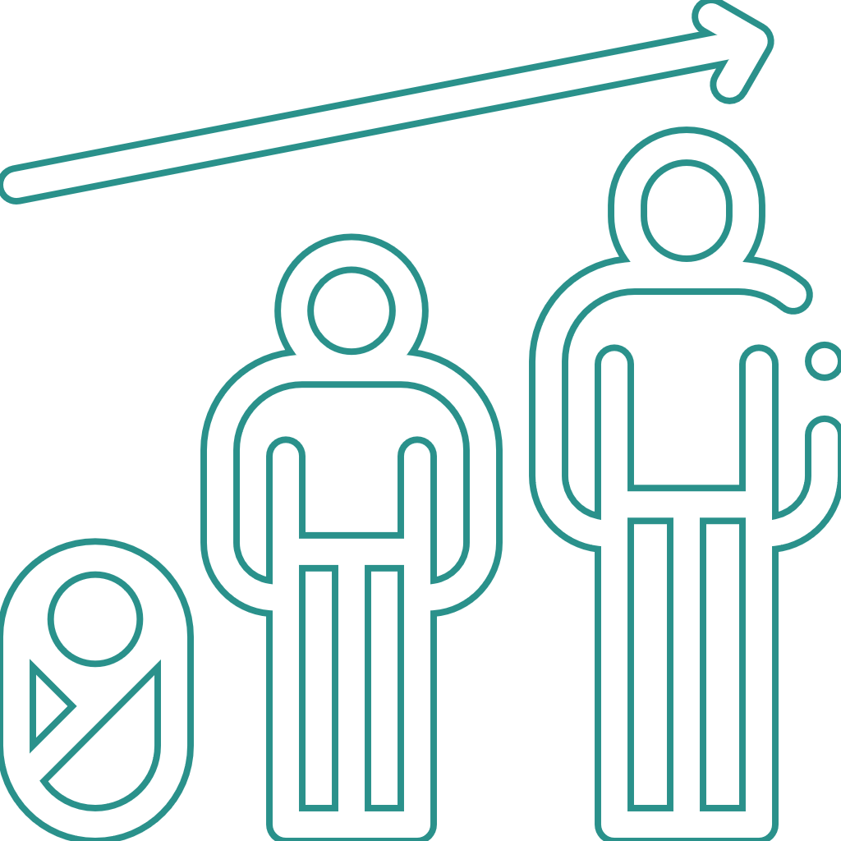

Obesity: A multifactorial disorder
Genetics
Environment
Development
Behavior
Hruby A et al. Pharmacoeconomics 2015;33:673–689.
Notes:
SUGGESTED SPEAKER NOTES
One’s unique “genetics” interacts with the “assumed” obesogenic environment (discussed later in this module), which subsequently influences one’s development. The developmental impact on one’s eating behaviors may include resistance to signals of satiety

Slide 7


Individual weight gain or weight loss
Why do some people gain weight easily and others seem to never gain weight?
How can these differences be explained?
I eat a lot of food, but don’t gain
weight
When I eat this, I gain 3 pounds!
Behavioral factors
Hormonal factors
Sleep patterns
Eating habits
Genetics
Yáñez M et al. Austin J Nutr Metab 2017;4:1052.

Slide 8
Genetic predisposition to obesity
Genetic factors contribute to people’s differences in body weight and influence how individuals respond to weight promoting environments
This causes some to store energy
as fat while others do not
Twin, family, and adoption studies have estimated the heritability of obesity
to be between 40% and 70%
Loos RJF, Yeo GSH. Nat Rev Genet 2022;23:120–133.

Slide 9

Individual differences in regional body fat distribution*
Subcutaneous adipose tissue (SAT)¹
Fat present beneath the skin
Visceral adipose tissue (VAT)¹
Fat present around abdominal viscera and internal organs
Factors contributing to differences in regional body fat distribution²
Estrogens
Drive fat accumulation in the SAT depot rather than in the abdominal VAT depot, implicating estrogens as determinants of body fat distribution
Testosterone
Decreases in testosterone are associated with increased abdominal VAT accumulation, and restoration of physiological levels of testosterone was shown to decrease abdominal VAT
Aging
There is a shift from primarily SAT to VAT fat accumulation, which is linked to increased risk for obesity and T2DM in older individuals
Genetic variants
Evidence shows a link between fat distribution and obesity and: SNPs, sex chromosomes, and epigenetic effects
*Regional body fat distribution describes the way fat accumulates in the body, which looks different depending on patient demographic.
SAT, subcutaneous adipose tissue; SNP, single-nucleotide polymorphism; T2DM, type 2 diabetes mellitus; VAT, visceral adipose tissue.
1. Ibrahim MM. Obes Rev 2010;11:11–18; 2. Frank AP et al. J Lipid Res 2018;60:1710–1719.

Slide 10

Spillover effect of free fatty acids
Excess dietary fat impacts plasma FFA concentrations as a result of the
“spillover” effect, in which diet-derived fatty acids
add to the circulating FFA in the plasma¹
FFA produced by lipolysis in VAT insulin-resistant adipocytes are drained via the portal vein into the liver, contributing to the hepatic deposit of fatty acids³
Genetic susceptibility to dysfunctional SAT is associated with increased cardiometabolic risk via the FFA spillover effect
Increased FFA
availability
plays a role in:²
1. Ectopic fat accumulation
2. Insulin resistance
3. Hypertension
4. Dyslipidemia
FFA, free fatty acid; SAT, subcutaneous adipose tissue; VAT, visceral adipose tissue.
1. Puga GM et al. J Nutr 2012;142:1806–1811; 2. Almandoz JP et al. Diabetes 2013;62:1897–1903; 3. Santillana N et al. Nutrients 2023;15:1722.

Slide 11
Interaction of environment and genetic variability in multifactorial diseases
Interaction of environmental and genetic variance in complex multifactorial polygenic diseases*
Genetically predisposed
Unlike the genetically resistant population, individuals genetically predisposed to obesity will likely manifest the disease phenotype in healthy and obesogenic environments
Disease phenotype (i.e., BMI)
Genetically resistant
Healthy environment
Obesogenic environment
*A schematic diagram.
BMI, body mass index.
Mark AL. Hypertension 2008;51:1426–1434.

Slide 12
Significant genetic contribution to the development of obesity-related traits
Genome-wide association studies (GWAS)* have identified multiple gene loci associated with obesity.
Many of these genes have variants that are associated with monogenic (rare; e.g., melanocortin 4 receptor gene) and polygenic (common) obesity.
Obesity is the result of complex interactions among many genes and environmental factors.^{1–3}
Many act via the
central nervous system¹
Translation of these genes express tendencies in the CNS toward obesity†
The body's own counter-regulatory mechanisms make it difficult to maintain or lose weight²
Individual choices
Healthy/restrictive diet
Regular exercise²
Obesity-related gene loci¹
Combined with modern obesogenic environment^{2,3}
Obesity or hibernation genes that promote fat deposition in preparation for famine²
*GWAS is an approach used in genetics research to associate specific genetic mutations with particular diseases.
†Example, genes governing satiety (e.g., LEP) may be dysregulated leading to positive energy balance, increased adiposity, and increased BMI.
CNS, central nervous system; GWAS, genome-wide association study; MC4R, melanocortin 4 receptor gene.
1. Speliotes EK et al. Nat Genet 2010;42:937–948; 2. O’Rourke RW et al. Ann Surg 2014;259:642–648; 3. Link JC, Reue K. Annu Rev Nutr 2017;37:225–245.

Slide 13
Monogenic vs polygenic obesity
Monogenic
Early-onset, severe obesity; rare
Polygenic
Common obesity
Considerable genetic influence
Modest genetic influence
Variation in a single gene
Several variants in many genes
Large genetic effect
Each variant has a minimal effect
Rare
Common
Alleles with high penetrance
Alleles with low penetrance
No environmental influence
Environment is a key factor
Loos RJF, Yeo GSH. Nat Rev Genet 2022;23:120–133.

Slide 14
Monogenic mutations can cause early-onset obesity
(based on GWAS)^{1,2}
Gene* | Prevalence | Associated phenotypes
LEP | Uncommon | Gonadotropic and thyrotropic insufficiency Alteration in immune function
LEPR
POMC |  | ACTH insufficiency leading to hyperinsulinemia and increased insulin resistance Adrenal insufficiency with hypocortisolemia Red hair and pale skin due to lack of α-MSH
MC4R |  | Hyperinsulinemia with euglycemia, higher prevalence of metabolic syndrome, and often binge eating disorder, increased height
*Genes with GWAS-documented links to obesity and obesity syndromes in multiple age and ethnicity groups.
α-MSH, α-melanocyte stimulating hormone; ACTH, adrenocorticotropic hormone; GWAS, genome-wide association study; LEP, leptin; LEPR, leptin receptor; POMC, pro-opiomelanocortin; MC4R, melanocortin-4 receptor.
1. Huvenne H et al. Obes Facts 2016;9:158–173; 2. Baxter J et al. Obes Surg 2019;29:4077–4083.

Slide 15

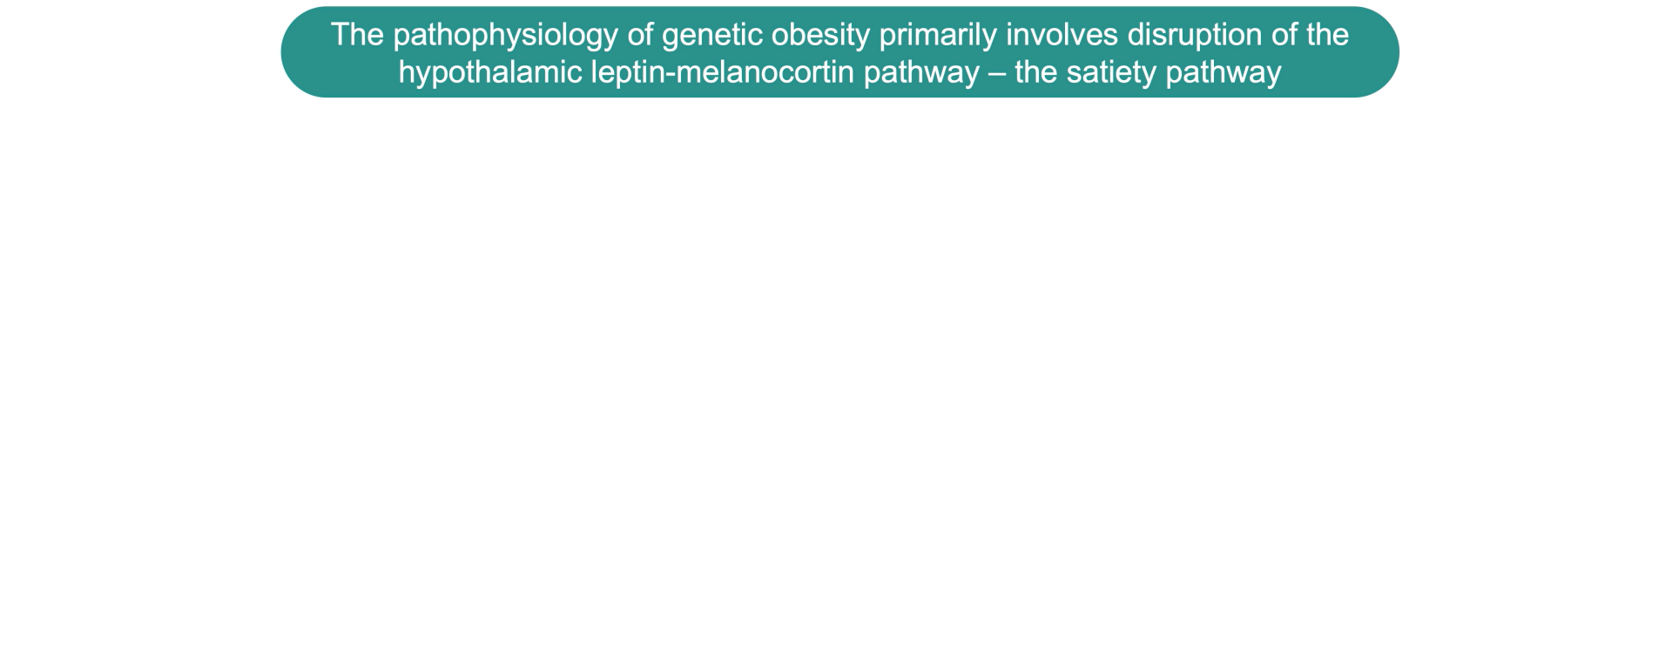
The pathophysiology of genetic obesity^{1,2}
Click to play video
α-MSH, α-melanocyte-stimulating hormone; LR, leptin receptor; MC4R, melanocortin-4 receptors; POMC, pro-opiomelanocortin.
1. Chamarthi VS, Daley SF. StatPearls [Internet] 2025. PMID: 34424641; 2. Huvenne H et al. Obes Facts 2016;9:158–173.
Notes:
Voice over:
The underlying cause of genetic obesity primarily involves disruption of the satiety pathway
Leptin, released from adipocytes, activates the POMC neurons in the hypothalamic arcuate nucleus
The POMC neurons then produce alpha-melanocyte-stimulating hormone
Alpha-melanocyte-stimulating hormone activates its receptors on downstream neurons in the hypothalamic paraventricular nucleus
This results in a signal to decrease food intake and increase energy expenditure
Mutations in genes in the leptin-melanocortin pathway disrupts hormonal neuronal signaling
This results in reduced satiety, persistent feelings of hunger, and decreased energy expenditure, leading to severe obesity

Slide 16

Polygenic obesity = “common obesity”
The heritability of obesity and body weight in general is high^{1,2}
The genetic predisposition to obesity for most individuals, however, has a polygenic basis¹
Polygenic obesity is due to the simultaneous presence of
DNA variations in multiple genes that control body weight¹
Any single variant will have a higher frequency in people
with obesity than in people with normal/lean weight:¹
Many polygenic variants
Body weight, obesity
Increased BMI
Obesity
With more than 100 different alleles identified for obesity, the different genetic
components that contribute to each person's obesity are unlikely to be the same¹
1. Hinney A et al. Eur Child Adolesc Psychiatry 2010;19:297–310; 2. Link JC, Reue K. Annu Rev Nutr 2017;37:225–245.

Slide 17
Genetics may limit the influence of environmental factors on body weight
Concordance of body types is higher in monozygotic than dizygotic twins¹
Monozygotic (identical) twins
Dizygotic (fraternal) twins
Relatively homogeneous body type
between twins
Relatively heterogeneous body type
between twins
The heritability of obesity is estimated to be about 40–70%,
indicating that genetics play a large role in fat accumulation²
1. Börjeson M et al. Acta Paediatr Scand 1976;65:279–287; 2. Loos RJF, Yeo GSH. Nat Rev Genet 2022;23:120–133.

Slide 18

Genetic testing in obesity for rare diseases
Genetic testing should be considered
in certain circumstances
Patients with early-onset severe obesity (before age 5)
With syndromic features such as developmental delays or dysmorphic features
A strong family history of severe obesity
Universal genetic testing for patients with obesity is not routinely recommended
Failure to respond to standard weight management interventions
Chamarthi VS, Daley SF. StatPearls [Internet] 2025. PMID: 34424641.

Slide 19



Epigenetics and obesity
Environmental factors¹
Diet, portion sizes
Physical activity
Aging
Smoking/toxins
Epigenetic factors¹
DNA methylation
Histone modifications
RNA-based mechanisms
Direct effects, interactions & mediation*
Obesity and adiposity-related diseases
Genetic sequence variation¹
Individuals with alternate allele
(e.g., T vs G)
Social factors²
Lack of green space
Lack of safety for outdoor activity
Food deserts
*The factors on the left can have a direct regulatory function or require interactions/mediation by other factors, to cause obesity and related diseases.
DNA, deoxyribonucleic acid; RNA, ribonucleic acid.
1. Fall T et al. Gastroenterology 2017;152:1695–1706; 2. Lovasi GS et al. Prev Med 2013;57:189–193.

Slide 20
Environmental and genetic factors and obesity
Environmental factors
Genetic factors
Person least genetically susceptible to obesogenic environment & can eat whatever they want
Person most genetically susceptible to obesogenic environment & struggles to watch everything they eat
Environmental factors driven by underlying obesity-associated genes
contribute to positive energy balance responsible for weight gain

Slide 21
Influence of biological sex and sex hormones on obesity
Chromosomal (XY) sex:¹
Chromosomal (XX) sex:¹
↑ % lean mass
↑ % fat mass
↑ visceral adipose tissue
↑ subcutaneous* adipose tissue
↑ plasma triglyceride levels
↑ HDL cholesterol
↑ hyperinsulinemia
↑ hyperinsulinemia
↑ cardiometabolic risk
↑ cardiometabolic risk
Gonadal hormones:²
Gonadal hormones:²
Visceral (android) adipose tissue distribution
Gynoid adipose tissue distribution
The health risk of an individual with obesity is determined not only by the total amount of adipose tissue,
but also by its distribution and metabolic activity²
*Subcutaneous deposition of adipose tissue is associated with lower risk of obesity-related complications.
1. Link JC, Reue K. Annu Rev Nutr 2017;37:225–245; 2. Kurylowicz A. Biomedicines 2023;11:690.

Slide 22
Environmental factors contributing to obesity
Abundance and variety of food
Added sugar (fructose):
  An inexpensive way to make food products tastier, which increases sales
  Unfortunate consequence of “low fat” products – less fat, more sugar
Physical features that reduce accessibility to or the need for physical activities:
Passive entertainment
Social media
Convenience services
Urban sprawl
Land-use mix
Food market
Built environment
Obesogenic environment^{1,2}
Excess supply of highly accessible, calorie-dense foods
Increased portion sizes now the norm
High-energy processed foods
Lack of sleep
High stress levels
Learned activity patterns
Food consumption
Psychological attributes
A genetically predisposed person will respond to this environment unfavorably with increased caloric intake
1. Lakerveld J et al. Obes Facts 2017;10:216–222; 2. Meldrum DR et al. Fertil Steril 2017;107:833–839.

Slide 23
Obesity and social determinants of health^{1,2}
There are persistent substantial disparities among certain population groups,
all of which further complicate the efforts to understand, control, and prevent obesity
Low income
Eating behavior
Social & societal stressors
Food insecurity
Obesity risk associated with…
Physical inactivity
Individuals from underrepresented groups
Poor diet
Low education
1. CDC. www.cdc.gov/obesity/index.html. Accessed November 2025; 2. May AL, et al. MMWR Morb Mortal Wkly Rep 2013:62(3 suppl):118–128.

Slide 24

Socioeconomic contributions to obesity prevalence
Childhood experiences
Children raised in social disadvantage have a higher prevalence of obesity
Economic instability has been associated with poor access to nutritious food and low healthy food spending; and poor behavioral patterns such as unhealthy dietary habits
Economically deprived neighborhoods may present limited opportunities for physical activity for children, such as parks/sidewalks
  These and related structural barriers may increase
  the risk of having overweight/obesity
Javed Z et al. Obesity (Silver Spring) 2022;30:491–502.

Slide 25

Psychosocial burden of obesity
Mental health
There is a greater proportion of individuals with obesity who
experience mental illness relative to the general population
Between 20–60% of persons with obesity suffer from a psychiatric illness, such as: depression, eating disorders, anxiety, and substance abuse
Psychological stress may increase the likelihood of obesity through:
  Behavioral mechanisms
  Increased consumption of energy-dense foods
  Biological mechanisms
  Raised cortisol levels due to stress and increased appetite/fat deposition
Sarwer DB, Polonsky HM. Endocr Metab Clin North Am 2016;45:667–688.

Slide 26
Stress and obesity
Cortisol
Activation of the sympathetic nervous system and recruitment of the HPA axis
Change in energy homeostasis
(Causes cravings for sweet and fatty food)
Chronic
stress
Prolonged cortisol release
Increased fat mass
Higher BMI
BMI, body mass index; HPA, hypothalamic–pituitary–adrenal.
Gianotti L et al. Endocrines 2021;2:334–347.

Slide 27
Sleep deprivation and obesity
Sleep restriction
The orexigenic (feeding) system contains neurohormonal signals that initiate an increase in food intake in the brain
Activation of orexigenic system
Alterations in appetite-regulating hormones
Leptin, Ghrelin, GLP-1, Endocannabinoid
Activity in food reward system
Hunger and
food intake
Positive energy balance
Weight
GLP-1, glucagon-like peptide 1.
Reutrakul S, Van Cauter EV. Metabolism 2018;84:56–66.

Slide 28
Key takeaways
1
There are multiple monogenic and polygenic factors that impact the obesity phenotype, impacting one’s behavior, hormones, sleep, and eating habits, and subsequently how fat is stored and distributed in
their body.
2
The obesogenic environment, comprised of the food market, built environment, food consumption, and psychological attributes can all cause increased caloric intake, and can be especially detrimental to someone who is genetically predisposed.
3
Socioeconomic status and mental health influence factors such as sleep and stress, which have been shown to increase the likelihood of obesity; additionally, the combination of social and environmental factors comprise the Social Determinants of Health, which take a holistic view of a patient and their predispositions to obesity.

Slide 29

Assessments
1
Which of the following statement on the role of genetics in obesity is correct?
Monogenic obesity is the more common than polygenic obesity
Polygenic obesity is due to the simultaneous presence of DNA variations in multiple genes that control body weight
Monogenic mutations cause late-onset obesity
Dizygotic twins have relatively homogenous body types
2
Tom is a new father and caring for his new baby has led to chronic sleep deprivation over the last few months. Besides sleep deprivation, what is another factor that could be contributing to Tom’s weight gain?
  Tom lives in a neighborhood with plenty of parks
  Tom is experiencing high stress levels
  Tom is a non-smoker
  Tom seldom drinks alcohol
3
Which of the following social determinants of health increases the risk of developing obesity?
  High income
  Food security
  High education
  Urban sprawl
Notes:
Answer key:
b (slides 9, 13, 14); polygenic obesity is due to the simultaneous presence of DNA variations in multiple genes that control body weight
b (slide 23 and 27); high stress levels can lead to weight gain
d (slides 23 and 24); urban sprawl reduces accessibility to/need for physical activities

