Slide 1
Obesity-Related Complications and the Impact of Weight Loss
Module 6

Slide 2
Thank you for using the FORWARD: Focus on Obesity Education curriculum.
Welcome to the FORWARD: Focus on Obesity Education curriculum. FORWARD was funded by Novo Nordisk Inc. A third-party provider developed the curriculum’s content in consultation with Novo Nordisk Inc. and leading obesity clinician experts.
FORWARD relies exclusively on open-source materials available to the general public.
The goal of FORWARD is to present a complete, accurate, non-promotional, and fair-balanced picture of the current state of obesity. FORWARD is intended to inspire the development of obesity education in clinical professional schools, ensuring adequate training of future healthcare providers on the diagnosis and management of obesity. By choosing to access and browse this module of FORWARD, you acknowledge that you have read, understand, and agreed to the FORWARD Terms of Use. If you do not agree with the FORWARD Terms of Use, you are not permitted to further access this module and should immediately discontinue your use.
Double click to view:
Content current as of December 2025
Content current as of January 2025

Slide 3

Learning outcomes
After completing this module,
the learner will be able to:
  Demonstrate knowledge of obesity-related metabolic, cardiovascular, renal, biomechanical, reproductive, and
  psychological complications
  Identify the benefits of weight reduction on these complications
Estimated time to complete: 50 min

Slide 4




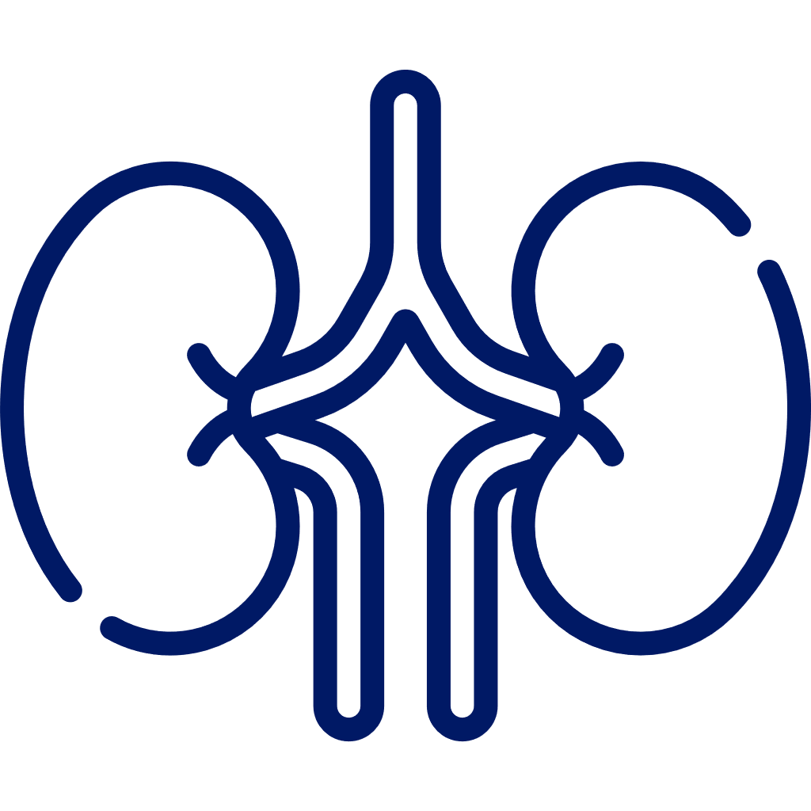




Table of Contents
Use the navigation arrow at the end of each section to return to this page.
Click on the icons below to view each chapter.
1. | Overview of obesity-related complications
2. | Metabolic complications
3. | Cardiovascular disease
4. | Chronic kidney disease
5. | Biomechanical complications
6. | Reproductive complications
7. | Psychological complications
8. | Key takeaways and assessment

Slide 5
Overview of obesity-related complications
Learning objective:
Demonstrate knowledge of obesity-related complications and identify the benefits of weight reduction

Slide 6
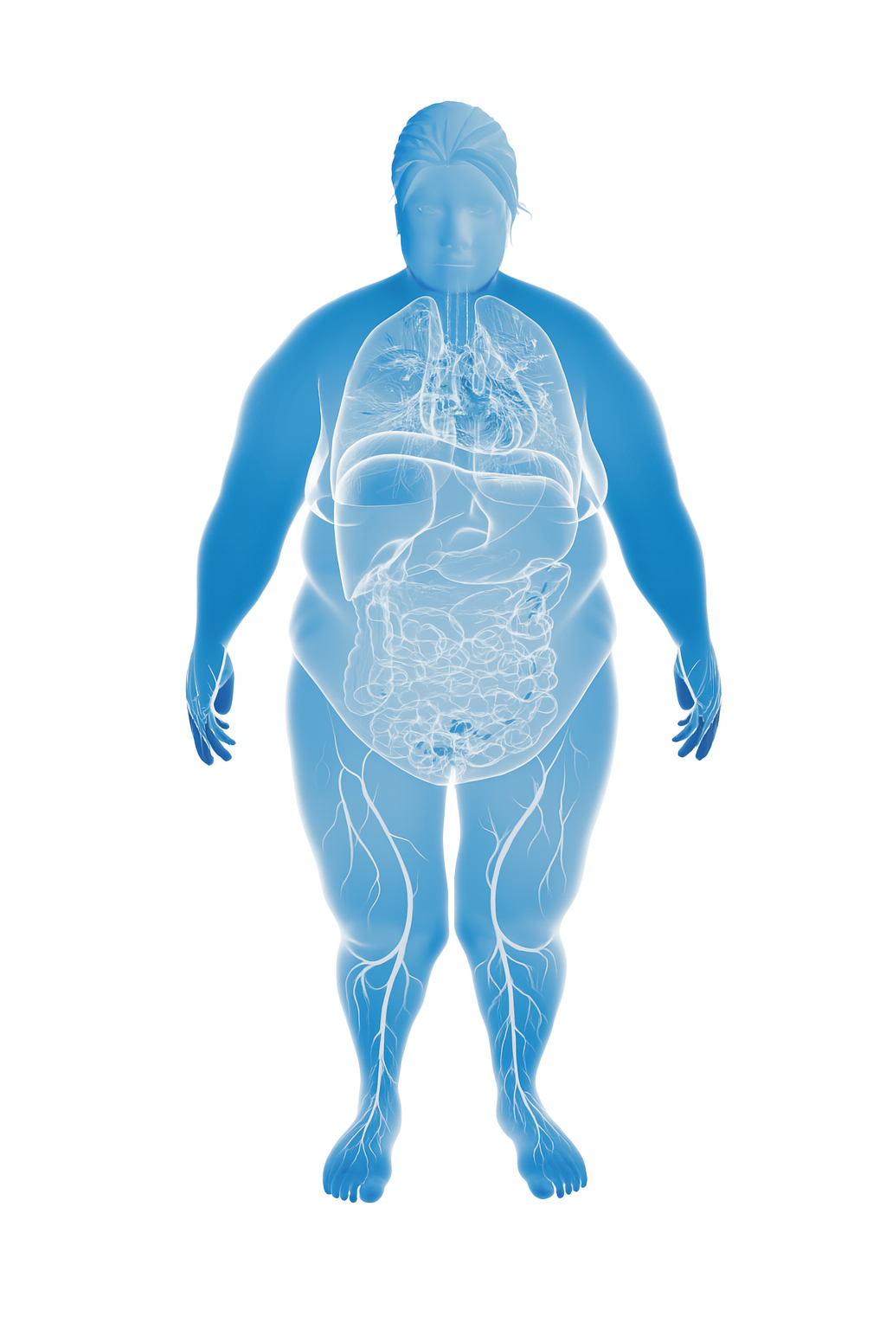
Obesity is associated with multiple complications^{1–8}
229+
complications affecting organ system by medical specialty
1
2
3
Liver
Cirrhosis (MASH)
Cardiovascular system
Heart failure incident
Congestive heart failure
Stroke (ischemic, hemorrhagic)
Stroke (mortality)
Myocardial infarction
Left ventricular hypertrophy
Coronary artery disease
Hypertension
Digestive system
GERD
Pancreatitis
Metabolic system
MASLD/MASH*
Type 2 diabetes
Hyperlipidemia
Reproductive system
Subfertility
Worsening of menopausal symptoms†
Poor semen quality
Renal system
CKD/end-stage renal failure
Benign prostatic hypertrophy
Albuminuria/proteinuria
Gallstones
*Previously known as NAFLD/NASH; †Weight loss is the only effective and recommended lifestyle modification when it comes to managing symptoms of menopause.
CKD, chronic kidney disease; GERD, gastroesophageal reflux disease; MASH, metabolic dysfunction–associated steatohepatitis; MASLD, metabolic dysfunction–associated steatotic liver disease; NAFLD, non-alcoholic fatty liver disease; NASH, non-alcoholic steatohepatitis.
1. Yuen MM et al. Obesity Week 2016 (Oct 31–Nov 4); New Orleans, LA. T-P-3166; 2. ElSayed NA et al. Diabetes Care 2023;46:S128–S139; 3. Rinella ME et al. Hepatology 2023;77:1797–1835; 4. Cusi K et al. Endocr Pract 2022;28:P528–P562; 5. The 2023 nonhormone therapy position statement of The North American Menopause Society. Menopause 2023;30:573–590; 6. Yuen MMA. Gastroenterol Clin North Am 2023;52:363–380; 7. Messineo L et al. Sleep Med Rev 2024;78:101996; 8. Batushansky A et al. Osteoarthritis Cartilage. 2022;30:501–515.

Slide 7
Obesity is associated with multiple complications^{1–8}
229+
complications affecting organ system by medical specialty
1
2
3
Cancer
Thyroid
Esophageal
Stomach
Colorectal
Pancreatic
Renal
Uterine
Breast
Multiple myeloma
Gallbladder
Hepatocellular carcinoma
Colorectal polyps
Ovarian cancer
Prostate cancer
Non-Hodgkin lymphoma
Central nervous system
Dementia
Mouth
Periodontitis
Skin
Acanthosis nigricans
Peripheral nervous system
Sciatica/lower back pain
Biomechanical
Impaired physical function/mobility
Obstructive sleep apnea
Osteoarthritis
1. Yuen MM et al. Obesity Week 2016 (Oct 31–Nov 4); New Orleans, LA. T-P-3166; 2. ElSayed NA et al. Diabetes Care 2023;46:S128–S139; 3. Rinella ME et al. Hepatology 2023;77:1797–1835; 4. Cusi K et al. Endocr Pract 2022;28:P528–P562; 5. The 2023 nonhormone therapy position statement of The North American Menopause Society. Menopause 2023;30:573–590; 6. Yuen MMA. Gastroenterol Clin North Am 2023;52:363–380; 7. Messineo L et al. Sleep Med Rev 2024;78:101996; 8. Batushansky A et al. Osteoarthritis Cartilage. 2022;30:501–515.

Slide 8
Obesity is associated with multiple complications^{1–8}
229+
complications affecting organ system by medical specialty
1
2
3
Pregnancy and newborn
Gestational
hypertension
Preeclampsia
Shoulder dystocia
Premature/
pre-term delivery
Large for gestational age
Low Apgar score in the newborn
Miscarriage
Congenital abnormality in newborn
1. Yuen MM et al. Obesity Week 2016 (Oct 31–Nov 4); New Orleans, LA. T-P-3166; 2. ElSayed NA et al. Diabetes Care 2023;46:S128–S139; 3. Rinella ME et al. Hepatology 2023;77:1797–1835; 4. Cusi K et al. Endocr Pract 2022;28:P528–P562; 5. The 2023 nonhormone therapy position statement of The North American Menopause Society. Menopause 2023;30:573–590; 6. Yuen MMA. Gastroenterol Clin North Am 2023;52:363–380; 7. Messineo L et al. Sleep Med Rev 2024;78:101996; 8. Batushansky A et al. Osteoarthritis Cartilage. 2022;30:501–515.

Slide 9
Prevalence of various complications in patients with obesity
MASLD¹ 46% Class 1 obesity²
Major depression⁷ 19% BMI ≥30 kg/m²
MASLD¹ 62% Class 2 obesity²
PCOS⁸ 5% Class 1 obesity
MASLD¹ 62% Class 3 obesity²
PCOS⁸ 12% Class 2 obesity
Hypertension³ 51% BMI ≥30 kg/m²
PCOS⁸ 12% Class 3 obesity
Iron deficiency (women)⁴ 46% BMI ≥30 kg/m²
Asthma⁹ 11% BMI ≥30 kg/m²
GERD symptoms*^{,5} 39% BMI ≥30 kg/m²
Ischemic heart disease³ 8% BMI ≥30 kg/m²
OSA⁶ 32% BMI ≥30 kg/m^{2 †}
Congestive heart failure³ 3.5% BMI ≥30 kg/m²
Type 2 diabetes³ 21% BMI ≥30 kg/m²
Stroke³ 3% BMI ≥30 kg/m²
Myocardial infarction³ 21 % BMI ≥30 kg/m²
DVT¹⁰ 2% ICD-9-CM code
*Weekly heartburn and regurgitation; †BMI ≥30.9 men and >31.7 for women.
DVT, deep venous thrombosis; GERD, gastroesophageal reflux disease; MASLD, metabolic dysfunction–associated steatotic liver disease; OSA, obstructive sleep apnea; PCOS, polycystic ovary syndrome.
1. Wang T et al. Ann Hepatol 2024;29:101154; 2. Centers for Disease Control and Prevention. https://www.cdc.gov/bmi/adult-calculator/bmi-categories.html?CDC_AAref_Val=https://www.cdc.gov/obesity/basics/adult-defining.html. Accessed December 2025; 3. Su W et al. J Med Economics 2015;18:886–897; 4. Kaner G et al. Prog Nutr 2016;18:102–110; 5. El-Serag HB et al. Am J Gastroenterol 2005;100:1243–1250; 6. Messineo L et al. Sleep Med Rev 2024;78:101996;
7. Simon GE et al. Arch Gen Psychiatry 2006;63:824–830; 8. Yildiz BO et al. J Clin Endocrinol Metab 2008;93:162–168; 9. Akinbami LJ. NCHS Data Brief 2016;239:1–8; 10. Stein PD et al. Am J Med 2005;118:978–980.

Slide 10











Life expectancy across BMI categories: Men
30% increase in mortality is associated with every 5 BMI point increase above a BMI of 25¹
Men: Estimated reduction in life expectancy* compared with an individual of
healthy weight (18.5–24.9 kg/m²), never-smokers, N=1,969,648²
BMI
Expected future age at death at 40 years
18.5–24.9 kg/m²
82.2 years
Underweight was associated with increased mortality, with the strongest association between
low BMI and mortality noted in
younger people²
<18.5 kg/m²
−4.3 y
77.9 years
25–29.9 kg/m²
−1.0 y
81.2 years
30–34.9 kg/m²
−3.4 y
78.7 years
35–39.9 kg/m²
−5.9 y
76.2 years
≥40 kg/m²
−9.1 y
73.1 years
*Reduction in life expectancy is calculated as expected age of death minus expected age at death in the healthy weight category. Expected age of death at age 40 years estimated from a Poisson model for overall survival with six-category BMI variable, 5-year age bands, sex, and interaction terms for BMI with age at BMI, and BMI with sex.
BMI, body mass index.
1. Prospective Studies Collaboration. Lancet 2009;373:1083–1096; 2. Bhaskaran K et al. Lancet Diabetes Endocrinol 2018;6:944–953.

Slide 11
Life expectancy across BMI categories: Women
30% increase in mortality is associated with every 5 BMI point increase above a BMI of 25¹
Women: Estimated reduction in life expectancy* compared with an individual of healthy weight (18.5–24.9 kg/m²), never-smokers, N=1,969,648²
BMI
Expected future age at death at 40 years
18.5–24.9 kg/m²
84.3 years
Underweight was associated with increased mortality, with the strongest association between
low BMI and mortality noted in
younger people²
<18.5 kg/m²
−4.5 y
79.8 years
25–29.9 kg/m²
−0.8 y
83.5 years
30–34.9 kg/m²
−2.4 y
81.9 years
35–39.9 kg/m²
−4.7 y
79.6 years
≥40 kg/m²
−7.7 y
76.6 years
*Reduction in life expectancy is calculated as expected age of death minus expected age at death in the healthy weight category. Expected age of death at age 40 years estimated from a Poisson model for overall survival with six-category BMI variable, 5-year age bands, sex, and interaction terms for BMI with age at BMI, and BMI with sex.
BMI, body mass index.
1. Prospective Studies Collaboration. Lancet 2009;373:1083–1096; 2. Bhaskaran K et al. Lancet Diabetes Endocrinol 2018;6:944–953.

Slide 12
BMI and risk of various cancers
BMI (kg/m²)
Relative risk vs
normal BMI
Adenocarcinoma of esophagus
Colorectal
Pancreas
Kidney
Postmenopausal breast
Endometrial
Cancer site and type
Data are meta-analysis summary relative risk scores.
BMI, body mass index.
Eheman C et al. Cancer 2012;118:2338–2366.
Notes:
FACILITATOR NOTES
Key points
Overweight and obesity also increase the risk of cancer; results from this comprehensive meta-analysis showed that each 5 kg/m² increase in BMI is associated with:¹
30–60% increased risk of adenoma of the esophagus, kidney cancer, and endometrial cancer
13–18% increased risk of colorectal cancer, pancreatic cancer, and postmenopausal breast cancer
A recent umbrella review of systematic reviews and meta-analyses through 2015 confirmed that 11 cancer types are associated with obesity, including esophageal adenocarcinoma, multiple myeloma, cancers of the gastric cardia, colon, rectum, biliary tract system, pancreas, breast, endometrium, ovary, and kidney²
Uncertainty remains concerning the association of other types of cancers with obesity, as the strongest evidence for a correlation with obesity in those organs of the digestive organs and hormone-related malignancies in women
Additional points
These data were provided in the Annual Report to the Nation on the status of cancer, which highlights several cancers associated with excess weight¹
Data relating to cancer incidence were obtained from the CDC, NCI, and NAACCR¹
Data from NHANES were used to estimate the proportion of adults who were overweight or have obesity¹
BMI, body mass index; CDC, Centers for Disease Control and Prevention; NAACCR, North American Association of Central Cancer Registries; NCI, National Cancer Institute; NHANES, National Health and Nutrition Examination Survey.
Eheman C et al. Cancer 2012;118:2338–2366.
Kyrgiou M et al. BMJ 2017;256:j477.

Slide 13

Greater and sustained weight loss is likely to improve obesity-related complications
Click to return to the table of contents
Long-term weight loss is associated with a favorable metabolic profile¹
0–5^{2,3}
Hyperglycemia
Steatosis
Metabolic conditions
Cardiovascular disease
Respiratory conditions
Musculoskeletal conditions
Fertility
Other conditions
T2D prevention
Dyslipidemia
Hypertension
CV mortality
OSA
PCOS
SUI
5–10^{4,5}
Weight loss (%)
T2D remission
MASH
Reduced CVD risk
Heart failure
Knee OA
GERD
10–15^{3,4,6–8}
CV, cardiovascular; CVD, cardiovascular disease; GERD, gastroesophageal reflux disease; MASH, metabolic dysfunction–associated steatohepatitis; OA, osteoarthritis; OSA, obstructive sleep apnea; PCOS, polycystic ovary syndrome;
SUI, stress urinary incontinence; T2D, type 2 diabetes.
1. Knell G et al. Mayo Clin Proc 2018;93:1611–1616; 2. ElSayed NA et al. Diabetes Care 2023;46:S128–S139; 3. Rinella ME et al. Hepatology 2023;77:1797–1835; 4. Garvey WT et al. Endocr Pract 2016;22(suppl 3):1–203; 5. Lincoff AM et al. N Engl J Med 2023;389:2221–2232; 6. Look AHEAD Research Group. Lancet Diabetes Endocrinol 2016;4:913–921; 7. Valabhji J et al. Lancet Diabetes Endocrinol 2024;12:653–663; 8. Kosiborod MN, et al. N Engl J Med 2024;390:1394–1407.

Slide 14
Metabolic complications
Learning objective:
Demonstrate knowledge of obesity-related metabolic complications and identify the benefits of weight reduction

Slide 15

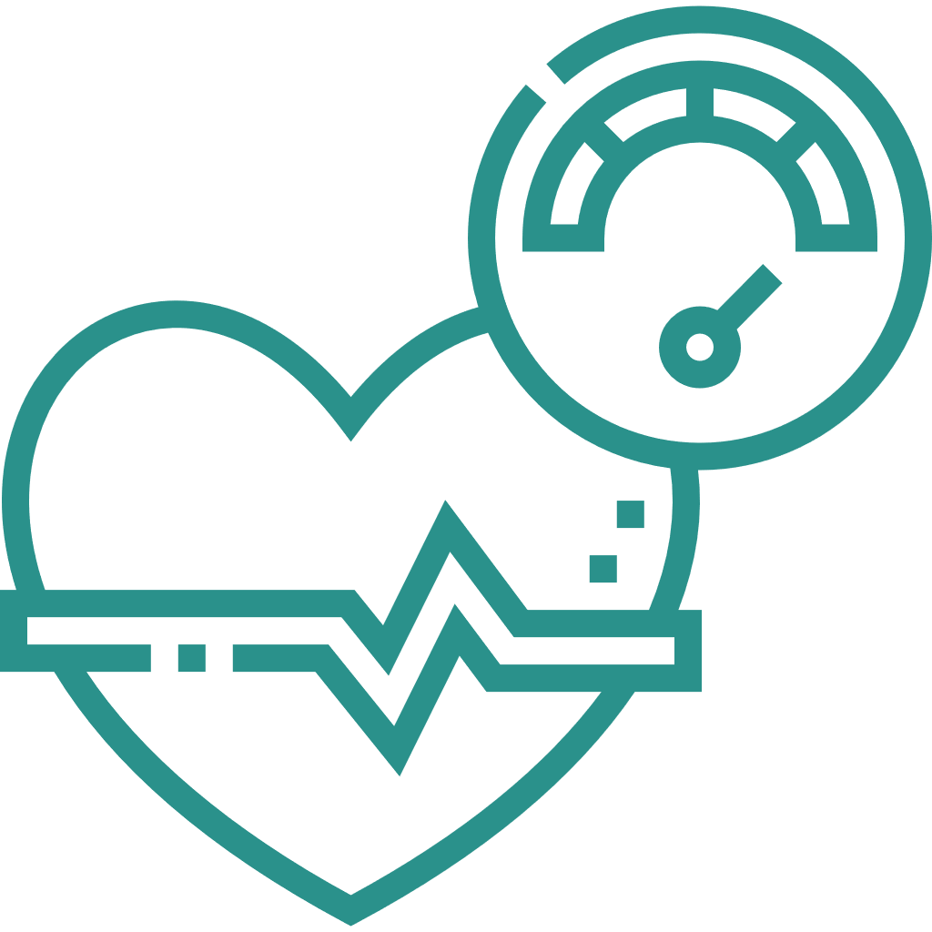
MetS is a cluster of metabolic abnormalities that increase the risk of T2D and CVD^{1,2}
Central obesity
Dyslipidemia
T2D
5-fold increased risk vs general population²
1. Elevated WC*†
Men >102 cm
Women >88 cm
2. Elevated TG
≥150 mg/dL
3. Reduced HDL-C
Men: <40 mg/dL
Women <50 mg/dL
MetS³
Presence of 3 out of 5 risk factors
CVD
2-fold increased risk vs general population²
Dysglycemia/
insulin resistance
Hypertension
MASLD
Hepatic manifestation of MetS³
5. Elevated fasting glucose
≥100 mg/dL
4. Elevated blood pressure
Systolic ≥130 and/or diastolic ≥85 mm Hg
*>94 cm in men and >80 cm in women for individuals with insulin resistance; †Ethnic-specific cut-offs should be applied.
CVD, cardiovascular disease; HDL-C, high-density lipoprotein cholesterol; MASLD, metabolic dysfunction–associated steatotic liver disease; MetS, metabolic syndrome; T2D, type 2 diabetes; TG, triglycerides; WC, waist circumference.
1. Alberti KGMM et al. Circulation 2009;120:1640–1645; 2. Swarup S et al. Metabolic Syndrome. Mar 7, 2024. In: StatPearls [Internet]. Treasure Island (FL): StatPearls Publishing; 2025; 3. Girish V, John S. Metabolic Dysfunction-Associated Steatotic Liver Disease (MΑSLD). Aug 9, 2025. In: StatPearls [Internet]. Treasure Island (FL): StatPearls Publishing; 2025.

Slide 16


Pathophysiology of MetS in obesity^{1–3}
Click to play video
CVD, cardiovascular disease; FFA, free fatty acid; HDL-C, high-density lipoprotein cholesterol; MASH, metabolic dysfunction–associated steatohepatitis; MASLD, metabolic dysfunction–associated steatotic liver disease; MetS, metabolic syndrome; T2D, type 2 diabetes; TG, triglyceride.
1. Fahed G et al. Int J Mol Sci 2022;23:786; 2. Kirk EP, Klein S. J Clin Hypertens (Greenwich) 2009;11:761–765; 3. Basil B et al. Clin Diabetes Endocrinol 2024;10:39.
Notes:
Voice over:
Visceral adiposity is an important trigger of key pathophysiological processes involved in metabolic syndrome.
Excess visceral adipose tissue is associated with insulin resistance, which leads to increased lipolysis and an increase in circulating free fatty acids.
Increased plasma free fatty acids contribute to insulin resistance in skeletal muscle cells and liver cells.
Insulin resistance results in decreased glucose uptake in skeletal cells and increased glucose production in liver cells, the net result being elevated plasma glucose levels, leading to hyperglycemia, a component of metabolic syndrome.
In liver cells, the increase in free fatty acids stimulates triglyceride production resulting in their accumulation in the hepatocytes and elevated levels in the plasma.
Excessive accumulation of triglycerides in the liver manifests as MASLD, which for some people advances to the more severe disease state, namely MASH.
Elevated triglyceride levels in the plasma increase HDL-cholesterol clearance and reduce plasma levels of HDL-cholesterol, resulting in dyslipidemia, a component of metabolic syndrome.
Free fatty acids can cause vasoconstriction, and as insulin is a vasodilator, insulin resistance can increase blood pressure leading to hypertension, a component of metabolic syndrome.
The pathophysiology of metabolic syndrome encompasses several complex mechanisms. Insulin resistance, chronic inflammation, and hormonal activation are all essential players in the development and progression of metabolic syndrome and its subsequent transition to type 2 diabetes and cardiovascular disease.
Insulin resistance, key in the development of metabolic syndrome, is the initiating factor in the pathophysiology of MASLD.

Slide 17
Obesity, prediabetes, and T2D
Diabetes Prevention Program Outcomes Study (DPPOS)
Prevalence
Prevalence of prediabetes and type 2 diabetes increases
with BMI
Prediabetes HbA_{1c} ≥5.7 to <6.5%
Diabetes HbA_{1c} ≥6.5%
ADA definitions: HbA_{1c}: prediabetes ≥5.7 to <6.5% and diabetes ≥6.5%.
ADA, American Diabetes Association; BMI, body mass index; HbA_{1c}, glycated hemoglobin; T2D, type 2 diabetes.
Perreault et al. Obes Facts 2016;9(suppl 1):151; Abstract PO1.194.

Slide 18
Pathophysiology of obesity causing T2D
Obesity^{1,2}
Hypothalamic inflammation
Leptin resistance
Increased lipolysis
Increased macrophage accumulation
Release of adipokines
Inflammation
Increased glucose and TG production
Reduced efficiency of glucose uptake
Increased ectopic fat
Reduced β-cell function and insulin secretion
Islet inflammation
Increased ectopic fat
Insulin resistance
BMI and waist circumference correlate positively with insulin resistance³
BMI, body mass index; T2D, type 2 diabetes; TG, triglycerides.
1. Oh DY et al. Nat Rev Drug Discov 2016;15:161–172; 2. ElSayed NA et al. Diabetes Care 2023;46(suppl 1):S128–S139; 3. Farin HMF et al. Am J Clin Nutr 2006;83:47−51.

Slide 19
Weight loss improves HbA_{1c} and fasting plasma glucose in people with T2D
Look AHEAD study
Change in HbA_{1c} by weight loss category
Change in FPG by weight loss category
Gained >2%
Gained ≤2%–
lost <2%
Lost
≥2%–<5%
Lost
≥5%–<10%
Lost
≥10%–<15%
Lost
≥15%
Gained >2%
Gained ≤2%–
lost <2%
Lost
≥2%–<5%
Lost
≥5%–<10%
Lost
≥10%–<15%
Lost
≥15%
Change in FPG (mg/dL)
Change in HbA_{1c} (%)
Mean baseline: 7.3 ± 1.2%; P<0.0001*
Mean baseline: 153 ± 46 mg/dL; P<0.0001*
The Look AHEAD study was a multicenter, randomized controlled trial designed to determine whether
intentional weight loss reduces cardiovascular morbidity and mortality in overweight individuals with type 2 diabetes
Data are least-squares means and 95% CIs adjusted for clinical sites, age, sex, race/ethnicity, baseline weight, baseline measurement of outcome variable, and treatment group assignment.
*P values are strength of association of improvement with magnitude of weight loss.
CI, confidence interval; FPG, fasting plasma glucose; HbA_{1c}, glycated hemoglobin; T2D, type 2 diabetes.
Wing RR et al. Diabetes Care 2011;34:1481–1486.

Slide 20
Reduction in risk to progression of prediabetes to T2D with AOMs
XENDOS study
SURMOUNT-1 trial
Cumulative incidence of T2D
Orlistat vs placebo: 6.2% vs 9.0%
Onset of T2D among patients with prediabetes
Tirzepatide vs placebo: 1.3% vs 13.3%
Orlistat + lifestyle changes significantly reduced the risk of progression of T2D compared with placebo + lifestyle changes by 37.3% (P=0.0032)¹
Tirzepatide + lifestyle changes significantly reduced the risk of progression of T2D compared with placebo + lifestyle changes
by 93% (P<0.0001)²
SCALE prediabetes
Percentage of participants with T2D at week 160
liraglutide vs placebo: 1.8% vs 6.2%
Liraglutide + lifestyle changes significantly reduced the risk of progression of T2D compared with placebo + lifestyle changes by 79% (P<0.0001)³
AOM, anti-obesity medication; T2D, type 2 diabetes.
1. Torgerson JS et al. Diabetes Care 2004;27:155–161; 2. Jastreboff AM et al. N Engl J Med 2025;392:958–971; 3. Mehta A et al. Obes Sci Pract 2017;3:3–14.

Slide 21
T2D remission* after bariatric surgery
Major studies on the long-term outcomes for people with obesity and T2D
SOS Study¹
LABG/VBG/RYGB
Weight loss at year 10: 39.5%
Utah Study²
RYGB
Weight loss at year 6: 27.7%
Arterburn et al.³
RYGB
EHR data; weight loss not reported
Mingrone et al.⁴
RYGB/BPD
Weight loss at year 2:
33.8% (BPD); 33.3% (RYGB)
T2D remission (%)
*T2D remission should be defined as a return of HbA_{1c} to <6.5% (<48 mmol/mol) that occurs spontaneously or following an intervention and that persists for at least 3 months in the absence of usual glucose-lowering pharmacotherapy.
BPD, biliopancreatic diversion; EHR, electronic health records; FU, follow-up; HbA_{1c}, glycated hemoglobin; LAGB, laparoscopic adjustable gastric banding; RYGB, Roux-en-Y gastric bypass; SOS, Swedish Obese Subjects;
T2D, type 2 diabetes; VBG, vertical-banded gastroplasty.
1. Sjöström L et al. N Engl J Med 2004;351:2683–2693; 2. Adams TD et al. JAMA 2012;308:1122–1131; 3. Arterburn DE et al. Obes Surg 2013;23:93–102; 4. Mingrone G et al. Lancet 2015;386:964–973.

Slide 22







Metabolic dysfunction–associated steatotic liver disease— MASLD
MASLD is defined by presence of:
Hepatic steatosis
≥1 cardiometabolic risk factor
TG
HDL-C
1. BMI ≥25 kg/m² or waist circumference >94 cm (male) or >80 cm (female) or ethnicity adjusted
2. Fasting serum glucose ≥5.6 mmol/L (100 mg/dL) or 2-hour post-load glucose levels ≥7.8 mmol/L (≥140 mg/dL) or HbA1c ≥5.7% or T2D or on treatment for T2D
3. Blood pressure ≥130/85 mm Hg or on antihypertensive treatment
4. Plasma triglycerides ≥1.70 mmol/L (≥150 mg/dL) or lipid-lowering treatment
5. Plasma HDL-C ≤1.0 mmol/L (40 mg/dL for males) and ≤1.3 mmol/L (50 mg/dL for females) or lipid-lowering treatment
BMI, body mass index; HDL-C, high-density lipoprotein cholesterol; MASLD, metabolic dysfunction–associated steatotic liver disease; T2D, type 2 diabetes; TG, triglyceride.
Rinella ME et al. Hepatology 2023;78:1966–1986.

Slide 23
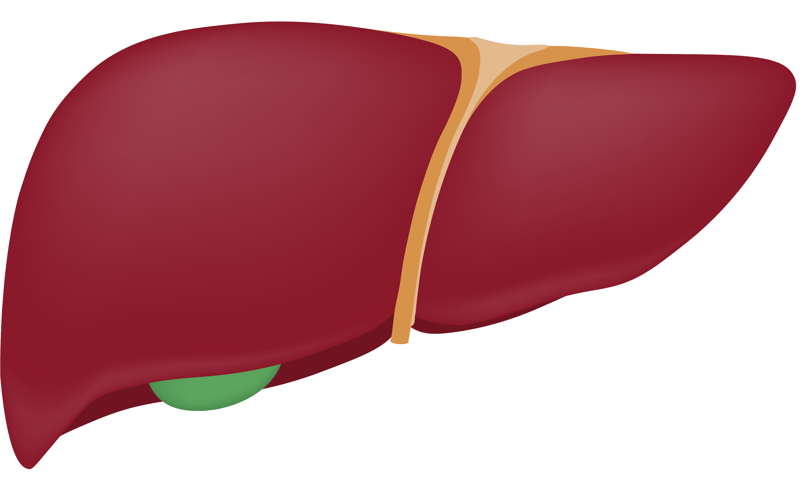
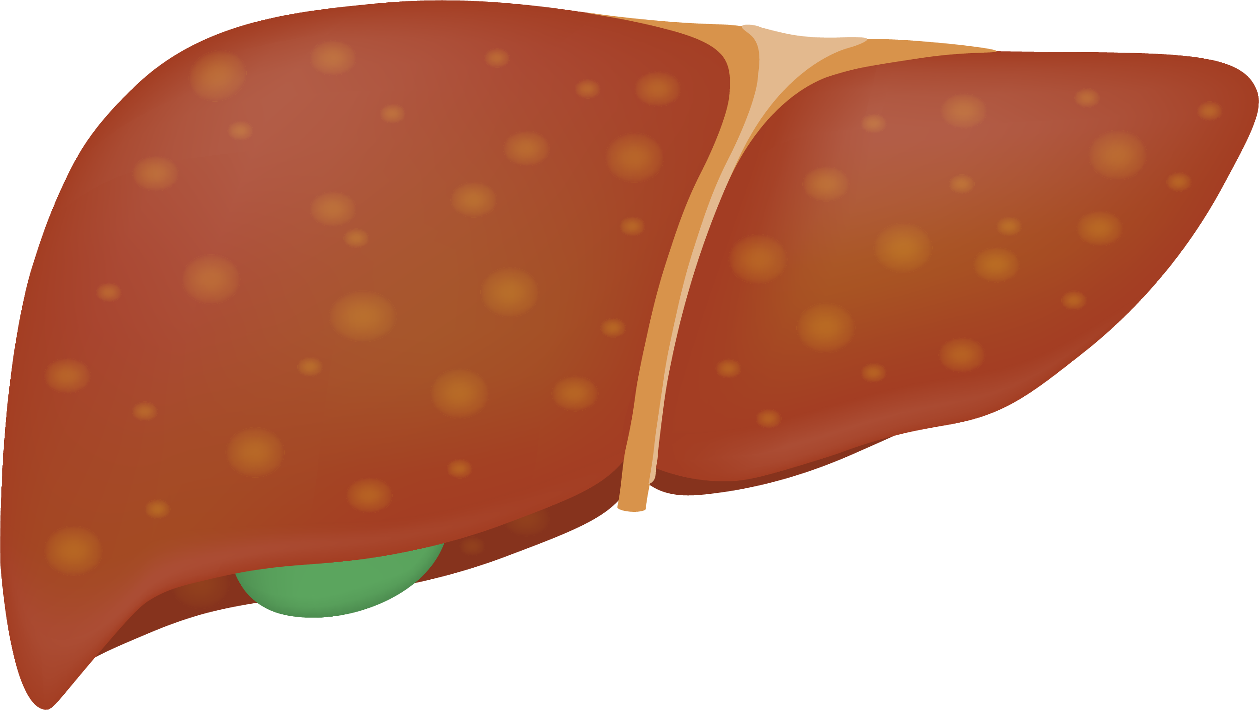
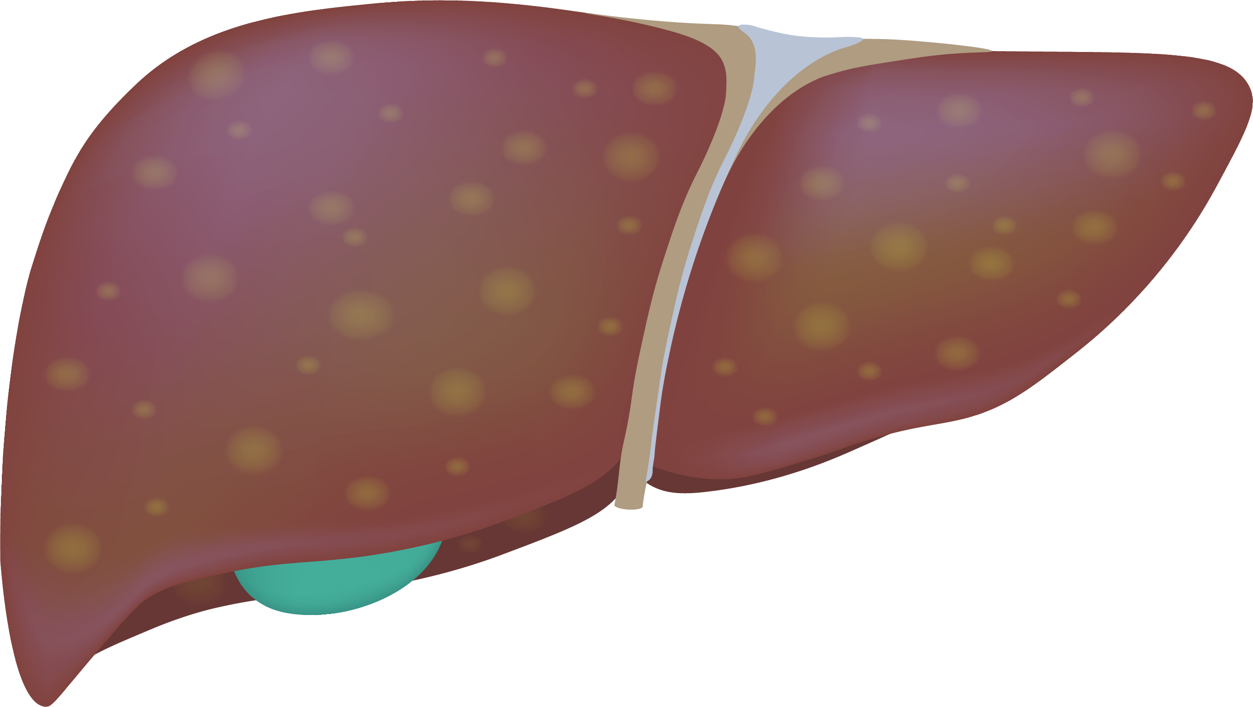
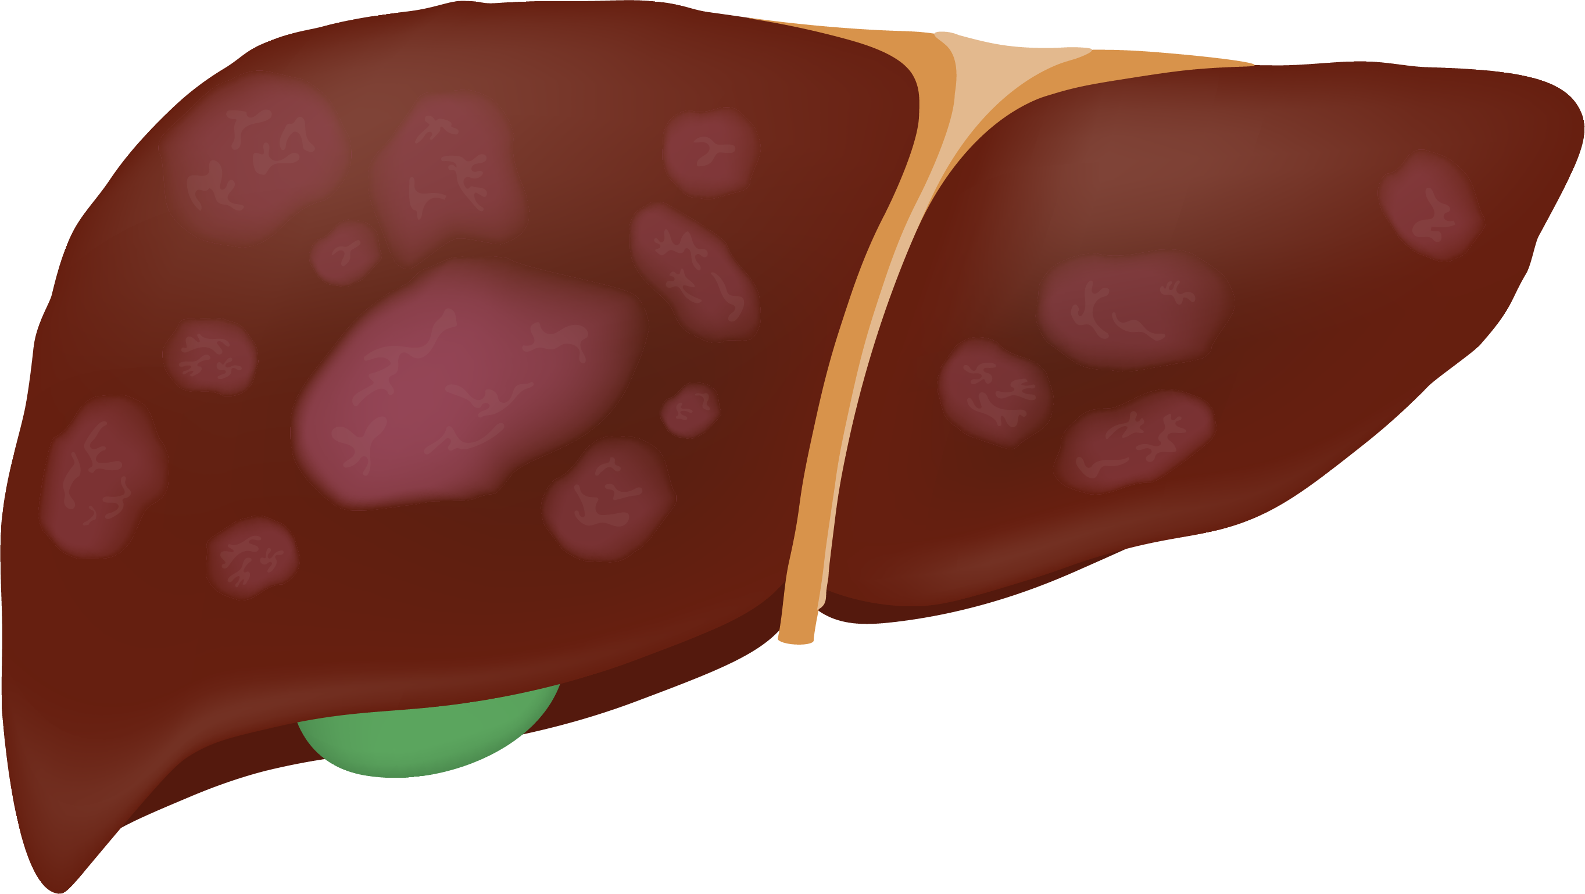
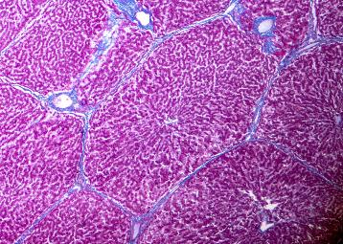
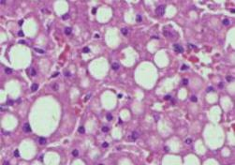
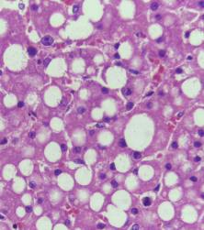
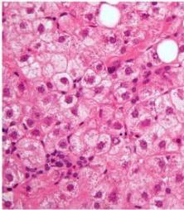
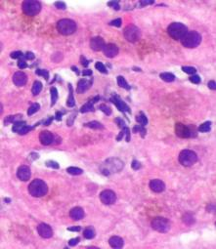
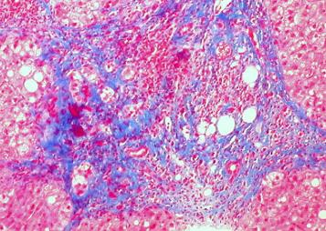
MASH is the progressive form of MASLD
Spectrum of MASLD
MASLD
Normal
Steatosis
MASH
MASH with fibrosis
Steatosis
Ballooning
Inflammation
MASH, metabolic dysfunction–associated steatohepatitis; MASLD, metabolic dysfunction–associated steatotic liver disease.
Chalasani N et al. Hepatology 2018;67:328–335.
Images are licensed under the Creative Commons Attribution-Share Alike 4.0 International license: Steatosis images: Copyright © 2014 Calicut Medical College. Ballooning image: Copyright © 2009 Michael Bonert.
Inflammation image: Copyright © 2016 Michael Bonert. MASH with cirrhosis: Copyright © 2016 Ed Uthman.
Notes:
MASLD is a spectrum of hepatic consequences ranging from steatosis to MASH with fibrosis. A healthy liver will progress into a MASL where it will experience steatosis. Fibrosis is the scarring of the liver due to inflammation, and it is categorised into four groups from F1 to F4, increasing in severity. Progression from F1 to F4 is characterized by the joint increase in steatosis, hepatocyte ballooning, and lobular inflammation. The last stage is MASH with advanced fibrosis (F4), which can eventually lead to irreversible cirrhosis. Many factors contribute to the unchallenged progression of MASH, which is why it is important to take the correct steps to stop progression and aid the reversal of any damage that has already occurred.
Abbreviations
MASH, metabolic dysfunction–associated steatohepatitis; MASL, metabolic dysfunction–associated steatotic liver; MASLD, metabolic dysfunction–associated steatotic liver disease.
References
1. Chalasani N et al. Hepatology. 2018;67:328–35.
Images are licensed under the Creative Commons Attribution-Share Alike 4.0 International license. Steatosis images: Copyright © 2014 Calicut Medical College. You are free to share and adapt this image as per the CC BY-SA 4.0. Ballooning image: Copyright © 2009 Michael Bonert. You are free to share and adapt this image as per the CC BY-SA 3.0. Inflammation image: Copyright © 2016 Michael Bonert. You are free to share and adapt this image as per the CC BY-SA 3.0. MASH with cirrhosis: Copyright © 2016 Ed Uthman. You are free to share and adapt this image as per the CC BY-SA 2.0.

Slide 24

Prevalence of MASLD and MASH among people with overweight/obesity
Global prevalence³
MASLD is present in ~25% of adults in the US¹
In US adults with obesity, MASLD is present in*^{,2}
46% with Class 1 obesity
62% with Class 2 obesity
62% with Class 3 obesity
MASLD and MASH is present in^{†,3}
70.0% and 33.5% of people with overweight
75.3% and 33.7% of people with obesity
*Data from NHANES 2011–2018 sample, n=7,429; †Systematic review, n=151 studies and pooled metanalyses, n=101,028 individuals.
MASH, metabolic dysfunction–associated steatohepatitis; MASLD, metabolic dysfunction–associated steatotic liver disease; NHANES, the National Health and Nutrition Examination Survey.
1. Arshad T et al. Curr Pharm Des 2020;26:993–997; 2. Wang T et al. Ann Hepatol 2024;29:101154; 3. Quek J et al. Lancet Gastroenterol Hepatol 2023;8:20–30.

Slide 25

MASH is associated with metabolic comorbidities
Of the 15.5 M US adults living with MASH^{*,1,2}…
15.5 M
82% with obesity^{†,3}
12.7 M
72% with dyslipidemia^{†,3}
11.2 M
71% with metabolic syndrome^{†,3}
10.9 M
68% with hypertension^{†,3}
10.5 M
44% with type 2 diabetes^{†,3}
6.8 M
*Calculated using the predicted prevalence of MASH in the US adult population in 2020 of 5.8%¹ and the US Census data of 266,978,268 resident adults in the US as of July 01 2024,² †Calculated by applying global prevalence data³ to estimated number of patients in the US with MASH.
All data referenced above were demonstrated in patients defined by NAFLD/NASH criteria.
M, million; MASH, metabolic dysfunction–associated steatohepatitis; NAFLD, nonalcoholic fatty liver disease; NASH, nonalcoholic steatohepatitis.
1. Le P et al. JAMA Netw Open 2025;8:e245470; 2. US Census Bureau. https://www2.census.gov/programs-surveys/popest/tables/2020-2024/national/asrh/nc-est2024-syasexn.xlsx. Accessed December 2025; 3. Younossi ZM et al. Hepatology 2016;64:73–84.

Slide 26
Patients with co-existing obesity and
T2D are at high risk of developing MASH
Prevalence of MASLD, at-risk MASH,* and cirrhosis
†
‡
The prevalence of MASLD, at-risk MASH, and cirrhosis was significantly higher in those with obesity vs those without obesity
*MASH with significant fibrosis (fibrosis stage 2 or higher); †BMI ≥30 kg/m²; ‡BMI <30 kg/m².
BMI, body mass index; MASH, metabolic dysfunction–associated steatohepatitis; MASLD, metabolic dysfunction–associated steatotic liver disease.
Mittal N et al. Aliment Pharmacol Ther 2024;59:1571–1578.

Slide 27

Obesity-driven pathophysiology of MASLD and MASH^{1,2}
Adipose tissue
Immune cells
Adipocyte dysfunction
Increased insulin resistance
Increased lipolysis
Intrahepatic fat
accumulation
Inflammation
Fibrosis
Cell death
Apoptosis
Scarring
Normal liver
MASLD
MASH
Cirrhosis
MASH, metabolic dysfunction–associated steatohepatitis; MASLD, metabolic dysfunction–associated steatotic liver disease.
1. Polyzos SA et al. Metabolism 2019;92:82–97; 2. Rinella ME et al. Hepatology 2023;77:1797–1835.

Slide 28

MASLD/MASH morbidity and mortality
~10‒25% of patients with MASH will develop advanced fibrosis and cirrhosis¹
The odds of a CVD event‡ in patients with MASLD are 1.63 times that of those without MASLD^{§,3}
MASLD/MASH is the predominant underlying risk factor for HCC—
present in 59% of HCC cases^{#,5}
Patients with MASLD had a 1.93-fold higher risk of overall mortality vs population comparators^{¢,7}
Liver-related
complications
Cardiovascular
complications
Cancer
Mortality
Compared with MASLD patients with F0‒2 fibrosis the rate of new-onset hepatic decompensation events* was
19 times greater for those with F3 fibrosis and
36 times for those with F4 fibrosis^{†,2}
The odds of a CVD event¶ in patients with MASLD and T2D are 2.2 times that of those with T2D alone^{$,4}
Patients with MASLD had a nearly
1.5- to 2-fold risk of GI cancers and a 1.2- to 1.5-fold risk of lung, breast, gynecological, or urinary system cancers, regardless of confounders^{¥,6}
Mortality risk increased with worsening disease severity^{¢,7}
Simple steatosis: 1.71-fold higher risk
MASH without fibrosis: 2.14-fold higher risk
With non-cirrhotic fibrosis: 2.44-fold higher risk
With cirrhosis: 3.79-fold higher risk
*Variceal hemorrhage, ascites, or encephalopathy; †Prospective multicenter, non-interventional registry study which included 1773 adults with MASLD followed up for 4 years;² ‡Myocardial infarction, angina, ischaemic stroke, or coronary revascularization; §Meta-analysis of 16 observational studies, which included a total of 34,043 adults followed up for a median of 6.9 years;³ ¶Congestive heart failure, unstable angina, myocardial infarction, coronary revascularization, ischemic stroke, or cerebral hemorrhage; $Meta-analysis of 11 studies, which included a total of 8346 patients with T2D;⁴ #Retrospective analysis of claims data from MarketScan Research Databases;⁵ ¥Meta-analysis of 10 studies, which included a total of 183,302 adults in middle age, 24.5% of whom had MASLD, followed up a median of 5.8 years; ¢Nationwide cohort study in Sweden of 10,568 patients with MASLD followed up for a median of 14.2 years.
CVD, cardiovascular disease; GI, gastrointestinal; HCC, hepatocellular carcinoma; MASH, metabolic dysfunction–associated steatohepatitis; MASLD; metabolic dysfunction–associated steatotic liver disease; T2D, type 2 diabetes.
1. Lekakis V, Papatheodoridis GV. Eur J Intern Med 2024;122:3–10; 2. Sanyal AJ et al. N Engl J Med 2021;385:1559–1569; 3. Targer GJ et al. Hepatol 2016;65:589–600; 4. Zhou Y-Y et al. Eur J Gastroenterol Hepatol 2018;30:631–636;
5. Sanyal AJ et al. Curr Med Res Opin 2010;26:2183–2191; 6. Mantovani A et al Gut 2022;71:778–788; 7. Simon TG et al. Gut 2021;70:1375–1382.

Slide 29
MASLD/MASH morbidity and mortality
~10‒25% of patients with MASH will develop advanced fibrosis and cirrhosis¹
The odds of a CVD event‡ in patients with MASLD are 1.63 times that of those without MASLD^{§,3}
MASLD/MASH is the predominant underlying risk factor for HCC—
present in 59% of HCC cases^{#,5}
Patients with MASLD had a 1.93-fold higher risk of overall mortality vs population comparators^{¢,7}
Liver-related
complications
Cardiovascular
complications
Cancer
Mortality
Compared with MASLD patients with F0‒2 fibrosis the rate of new-onset hepatic decompensation events* was
19 times greater for those with F3 fibrosis and
36 times for those with F4 fibrosis^{†,2}
The odds of a CVD event¶ in patients with MASLD and T2D are 2.2 times that of those with T2D alone^{$,4}
Patients with MASLD had a nearly
1.5- to 2-fold risk of GI cancers and a 1.2- to 1.5-fold risk of lung, breast, gynecological, or urinary system cancers, regardless of confounders^{¥,6}
Mortality risk increased with worsening disease severity^{¢,7}
Simple steatosis: 1.71-fold higher risk
MASH without fibrosis: 2.14-fold higher risk
With non-cirrhotic fibrosis: 2.44-fold higher risk
With cirrhosis: 3.79-fold higher risk
*Variceal hemorrhage, ascites, or encephalopathy; †Prospective multicenter, non-interventional registry study which included 1773 adults with MASLD followed up for 4 years;² ‡Myocardial infarction, angina, ischaemic stroke, or coronary revascularization; §Meta-analysis of 16 observational studies, which included a total of 34,043 adults followed up for a median of 6.9 years;³ ¶Congestive heart failure, unstable angina, myocardial infarction, coronary revascularization, ischemic stroke, or cerebral hemorrhage; $Meta-analysis of 11 studies, which included a total of 8346 patients with T2D;⁴ #Retrospective analysis of claims data from MarketScan Research Databases;⁵ ¥Meta-analysis of 10 studies, which included a total of 183,302 adults in middle age, 24.5% of whom had MASLD, followed up a median of 5.8 years; ¢Nationwide cohort study in Sweden of 10,568 patients with MASLD followed up for a median of 14.2 years.
CVD, cardiovascular disease; GI, gastrointestinal; HCC, hepatocellular carcinoma; MASH, metabolic dysfunction–associated steatohepatitis; MASLD; metabolic dysfunction–associated steatotic liver disease; T2D, type 2 diabetes.
1. Lekakis V, Papatheodoridis GV. Eur J Intern Med 2024;122:3–10; 2. Sanyal AJ et al. N Engl J Med 2021;385:1559–1569; 3. Targer GJ et al. Hepatol 2016;65:589–600; 4. Zhou Y-Y et al. Eur J Gastroenterol Hepatol 2018;30:631–636;
5. Sanyal AJ et al. Curr Med Res Opin 2010;26:2183–2191; 6. Mantovani A et al Gut 2022;71:778–788; 7. Simon TG et al. Gut 2021;70:1375–1382.

Slide 30
MASLD/MASH morbidity and mortality
~10‒25% of patients with MASH will develop advanced fibrosis and cirrhosis¹
The odds of a CVD event‡ in patients with MASLD are 1.63 times that of those without MASLD^{§,3}
MASLD/MASH is the predominant underlying risk factor for HCC—
present in 59% of HCC cases^{#,5}
Patients with MASLD had a 1.93-fold higher risk of overall mortality vs population comparators^{¢,7}
Liver-related
complications
Cardiovascular
complications
Cancer
Mortality
Compared with MASLD patients with F0‒2 fibrosis the rate of new-onset hepatic decompensation events* was
19 times greater for those with F3 fibrosis and
36 times for those with F4 fibrosis^{†,2}
The odds of a CVD event¶ in patients with MASLD and T2D are 2.2 times that of those with T2D alone^{$,4}
Patients with MASLD had a nearly
1.5- to 2-fold risk of GI cancers and a 1.2- to 1.5-fold risk of lung, breast, gynecological, or urinary system cancers, regardless of confounders^{¥,6}
Mortality risk increased with worsening disease severity^{¢,7}
Simple steatosis: 1.71-fold higher risk
MASH without fibrosis: 2.14-fold higher risk
With non-cirrhotic fibrosis: 2.44-fold higher risk
With cirrhosis: 3.79-fold higher risk
*Variceal hemorrhage, ascites, or encephalopathy; †Prospective multicenter, non-interventional registry study which included 1773 adults with MASLD followed up for 4 years;² ‡Myocardial infarction, angina, ischaemic stroke, or coronary revascularization; §Meta-analysis of 16 observational studies, which included a total of 34,043 adults followed up for a median of 6.9 years;³ ¶Congestive heart failure, unstable angina, myocardial infarction, coronary revascularization, ischemic stroke, or cerebral hemorrhage; $Meta-analysis of 11 studies, which included a total of 8346 patients with T2D;⁴ #Retrospective analysis of claims data from MarketScan Research Databases;⁵ ¥Meta-analysis of 10 studies, which included a total of 183,302 adults in middle age, 24.5% of whom had MASLD, followed up a median of 5.8 years; ¢Nationwide cohort study in Sweden of 10,568 patients with MASLD followed up for a median of 14.2 years.
CVD, cardiovascular disease; GI, gastrointestinal; HCC, hepatocellular carcinoma; MASH, metabolic dysfunction–associated steatohepatitis; MASLD; metabolic dysfunction–associated steatotic liver disease; T2D, type 2 diabetes.
1. Lekakis V, Papatheodoridis GV. Eur J Intern Med 2024;122:3–10; 2. Sanyal AJ et al. N Engl J Med 2021;385:1559–1569; 3. Targer GJ et al. Hepatol 2016;65:589–600; 4. Zhou Y-Y et al. Eur J Gastroenterol Hepatol 2018;30:631–636;
5. Sanyal AJ et al. Curr Med Res Opin 2010;26:2183–2191; 6. Mantovani A et al Gut 2022;71:778–788; 7. Simon TG et al. Gut 2021;70:1375–1382.

Slide 31
MASLD/MASH morbidity and mortality
~10‒25% of patients with MASH will develop advanced fibrosis and cirrhosis¹
The odds of a CVD event‡ in patients with MASLD are 1.63 times that of those without MASLD^{§,3}
MASLD/MASH is the predominant underlying risk factor for HCC—
present in 59% of HCC cases^{#,5}
Patients with MASLD had a 1.93-fold higher risk of overall mortality vs population comparators^{¢,7}
Liver-related
complications
Cardiovascular
complications
Cancer
Mortality
Compared with MASLD patients with F0‒2 fibrosis the rate of new-onset hepatic decompensation events* was
19 times greater for those with F3 fibrosis and
36 times for those with F4 fibrosis^{†,2}
The odds of a CVD event¶ in patients with MASLD and T2D are 2.2 times that of those with T2D alone^{$,4}
Patients with MASLD had a nearly
1.5- to 2-fold risk of GI cancers and a 1.2- to 1.5-fold risk of lung, breast, gynecological, or urinary system cancers, regardless of confounders^{¥,6}
Mortality risk increased with worsening disease severity^{¢,7}
Simple steatosis: 1.71-fold higher risk
MASH without fibrosis: 2.14-fold higher risk
With non-cirrhotic fibrosis: 2.44-fold higher risk
With cirrhosis: 3.79-fold higher risk
*Variceal hemorrhage, ascites, or encephalopathy; †Prospective multicenter, non-interventional registry study which included 1773 adults with MASLD followed up for 4 years;² ‡Myocardial infarction, angina, ischaemic stroke, or coronary revascularization; §Meta-analysis of 16 observational studies, which included a total of 34,043 adults followed up for a median of 6.9 years;³ ¶Congestive heart failure, unstable angina, myocardial infarction, coronary revascularization, ischemic stroke, or cerebral hemorrhage; $Meta-analysis of 11 studies, which included a total of 8346 patients with T2D;⁴ #Retrospective analysis of claims data from MarketScan Research Databases;⁵ ¥Meta-analysis of 10 studies, which included a total of 183,302 adults in middle age, 24.5% of whom had MASLD, followed up a median of 5.8 years; ¢Nationwide cohort study in Sweden of 10,568 patients with MASLD followed up for a median of 14.2 years.
CVD, cardiovascular disease; GI, gastrointestinal; HCC, hepatocellular carcinoma; MASH, metabolic dysfunction–associated steatohepatitis; MASLD; metabolic dysfunction–associated steatotic liver disease; T2D, type 2 diabetes.
1. Lekakis V, Papatheodoridis GV. Eur J Intern Med 2024;122:3–10; 2. Sanyal AJ et al. N Engl J Med 2021;385:1559–1569; 3. Targer GJ et al. Hepatol 2016;65:589–600; 4. Zhou Y-Y et al. Eur J Gastroenterol Hepatol 2018;30:631–636;
5. Sanyal AJ et al. Curr Med Res Opin 2010;26:2183–2191; 6. Mantovani A et al Gut 2022;71:778–788; 7. Simon TG et al. Gut 2021;70:1375–1382.

Slide 32

Weight loss reduces the incidence of hepatic steatosis and MASLD
Weight loss improves liver fibrosis (P=0.04*)³
n=73
n=16
n=8
n=16
Weight loss reduced hepatic steatosis and incident MASLD in patients with overweight/obesity and T2D¹
8.5%
weight loss
with intensive lifestyle intervention
50.8%
reduced liver fat
Worsened
Stabilized
Regressed
Weight loss with lifestyle intervention improved liver histology in patients with overweight/obesity and biopsy-proven MASH^{2–4}
Weight loss
*P values for the Mantel–Haenszel χ² test for trend stratified by age older than 55 years, sex, BMI ≥35, type 2 diabetes, medication of diabetes/hyperlipidemia, and baseline fibrosis score.
BMI, body mass index; MASH, metabolic dysfunction–associated steatohepatitis; MASLD, metabolic dysfunction–associated steatotic liver disease; T2D, type 2 diabetes.
1. Lazo M et al. Diabetes Care 2010;33:2156–2163; 2. Promrat K et al. Hepatology 2010;51:121–129; 3. Vilar-Gomez E et al. Gastroenterology 2015;149:367–378; 4. Koutoukidis DA et al. JAMA Intern Med 2019;179:1262–1271.

Slide 33


Impact of incretin mimetics on MASLD/MASH
Click to return to the table of contents
Only
Several drugs have been evaluated for the treatment of MASLD, each of them aiming at one or more of the following pathophysiological aspects:
of MASLD patients can achieve and maintain the predefined weight loss targets long-term
1 Insulin resistance and lipid metabolism
2 Inflammation and immune activation
3 Cell death
4 Lipotoxicity
5 Oxidative stress
6 Fibrogenesis
Research suggests that incretin analogs are a promising therapeutic agent for the disease, with the most well-studied class being GLP-1RAs
GLP-1RA, glucagon-like peptide-1 receptor agonist; MASH, metabolic dysfunction–associated steatohepatitis; MASLD, metabolic dysfunction–associated steatotic liver disease.
Chrysavgis LG et al. Int J Mol Sci 2024;25:3832.

Slide 34
Cardiovascular disease
Learning objective:
Demonstrate knowledge of obesity-related cardiovascular complications and identify the benefits of weight reduction

Slide 35
Prevalence of hypertension by BMI
P value for trend <0.001
Prevalence (%)
Hypertension was defined as mean systolic blood pressure ≥140 mm Hg and/or diastolic blood pressure ≥90 mm Hg and/or antihypertensive drug use.
Data collected from 7907 community-living adults in the present analyses (Longevity Check-Up 7+ Study).
BMI, body mass index.
Landi F et al. Nutrients 2018;10:1976.

Slide 36
Obesity-related hypertension is multifactorial^{1–3}
Obesity
Sympathetic
nervous
system
Renin–
angiotensin
system
Aldosterone
Physical
pressure
on kidneys*
Uric acid†
Renal sodium and water retention
Oxidative stress
Hypertension
*Renal medullary compression by excessive adipose tissue and by glomerular injury, further increasing renal tissue pressure; †Increased fructose consumption leads to an increase in levels of uric acid.
1. Jansen PM et al. Curr Hypertens Rep 2010;12:220–225; 2. Rinella ME et al. Hepatology 2023;77:1797–1835; 3. Lanaspa MA et al. J Biol Chem 2012;287:40732–40744.

Slide 37
Weight loss lowers blood pressure
Weight loss via pharmacological intervention¹
STEP 3: Semaglutide 2.4 mg (n=407) plus IBT vs placebo + IBT (n=204)
Weight loss: 16% vs 5.7% (P<0.001)
Weight loss via bariatric surgery²
Meta-analysis, N=52 studies
Follow-up, mean 34 months
Mean excess WL: 52% (range, 16–87%)
P=0.008
P=0.001
*SBP/DBP at baseline was 124/80 mm Hg in the semaglutide group and 124/81 mm Hg in the placebo group.
BP, blood pressure; DBP, diastolic blood pressure; IBT, intensive behavioral therapy; SBP, systolic blood pressure; WL, weight loss.
1. Wadden TA et al. JAMA 2021;325:1403–1413; 2. Heneghan HM et al. Am J Cardiol 2011;108:1499–1507.

Slide 38
Obesity-induced inflammation contributes to ASCVD
Excess visceral and epicardial adipose tissue
Activation of adipokine/cytokines
Increased circulating aldosterone
Immune cell
infiltration into
adipose tissue
Increased blood volume
Platelet
aggregation
Thrombosis
Visceral adipose and systemic tissue inflammation
Decreased anti-inflammatory/ atheroprotective adipokines
Abnormal lipid metabolism
Insulin resistance
Hyperpermeability of vascular endothelial junctions
Hypercoagulability
Vascular endothelial dysfunction
Atherosclerotic cardiovascular disease
Each 1-point increase in an individual’s BMI above normal weight causes
a 10% increase in the risk for atherosclerosis and coronary heart disease
ASCVD, atherosclerotic cardiovascular disease; BMI, body mass index.
Henning RJ. Am J Cardiovasc 2021;11:504–529.

Slide 39
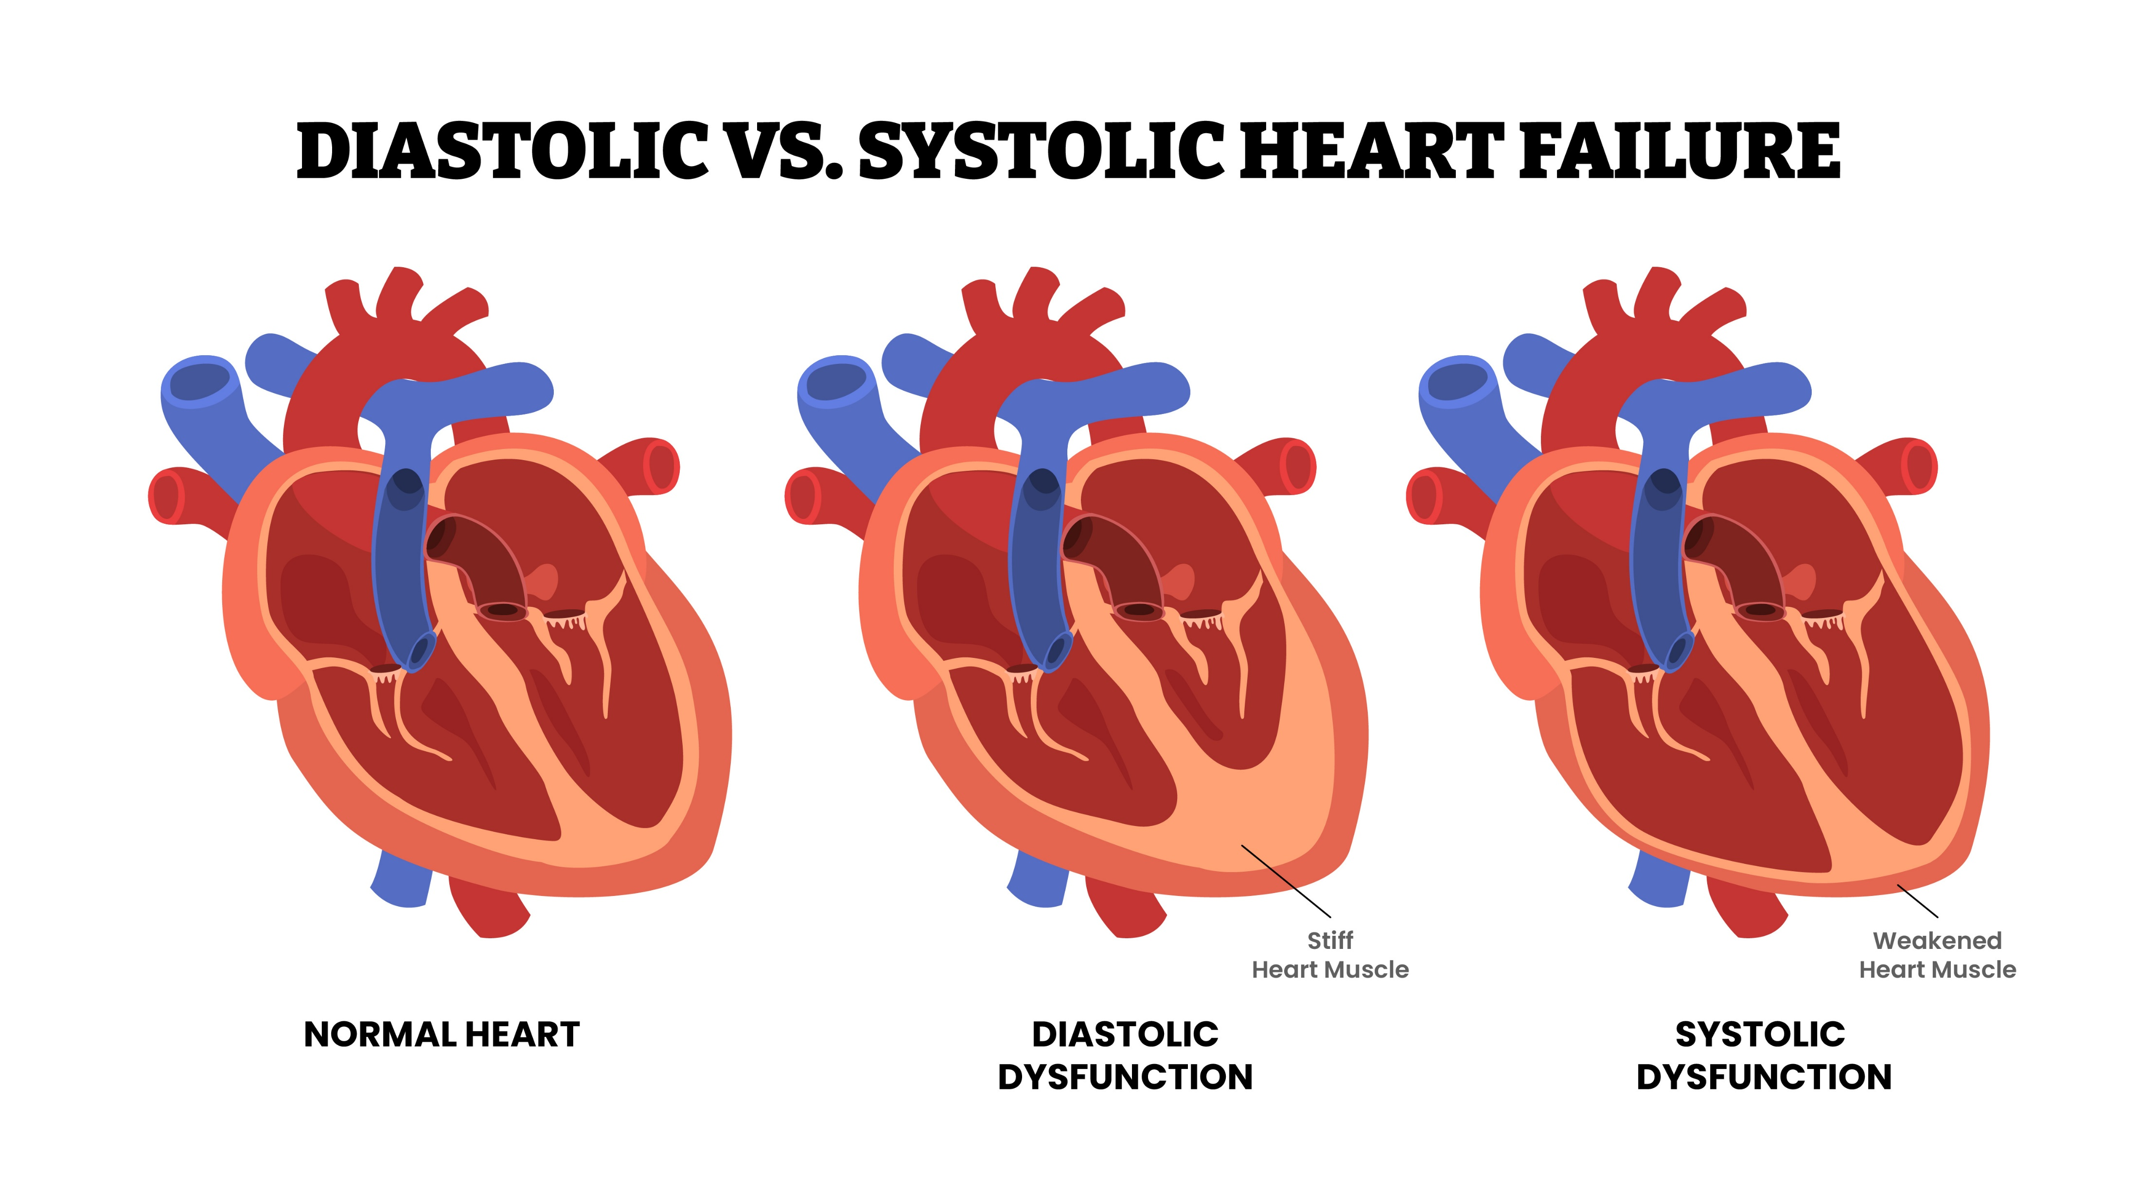
Obesity is a risk factor for heart failure — both reduced EF and preserved EF
Risk of HF increases by 41%
for every 5 kg/m² higher BMI¹
HFpEF: ≥50% ejection fraction
HFrEF: ≤40% ejection fraction
Higher BMI is more strongly
associated with risk
of HFpEF than HFrEF²
The left ventricle loses its ability to relax normally, and the heart is unable to properly fill with blood during the resting period between each beat
The left ventricle loses its ability to contract normally, and the heart is unable to pump enough blood into circulation
BMI, body mass index; EF, ejection fraction; HF, heart failure; HFpEF, heart failure with preserved ejection fraction; HFrEF, heart failure with reduced ejection fraction.
1. Aune D et al. Circulation 2016;133:639–649; 2. Chrysant SG et al. Hosp Pract (1995) 2019;47:67–72.

Slide 40


Impact of weight loss on HFpEF
Bariatric surgery is associated with decreased risk of developing heart failure in patients with diabetes and obesity² (BMI ≥30 kg/m²)
7% intentional weight loss in patients with obesity and HFpEF resulted in:¹
Increased exercise tolerance
Improved MRI and echocardiographic measures of diastolic heart function
In patients with HFpEF and obesity, AOMs* have been shown to:^{3,4}
lead to larger reductions in symptoms and physical limitations
achieve greater improvements in exercise function
provide reduced circulatory volume-pressure overload and systemic inflammation
mitigate CV/kidney end-organ injury
*No AOMs have been approved for the treatment of HFpEF.
AOM, anti-obesity medication; BMI, body mass index; CV, cardiovascular; HFpEF, heart failure with preserved ejection fraction; MRI, magnetic resonance imaging.
1. Kitzman DW et al. JAMA 2016;315:36–46; 2. Aminian A et al. JAMA 2019;322:1271–1282; 3. Kosiborod MN et al. N Engl J Med 2023;389:1069–1084; 4. Borlaug BA et al. Nat Med 2025;31:544–551.

Slide 41

Obesity is associated with an increased risk of atrial fibrillation^{1–3}
Click to play video
1. Sha R et al. J Am Heart Assoc 2024;13:e032277; 2. Patel KHK et al. BMJ Med 2022;1:e000308; 3. Shu H et al. Cardiovasc Diabetol 2023;22:192.
Notes:
Voice over:
The increased adiposity associated with obesity can create a pro-arrhythmic environment in the heart.
Inflammation, oxidative stress, and neurohormonal changes associated with increased epicardial adipose tissue are key pathological processes of obesity-mediated atrial fibrillation.
Hemodynamic changes such as increased circulating blood volume and cardiac stroke volume associated with obesity can lead to structural alterations in the heart.
These pathologies drive structural and electrical remodeling of cardiac tissue, which increases the risk for atrial fibrillation.

Slide 42
Impact of weight loss on atrial fibrillation
Click to return to the table of contents
100
P value for trend <0.001
80
60
Reversal of AF
(Persistent to paroxysmal or no AF) (%)
40
20
26
49
88
0
<3% weight loss or
weight gain
3–9% weight loss
≥10% weight loss
AF, atrial fibrillation.
Middeldorp ME et al. Europace 2018;20:1929–1935.

Slide 43
Chronic kidney disease
Learning objective:
Demonstrate knowledge of obesity-related renal complications

Slide 44

Chronic Kidney Disease: KDIGO definition
The National Kidney Foundation KDIGO defines CKD as:
Abnormalities of kidney structure or function, present for a minimum of 3 months, with implications for health¹
End-stage kidney disease
  Criteria for CKD include either of the following present for ≥3 months
  ≥1 markers of kidney damage
    Albuminuria (ACR ≥30 mg/g [≥3 mg/mmol])
    Urine sediment abnormalities
    Persistent hematuria
    Electrolyte and other abnormalities due to tubular disorders
    Abnormalities detected by histology
    Structural abnormalities detected by imaging
    History of kidney transplantation
  GFR <60 mL/min/1.73 m²
ESKD is the final stage of kidney disease when the kidneys no longer function well enough to meet the needs of everyday life²
Defined as GFR <15 mL/min/1.73 m² or treatment by dialysis³
ACR, albumin-to-creatinine ratio; CKD, chronic kidney disease; ESKD, end-stage kidney disease; GFR, glomerular filtration rate; KDIGO, Kidney Disease: Improving Global Outcomes.
1. KDIGO 2024 Clinical Practice Guideline for the Evaluation and Management of Chronic Kidney Disease. Kidney Int 2024;105(4S):S117–S314; 2. Rodger RSC et al. Clin Med 2012;12:472–475; 3. A KDIGO Consensus Conference on Nomenclature. June 27–29, 2019. https://kdigo.org/wp-content/uploads/2018/10/KDIGO-Nomenclature-Conf_Scope-for-Public-Review.pdf. Accessed December 2025.

Slide 45


Impact of obesity on CKD
CKD affects ~1 in 6 adults with obesity in the US¹
Higher BMI is an independent
risk factor for kidney failure^{†,‡,2}
BMI, kg/m² |  | aRR (95% CI)†
18.5‒24.9 (Reference) |  | 1.00
25.0‒29.9 |  | 1.87 (1.64, 2.14)
30.0‒34.9 |  | 3.57 (3.05, 4.18)
35.0‒39.9 |  | 6.12 (4.97, 7.54)
≥40 |  | 7.07 (5.37, 9.31)
Prevalence of CKD in US adults
by obesity status*^{,1}
1
Increased risk for kidney failure
*Data are from 2017 to March 2020; †Multivariable models adjusted for age, sex, race, education level, smoking status, history of myocardial infarction, serum cholesterol level, urinalysis proteinuria, urinalysis hematuria, and serum creatinine level; ‡Higher baseline BMI remained an independent predictor for kidney failure after additional adjustments for baseline blood pressure level and presence or absence of diabetes mellitus.
aRR, adjusted relative risk; BMI, body mass index; CI, confidence interval; CKD, chronic kidney disease.
1. NIH. NIDDK. USRDS. 2024 Annual Data Report: Chronic Kidney Disease. Figure 1.1: Prevalence of CKD in U.S. Adults, see the Obesity tab. https://usrds-adr.niddk.nih.gov/2024/chronic-kidney-disease/1-ckd-in-the-general-population. Accessed December 2025; 2. Hsu C-Y et al. Ann Intern Med 2006;144:21‒28.
Notes:
Overweight: 1.87 (95% CI 1.64, 2.14)
Class 1: 3.57 (95% CI 3.05, 4.18)
Class 2: 6.12 (95% CI 4.97, 7.54)
Class 3: 7.07 (95% CI 5.37, 9.31)

Slide 46


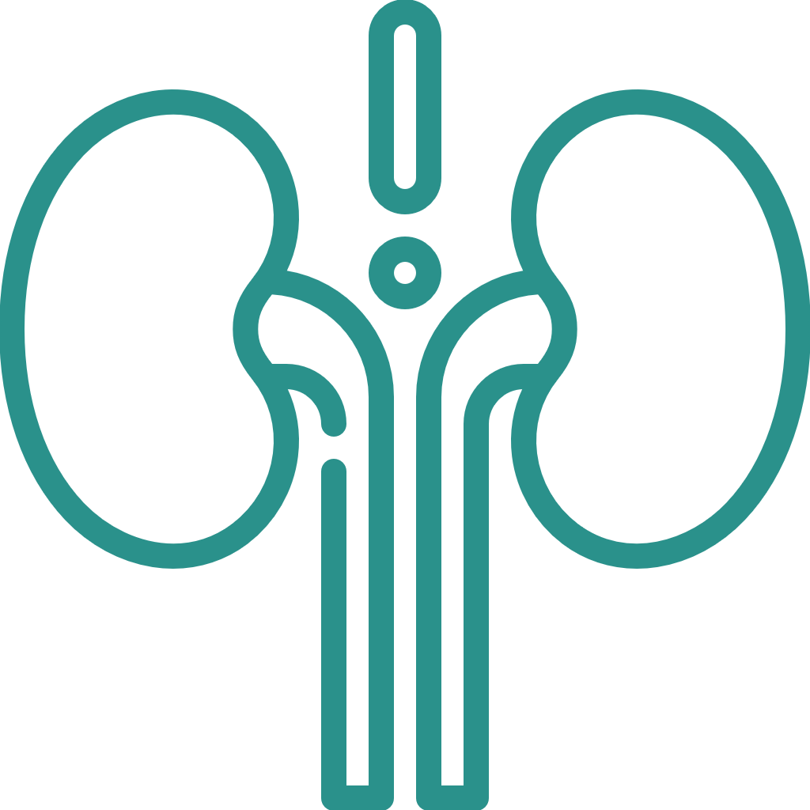


Relationship between obesity and CKD
Adiposity may have direct pathophysiological effects on the kidney:
Hypertension
Glomerular hyperfiltration, growth factors, and adipokine alterations may lead to fibrosis, glomerulosclerosis, and CKD
Obesity may lead to CKD indirectly via ORC of T2D, atherosclerosis, and hypertension
Atherosclerosis
Obesity
CKD
Type 2 diabetes
Glomerular hyperfiltration, growth factors, adipokines
CKD, chronic kidney disease; ORC, obesity-related complications; T2D, type 2 diabetes.
Stenvinkel P et al. J Am Soc Nephrol 2013;24:1727–1736.

Slide 47


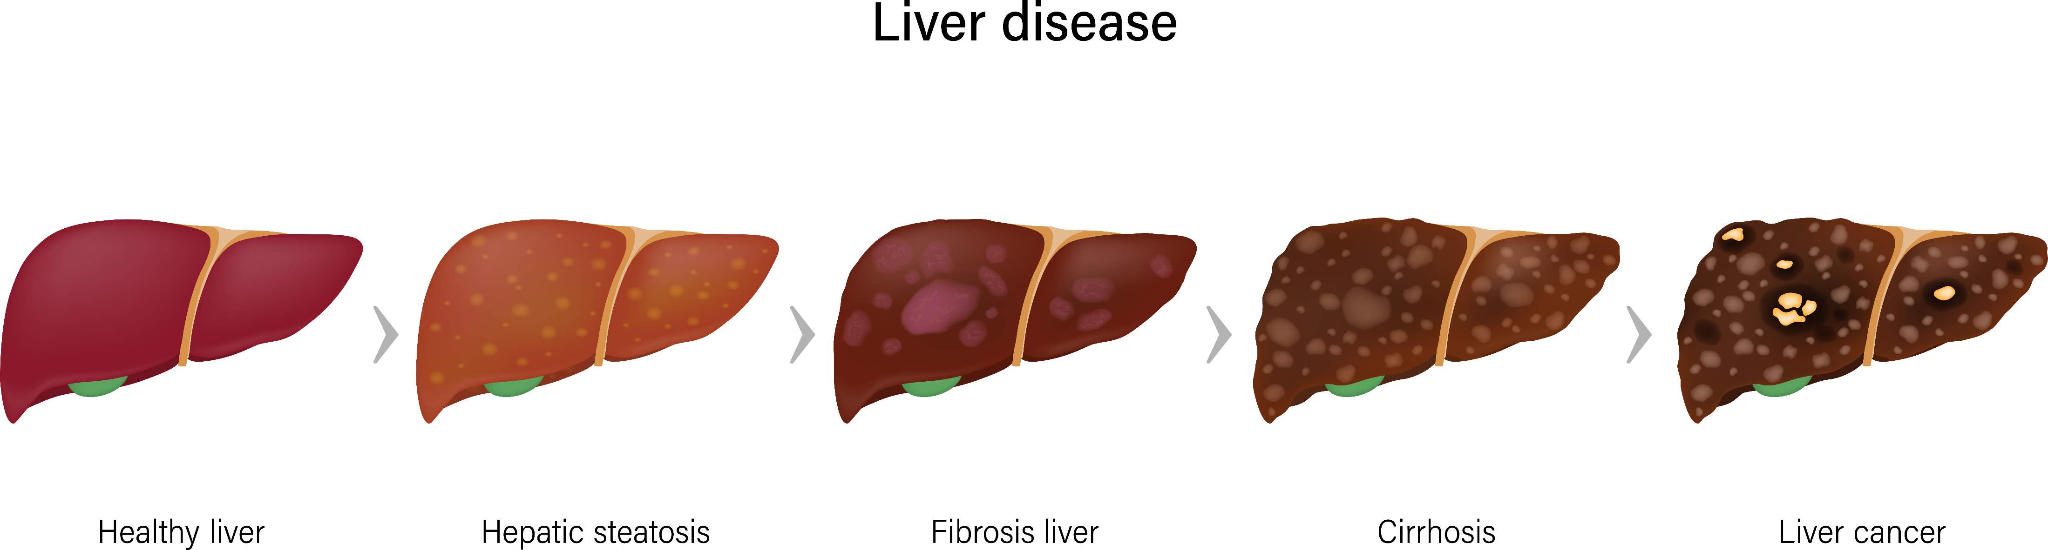
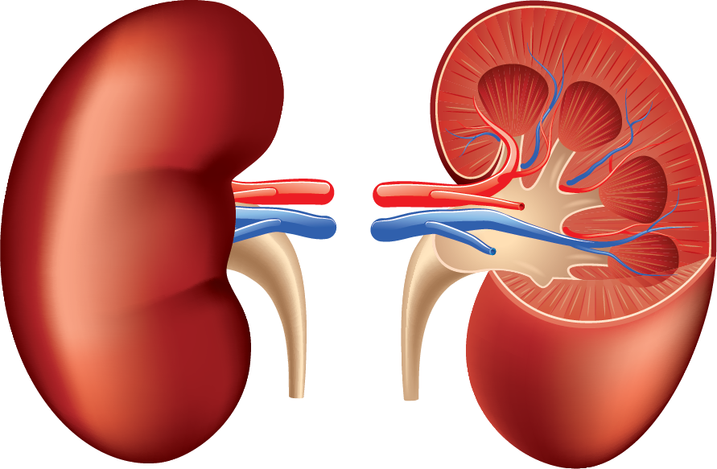


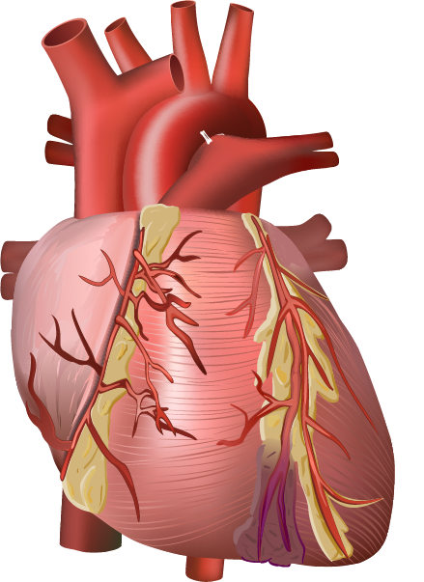
Recognizing CKM syndrome acknowledges the interconnectedness between kidney health and other cardiometabolic processes
CKM syndrome has been defined
by the AHA as:¹
Conceptual diagram for CKM syndrome
and underlying pathophysiology²
It includes:¹
Individuals at risk for CVD due to the presence of metabolic risk factors, CKD, or both
Individuals with existing CVD that is potentially related to or complicates metabolic risk factors or CKD
Excess/dysfunctional adipose tissue
A systemic disorder characterised by pathophysiological interactions among metabolic risk factors, CKD, and the cardiovascular
system leading to multiorgan dysfunction
and a high rate of adverse
cardiovascular outcomes
Glomerular hyperfiltration
Adipokines
Cytokines
Potentiates
Inflammation
Oxidative stress
Insulin resistance
Vascular dysfunction
Ectopic fat deposition
MASLD
Hypertension
Dyslipidemia
Metabolic syndrome
Diabetes
Glomerulosclerosis
Tubulointerstitial fibrosis
CKD
Heart–kidney
interactions
(Cardiorenal
syndrome)
Potentiates
Albuminuria/proteinuria
Bone mineral disease
Atherosclerosis
Myocardial remodeling
Fibrosis
Cardiac dysfunction
Neurohormonal activation
Plasma volume expansion
AHA, American Heart Association; CKD, chronic kidney disease; CKM, cardiovascular-kidney-metabolic; CVD, cardiovascular disease; MASLD, metabolic dysfunction–associated steatotic liver disease.
1. Ndumele CE et al. Circulation 2023;148:1606–1635; 2. Ndumele CE et al. Circulation 2023;148:1636–1664.
Notes:
Narration:
There is a well-described bidirectional association between the dysfunction of the heart and the kidneys, known as cardiorenal syndrome, whereby dysfunction in one of the organs is associated with dysfunction in the other. There is similarly widespread appreciation of the syndrome of cardiometabolic disease. Excess and dysfunctional adipose tissue (particularly visceral adiposity and other ectopic fat deposition) can cause inflammation, insulin resistance, and the emergence of metabolic risk factors and myriad systemic effects, including an increased risk for CVD. Although these syndromes are well recognized, there is growing awareness that metabolic abnormalities play a key pathophysiological role in bidirectional cardiovascular–kidney interactions. In addition, kidney dysfunction is increasingly recognized as a key mediator of the relationship between metabolic risk factors and CVD, particularly HF.^{1,2}
Therefore, rather than simply considering cardiorenal syndrome and cardiometabolic disease as separate entities, it is increasingly clear that we need to consider their overlap as a broader construct of CKM syndrome.
Abbreviations for narration:
CKM, cardiovascular-kidney-metabolic; CVD, cardiovascular disease; HF, heart failure.
References for narration:
Ndumele CE et al. Circulation 2023;148:1606–1635.
Ndumele CE et al. Circulation 2023;148:1636–1664.

Slide 48




KDIGO 2024 guidelines for patients with CKD
Click to return to the table of contents
Regular
risk factor
reassessment
(every 3–6
months)
Lifestyle
Healthy diet
Physical activity
Smoking cessation
Weight management
First-line
drug therapy
SGLT2i
(Continue until dialysis or transplant)
Aim for SBP <120 mm Hg
RAS inhibitor
at maximum tolerated dose (if HTN*)
Statin-based therapy moderate- or high-intensity statin
Regular reassessment
of glycemia, albuminuria,
BP, CVD risk, and lipids
BP
ASCVD risk, lipids
Additional
risk-based
therapy
GLP-1RA if required to reach individualized glycemic target
Non-steroidal MRA
in people with diabetes and an indication for use
Dihydropyridine CCB and/or diuretic* if required to reach individualized BP target
Antiplatelet agent
for clinical ASCVD
Manage anemia, CKD-MBD, acidosis, and potassium abnormalities
Steroidal MRA if needed for resistant hypertension if eGFR ≥45
Ezetimibe, PCSK9i indicated based on ASCVD risk and lipids
*Angiotensin-converting enzyme inhibitor (ACEi) or angiotensin 2 receptor blocker (ARB) should be first-line therapy for HTN when albuminuria is present, otherwise dihydropyridine calcium channel blocker (CCB) or diuretic can also be considered; all 3 classes are often needed to attain blood pressure (BP) targets. Icons presented indicate the following benefits: blood pressure cuff = blood pressure–lowering; glucometer = glucose-lowering; heart = heart protection; kidney = kidney protection; scale = weight management. ASCVD, atherosclerotic cardiovascular disease; BP, blood pressure; CKD-MBD, chronic kidney disease-mineral and bone disorder; CVD, cardiovascular disease; eGFR, estimated glomerular filtration rate; GLP-1RA, glucagon-like peptide-1 receptor agonist; HTN, hypertension; KDIGO, Kidney Disease: Improving Global Outcomes; MRA, mineralocorticoid receptor antagonist; PCSK9i, proprotein convertase subtilisin/kexin type 9 inhibitor; RAS, renin–angiotensin system; SBP, systolic blood pressure; SGLT2i, sodium-glucose cotransporter-2 inhibitor.
KDIGO 2024 Clinical Practice Guideline for the evaluation and management of Chronic Kidney Disease. Kidney International 2024;105:S117–S314.

Slide 49
Biomechanical complications
Learning objective:
Demonstrate knowledge of obesity-related biomechanical complications and identify the benefits of weight reduction

Slide 50
Sleep apnea and obesity
>80% of adult patients with OSA have overweight
and >50% have obesity¹
Studies suggest that approximately 25% of adults with a BMI between 25–28 kg/m² have at least mild OSA*^{,2}
BMI ≥40 kg/m²
(or ≥30 kg/m² with metabolic comorbidities; N=238)³
Patients with obesity are:³
2×
more likely to have OSA compared
to people with healthy weight
of which
6×
more likely to develop OSA if 10% of baseline weight is gained
*Mild OSA is defined as Apnea–Hypopnea Index (AHI) ≥5, but <15 events per hour of sleep.
BMI, body mass index; OSA, obstructive sleep apnea.
1. Almendros I et al. Int J Obes (Lond) 2020;44:1653–1667; 2. Romero-Corral A et al. Chest 2010;137:711–719; 3. Kositanurit W et al. Sleep Breath 2018;22:251–256; 4. Church TS et al. Gastroenterology 2006;130:2023–2030.

Slide 51



The bidirectional relationship between obesity and OSA
The pathogenesis of OSA in people with obesity is multifactorial,
involving both anatomical and physiological factors
Anatomical
Narrowed airway
Decrease lung volume
Physiological
Reduced activity or responsiveness of the upper airway dilator muscles
Obesity
Fat deposition in the neck and pharyngeal structures can narrow the airway, and
fat deposition in the abdomen can decrease lung volume when lying down to sleep
OSA
OSA may promote weight gain
Changes in appetite control mechanisms
Physical inactivity due to daytime sleepiness
OSA, obstructive sleep apnea.
Figorilli M et al. Nutr Metab Cardiovasc Dis 2025;35:104014.

Slide 52
Weight loss is associated with reduced AHI and increased remission in adults with mild OSA
Change in AHI over 1 year (N=72)
Remission in OSA over 1 year* (N=72)
Change in AHI from
baseline to 12 months
Proportion of weight loss
subgroup with OSA remission (%)
Weight change over 1 year (kg)
Weight loss over 1 year (kg)
The Apnea–Hypopnea Index represents the average number of apneas and hypopneas experienced each hour during sleep
*Remission defined as AHI <5.
AHI, Apnea–Hypopnea Index; OSA, obstructive sleep apnea.
Tuomilehto HPI et al. Am J Respir Crit Care Med 2009;179:320–327.

Slide 53

Effect of overweight and obesity on knee osteoarthritis risk
5 kg/m²
increase in BMI
35% increase in risk of knee OA
(95% CI 1.18, 1.53; P<0.001)¹
Biomechanical
Obesity increases the load and impact on the articular cartilage of the knee, driving fibrillation (softening of the cartilage)
and degradation
Metabolic mechanisms
Systemic metabolic factors that act as a link between obesity and knee osteoarthritis
Adipokines may influence cartilage homeostasis
Two primary ways in which obesity increases the risk of knee OA^{2–4}
BMI, body mass index; CI, confidence interval; OA, osteoarthritis.
1. Zheng H et al. BMJ Open 2015;5:e007568; 2. Lee R, Kean WF. Inflammopharmacology 2012;20:53–58; 3. Pottie P et al. Ann Rheum Dis 2006;65:1403–1405; 4. Alexander CJ. Skeletal Radiol 2004;33:321–324.

Slide 54

Weight loss in people with obesity and OA as assessed by increased WOMAC score
 | Low-energy diet* (n=40) 812.1 kcal/day | Control (n=40) 1194.2 kcal/day | Difference | P value
Weight loss (%) | 11.1 | 4.3 | 6.8 | <0.0001
Percent change in WOMAC Index
Total index (%) | 35.2 | 13.7 | 21.5
Pain (%) | 28.9 | 17.5 | 11.4
Functional limitation (%) | 37.2 | 14.5 | 22.7
Stiffness (%) | 30.3 | 13.6 | 16.7
WOMAC is a
self-administered questionnaire used by HCPs to evaluate the condition of patients with OA of the knee and hip
≥10% reduction in body weight was associated with improvements in functional status
(28% improvement in OA) comparable to knee joint replacement^{1,2}
*812 kcal/day is close to what is considered a very low-calorie diet (typically <800 kcal/day), which is difficult to sustain.
HCP, healthcare professional; OA, osteoarthritis; WOMAC, Western Ontario and McMaster Universities Osteoarthritis Index.
1. Christensen R et al. Osteoarthritis Cartilage 2005;13:20–27; 2. Bachmeier CJ et al. Osteoarthritis Cartilage 2001;9:137–146.

Slide 55

Weight loss in people with hip OA and obesity or overweight as assessed by increased WOMAC score
Click to return to the table of contents
Obesity and overweight are risk factors for hip OA
Exercise and weight loss program in patients with hip OA and obesity or overweight led to an improvement of 32.6% in WOMAC score after 8 months
The results were similar for participants who were overweight or have obesity, with no significant difference between the 2 BMI categories
BMI, body mass index; OA, osteoarthritis; WOMAC, Western Ontario and McMaster Universities Osteoarthritis Index.
Paans N et al. Phys Ther 2013;93:137–146.

Slide 56
Reproductive complications
Learning objective:
Demonstrate knowledge of obesity-related reproductive complications and identify the benefits of weight reduction

Slide 57

Obesity is a risk factor for impaired fertility in both men and women
Women with overweight
or obesity:¹
Have a higher incidence of menstrual dysfunction and anovulation
Are at a high risk for reproductive challenges
  Increased risk of subfecundity and infertility, conception rates, miscarriage rates, and pregnancy complications
Men with overweight
or obesity:²
Have reduced sperm quality
Have physically and molecularly altered germ
cells in the testes and
mature sperm
Have decreased levels of testosterone and
sperm counts
1. Dag ZO et al. J Turk Ger Gynecol Assoc 2015;16:111–117; 2. Palmer NO et al. Spermatogenesis 2012;2:253–263.

Slide 58
Prevalence of PCOS and relation to BMI
Prevalence of PCOS according to BMI among adolescents (ages 15–19 years; n=137,502)*^{,1}
Prevalence of PCOS according to BMI among
adults (aged 18–45 years; n=675)*^{,2}
Obesity
Elevated BMI at age 18 is a risk factor for subsequent ovulatory infertility
Relative risks were significantly elevated
(above BMI of 23.9)^{†,3}
*Weight categories were according to age-specific and sex-specific BMI percentiles; †Infertility, defined as an inability to become pregnant for at least 1 year due to ovulatory disorder.
BMI, body mass index; PCOS, polycystic ovary syndrome.
1. Christensen SB et al. Fertil Steril 2013;100:470–477; 2. Yildiz BO et al. J Clin Endocrinol Metab 2008;93:162–168; 3. Rich-Edwards JW et al. Am J Obstet Gynecol 1994;171:171–177.

Slide 59
Weight loss improves clinical and biochemical parameters in women with PCOS and obesity
N=144; 54% participants lost >5% weight after caloric restriction for 4 weeks
Free testosterone
Fasting insulin
P=0.009
P=NS
P=0.018
P=NS
Fasting insulin (mU/L)
Before diet
After diet
Patients with >5% weight loss show improvements in clinical and biochemical abnormalities related to PCOS
NS, not significant; OGTT, oral glucose tolerance test; PCOS, polycystic ovary syndrome; SHBG, sex hormone–binding globulin.
Tolino A et al. Eur J Obstet Gynecol Reprod Biol 2005;119:87–93.
Notes:
A study conducted to examine the effect of long-term caloric restriction on the clinical and biochemical abnormalities in women with PCOS and obesity (n=144) showed that caloric restriction for 4 weeks causes an increase in SHBG and decreases of free testosterone and insulin, with consequent improvement of the clinical picture.

Slide 60
Weight loss improves clinical and biochemical parameters in women with PCOS and obesity
Click to return to the table of contents
N=144; 54% participants lost >5% weight after caloric restriction for 4 weeks
SHBG
Insulin during OGTT
P=0.002
P=NS
P<0.03
P=NS
Insulin during OGTT (mU/L)
Before diet
After diet
Patients with >5% weight loss show improvements in clinical and biochemical abnormalities related to PCOS
NS, not significant; OGTT, oral glucose tolerance test; PCOS, polycystic ovary syndrome; SHBG, sex hormone–binding globulin.
Tolino A et al. Eur J Obstet Gynecol Reprod Biol 2005;119:87–93.
Notes:
A study conducted to examine the effect of long-term caloric restriction on the clinical and biochemical abnormalities in women with PCOS and obesity (n=144) showed that caloric restriction for 4 weeks causes an increase in SHBG and decreases of free testosterone and insulin, with consequent improvement of the clinical picture.

Slide 61
Psychological
complications
Learning objective:
Demonstrate knowledge of obesity-related cardiovascular complications and identify the benefits of weight reduction

Slide 62
Obesity is associated with increased risk of developing anxiety and depression
Neuroinflammation alters structure, excitability, and connectivity in corticolimbic networks controlling mood, motivation, and emotion
Adipose- and gut-derived inflammation and poor diet stimulate neuroinflammation
Can increase
risk of anxiety
and depression
Genetic, epigenetic, and adverse environmental and psychosocial factors
Fulton S et al. Trends Endocrinol Metab 2022;33:18–35.

Slide 63
Weight loss may improve mood in patients with obesity
Click to return to the table of contents
Multimodal therapy that includes weight reduction is helpful in patients with obesity
Combining approaches that include diet, psychotherapy, and/or bariatric surgery can have antidepressant efficacy in patients with obesity
For example, adding a dietary weight loss intervention and psychotherapy has been shown to enhance the efficacy of antidepressant medications in patients
with obesity
Reduced pain, physical symptoms
Studies have shown that patients with obesity may have improved mood with weight loss:
Improved self-esteem
Fulton S et al. Trends Endocrinol Metab 2022;33:18–35.

Slide 64
Key takeaways

Slide 65
Key takeaways
Click to return to the table of contents
1
Obesity is associated with a reduction in life expectancy compared with individuals of
healthy weight
2
Obesity is associated with over 200 complications affecting every major organ system, the body’s biomechanics, and a person’s mental health
3
Obesity increases the risk of several types of cancer, with the risk increasing with BMI
4
Significant reductions in obesity-related complications can be achieved through weight loss

Slide 66

Assessments
(1/3)
1
True or false. Ischemic heart disease is more prevalent than myocardial infarction in people with obesity?
True
False
2
Jessica and Amy were both born in 1985. Jessica has always been in the healthy BMI range, whereas Amy’s weight increased from her teenage years and for the past 10 years her BMI has between 35 and 38 kg/m². If their BMIs stay roughly the same as today, which statement is incorrect?
  Jessica is likely to live around 10 years longer than Amy
  Jessica is likely to live around 5 years longer than Amy
  Amy has twice the relative risk of endometrial cancer than Jessica
  Amy has a 6-fold relative risk for kidney failure than Jessica
3
Sandra is 1.7 meters in height and weighs 90.7 kilograms, with a BMI of
31.4 kg/m². She is diagnosed with type 2 diabetes and knows that weight
loss can improve this obesity-related complication. What is the minimum amount of weight Sandra needs to lose to achieve remission of type 2 diabetes?
  3.6 kg
  7.8 kg
  9.7 kg
  13.6 kg
4
Which metabolic process underlies the increase in free fatty acids from excess visceral adipose tissue that is central to the development of metabolic syndrome?
  Glycolysis
  Lipogenesis
  Gluconeogenesis
  Lipolysis
Notes:
Answer key:
b (slide 9, in people with obesity, the prevalence of myocardial infarction is 21% and the prevalence of ischemic heart disease is 8%)
a (slide 11, at age 40, women with class 2 obesity are likely to die around 5 years earlier than counterparts of healthy BMI; slide 12, women with obesity have a 2-fold risk of endometrial cancer vs women of healthy BMI; slide 45, people with class 2 obesity have a 6.12 relative risk of kidney failure compared with people in the healthy BMI range)
c (slide 13, T2D remission is expected for weight loss 10–15% of total body weight; 10–15% of 90.7 kilograms is 9.7–13.6 kilograms)
d (slide 16 video, in obesity, the development of insulin resistance in adipose tissue increases lipolysis—the breakdown of stored triglycerides into glycerol and fatty acids [for information lipogenesis is the synthesis of fatty acids; glycolysis is the breakdown of glucose into pyruvate to generate energy; gluconeogenesis is the synthesis of glucose from non-carbohydrate sources like pyruvate, lactate, and amino acids])

Slide 67
Assessments
(2/3)
5
What role does the pancreas play in contributing to insulin resistance in those who have obesity and type 2 diabetes?
  Reduced insulin secretion
  Leptin resistance
  Increased triglyceride production
  Islet cell production of anti-inflammatory cytokines
6
Which one statement about MASLD is correct?
  MASLD is the hepatic manifestation of metabolic syndrome
  MASLD is defined by the presence of hepatic steatosis and at least three cardiometabolic risk factors
  MASLD is the mild form of MASH
  People with BMI in the healthy range will never develop MASLD
7
What would be the expected metabolic benefits of weight loss for individuals with obesity? Select all that apply.
  Reduce risk of progression of prediabetes to type 2 diabetes
  Induce remission of type 2 diabetes
  Improve liver histology in patients with MASH
  All of the above
8
What are the common pathophysiological features behind the development of atrial fibrillation and atherosclerotic cardiovascular disease in patients with obesity?
  Epicardial adipose tissue and increased blood volume
  Inflammation and thrombosis
  Neurohormonal changes and structural remodeling of the heart
  None of the above
Notes:
Answer key:
d (slide 18, reduced β-cell activity and insulin secretion, along with islet inflammation in the pancreas, leads to insulin resistance)
a (slide 15, MASLD is the hepatic manifestation of metabolic syndrome; slide 22, MASLD is defined by the presence of 1 or more cardiometabolic factors— as obesity is one of those factors, individuals without obesity can still develop MASLD; slide 23, MASLD is an umbrella term for the spectrum of histological changes that goes from simple hepatic steatosis at one end to MASH with fibrosis at the other end)
d (slide 20, multiple studies have shown weight loss can reduce risk of progression of prediabetes to type 2 diabetes in people with obesity; slide 21, weight loss can induce remission in type 2 diabetes; slide 32, weight loss can improve liver fibrosis in patients with MASH)
a (slide 38 and slide 41 video, epicardial adipose tissue and increased blood volume are features of both atrial fibrillation development and atherosclerotic cardiovascular disease; inflammation is a feature of both but thrombosis is only a feature of atherosclerotic cardiovascular disease; neurohormonal changes are common to both, but structural remodeling of the heart is only a feature of atrial fibrillation)

Slide 68
Assessments
(3/3)
Click to return to the table of contents
9
Mark is 54 years old and lives with class 2 obesity. Following a diagnosis of HFpEF, he was motivated to lose weight and his endocrinologist prescribed an anti-obesity medication. What cardiovascular benefits can Mark expect if he reduces his body weight by 10%?
  Ability to exercise more
  Improve heart function
  Decrease risk of kidney disease
  All of the above
10
What is an anatomical factor that leads to obstructive sleep apnea as a result of increased fat mass from obesity?
  Inflammation
  Hyperglycemia
  Narrowed airway
  Sympathetic activity
Notes:
Answer key:
d (slide 40, AOMs have been shown to improve exercise function, decrease risk of kidney disease, and improve heart function through weight loss)
c (slide 51, narrowed airway is a weight-dependent factor)

