Slide 1
Lifestyle Modifications and Behavioral Interventions for Obesity​
Module 8

Slide 2
Thank you for using the FORWARD: Focus on Obesity Education curriculum.
Welcome to the FORWARD: Focus on Obesity Education curriculum. FORWARD was funded by Novo Nordisk Inc. A third-party provider developed the curriculum’s content in consultation with Novo Nordisk Inc. and leading obesity clinician experts.
FORWARD relies exclusively on open-source materials available to the general public.
The goal of FORWARD is to present a complete, accurate, non-promotional and fair-balanced picture of the current state of obesity. FORWARD is intended to inspire the development of obesity education in clinical professional schools, ensuring adequate training of future healthcare providers on the diagnosis and management of obesity. By choosing to access and browse this module of FORWARD, you acknowledge that you have read, understand and agreed to the FORWARD Terms of Use. If you do not agree with the FORWARD Terms of Use, you are not permitted to further access this module and should immediately discontinue your use.
Double click to view:
Content current as of October 2025
Content current as of January 2025

Slide 3


Learning outcomes
After completing this module, the learner will be able to apply evidence-based lifestyle modifications to develop personalized care plans for patients with obesity
Lifestyle modifications include
Behavioral therapies
Nutritional interventions
Physical activity
Estimated time to complete: 15 min

Slide 4





Treatment interventions for obesity
Behavioral interventions
Addition of pharmacotherapy
to diet and exercise
Metabolic and
bariatric surgery
Improved food choices
Increased physical activity
Patient-led health tracking
Sleep hygiene and stress reduction
Jensen MD et al. J Am Coll Cardiol 2014;63:2985–3023.

Slide 5



Clinical guidelines
Lifestyle intervention is the foundation of obesity treatment
If lifestyle counseling does not yield adequate results,
care should be escalated to include pharmacotherapy +/- surgery
Treatment | BMI category (kg/m²)
 | ≥25 | ≥27 | ≥30 | ≥35 | ≥40
Diet, physical activity, behavior therapy (AHA/ACC/TOS)¹ | With comorbidities | With comorbidities | + | + | +
Pharmacotherapy (AACE)² | Consider | + | + | + | +
Surgery (ASMBS/IFSO)³ |  |  | With comorbidities | + | +
Note: Guidelines on AOMs are evolving; the latest guidance from AACE is to treat overweight/obesity
based on an individual’s risk and presence or severity of obesity-related complications and diseases⁴
ACC, American College of Cardiology; AACE, American Association of Clinical Endocrinology; AHA, American Heart Association; AOM, anti-obesity medications; ASMBS, American Society for Metabolic and Bariatric Surgery; BMI, body mass index; IFSO, International Federation for the Surgery of Obesity and Metabolic Disorders; TOS,The Obesity Society.
1. Jensen MD et al. Circulation 2014;129(25 suppl 2):S102–S138; 2. Samson SL et al. Endocr Pract 2023;29:305‒340; 3. Eisenberg D et al. Surg Obes Relat Dis. 2022;18:1345–1356; 4. Nadolsky K et al. Endocr Pract 2025:S1530-891X(25)00977-2.

Slide 6

Dietary recommendations for patients with obesity^{1,2}
The overall goal is reductions in portion sizes of food and caloric intake
Element | Nutritional goal | Recommendation
Fat | 20–35% of total calorie intake | Fat is high in energy density. Choose appropriate portions of healthy fats to improve diet quality and meet nutritional needs Substitute lower-fat foods for those higher in fat Include monounsaturated and polyunsaturated fats
Protein | ≥2.3 g/kg of body mass/day when resistance training during calorie deficit For comparison: ≥1.2 g/kg of body mass/day for most people and ≥0.8 g/kg of body mass/day for patients with diabetes mellitus or CKD not treated with dialysis | Include protein to create satisfying meals and meet nutrient needs Include lean meats, poultry without skin, fish, eggs, legumes, tofu, and low-fat dairy products
Carbohydrate | 45–65% of total calorie intake | Switch to whole grains instead of refined grains Examples include wheat, brown rice, oats, barley, corn
Fiber | 20–35 grams per day | Include fiber to help increase satiety Add legumes, fruits, vegetables, and whole grains
Added sugar | Limit to <10% of total calorie intake | Limit foods and beverages containing added sugars Main sources of added sugars are snacks, sweets, and beverages Non-nutritive sweeteners can be a substitute
Beverages |  | Select low-calorie beverages Water is the best choice Limit intake of alcoholic beverages
1. Smethers AD and Rolls BJ. Med Clin North Am 2018;102:107–124; 2. Nadolsky K et al. Endocr Pract 2025:S1530-891X(25)00977-2.
Notes:
CKD, chronic kidney disease.

Slide 7

Structured weight loss programs
Commercial meal replacements^{1–3*}
Strict caloric intake while providing essential nutrients
On this plan, individuals consume ~1200–1500 kcal/day
Effective for long-term weight loss⁴
Participants may:
  Follow an outlined diet plan
  Join a diet center
  Subscribe to an online weight loss program that includes member interaction and tools to track weight loss progress
*Demonstrated clinically relevant initial weight loss and maintenance over a period of 36 months in participants of a standardized, meal replacement-based weight loss program. This intervention complies with national and international guidelines for the therapy of obesity in adults and is efficient and meaningful for long-term therapeutic use in primary care.³
1. Institute of Medicine (US) Subcommittee on Military Weight Management. Weight-loss and maintenance strategies. https://www.ncbi.nlm.nih.gov/books/NBK221839/. Accessed October 2025; 2. Maston G et al. Behav Sci (Basel) 2020;10:136; 3. Kruschitz R et al. Obes Facts 2017;10:76–84; 4. Astbury NM et al. Obes Rev 2019;20:569–587.

Slide 8

Structured weight loss programs
Multidisciplinary support¹
Medical specialists
Endocrinologists
Gastroenterologists
Obesity medicine physicians
General practice physicians
and nurses
Registered dietitians and nutritionists
Exercise physiologists
Psychologists and counselors
Diabetes educators
Digital health tools
1. Maston G et al. Behav Sci (Basel) 2020;10:136.

Slide 9

Structured weight loss programs
Diabetes Prevention Program
lifestyle change program¹
Physicians contribute by increasing referrals to
and participation in the
lifestyle change program
Goal is to reduce weight by 7% via:
Behavior modification
Low fat diet
150 minutes of exercise per week
1. Centers for Disease Control and Prevention (CDC). National Diabetes Prevention Program. https://www.cdc.gov/diabetes-prevention/index.html. Accessed October 2025.

Slide 10


Clinical effects of improved diet on weight management
Reduced weight/BMI^{1–3*†}
*Weight loss of ~7%
with caloric restriction by reducing food portion sizes and by replacing energy-dense foods with those of lower energy density
Reduced visceral obesity^{1*}
Reduced health complications^{2†}
Improved sleep⁴
†The traditional Mediterranean dietary pattern is inversely associated with BMI and obesity
Increased life expectancy^{5†}
BMI, body mass index.
1. Weiss EP et al. Med Sci Sports Exerc 2017;49:206–217; 2. Schröder H et al. J Nutr 2004;12:3355–3361; 3. Look AHEAD Research Group. N Engl J Med 2013;369:145–154; 4. Hur S et al. Nutrients 2021;13:3181;
5. Fadnes LT et al. PLoS Med 2022;19:e1003889.
Notes:
Most people with obesity try caloric restriction as a means for weight management and most need pharmacotherapy to help MAKE IT HAPPEN. (Need to always keep in mind the reality that people with obesity may know what to do but their bodies don't allow them to do it and can’t just achieve “caloric restriction” – we need to flip the narrative that we’re treating a disease, not a choice

Slide 11
Weight loss through lifestyle modifications reduces the incidence of diabetes^{1,2}
The Diabetes Prevention Program (DPP)
Assessed the effects of lifestyle* vs medical interventions for diabetes prevention¹
Approximate change in weight
Approximate cumulative incidence of diabetes
Placebo
Metformin
Lifestyle
*Lifestyle intervention was 22 group sessions over 1 year, exercise classes, and a “Toolbox” of meal replacement shakes, exercise equipment, meal plans.
1. Knowler WC et al. N Engl J Med 2002;346:393–403; 2. ElSayed NA et al. Diabetes Care 2023;46(suppl 1):S128–S139.

Slide 12
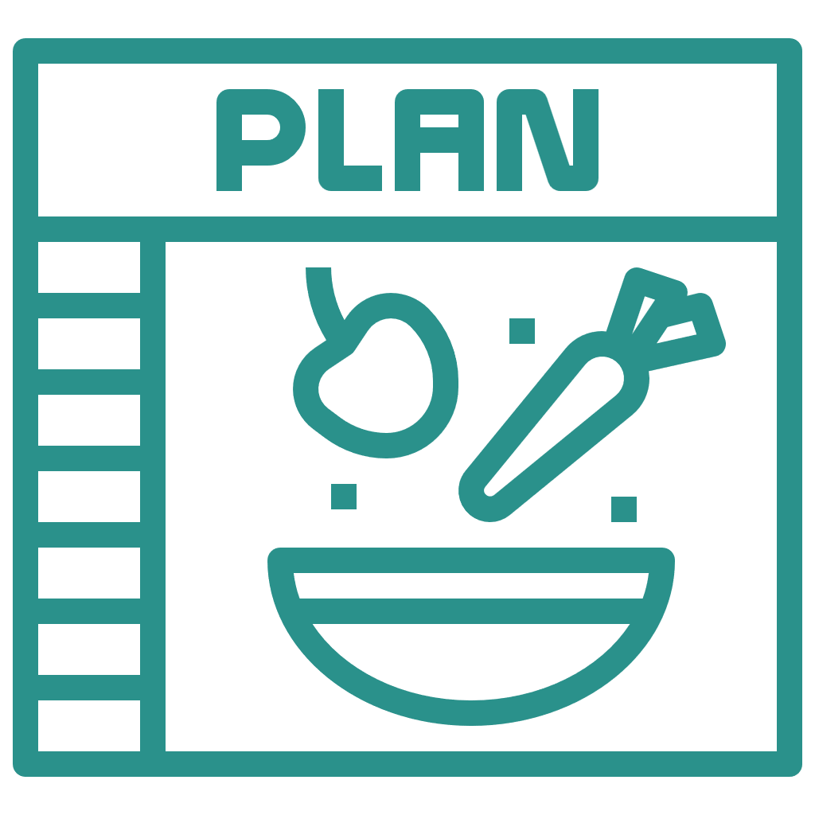
Fad diets
Negative health consequences
Lack of physical activity
Fad diets may temporarily reduce daily caloric intake^{1,2}
However
Rapid weight loss
Missing food groups
Adverse health outcomes may include inadequate micronutrient intake and increased LDL-C^{*,1}
Fad diet¹
Trendy dietary pattern known to be a
quick fix for long-
term problems
Inconsistent scientific evidence
Nutritionally inadequate
Micronutrient deficiencies may increase the risk of developing comorbidities^{†,2}
May be detrimental
for those with chronic diseases
Promotes short-term changes
Long-term
adherence maintenance concerns
*Increased LDL-C is associated with the ketogenic diet.
†Comorbidities such as type 2 diabetes, cardiovascular disease, cancer, and osteoporosis.
LDL-C, low-density lipoprotein cholesterol.
1. Tahreem A et al. Front Nutr 2022;9:960922; 2. Malik N et al. Food Sci Nutr 2020;8:6047–6060.

Slide 13





Recommendations for physical activity^{1,2}
Adults
        Simple recommendations:
        Be on your feet, not in your seat Less sitting, move living
        At least 200–300 minutes of moderate-intensity aerobic activity each week or at least 75–150 minutes of vigorous-intensity aerobic activity each week
        Engage in muscle-strengthening exercises at least 2 days per week
        Brief exercise bouts after meals can improve metabolic control
        Use of fitness trackers and realistic step count goals
Older adults
        Same volume recommendations
        as the younger adult population for aerobic activity and muscle-strengthening exercises
        Multicomponent physical activity with balance training should be incorporated to improve function and reduce risk of falls
        Tailor exercise intensity level and modality based on patient-specific conditions (e.g., cardiovascular or orthopedic conditions)
1. US Department of Health and Human Services (DHHS). Physical activity guidelines for Americans, 2nd ed (2018). https://health.gov/sites/default/files/2019-09/Physical_Activity_Guidelines_2nd_edition.pdf. Accessed October 2025;
2. ElSayed NA et al. Diabetes Care. 2023;46(suppl 1):S128–S139.

Slide 14

Vigorous* physical activity is effective in reducing modest body weight
6.5%
weight loss was reported in premenopausal women
(BMI >27 kg/m²) following
14 weeks of aerobic exercise training, without dietary changes¹
5.3%
weight loss was reported in men (BMI 31 kg/m²) following
16 weeks of aerobic exercise training²
7%
weight loss was reported in men and women (BMI 31 kg/m²) following 16.8 weeks of aerobic exercise training, without dietary changes³
7.5 ± 0.5 hours per week;
intensity 77% HR_{max}
Daily energy expenditure:
500 kcals per session
Energy expenditure:
2000 kcals per week
Energy expenditure:
412 kcals per day
The duration (225–300 min/week) and intensity of the physical activity must be very high, exceeding the minimum national recommendations for health, for clinically meaningful weight loss to occur and to prevent weight regain^{1–4}
*High-intensity physical activity is any form of aerobic exercise that brings an individual’s heart rate up above 75% of their maximum heart rate.
BMI, body mass index; HR_{max}, maximum heart rate.
1. Ross R et al. Obes Res 2004;12:789–798; 2. Donnelly JE at al. Med Sci Sports Exerc 2009;41:459–471; 3. Weiss EP et al. Med Sci Sports Exerc 2017;49:206–217; 4. Swift DL et al. Prog Cardiovasc Dis 2014;56:441–447.

Slide 15

Clinical effects of exercise
Weight loss
Reductions in anxiety and depression
Improved CV and respiratory health
Reduced risk for developing T2D and metabolic syndrome
Reduced risk for developing several cancers
Improves musculoskeletal health
Lowers SNS and
HPA axis reactivity¹
Improved stroke volume; improved oxygen utilization²
Improves glycemia^{3,4} and reduces need for glucose-lowering medications*⁴
Inhibition of cancer cell proliferation and induction of apoptosis⁵
Improved bone mineral density⁶
Regular physical activity helps to prevent and manage non-communicable diseases such as
CVD, T2D, hypertension, and several cancers; and can improve mental health
*Weight loss >10% substantially reduces HbA1c and fasting glucose and has been shown to promote sustained diabetes remission through at least 2 years.
CV, cardiovascular; CVD, cardiovascular disease; HPA, hypothalamic-pituitary-adrenal; SNS, sympathetic nervous system; T2D, type 2 diabetes.
1. Anderson E and Shivakumar G. Front Psychiatry 2013;4:27; 2. Gries KJ et al. J Appl Physiol 2018;1636–1645; 3. Kanaley JA et al. Med Sci Sports Exerc 2022;54:353–368; 4. ElSayed NA et al. Diabetes Care. 2023;46(suppl 1):S128–S139; 5. Wang Q and Zhou W. J Sport Health Sci 2021;10:201–210; 6. Shah K et al. J Bone Miner Res 2011;26:2851–2859.

Slide 16
Non–weight-related benefits of physical activity
Keep and improve your strength so you can stay active and independent, and have more energy to do the things you want and reduce fatigue
Improve your balance and lower risk of falls and injuries from falls
Significantly lower cardiovascular disease mortality and cancer mortality
Improve or maintain some aspects of cognitive function, such as the ability to shift quickly between tasks
1. NIH National Institute on Aging. Health benefits of exercise and physical activity. https://www.nia.nih.gov/health/exercise-and-physical-activity/real-life-benefits-exercise-and-physical-activity. Accessed October 2025;
2. Saint-Maurice PF et al. JAMA 2020;323:1151–1160.

Slide 17

How to motivate patients to increase physical activity
Set realistic weight loss goals¹
Motivational interviewing techniques¹
Encourage the use of activity diaries¹
Suggest positive family discussions
about physical activity¹
Discuss health and wellness
benefits of weight loss¹
Encourage feelings of
“self-worth” or “self-efficacy”¹
Provide positive reinforcement regarding
marked early weight loss¹
Increase consultation frequency¹
Fogg Behavior Model²
Motivation: Select exercises that are enjoyable (e.g., swimming)
Ability: The exercise should be easy to perform (e.g., ability to swim, access to a pool)
Prompts: Define an anchor point that builds the exercise into a daily routine (e.g., an alarm)
1. Fruh SM. J Am Assoc Nurse Pract 2017;29:S3–S4; 2. Fogg Behavior Model. https://behaviormodel.org/. Accessed October 2025.

Slide 18
Use SMART Goals to support patients to increase physical activity
    Specific
Ensure the goal is clear and focused
    Measurable
Define assets of the goal that can be measured
    Attainable
Ensure the goal can be reasonably accomplished
    Relevant
The goal should align with the patient’s values and objectives
    Time-bound
Set an end date to ensure prioritization and increase motivation
Specific: Walk for 10 minutes, 5 days a week, at a comfortable pace
Measurable: Use a timer to track each session and record sessions in calendar
Attainable: Start with short walks that fit easily into the daily routine
Relevant: Supports desire to improve health in a manageable way
Time-bound: Follow the plan for the next 4 weeks, then reassess
    SMART Goal
O’Neill J and Cozemius A. The Power of SMART Goals: Using Goals to Improve Student Learning. Bloomington, IN: Solution Tree, 2005.

Slide 19

Behavioral strategies for unhealthy eating patterns
Stimulus control
Behavior therapy
Cognitive restructuring
Establish eating patterns
that maximize satiety^{1–3}
  Example: Consuming whole foods with a higher percentage of their energy from protein and fiber^{1,2}
Environmental removal of
foods identified as tempting³
  Example: Scheduling and meal planning to
  prevent temptation at the supermarket⁴
Thoughts
Encourage patient to:
Acknowledge they are capable of positive thoughts and behaviors
Replace unhelpful thoughts and behaviors with more productive ones
Practice behavior therapy skills
between clinician encounters³
Feelings
Behavior
Cognitive behavioral therapy (CBT) is the gold standard for psychotherapy⁵
CBT is a form of psychological treatment that is traditionally recognized as the most preferred intervention for obesity and could be considered as the first-line treatment among psychological approaches.
1. Holt SH et al. Eur J Clin Nutr 1995;49:675–690; 2. Njike VY et al. Adv Nutr 2016;7:866–878; 3. Tondt J et al. Obesity Medicine Association. Obesity Algorithm® (2025). https://obesitymedicine.org/resources/obesity-algorithm/. Accessed October 2025; 4. Appelhans BM et al. Appetite 2016;96:268–279; 5. Castelnuovo G et al. Psychol Res Behav Manag 2017;10:165–173.

Slide 20




Sleep hygiene and stress management
Insufficient sleep is associated with insulin resistance and a higher risk of weight gain and obesity;
obesity may lead to reduced sleep quality^{1‒3}
Sleep deprivation
Sleep extension may mitigate the risk of obesity³
How to improve and maintain sleep duration:⁴
Ghrelin^{2*}
Leptin^{2*}
Hedonic signaling
Time and opportunities for eating²
Physical activity
Due to fatigue²
Establish regular
bed- and
wake-times
Avoid caffeine and alcohol in the evening; avoid nicotine
Minimize stress to avoid
pre-sleep arousal
Engage in relaxing activities
Mindfulness† meditation
Overeating²
Exercise regularly
Restrict use of electronic devices
near bedtime
Energy
intake
Energy expenditure
*Ghrelin stimulates appetite, leptin suppresses food intake; †Mindfulness is focused attention on the present moment without judgement.
1. Singh T et al. Cureus 2022;14:e23501; 2. Cooper CB et al. BMJ Open Sport Exerc Med 2018;4:e000392; 3. Tasali E et al. JAMA Intern Med 2022;182:365–374; 4. Irish LA et al. Sleep Med Rev 2015;22:23–36.

Slide 21


Patient-led health tracking
Helps people to know whether their goals for physical activity or healthy eating were achieved¹
Activity monitors and calorie allotment trackers
Visualize proof of effort¹
Allow for self-monitoring engagement to enhance and sustain weight loss²
Example programs
        USDA SuperTracker app¹
        Bite Counter device²
Keep a food log
Keep a food log
There is strong support for the use of patient-directed tools to monitor and managing their weight¹
These tools can be integrated into everyday life
Allow patients and HCPs the ability to track changes that may bridge the gap between consultations
HCP, healthcare professional; USDA, United States Department of Agriculture.
1. Painter SL et al. J Med Internet Res 2017;19:e160; 2. Patel ML et al. JMIR Form Res 2022;6:e42191.

Slide 22
Key takeaways
1
Lifestyle intervention is the foundation of obesity management
2
It is comprised of behavior modification, improved food choices, increased physical activity, stress reduction, and sleep hygiene
3
Long-term adherence to fad diets may lead to negative health outcomes
4
Lifestyle treatments for weight loss provide various health-related benefits
5
Lifestyle modification programs can be successfully implemented by the individual, with a coach/medical specialist, or in a community setting with frequent monitoring
6
In addition to lifestyle interventions, treatment with pharmacotherapy and/or surgery should be explored with the patient to maximize treatment efficacy and patient success

Slide 23

Assessments
1
Which of the following statements is true for the recommended protein intake for patients working towards weight loss with maintenance of muscle mass?
≥0.8 g of protein per kg of body mass per day
≥2.3 g of protein per kg of body mass per day
≥3.5 g of protein per kg of body mass per day
Animal protein should be a component of every meal
2
Jane is a 25-year-old female with a BMI of 32 kg/m². She expresses that she has noticed a substantial increase in her weight over the past 3 months. Upon further assessment, you realize that her weight gain could be the result of her poor sleep hygiene. Which of the following is NOT an appropriate recommendation to improve her sleep hygiene?
  Avoiding exercise
  Establishing regular bed- and wake-times
  Restricting the use of electronic devices near bedtime
  Mindfulness and meditation
3
Warren is a 45-year-old male with a BMI of 29 kg/m². Although he understands the importance of physical activity for the management of his weight, he lacks motivation to exercise on a regular basis. Which of the following is the most appropriate strategy to help motivate Warren to improve his physical activity?
  Inform Warren that he needs at least 500 minutes of moderate-intensity
  exercise per week to manage his weight
  Decrease consultation frequencies
  Use motivational interviewing techniques and set realistic goals for Warren
  Encourage the use of activity diaries and discourage the use of
  patient-led tracking devices
Notes:
Answer key:
b (slide 6; all other statements are false)
a (slide 7-9; regular exercise improves sleep extension)
c (slide 18; motivational interviewing techniques and realistic goal-setting are effective strategies to motivate patients)

